Slide 1
Welcome to BINC 2016!
This year it’s in our own backyard!
Pat Onufrak
Director, DC Chapter BI

Slide 2
Become part of Better Investing history — Attend the 65TH National Convention in Washington, D.C.
May 19 - 22, 2016

Slide 3
MAY I TEMPT YOU WITH …
More than 65 sessions on a range of topics …
understanding investment fundamentals
portfolio management
REITs, master limited partnerships, options
improving returns, a book review, panel discussions, and much, much more …

Slide 4
Develop Future Leadership
Network with BI Headquarters and other Chapter leadership
Share what you learn with your Chapter/Club
Update your volunteer skills
Special rate for Chapter volunteers!

Slide 5
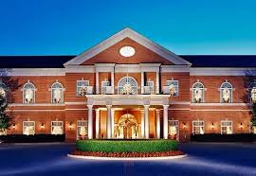
It’s not really in D.C.
Westfields Marriott Washington Dulles Hotel, in Chantilly, Va.

Slide 6
SO I WILL TEMPT YOU WITH …
Free Parking
Traveling against Rush Hour Traffic

Slide 7
To stay or not to stay?
Convenience
Ample time for networking
Enjoying the Full “Convention Experience”

Slide 8
You were probably wondering about my

Slide 9
No need to feel shy …

Slide 10
Suggestion for AN ice breaker
What sessions would you recommend?
Who are your favorite speakers?
What should I absolutely not miss?

Slide 11
For Newbees … the beginners’ track
Understanding the Jargon / Selecting the Best Companies / Determining a Fair Price / Estimating Future Growth / Estimating Future P/Es
You must pre-register for this track of classes as space is limited.
Send your email request to dianeamendt@flash.net

Slide 12
Some who are not to be missed
Ken Kavula & Ann Cuneaz, who we know from many webinars
Doug Gerlach, president of iClub and Toolkit guru
Dan Boyle, who writes the Repair Shop in BI magazine
Mark Robertson, founder of Manifest Investing
Christi Powell, Oklahoma Chapter, well versed in retirement planning
Gary Ball & Hugh McManus, for you advanced investors

Slide 13
And more …
Let's Talk Stocks panel
Scott Horsburgh’s Live Repair Shop will feature a review of MicNOVA’s portfolio (thanks, Ty!)
Our very own Irina Clements will be co-presenting on Investment Opportunities in the Tech Sector and role-playing(!) a conversation between a financial planner and a client as they discuss planning for retirement

Slide 14
BINC Free public day
Bring your family and friends on Saturday, May 21 for classes, presentations, and more
The link to the Eventbrite site is
https://www.eventbrite.com/e/betterinvesting-national-convention-
2016-free-public-day-westfield-marriott-washington-dulles-tickets-23932321217

Slide 15
Arrive early, Having done your homework …
On the Better Investing website, under 65th Annual Better Investing National Convention, you will find:
Conference schedule
Current list of classes and presenters
… and, in the past, BI has given attendees the printed PowerPoints to download prior to the convention. Look them over and create your own tentative schedule

Slide 16
Understand that you can’t do it all
There are 65 sessions
Presenters usually post their PowerPoint sides on the BI website
Buy the DVD/Class recording
Avoid bouncing around from class to class mid-session – You won’t get a good seat and you will miss a lot of both sessions
Take a breather once in a while, this is not a marathon

Slide 17
Trust serendipity and be flexible
You may have your schedule planned ahead of time but then find that you especially enjoy certain presenters and decide to attend their other presentations
The table of strangers [new friends] you join for lunch may have someone you really needed to talk to … whether you knew it or not ahead of time
A Convention is an Adventure!

Slide 18
Online Registration

Slide 19
BINC – What’s included

Slide 20
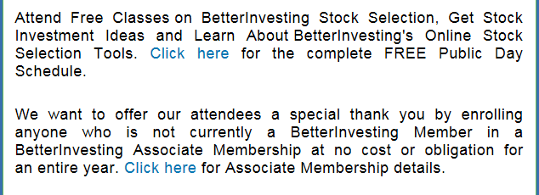

Slide 21
See you at binc 2016!

