Slide 1
Determining Quality Stocks, The Acid Test (July 2019 – Using data & reports from the BI SSG Tool)
Adapted from Kathleen G Richards, “Quality Matters,” BINC 2019

Slide 2
1
2
3

Slide 3
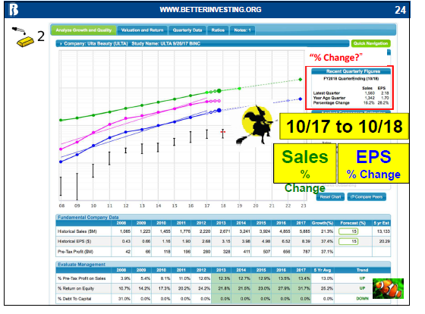
“Acid Test “ # 1: Are Sales Consistently Growing? How much?
Are Sales going up? % ?
Is the Company doing better this year than last?
1
Sales
usually
Sales
Sales Growth Targets:
Large Co (>$10B/yr) = 5%-7%
Med Co ($1B-$10B) = 7%-12%
Small Co (< $1B) = 12% +

Slide 4
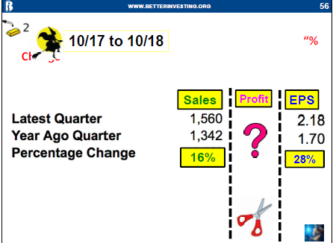
“Acid Test “ # 2: a. Are Profits Consistently Growing? How much?
b. Are Profit Margins Even or Growing?
Profits:
-Even w Sales?
-Widening % Pre-Tax Profit on Sales? (“Margins”)

Slide 5
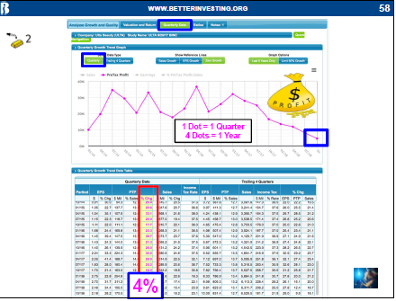
“Acid Test “ # 2: c. What have been Profits (as well as sales & EPS) over the last 4 Quarters? How does this compare to previous years? (Up, even, down?)

Slide 6
“Acid Test “ # 3: a. Are Earnings Per Share (EPS) Consistently Growing? Latest Quarter vs Year Ago Quarter?
b. Even or Growing, recent 4 Quarters?
c. Debt to Capital Level (prefer less than 33%) ?
d. How is Company Performing over the last 4 Quarters?
3a
3a
3c

Slide 7
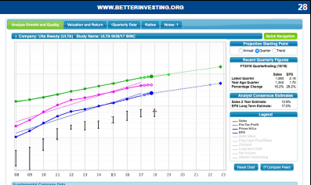
Conclusion: Do the stocks you see pass all 3 Acid Tests?
a. Are Sales, Profits, and Earnings Growing consistently?
b. Do the last four quarters reflect the same trends?
c. Are debt levels “0,” under 33%, trend?
1 Sales
2. Profit B4 Taxes
(Profits)
Share Price/yr
3. a. Earnings
(EPS)
3. b. Debt?

