Slide 2
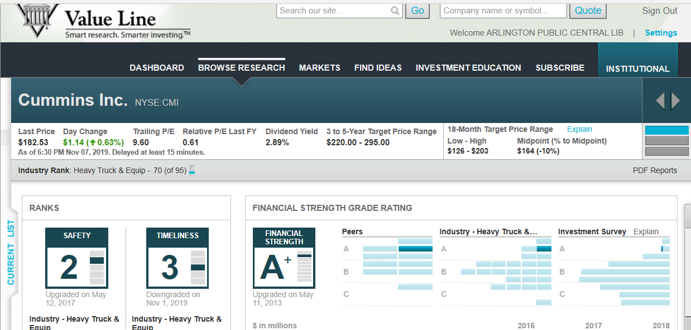
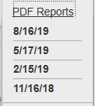
Go here next
(“1” is VL’s highest ranking)
Peers- Fin Strength Ratings: A++ = Deere; A+ =CMI & CAT A =AGCO & PCCAR; B++ = FTT.TO & OSK, etc.

Slide 3
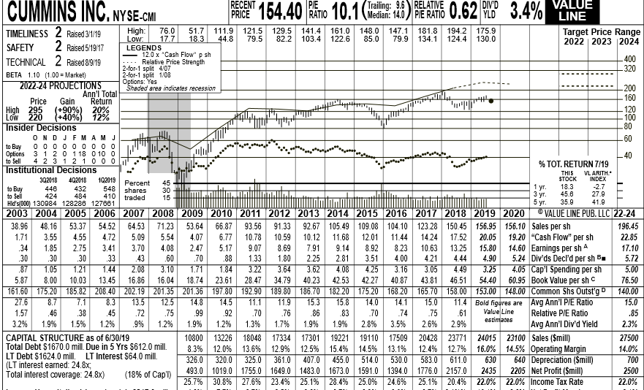
Upper 1/3-1/2 of Value Line, August 2019 Pdf, Report
1
3, 5
2

Slide 4
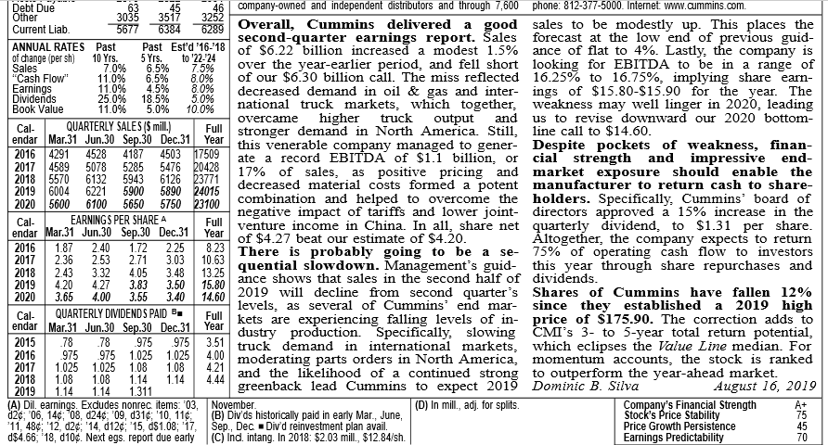
Lower 1/3-1/2 of Value Line, August 2019 Pdf, Report
4
6

