Slide 8
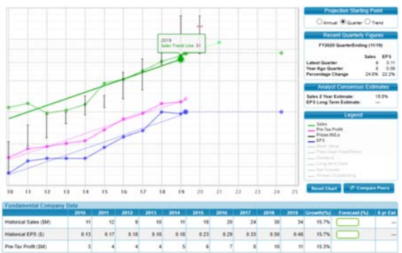
Move next to the visual analysis and explain any potentially misleading data. For example, the EPS on this graph for 2017 has a one-time addition for a tax credit.

Slide 10
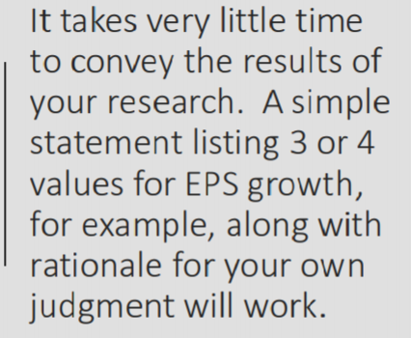

Slide 14
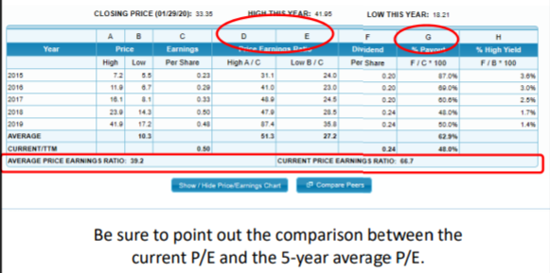

Slide 15
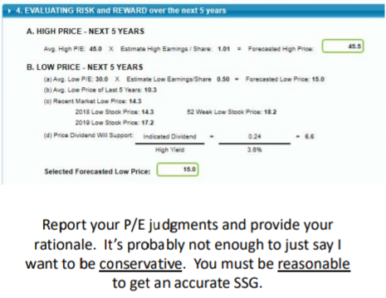

Slide 16
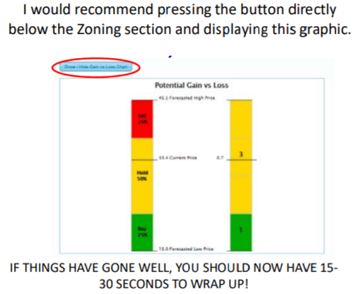

Slide 17
