Slide 1
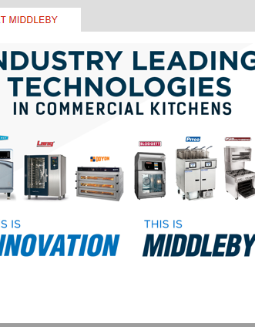
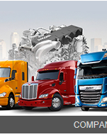

Kathy’s Stock Study Team
PACCAR
United Natural Foods
August 8, 2018
Notes:
NOTE: To replace a picture, just select and delete it. Then use the Insert Picture icon to replace it with one of your own!

Slide 2
Kathy’s Stock Study Team - Overview
Search Sources: Value Line, BINC, BI Ticker Talks, Manifest Investing Screener
2 Industries, 3 Stocks, for your Review
  Industrials | Heavy Truck & Equip - PACCAR
  Industrials | Machinery – Middleby
  Staples | Food (Retail) - United Natural Foods

Slide 3
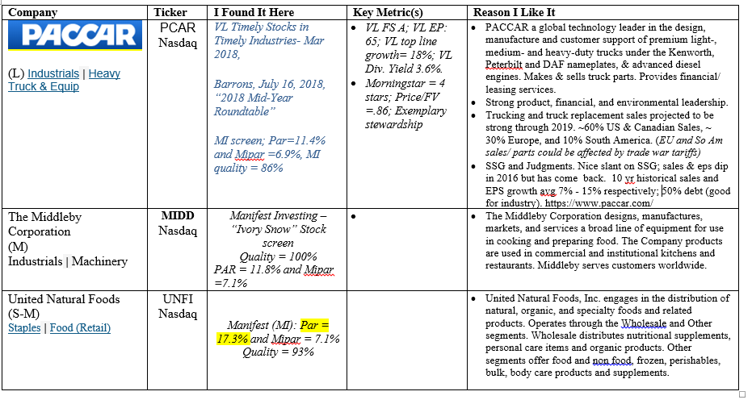
Kathy’Stock Study Team Template – Aug 2018

Slide 4
PCAR 2017 Operations (from 2017 Annual Report)
Truck Manufacturing and Sales, 2017 Revenue was ~75%
  Manufactures premium quality light, medium and heavy duty commercial vehicles sold worldwide under the Kenworth, Peterbilt and DAF nameplates
  Nearly 52% of sales & manufacturing in Europe, 37% in US & Canada, 11% in South America & rest of world
  Projected worldwide 2018 sales growth ~ 3%-10%
Parts Manufacturing and Sales, 2017 Revenue was ~ 17%
  Produces & sells powertrain and aftermarket truck components
  Projected 2018 sales growth ~ 8%
Truck Leasing and Financing,2017 Revenue was ~ 8%
  Projected 2018 growth ~ 4%

Slide 5
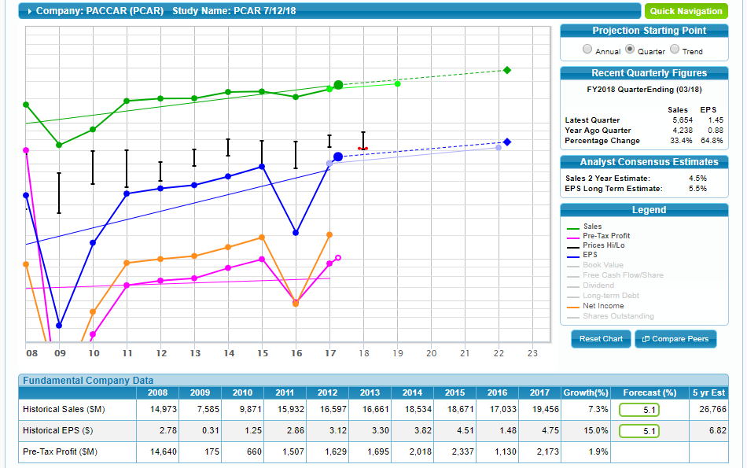
PACCAR Front Page of Current SSG
2016 results:
-Lower world-wide truck sales
-One-time $833M settlement
payable to European Commission
which fined PCAR, Daimler, &
other truck manufacturers for
14 yrs price-fixing.

Slide 6
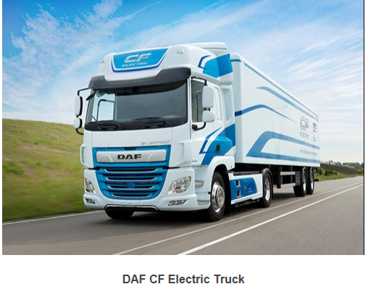
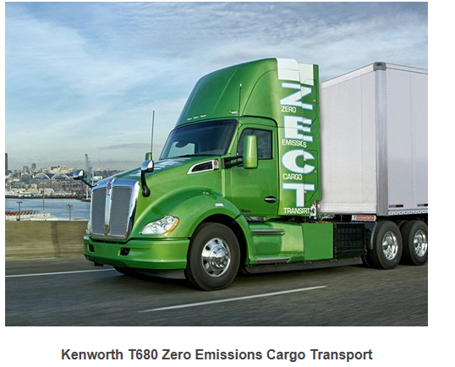
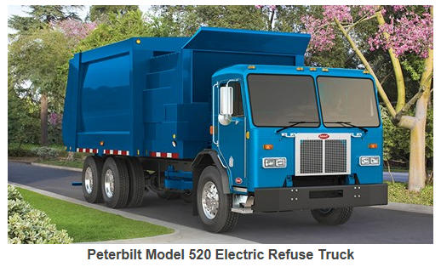
PACCAR Trucks: DAF, Kenworth and Peterbilt - Awards & Innovation
Awards: DAF XF and CF models - “International Truck of the Year 2018,” named by transportation journalists from 23 European countries; DAF - “Truck Fleet Manufacturer of the Year” (2017) by UK; Quality Magazine named PACCAR Engine Company “Quality Plant of the Year” (2017)
Innovation: DAF, Kenworth and Peterbilt leaders in battery electric, hydrogen fuel cell and hybrid vehicles - field-testing such powertrains in North America & Europe. Technical Centers & Information Technology Division (ITD) - an industry leader in innovative digital technologies -have developed state-of-the-art products, vehicle design & software– e.g. road simulators, driver assistance systems, connectivity & augmented reality tools for diagnostics & servicing (partnered w. MSFT), vehicle & fuel efficiency, PACCAR front and rear axle & automated transmission.
Environment: focused on zero emissions all electric vehicles and fuel cell /natural gas hybrids.

Slide 7
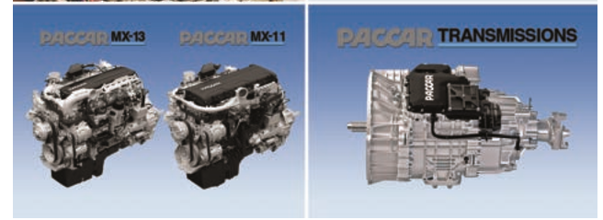
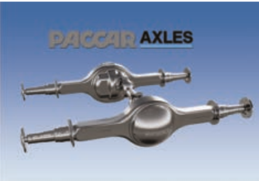
PACCAR Parts: Operation, Innovation and Environment
PACCAR Parts Operation & Innovation= primary source for aftermarket parts and services for PACCAR vehicles & “TRP” branded parts supplied for all makes of trucks, trailers and buses.
  Expanded global Fleet Services program by offering national pricing and centralized billing to over 1,000 commercial vehicle fleets with more than 735,000 vehicles. PACCAR Parts’ advanced eCommerce program allows customers 24/7 online ordering access to more than 1.4 million quality aftermarket products.
  TRP’s successful aftermarket parts retail stores expanded to 130 locations in 31 countries & offers customers cost-effective parts choices for vehicle and trailer repair and maintenance.
Environment: All PACCAR manufacturing facilities have earned ISO 14001 environmental certification. The company’s manufacturing facilities enhanced their “Zero Waste to Landfill” programs during the year.

Slide 8
PACCAR Leasing & Financing, and Other Assets: Operations
PACCAR Financing Operation financing or leasing PACCAR products in North America, Europe and Australia.
  PACCAR Financial Services’ (PFS) conservative business approach, coupled with PACCAR’s S&P credit rating of A+ and the strength of the dealer network, enabled PFS to earn pre-tax profits of $264.0 million in 2017. PFS has operations covering 24 countries on four continents.
  PACCAR Leasing (PacLease) - one of the largest full-service truck rental and leasing operations in North America, Germany and Australia. PacLease placed nearly 6,200 new PACCAR vehicles in service, a 23% increase over 2016.
Other Assets: used trucks (units returned from matured operating leases), repossessions, and trades; manufacturing and marketing of industrial winches

Slide 9
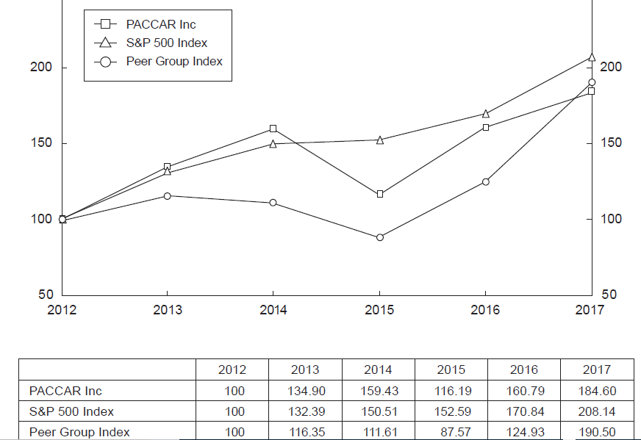
PCAR Stockholder Return vis-à-vis S&P 500 & Peer Group (from 2017 Annual Report)
PACCAR’s Peer Group Index: AGCO Corp., Caterpillar Inc., Cummins Inc., Dana Inc., Deere & Co., Eaton Corp., Meritor Inc., Navistar International Corp., Oshkosh Corp., AB Volvo and CNH Industrial N.V.

Slide 10
Highlights of PCAR’s 2nd Qtr 2018 Financial Report (Issued July 24, 2018)
Record Quarterly Revenues and Excellent Profits-Strong Global Truck Deliveries and Parts Sales Drive Results
Robust Global Truck Markets
PACCAR Trucks Achieve Record Quarterly Deliveries

Slide 11
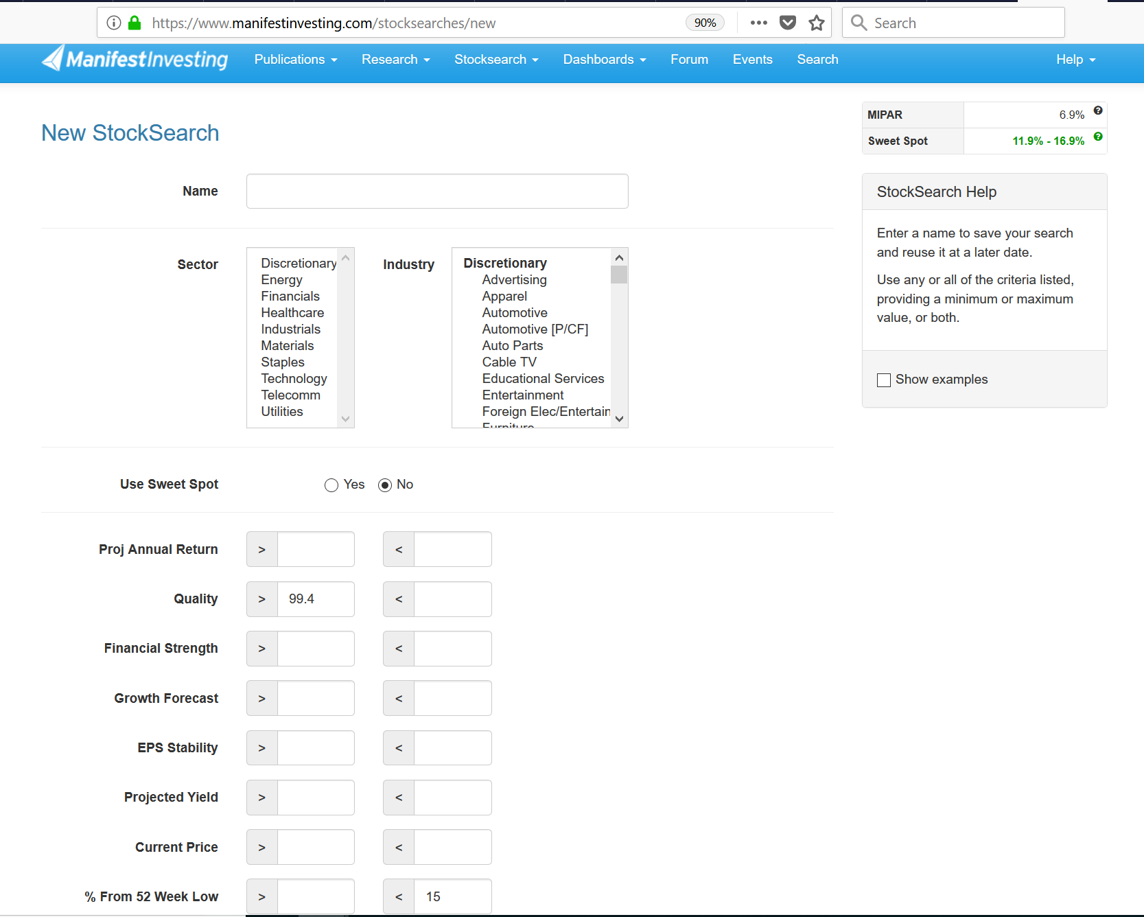
IVORY SNOW SEARCH

Slide 12
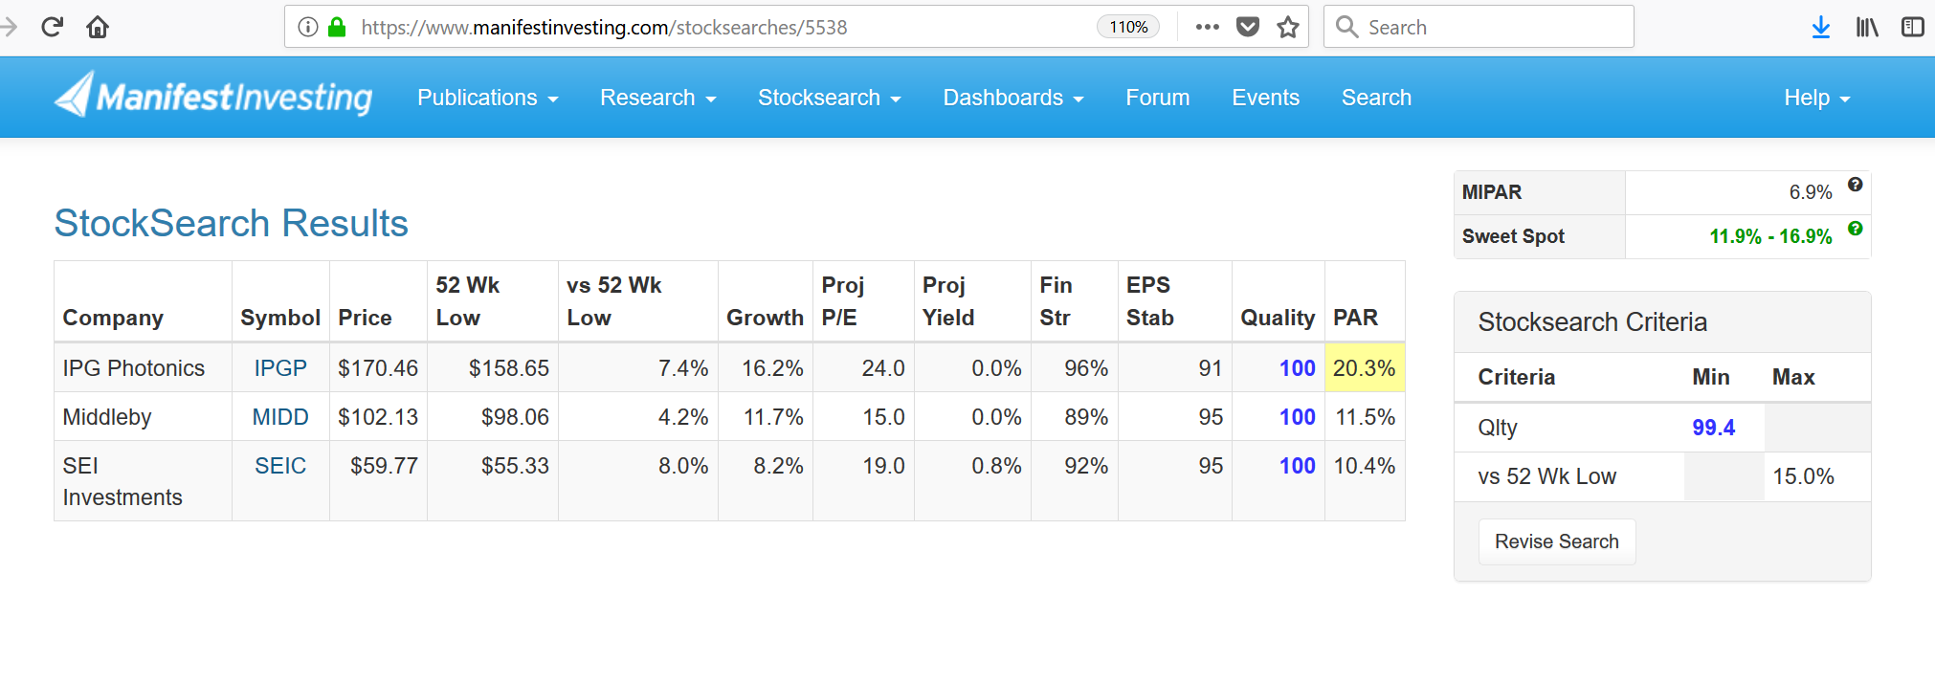

Slide 13
MIDD - MIDDLEBY
is an American publicly traded commercial and residential cooking and
industrial process equipment company based in Elgin, Illinois.
Manufactures commercial cooking equipment. Does business with 97 out of the
top 100 food service chains in the United States and internationally.
A leader in systems for the industrial processing, baking and packaging industry.
Acquired Viking Range in 2013 and U-Line in 2014. Viking is a leading brand in
residential cooking equipment.
The company manufactures commercial cooking equipment, industrial processing equipment, and residential appliances.

Slide 14
WHY IT’S ON SALE
In May 2018, Taylor Company, a manufacturer of ice cream dispensing equipment and frozen drink machines was acquired for $1 billion.

Slide 15
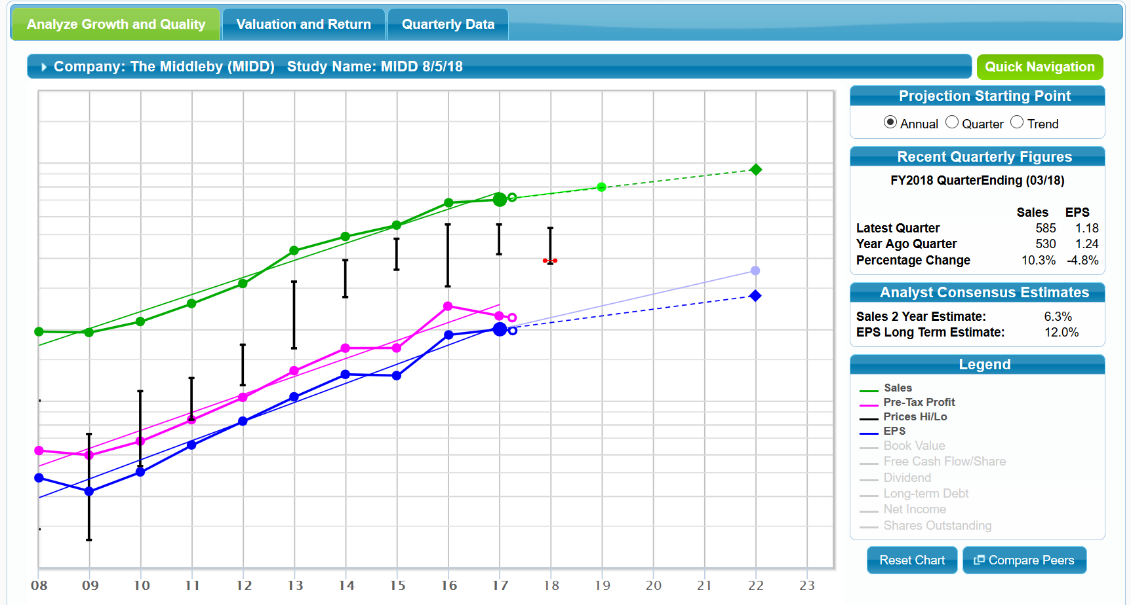

Slide 16
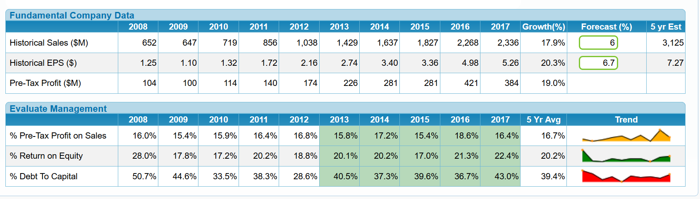
MIDD

Slide 17
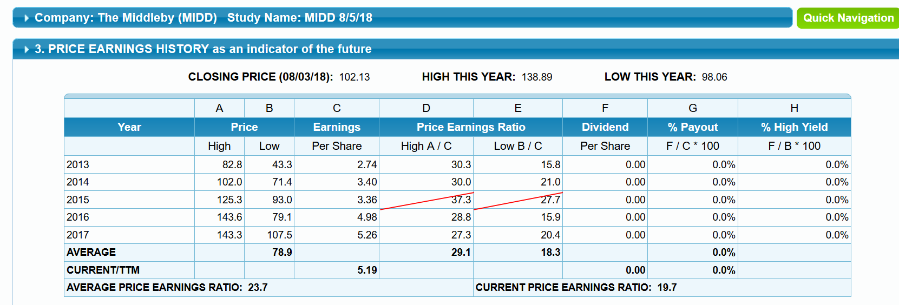

Slide 18
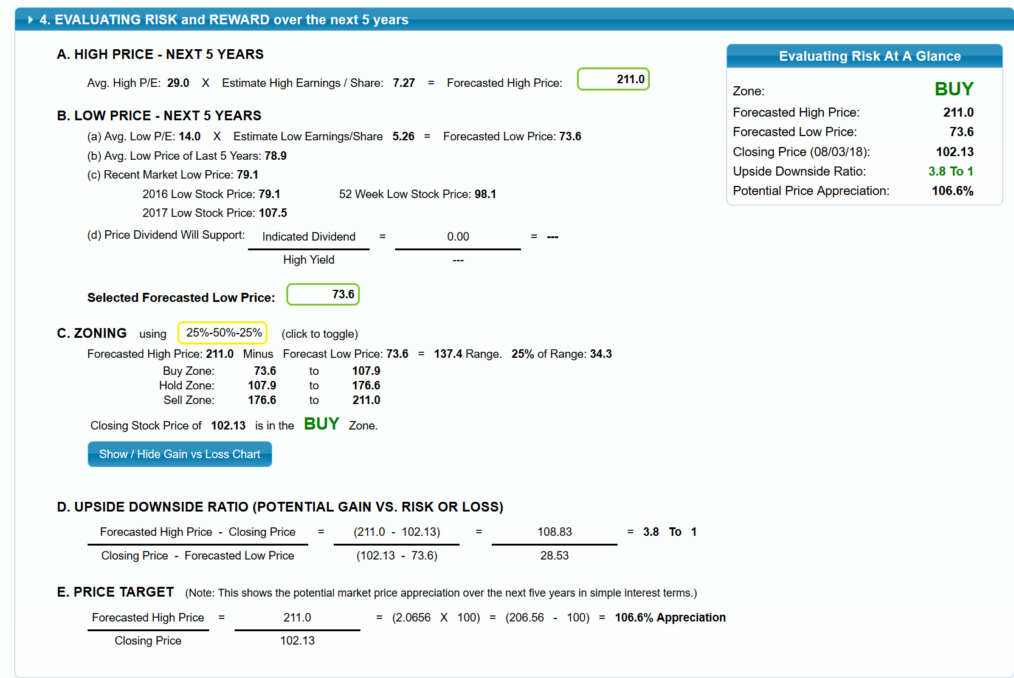
MIDD

Slide 19
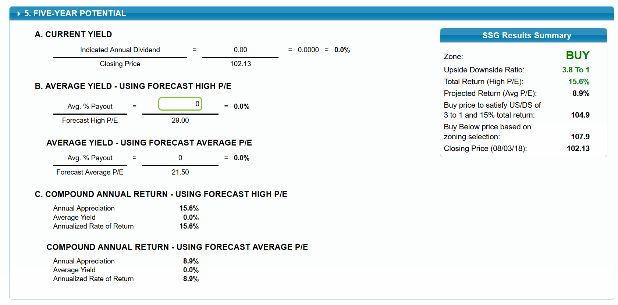
MIDD

Slide 20
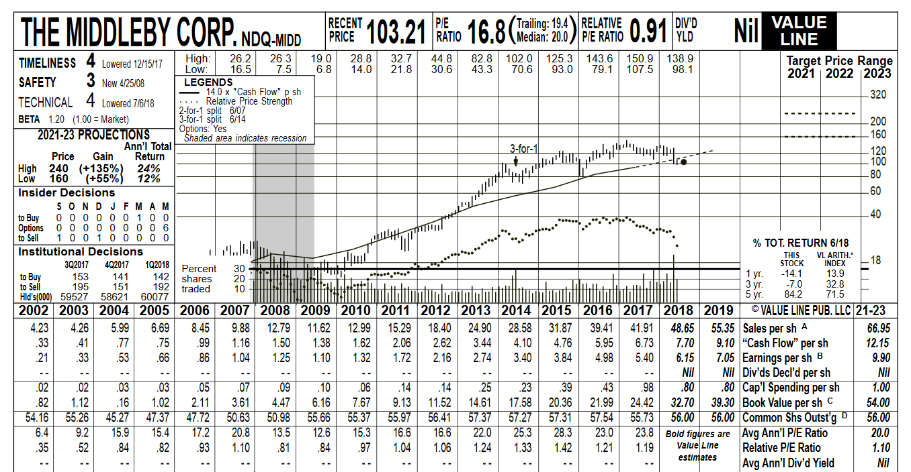

Slide 21
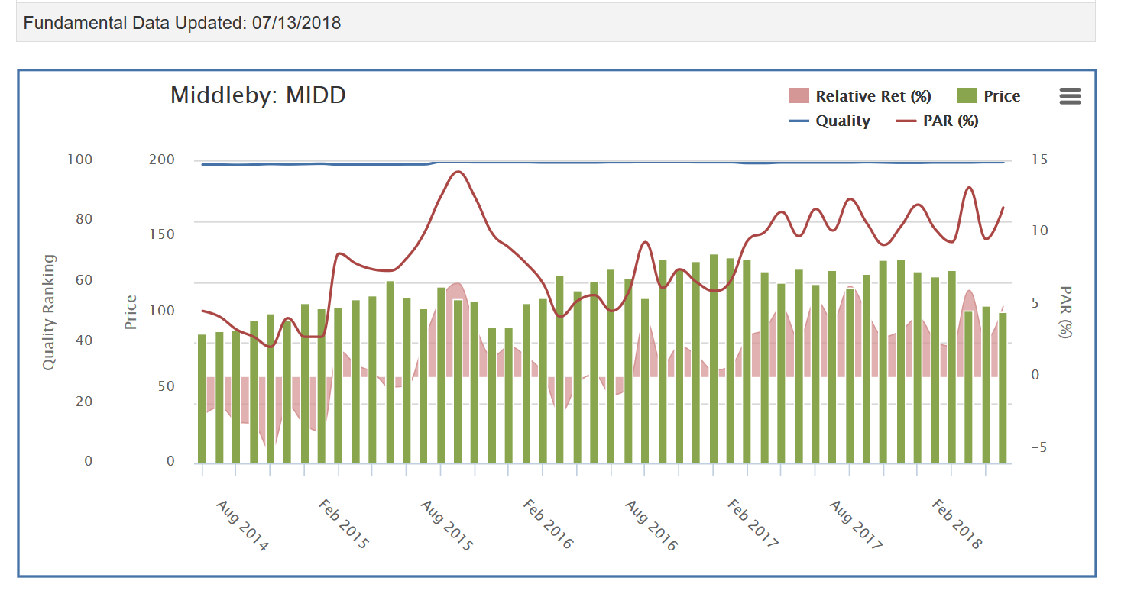

Slide 22
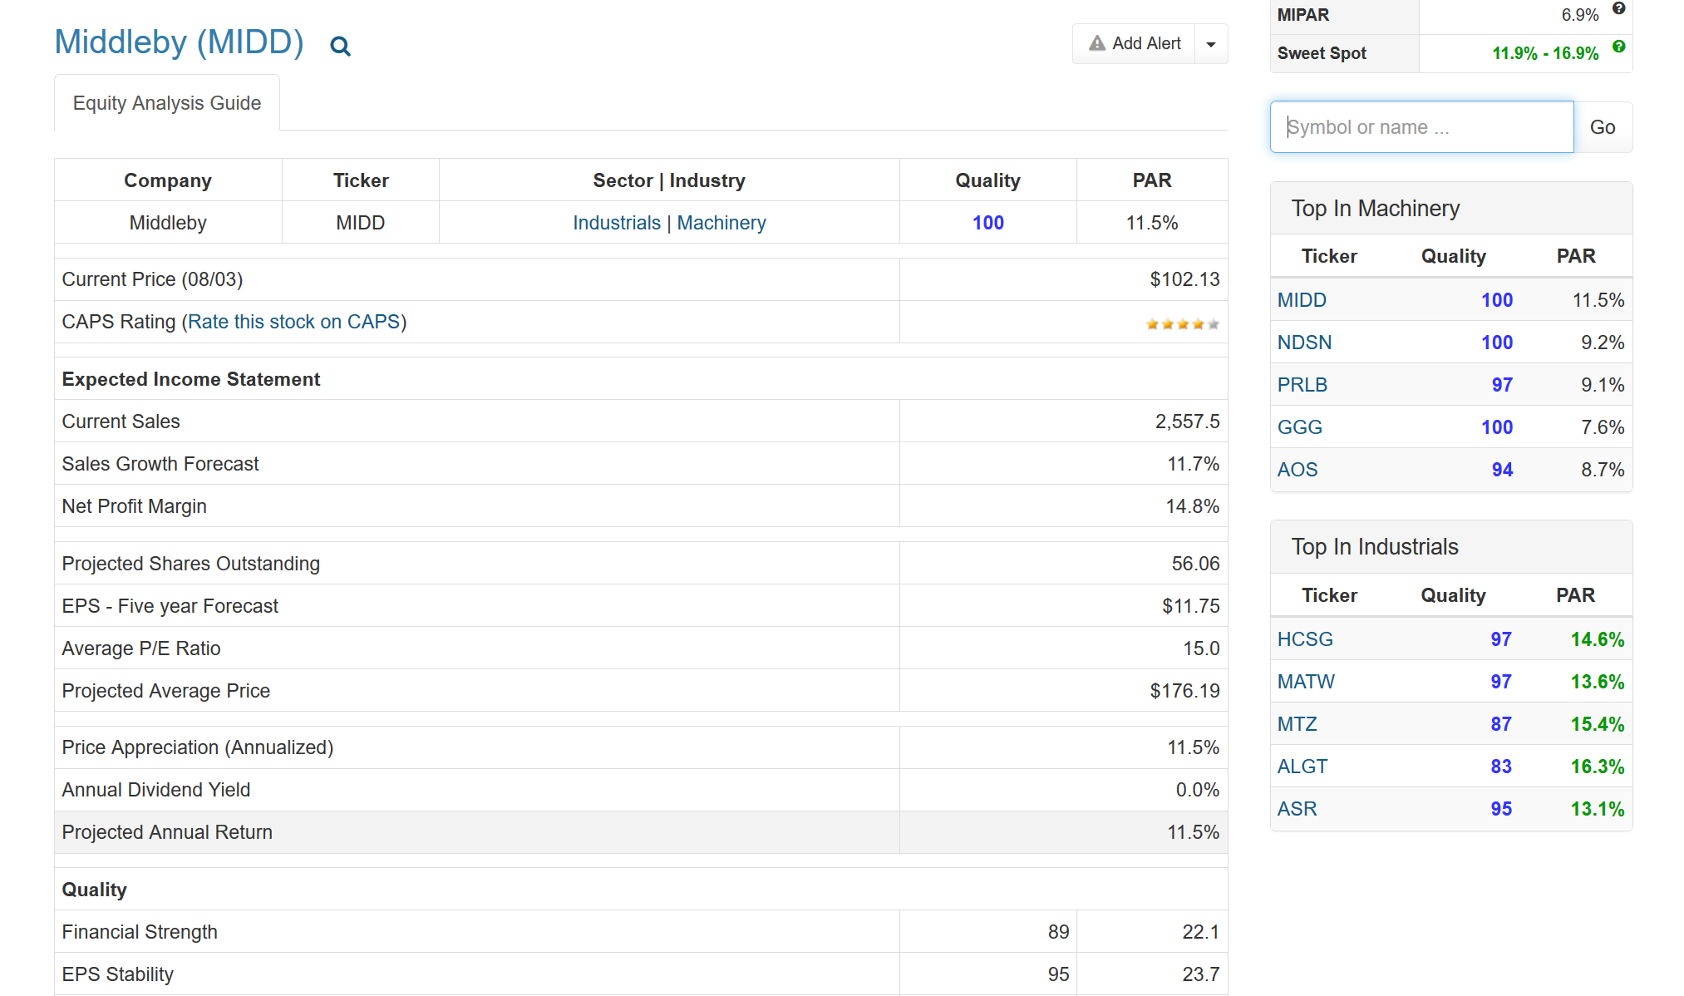

Slide 23
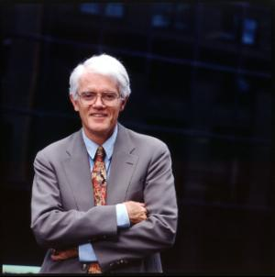
United Natural Foods
Manifest Screen by M Robinson July 2018
Manifest ”Stock to Study” July 20, 2018
Peter Lynch concept—my personal interest in our food chain and food supply

Slide 24
What is United Natural Foods?
One of only 2 nationwide distributors of natural products
Owns 13 natural product retail stores in FL, MD, and MA
Serving more than 40,000 accounts in US and internationally
33% of 2017 sales to Whole Foods Market
Corporate Hqs in Providence, RI; Incorporated in Delaware

Slide 25
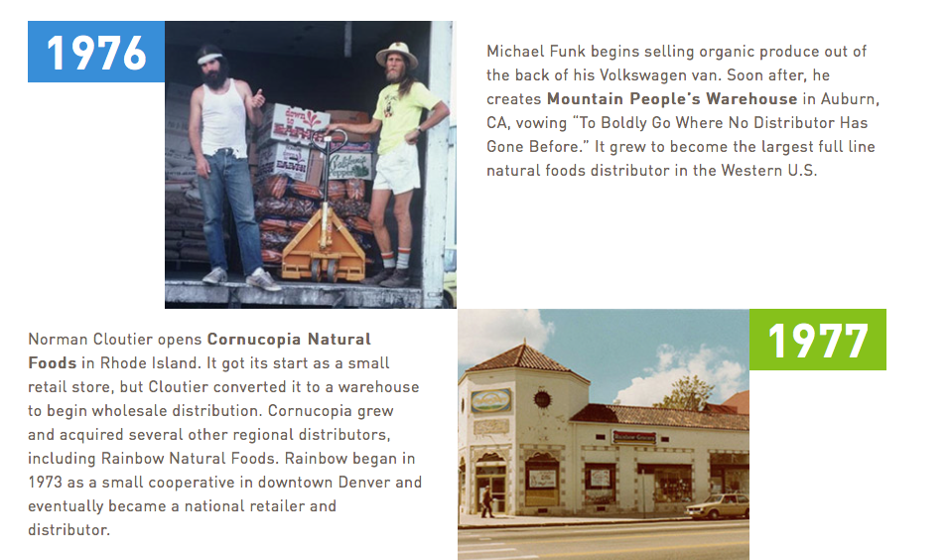

Slide 26
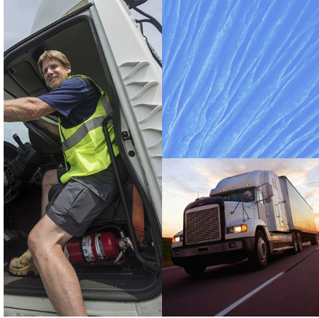
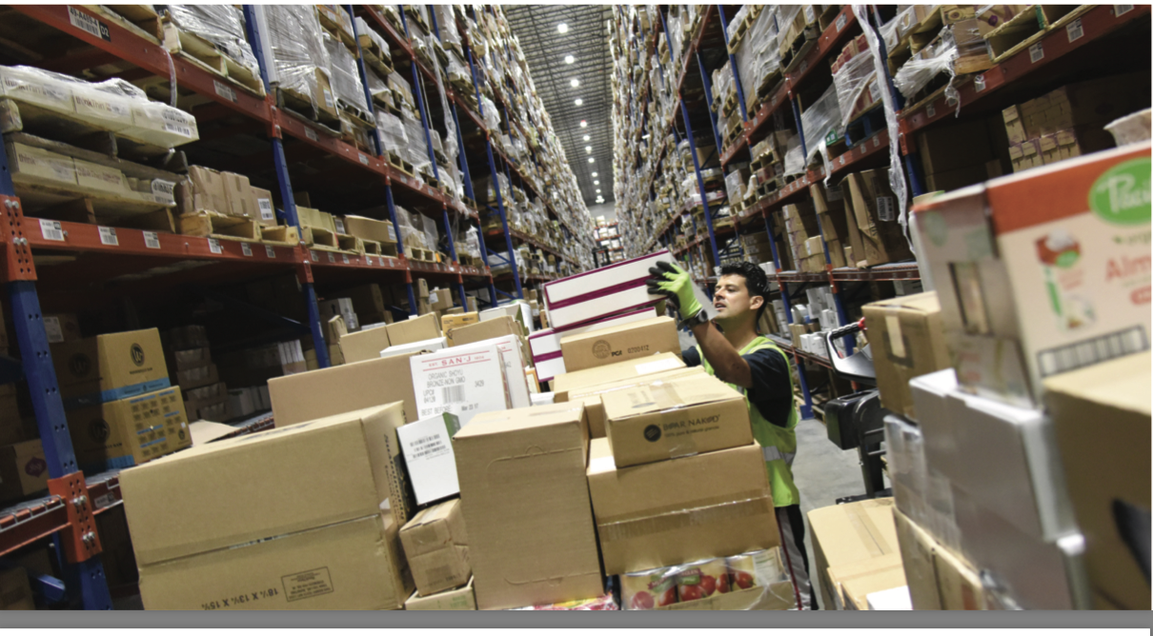
Now

Slide 27
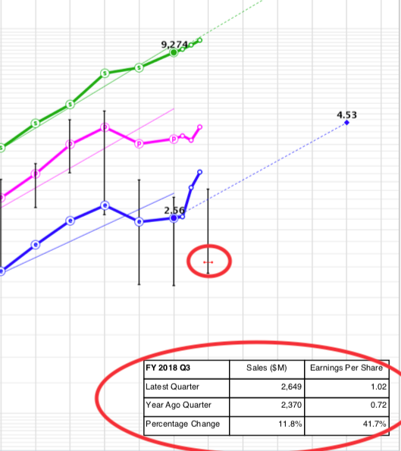
Quick Visual—up, straight and parallel

Slide 28
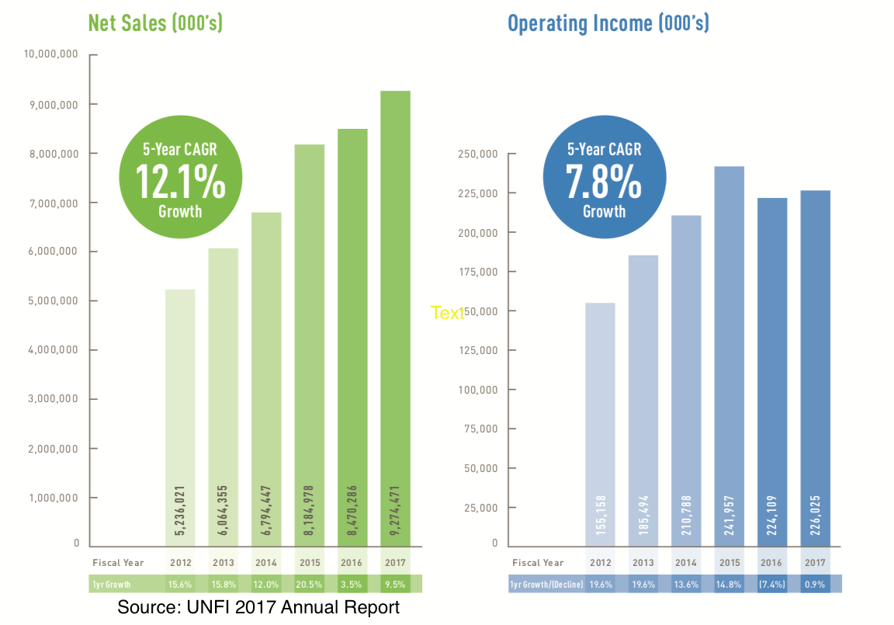
Growth

Slide 29
FY 2018 Reporting 3rd Quarter June 11, 2018
Net sales climbed 11.8 percent to $2.65 billion
Operating income also rose 26.5 percent to $82.257 million.
Operating expenses declined 40 basis points

Slide 30
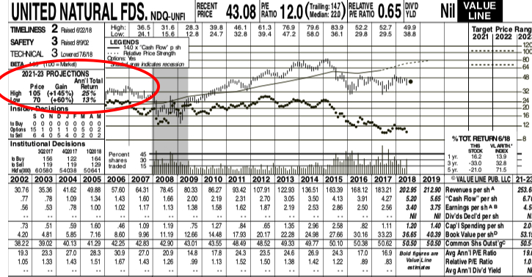
July 20, 2018

Slide 31
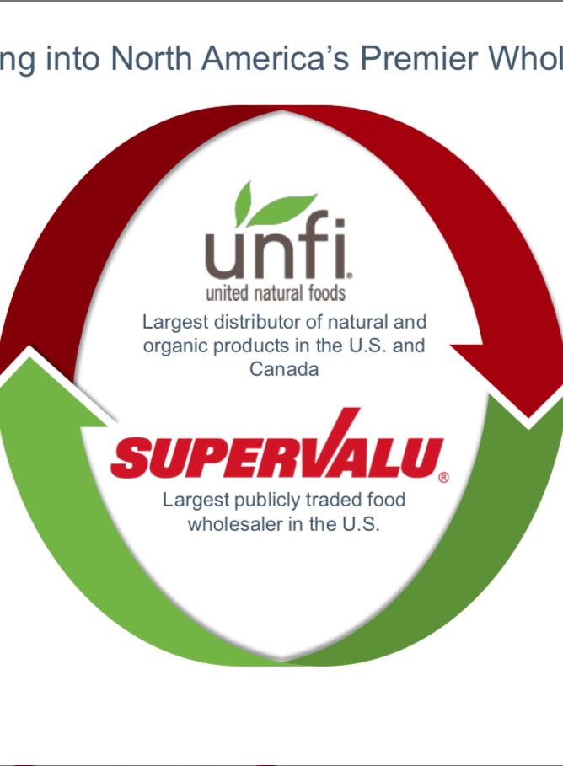
26 JULY ANNOUNCEMENT
Buying Supervalue
Paying 85% premium over 200 day moving average

Slide 32
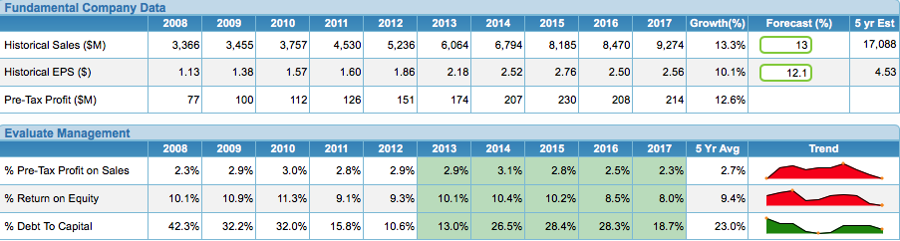
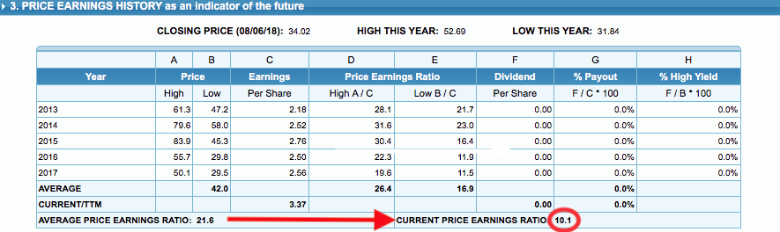
SSG Annalysis

Slide 33
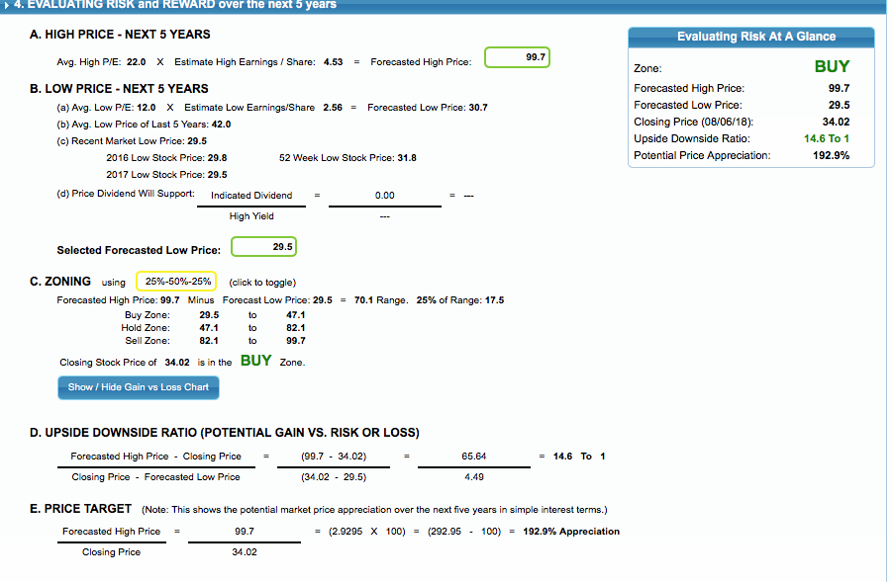
Judgement

Slide 34
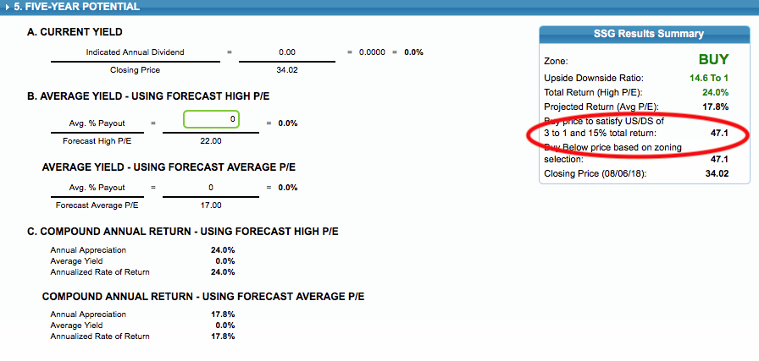
Potential

Slide 35
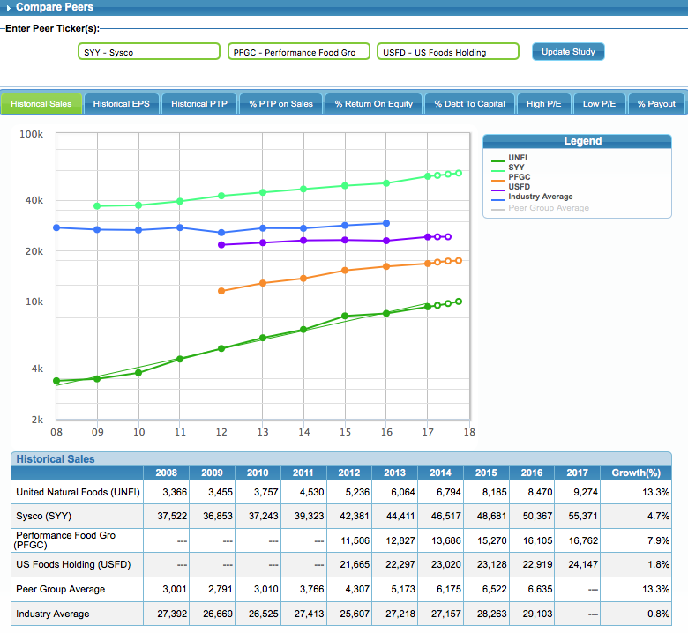
Peers

Slide 36
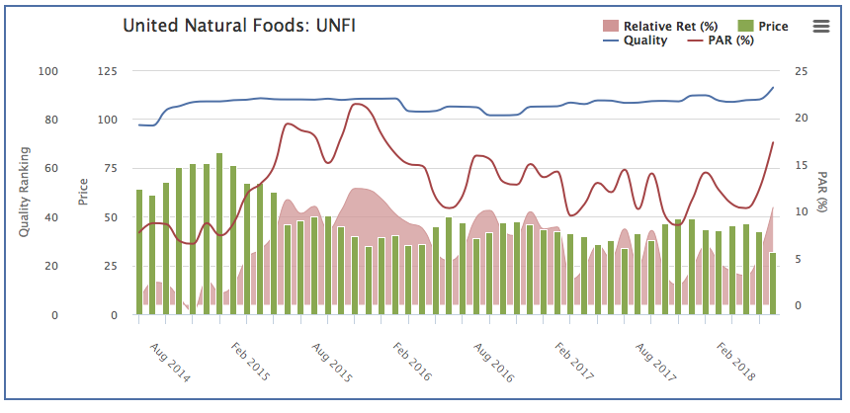
Graph from Manifest Investing

