Slide 1
MicNova -Dec 21, 2017 Small Cap Stock Study: Cambrex (CBM)
Adapted from Manifest Investing’s Turnout Tuesday, Nov 6, 2017, by Mark Robertson
https://www.manifestinvesting.com/

Slide 2
CAMBREX Corp. (CBM) Discussion by Mark Robertson and Ken Kavula

Slide 3
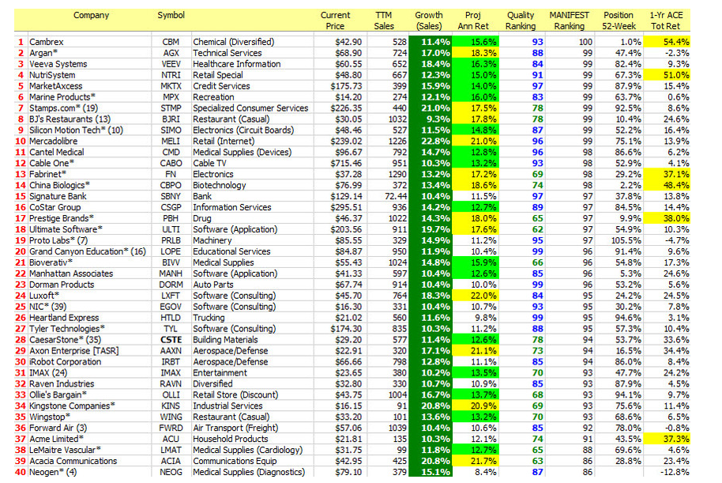
Manifest Investing’s Best Small
Companies for 2018

Slide 4
Cambrex, analysis from Small Cap Informer, Nov 2017
Company Overview. One of the largest, & premium, manufacturers of small molecule and generic active pharmaceutical ingredients (APIs) compounds, used by other pharmaceutical companies. Sells its often niche-market compounds to leading pharmaceutical companies worldwide from six operating sites within the U.S., E.U., and India.
Market Drivers. Continued world-wide growth for products; limited API manufacturing capacity, especially in U.S.; and customer preference for high-quality suppliers like Cambrex.
Strong Pipeline. Early & late stage clinical projects and growing pipeline of new generic APIs in development.
Examples of Products. Involved with Gilead’s 2014 & 2016 launch of HCV treatments; Courting other pharmaceutical companies; Treatments for pain & ADHD.
Quality & Value Analysis. Quality: pre-tax profit margin and return on equity trending up; debt-free, cash available for acquisitions. Value: Projected high price in 5 years of $123 based on P/E of 19.

Slide 5
Review: Market Capitalization (from Investopedia)
Mega-Cap: Over $200 B
Big/Large Cap: $10B-$200B
Medium Cap: $2B -$10B
Small Cap: $300M -$2B
Cambrex Corp, in 2017, has about 33.38M shares outstanding; price ~ $50/share, so Market capitalization is 33.38*$50 = $1.66 B
First listed on NYSE – 1990
Ownership = about 83% institutions and mutual funds
Micro-Cap: $50M -$300M

Slide 6
CBM Financial History ($M) , MorningStar

Slide 7
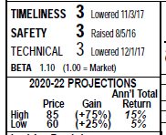
Value Line Analysis of Cambrex, Dec 2017

Slide 8
Analyses Variations for Projected Cambrex Performance
Mark Robertson & Ken Kavula, November 8, 2017, Turnout Tuesday & Best Small Companies for 2018:
Projected Sales Growth =11.4%; Proj Ann Ret = 15.6%
Manifest Investing, December 2017, Equity Analysis Guide
Projections: Sales Growth = 9.8%; Ann Ret = 9.5%; P/E =16; Price =$80
Value Line Dec 2017
Average annual return range, next 5 years: 5%-15%; Avg. P.E ration = 17.5; Price range/share = $60-$85
Gladys’s SSG for next 5 years:
Estimated High and low P/Es = 14-19.5; Future Sales Growth & EPS = 7.1%; Annual return range =6.5%-10.2%
Better Investing “Analysts” – 2 yr growth =5.2%, EPS = 10%

Slide 9
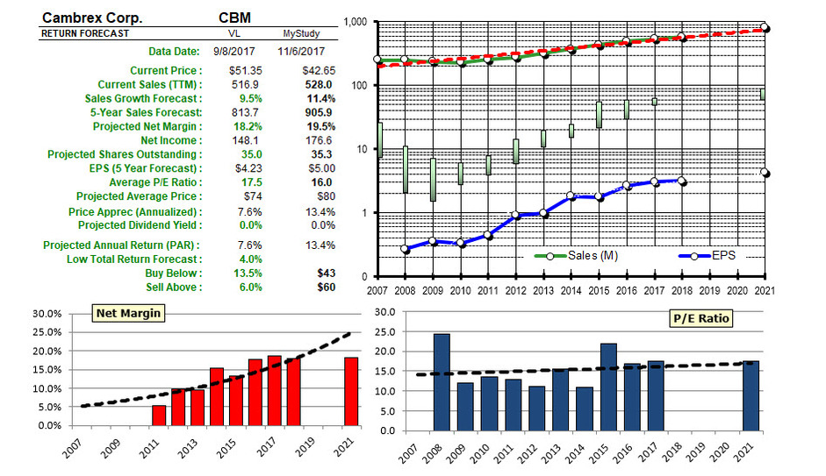

Slide 10
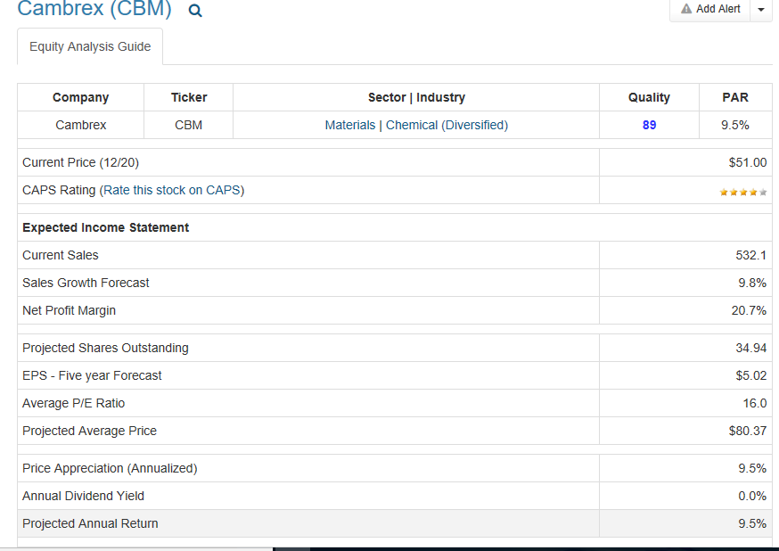
CAMBREX Corp. (CBM) Manifest Investing Projections – Dec 2017

Slide 11
Conclusion
Cambrex is a Small Cap Stock that has grown and performed well in a niche health-care pharmaceutical market since 1990
It has a strong balance sheet and strong product pipeline
Because it is a small company and dependent upon the sales of some of its large customers, like Gilead, the stock price and its performance can be volatile.
Gladys’s SSG suggests the stock, at about $51/share, is in the “buy” range. Best return is more than 10%.

Slide 12
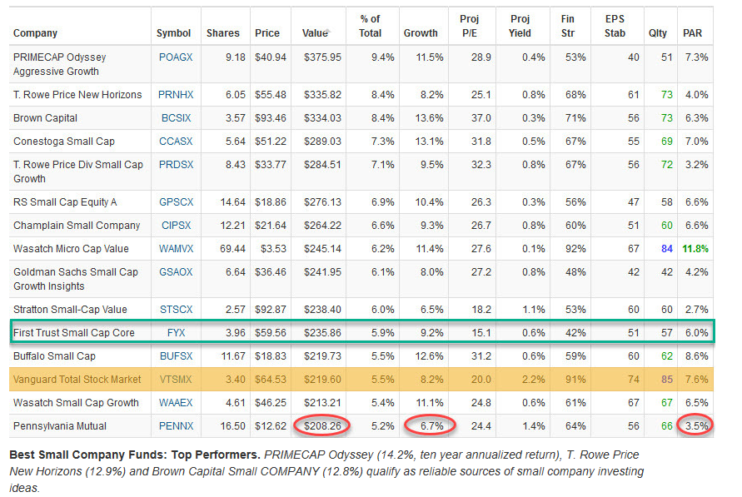
Addendum: Mark’s Best Sources for Small Company Ideas: Well-Run Mutual Funds

