Slide 1
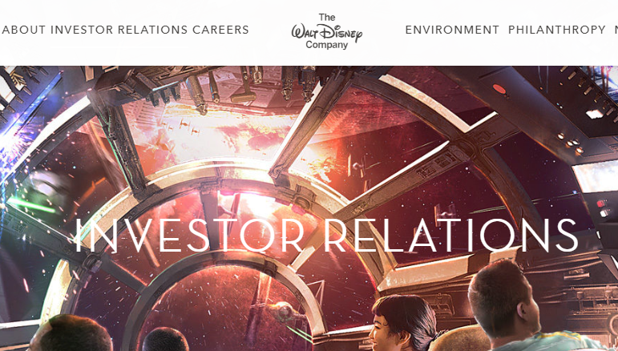

Slide 2
two distinct yet complementary businesses
1. Media Networks
Walt Disney Studios
2. Disney Branded Business

Slide 3
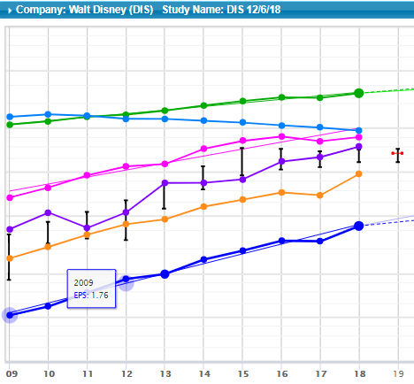
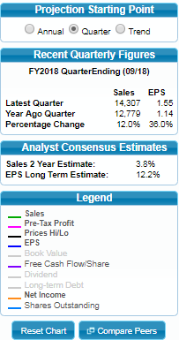

Slide 6
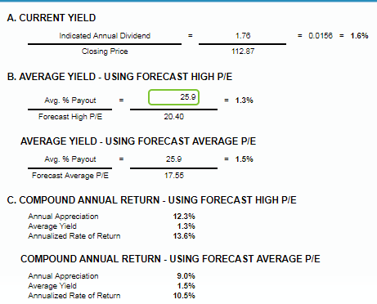
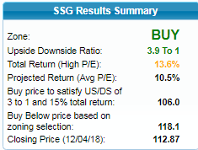

Slide 7
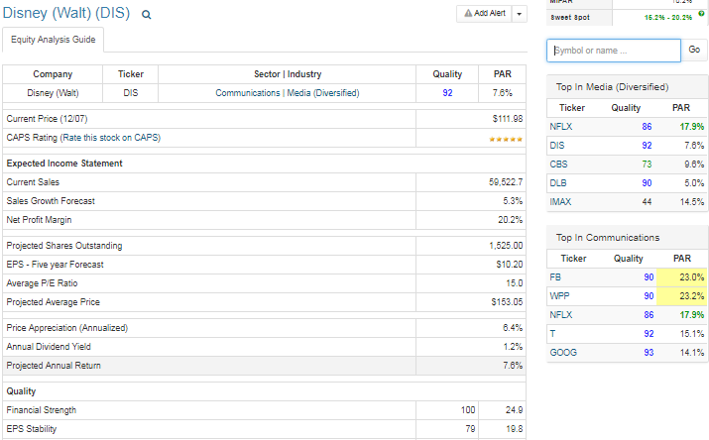
Current EPS 7.25

Slide 8
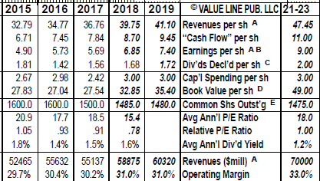

Slide 9
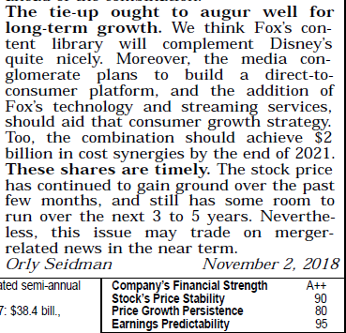

Slide 10
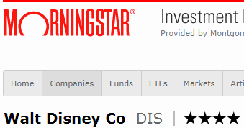
Analyst Note 11/08/2018
Disney ended its fiscal 2018 with a strong fourth quarter as revenue and EBITDA beat both the Street and our expectations. The studio segment outperformed again as the firm continues to benefit from a strong 2018 slate including Incredibles 2, the highest grossing Pixar film ever. The Fox media assets and the firm’s direct-to-consumer efforts continue to be the focus of CEO Bob Iger as the firm enters an important transitional fiscal year. We continue to believe the launch of Disney+ (the newly announced name for the firm’s SVOD) and the closing of the Fox acquisition will help boost the firm’s positive trajectory for the near future. We are maintaining both our wide moat rating and our fair value estimate of $130.
While Walt Disney is a media conglomerate, we view the company as two distinct yet complementary businesses: media networks, which include ESPN and ABC, and Disney-branded businesses, including parks, filmed entertainment, and consumer products.
The crown jewel of Disney's media networks segment is ESPN. It dominates domestic sports television with its 24-hour programming on ESPN, ESPN2, and its growing sister networks. ESPN has exclusive rights with NFL and college football, the premier sports programming rights in the United States. It profits from the highest affiliate
fees per subscriber of any cable channel and generates revenue from advertisers interested in reaching adult males ages 18-49, a key advertising demographic that watches less scripted television than other groups.

Slide 11
Bulls Say
• The parks and resorts segment has rebounded strongly from the recession, and the opening of Disneyland Shanghai should provide additional momentum.
• The addition of the Star Wars franchise broadens the demographics that the company can address. Additionally, Disney's strong distribution and merchandising capabilities should help to speed the monetization of the Lucasfilm acquisition.
• Although making movies is a hit-or-miss business, Disney's large library of content with popular franchises and characters reduces this volatility over time.
Bears Say
• The business model for the media networks depends on the continued growth of retransmission and reverse compensation fees. Any slowdown in the growth of these fees, perhaps because the pay-television business begins to shrink, would hurt the profitability of this segment.
• Increases in the cost of popular programming such as sports events and television series could adversely affect margins at ESPN and ABC.
• Developing mass-market hit programs can be unpredictable, especially as media fragmentation continues.

Slide 12
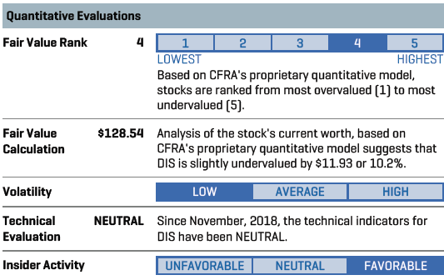

Slide 13
IMPACT OF SIGNIFICANT DEVELOPMENTS. In June 2018, after a bidding war against Comcast (CMCSA), Disney revised its offer to acquire certain entertainment assets of Twenty-First Century Fox to about $71.3 billion in a 50/50 cash-and-stock transaction. The deal includes Fox's film/television assets; FX and National Geographic channels, the regional sports networks, Fox international networks and STAR India; as well as the FOX's minority stakes in Hulu (30%) and Sky Plc. (39%). With U.S. regulatory approvals already in place, in June, the company expected the deal to close in the next year -- subject to pending approvals in international jurisdictions. The company expects about $2 billion in cost synergies related to the deal, pursuant to which it extended the tenure of its CEO Robert Iger until the end of 2021.
CORPORATE STRATEGY. As a content-oriented company, DIS's top strategic priorities include creativity and innovation, international expansion, and leveraging new technology applications. Under CEO Robert Iger, DIS has been making its content available across various digital platforms (broadband, wireless/mobile -- including iTunes, iPhone/iPad, Netflix, and Amazon -- and video games). In August 2017, the company unveiled plans to launch ESPN-branded and Disney-branded streaming offerings in early 2018 and in 2019, respectively. Concurrently, DIS also announced plans to end its distributions agreement with Netflix beginning with the 2019 calendar year theatrical slate. In September 2017, the company paid $1.5 billion for an additional 42% stake i

