Slide 1
ULTA Beauty First Presented to MicNova 2017 (Sheryl Patterson)
On Watch List: GH Review on Sept 11, 2019

Slide 2
Disclaimer
The information in this presentation is for educational purposes only and is not intended to be a recommendation to purchase or sell any of the stocks, mutual funds, or other securities that may be referenced. The securities of companies referenced or featured in the seminar materials are for illustrative purposes only and are not to be considered endorsed or recommended for purchase or sale by BetterInvesting™ National Association of Investors Corporation (“BI”) or the National Investors Association, its volunteer advisory board (“NIA”). The views expressed are those of the instructors, commentators, guests and participants, as the case may be, and do not necessarily represent those of BetterInvesting™ or NIA. Investors should conduct their own review and analysis of any company of interest before making an investment decision.
Securities discussed may be held by the instructors in their own personal portfolios or in those of their clients. BI presenters and volunteers are held to a strict code of conduct that precludes benefiting financially from educational presentations or public activities via any BetterInvesting programs, events and/or educational sessions in which they participate. Any violation is strictly prohibited and should be reported to the President of BetterInvesting or the Manager of Volunteer Relations.
Notes:
2

Slide 3
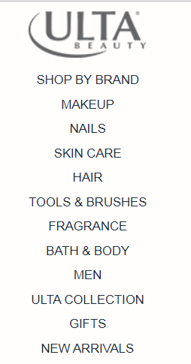

Slide 5
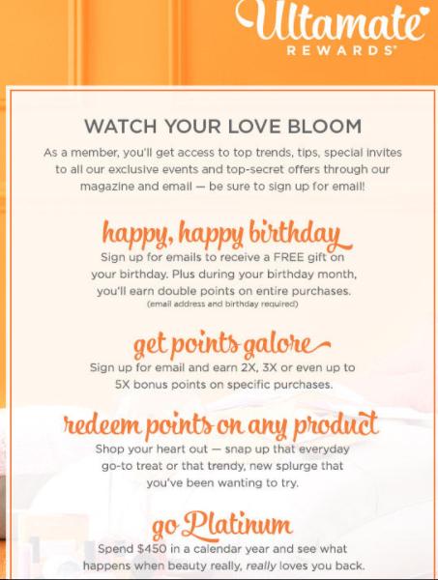

Slide 6
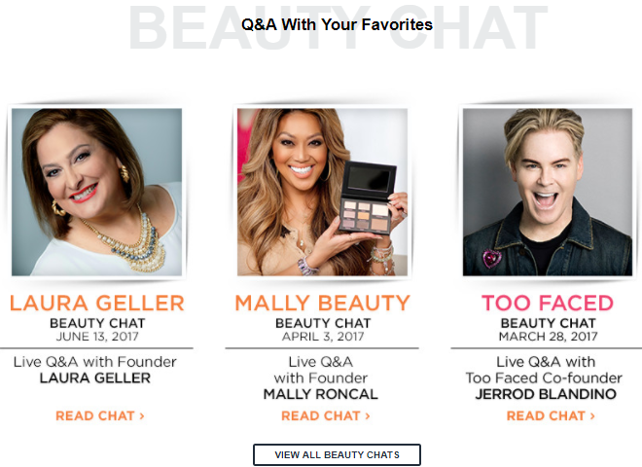

Slide 8
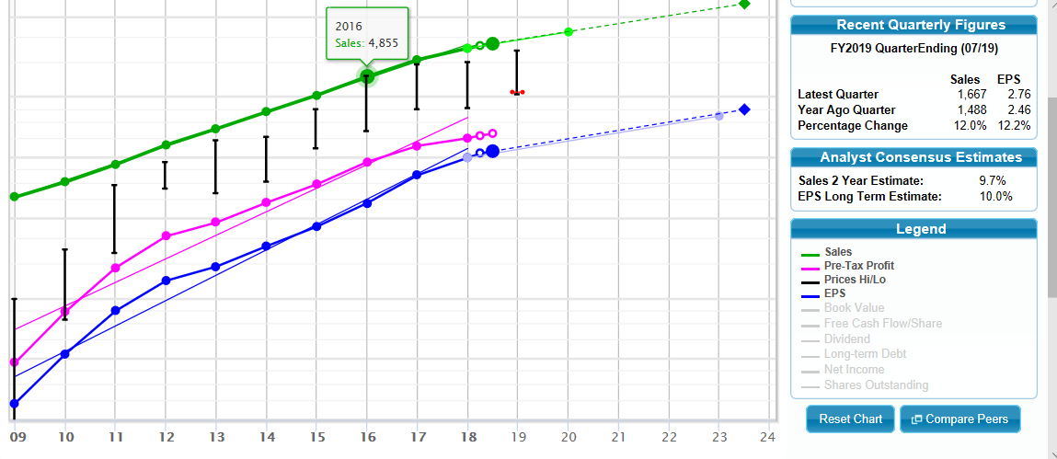
My Judgments:
Sales 9.5%
EPS 10%

Slide 9
Manifest Investing Quality Rating: 98%
Manifest Investing Projected Average Return (PAR): High double digits
Make-up/ personal appearance products – historically resistant to recessions
From 2 Guys Talk Stock, Sept 4, 2019: This may be a stock one buys low & sells high, rather than buy & hold.
Other analysts’ projections, July 2019: CFRA sees Ulta target price at $370; Value Line sees price in next 5 yrs between $410-$615. (GH price projections = $ 191- $475)

Slide 10
