Slide 1
Pepico, Inc
Global Dominance in Beverage and Snack Distribution Operations

Slide 2
A Leader in Manufacture and Distribution of Snacks, Non-Alcoholic Beverages and Convenience Foods
Portfolio of brands (Frito-Lay, Gatorade, Pepsi-Cola, Quaker and Tropicana)
Make, market, distribute, and sell beverages, foods and snacks
More than 200 countries and territories
Vision: To be the global leader in convenient foods and beverages by “Winning with Purpose”
  Reduce use of plastics, use sustainable agriculture, and promote more healthy food and beverage preferences world-wide.
  Promote diversity and equality in corporate leadership and workforce

Slide 3
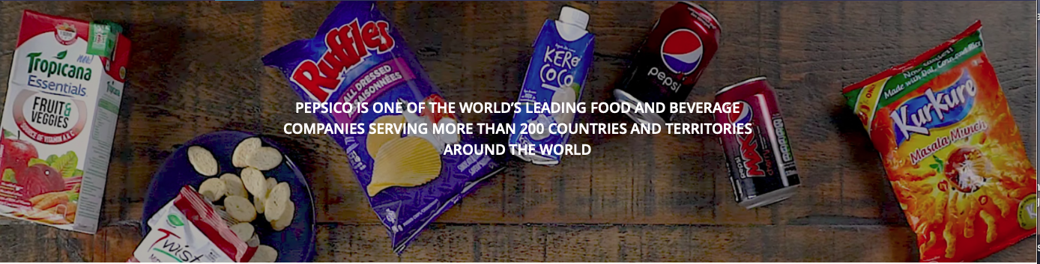
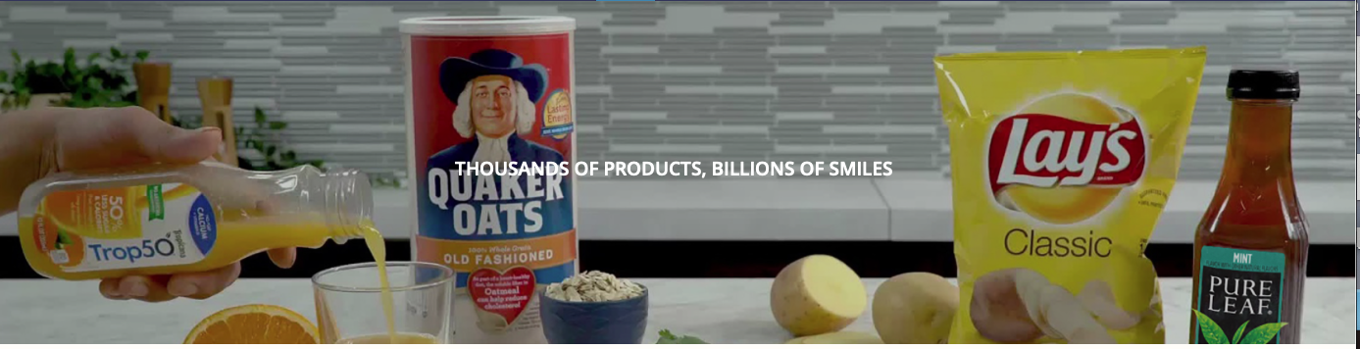
Snacks & Beverages

Slide 4
CFRA
PEP is a “low-beta” defensive blue-chip name with strong balance sheet and high degree of earnings stability
Consumer “Staple”
Net sales to rise about 1% after foreign currency headwinds
Continued growth in emerging markets
Proactive in shifting product mix to healthier beverages and snack products (Bubly flavored sparkling water, Sabra Hummus, Stacy’s Pita Chips, and purchase of Rockstar Energy
EBITDA margins decline from impacts of Covid-19 safety precautions
Dividend of $4.09 for FY 2020 and $2.0 Billion for share repurchase
RISKS: lower demand, unfavorable weather conditions, and political and currency risks ……..and COVID-19 worldwide….

Slide 5
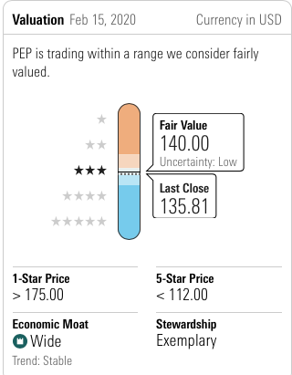
Morningstar--***

Slide 6
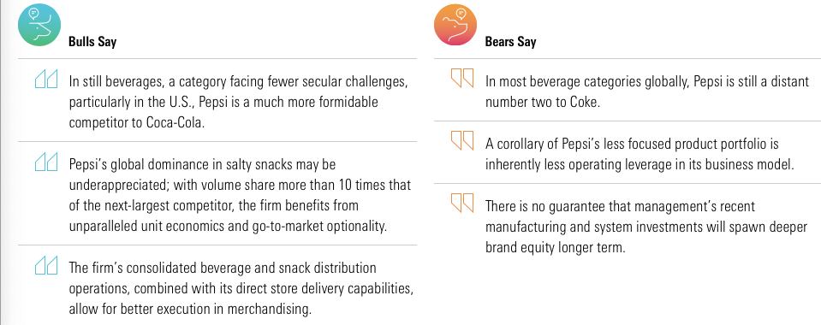

Slide 7

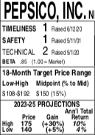
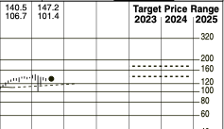
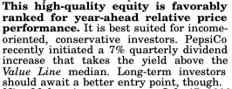
VALUE LINE

Slide 8
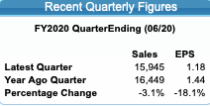

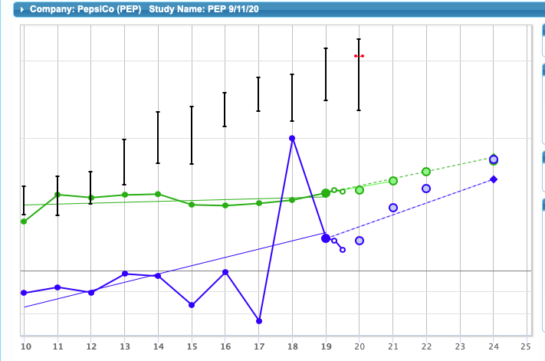
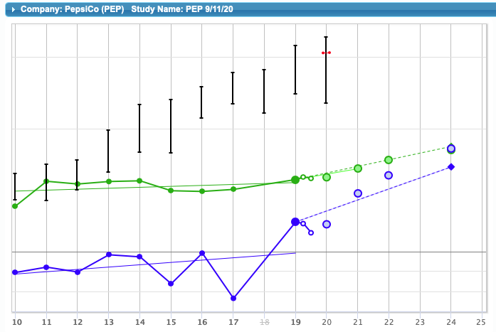
SSG with and without TCJ ACT

Slide 9
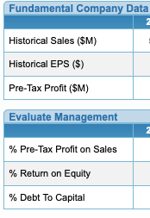
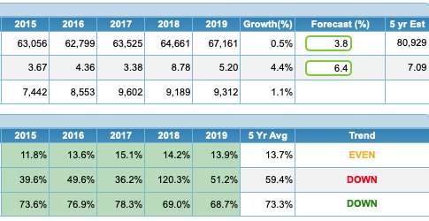

Slide 10
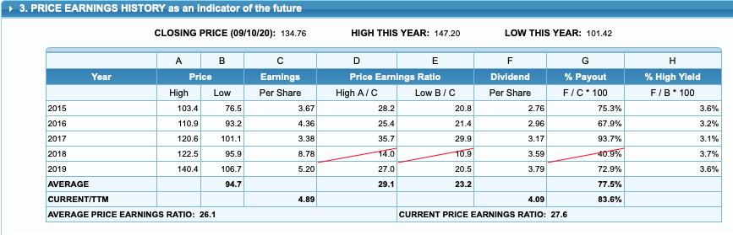

Slide 11
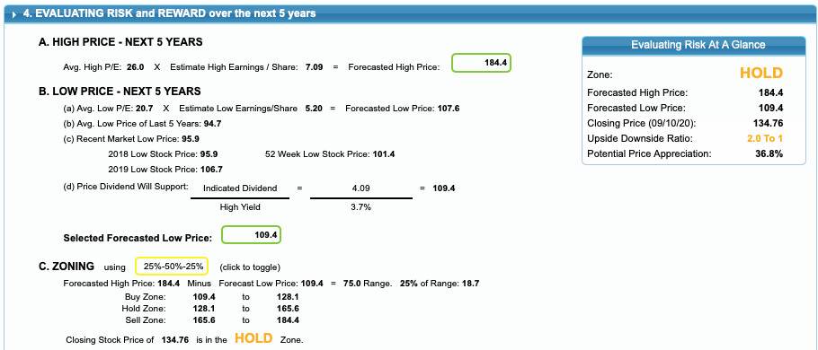

Slide 12
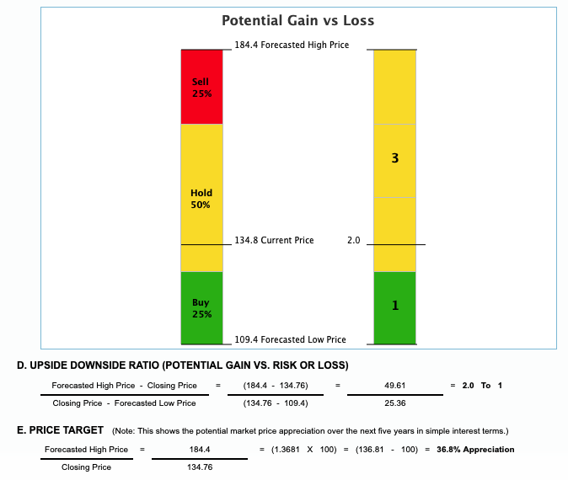
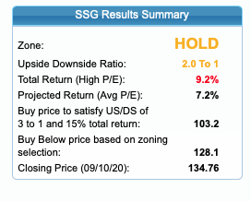

Slide 13
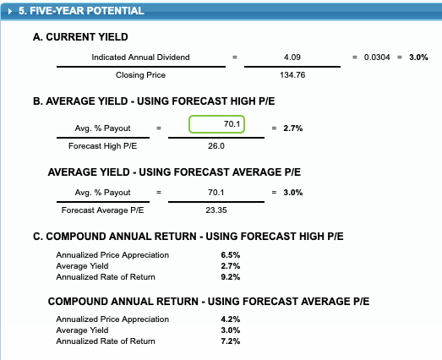

Slide 14
Conclusion
Per VL July 17, 2020:
This high-quality equity is favorably ranked for year-ahead relative price performance.
Best suited for income-oriented, conservative investors.
Kathy Emmons says, “If you own it, hold it. If it goes below 131, I am buying it.”

