Slide 1
MicNOVA
December 2010

Slide 2
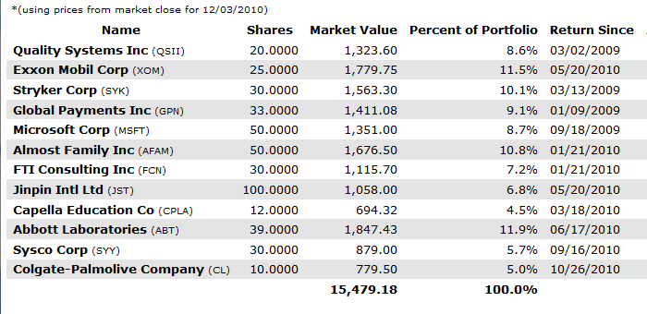
Holdings Dec. 2010

Slide 3
Portfolio
We have 12 stocks, and 12 members.
If holdings were equally weighted, each would be 8.33% of the total.
Rule of thumb: Try not to let any stock be more than 2X that 8.33%, or 16.66%.
Or any stock less than half that 8.33%, or 4.16%.

Slide 4
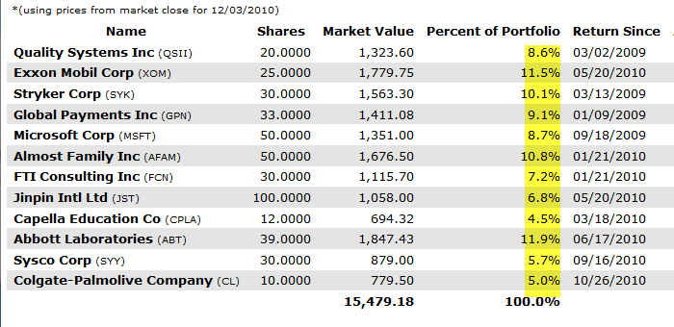
Portfolio

Slide 5
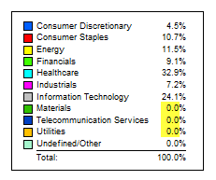
Sector Breakdown

Slide 6
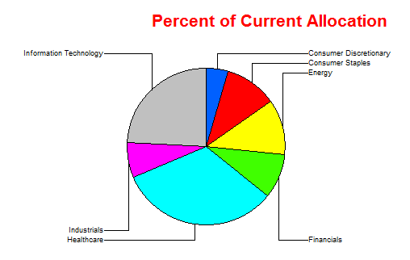
Sector Graph

Slide 7
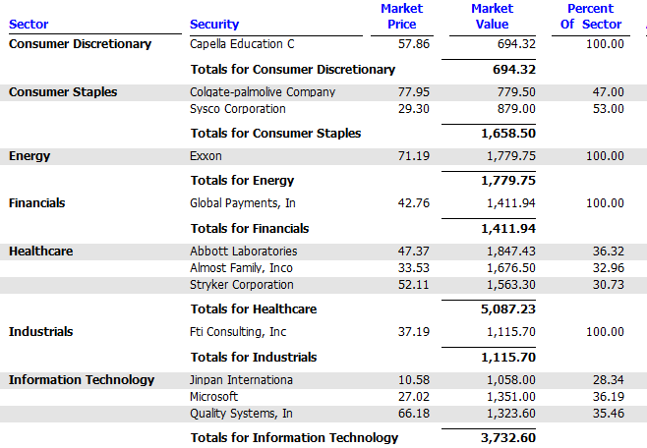
Sector Contents

Slide 8
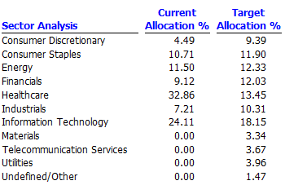
Compare to S&P 500

Slide 9

Portfolio by Size

Slide 10
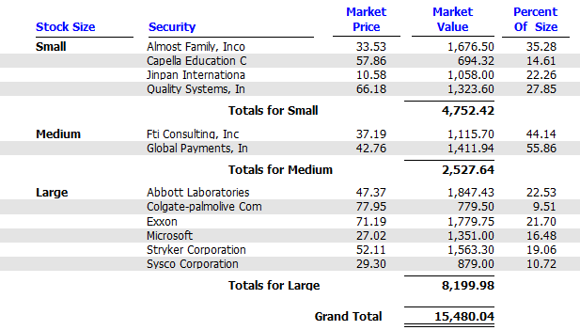
Small, Medium & Large Stocks

Slide 11
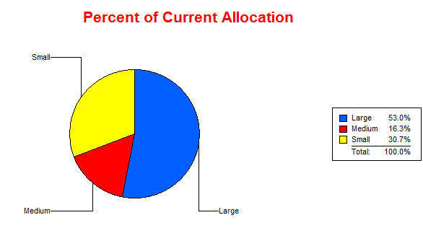
Small, Medium & Large

Slide 12
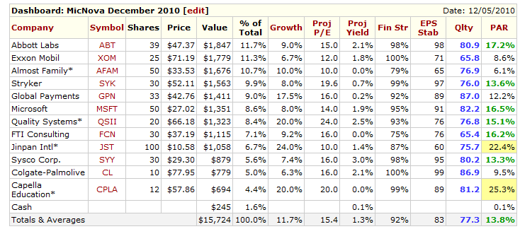
Manifest Investing Dashboard
Looking Forward

Slide 13
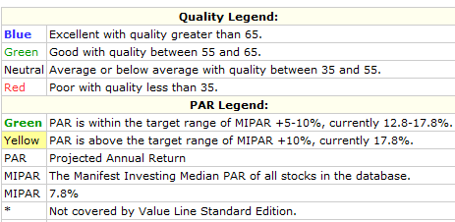
Manifest Investing Looking Forward: what colors mean

Slide 14
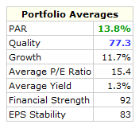
Portfolio Potential Growth

Slide 15
Suggestions
Look for more middle –sized companies: (Revenues between 5Million and 5Billion)

