Slide 1
Stock Presentation
Wilbert Nixon, McNoVA
-- April 8, 2019

Slide 3
… interesting times.
The rapidly spreading novel coronavirus has claimed innumerable lives, roiled the stock market and brought the economy to a standstill.
The retail sector, in particular, has been hit hard due to this pandemic.

Slide 4
… interesting times (cont.)
Supply-chain bottlenecks and reduced traffic has led to a number of store closures, which in turn hurt sales and productivity.
Moreover, some of the companies are even slashing pay and furloughing employees.
If not already here, recession is at the door.

Slide 5
The Market vs. the Consumer Staples Sector
In recessionary times, consumer staples have been known to fare better than other sectors.
We can use the S&P 500 Consumer Staples ETF (XLP) as a proxy for the consumer staples (or consumer defensive) sector of the market.
Let’s compare the S&P 500 and the XLP over the last 5 years, 3 months and 1 month

Slide 6
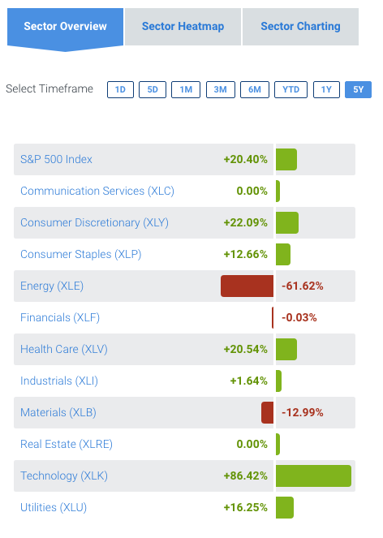

Slide 7
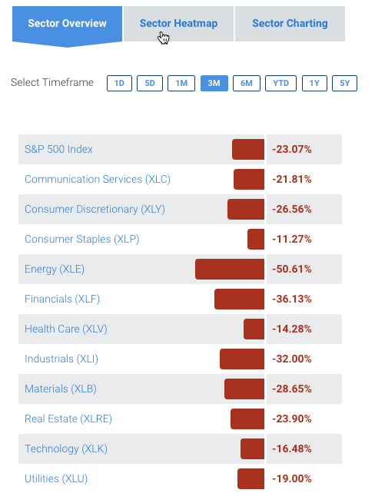

Slide 8
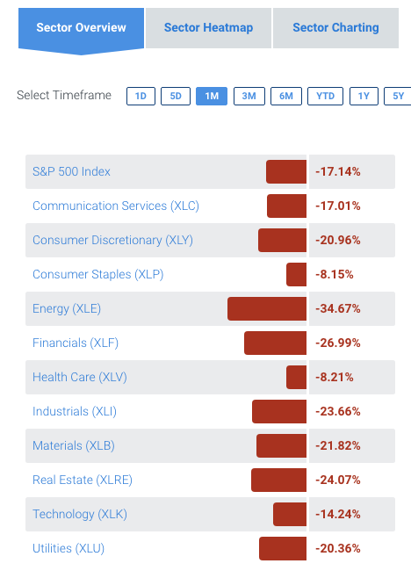

Slide 9
Costco vs. the sector and the market
However, even amid such crisis, Costco Wholesale Corporation (COST) looks quite resilient owing to the company’s business model and products it offers, which have been in high demand since the outbreak began.
Notably, Costco shares have declined a meager 1% in the past three months compared with the consumer staples sector’s decline of 11.3%.
Costco has fared far better than the Retail – Wholesale industry sub-sector and the S&P 500 index that have fallen 15.8% and 23% respectively.

Slide 10
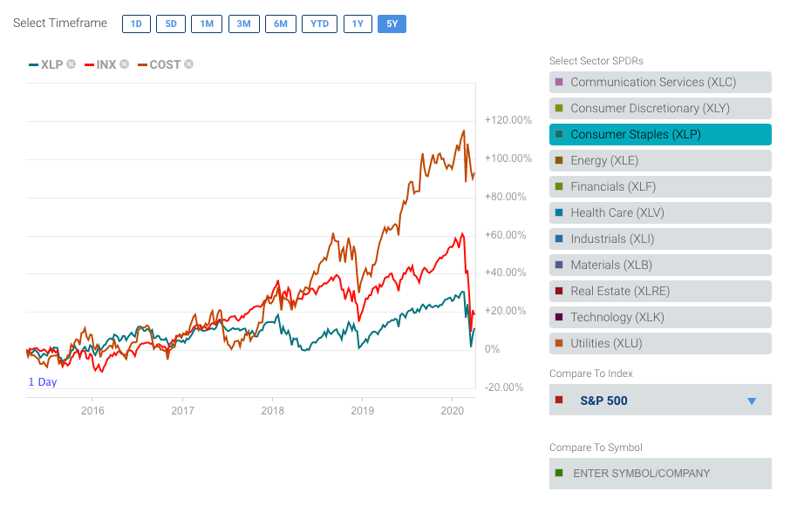

Slide 11
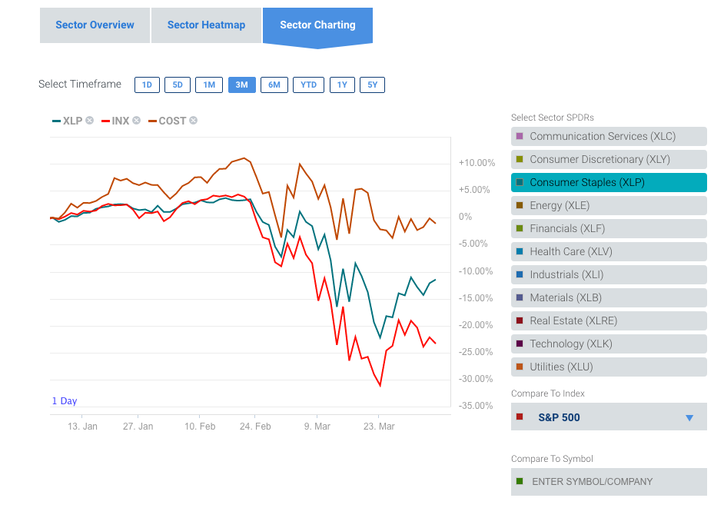

Slide 12
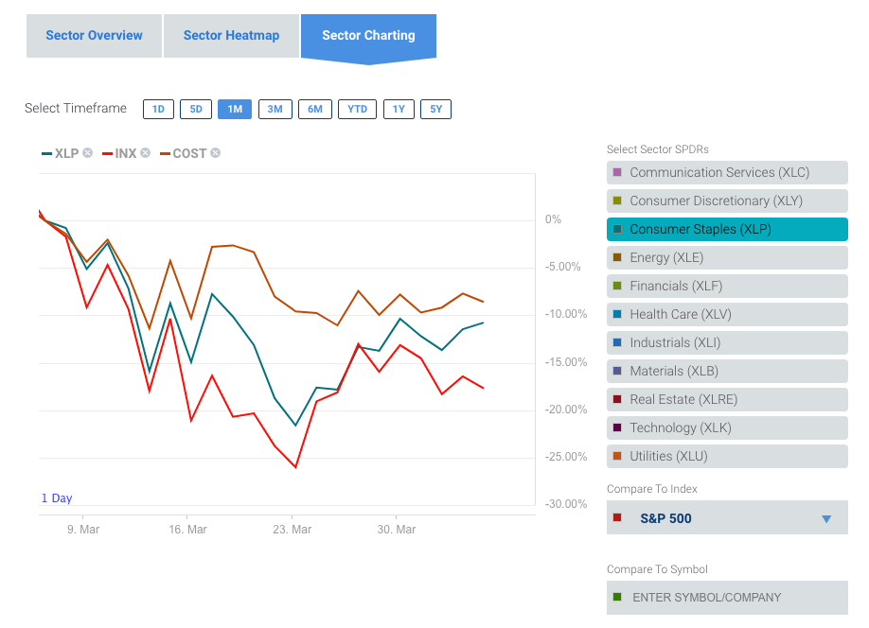

Slide 13
Costco Wholesale Corporation

Slide 14
Costco Today
₃rd
Largest Global retailer
14th
Largest in Fortune 500
$141 Billion market cap

Slide 15
Costco Today
Sales $154.9B (LTM)
• 114.2M Sq. Ft. (145K / whse.)
258K employees worldwide

Slide 16
Costco Today
785 Warehouses Worldwide
546 - U.S.
100 - CN
39 - Mexico
29 - UK
26 - Japan
16 - Korea
13 - Taiwan
11 - Australia
2 - Spain
1 - Iceland
1 - France
1 - China

Slide 17
Costco Today
Members:
55.3M households
100.9M total cardholders
90.9% renewal rate (U.S. & CN)
$3.5B in cash fees (LTM)

Slide 18
Fiscal Year
 | 2018 | 2019
Sales | $138,434 | $149,351
Gross Margin | 11.04% | 11.02%
Membership | 2.27% | 2.24%
SG&A | 10.02% | 10.04%
Operating Inc. | $4,480 | $4,737
Net Income | $3,134 | $3,659
E.P.S. | $7.09 | $8.26

Slide 19
2nd Quarter (MM$)
 | 2019 | 2020
Sales | $34,628 | $38,256 | +10%
Operating Income | $1,203 | $1,266 | +5%
Net Income | $889 | $931 | +5%
E.P.S. | $2.01 | $2.10 | +4%

Slide 20
Financial Position (M’s) Q2, FY’20
Cash, Equiv, & STI | $8,715
L.T. Debt | $5,599
Stockholders’ Equity | $16,614
Property & Equipment (net) | $21,481

Slide 21
Dividends
Initiated May 2004 at $0.40
Currently at $2.60
Compound Annual Growth Rate 13%
$1.1B Annually

Slide 22
New Brands

Slide 23
Store Locations

Slide 24
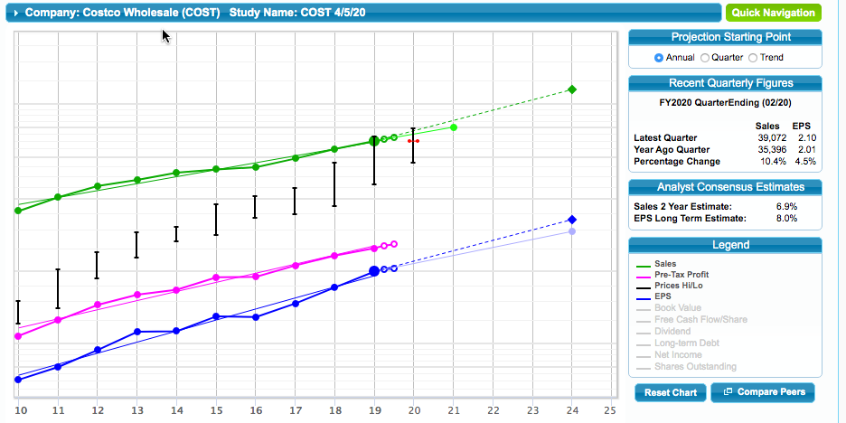
SSG Visual Analysis

Slide 25
SSG Quality and Management

Slide 26
SSG P/E History

Slide 27
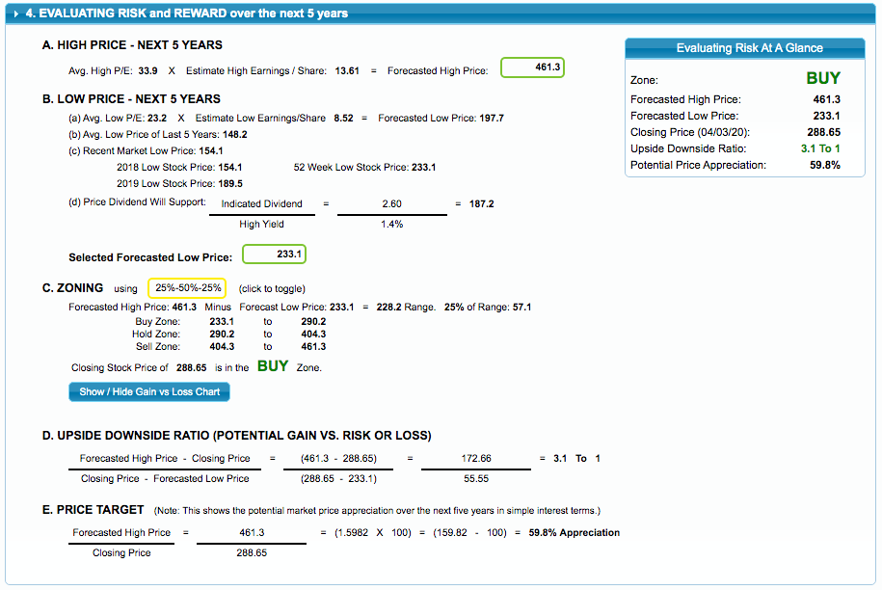
SSG Risk and Reward

Slide 28
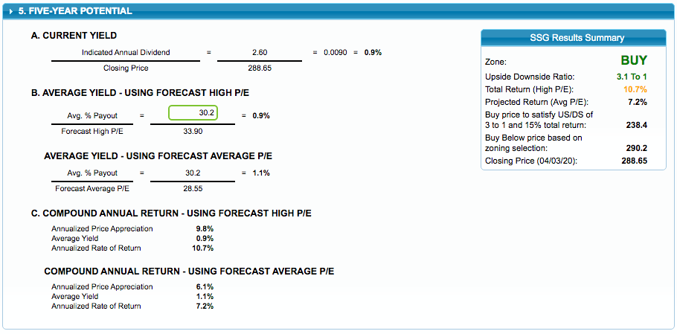
SSG Summary

Slide 29
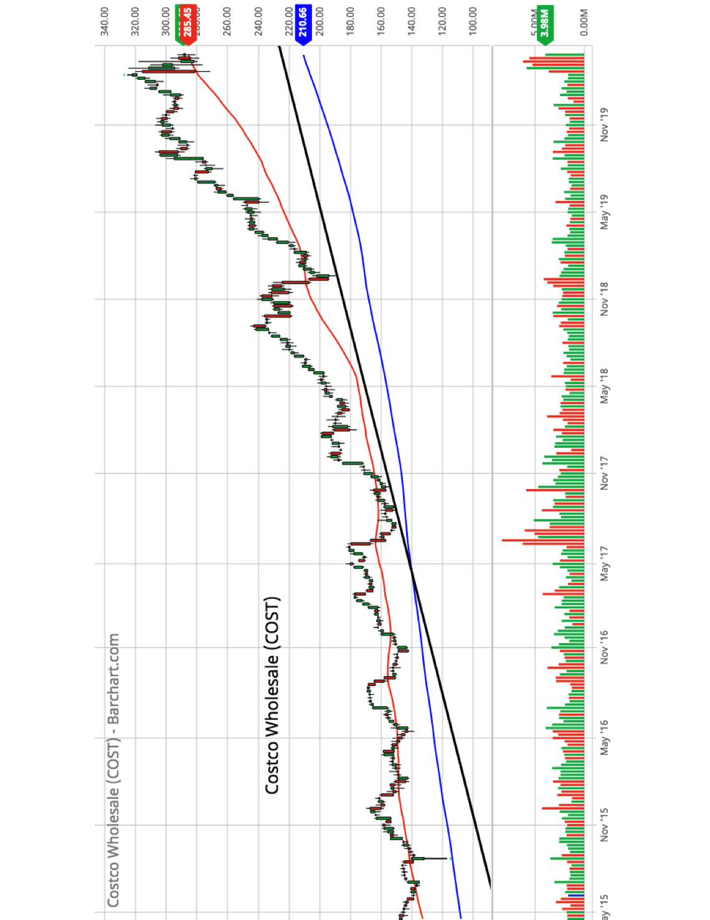

Slide 30
What will drive growth?
Costco’s growth strategies, better price management, strong membership trends and increasing penetration of e-commerce business have been supporting the performance.
Cumulatively, these factors have aided the company in sustaining impressive comparable sales (comps) run. The company witnessed comps growth of 12.1% during the month of February.

Slide 31
E-commerce
Costco, which competes with Walmart (WMT), Amazon (AMZN) and Target (TGT), operates e-commerce sites in the United States, Canada, the U.K., Mexico, Korea, Taiwan, Japan and Australia.
Costco’s e-commerce comparable sales advanced 28.4% in the last reported quarter.

Slide 32
E-commerce (cont.)
To drive its online sales, the company launched CostcoGrocery to deliver non-perishable items to buyer’s home, and expanded same day grocery delivery service in collaboration with Instacart.
Recently, it acquired Innovel Solutions, a leading provider of third-party end-to-end logistics solutions. The buyout will boost Costco’s e-commerce capabilities and facilitate sales of "big and bulky" items.

Slide 33
Resources and References
Barchart.com
Better Investing SSG Plus
Costco Today, Q2-FY’20, Costco’s quarterly report presentation
CFRA – S&P
MorningStar
sectorspdr.com/sectorspdr/
Value Line
Zack’s Equity Research

Slide 34
