Slide 1
Background on Team A’s analysis of Small/Mid Cap Options
1) Portfolio recovery association (PRAA)
2) HMS holding (HMSY)
3) Enersys (ENS)
4) Bio-Reference Lab(BRLI)
5) Varian Medical(VAR)
After doing research on the above stocks, their PAR’s were not high enough or we were already weighted heavily in the sector, except ABAT (see next pages)

Slide 2
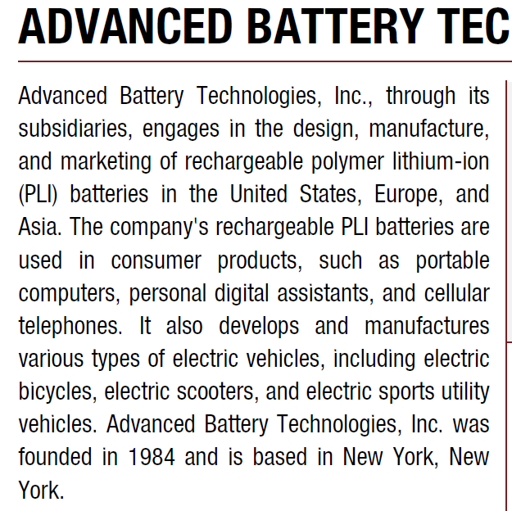
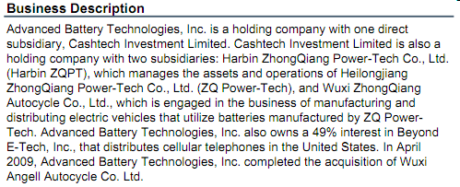
Background on ABAT, Advanced Battery Tech.

Slide 3
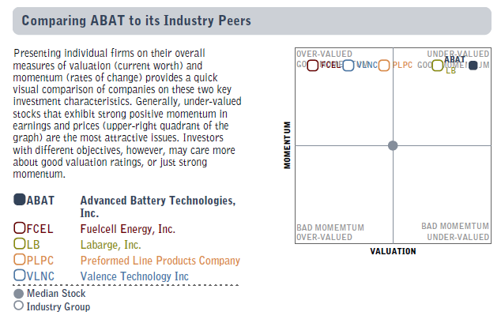
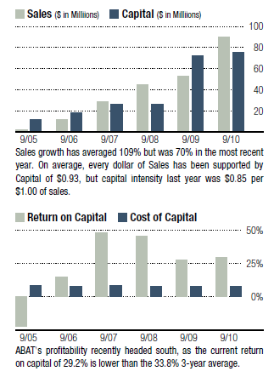
Peer Comparison, Columbine Capital Report via Fidelity
ABAT Return on Sales/Capital (right)

Slide 4
Thomson Peer group comparison

