Slide 1
Internet Content & Information Industry
Team A
Deb
Joe
Cliff
Teresa

Slide 2
Internet Content & Information
Screen on the Internet Content industry using the following criteria:
5 Yr Revenue >7%
5 Yr EPS >7%
Pre-Tax Income Trend - Even or Better
5 Yr EPS R2 >.7
Debt to Capital <60%
Industry: Internet Content & Information

Slide 3
Internet Content & Information (Value Line)
The performance of equities in the Internet Industry has been fairly mixed lately.
[It’s no surprise that] some have posted favorable results while others have experienced challenges.
On the whole, long-term prospects look relatively bright.
Many participants appear to be well positioned in markets with attractive growth prospects.

Slide 4
Internet Content & Information
For Example:
Revenues at Alphabet increased roughly 21% in the June quarter, year to year.
Earnings per share declined significantly due to a $2.7 billion fine by the European Commission.
Absent this charge, share net would have increased about 27%.
We anticipate solid growth in advertising revenues going forward, and impressive performance in other areas, as well.
Notes:
European Commission, which found that certain actions taken by the company related to its display and the ranking of shopping search results and ads infringed on European competition law.

Slide 5
Internet Content & Information
Facebook posted a considerable advance in revenues and earnings for Q2.
Monthly active users increased 17%, year to year.
Mobile advertising revenue comprised around 87% of total ad revenue, compared with 84% in the prior-year period.
Favorable trends in user engagement ought to further benefit performance in the coming quarters.
Mobile advertising should be the most important driver of performance in the near term, though we expect strength from other areas, as well.

Slide 6
Internet Content & Information
Several Caveats
Highly competitive and dynamic markets
As a result, many must continue to invest in product development to remain on the cutting edge.
Performance for some members of this group can fluctuate significantly from one period to the next.
Some equities in the Internet Industry trade at very rich valuations, which limits investment appeal and increases downside potential.

Slide 7
Internet Content & Information
The Internet Industry has fallen in Timeliness over the past three months, and is now ranked 77 (out of 97) for year-ahead relative price performance.
[VL] expect solid growth for the industry over the pull to early next decade.
Patient, risk-tolerant accounts are encouraged to examine these equities more closely.
Conservative investors should tread carefully here, given the aforementioned risks.

Slide 8
Internet Content & Information
Next, Joe will describe the process the team took to narrow the field to GOOGL & FB
Then Cliff will present FB

Slide 9
Internet Content & Information
Symbol | Company Name | Hist 5Yr Rev Gr(%) | Hist 5Yr EPS Gr(%) | EPS R2 5yr | Trend PTI | Debt / Capital(%) | Industry
CRTO | Criteo SA | 0.4903149 | 2.095951 | 0.8302723 | ++ | 0 | Internet Content & Information
FB | Facebook Inc | 0.5230687 | 2.481841 | 0.754364 | ++ | 0 | Internet Content & Information
GOOG | Alphabet Inc | 0.1503358 | 0.1403992 | 0.9821835 | Even | 0.02584718 | Internet Content & Information
GOOGL | Alphabet Inc | 0.1503358 | 0.1403992 | 0.9821835 | Even | 0.02584718 | Internet Content & Information
GRUB | GrubHub Inc | 0.5764538 | 0.6668909 | 0.9213009 | ++ | 0 | Internet Content & Information
MEET | The Meet Group Inc | 0.1413501 | 5.145201 | 0.7985662 | ++ | 0 | Internet Content & Information
TCX | Tucows Inc | 0.1380242 | 0.4693917 | 0.9345409 | ++ | 0.06115116 | Internet Content & Information
WB | Weibo Corp | 0.7377362 | 9.587279 | 0.8635648 | ++ | 0 | Internet Content & Information
 |  | Criteria Used for Screen:
 |  | 5 Yr Revenue | >7%
 |  | 5 Yr EPS | >7%
 |  | Pre-Tax Income Trend | Even or Better
 |  | 5 Yr EPS R2 | >.7
 |  | Debt to Capital | <60%
 |  | Industry | Internet Content & Information

Slide 10
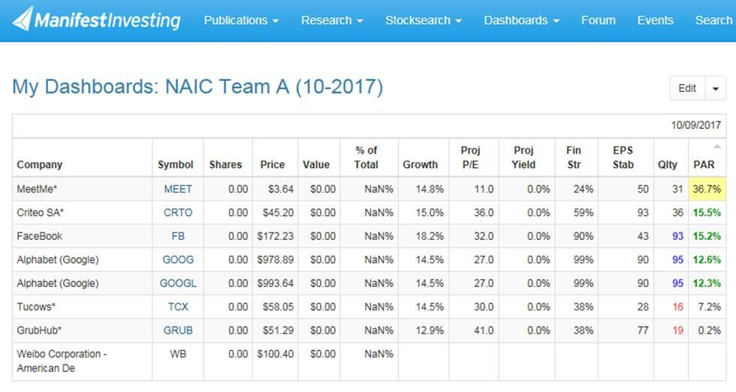
Internet Content & Information

Slide 11
Internet Content & Information

Slide 12
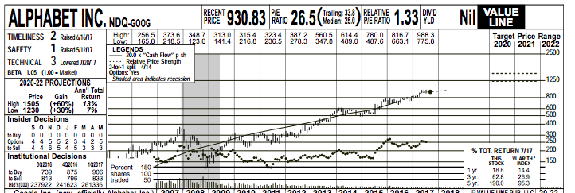
Internet Content & Information

Slide 13
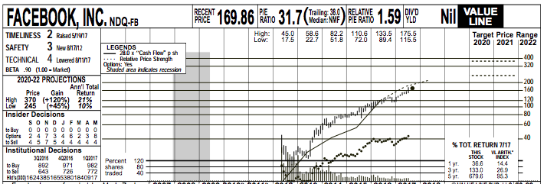
Internet Content & Information

Slide 14
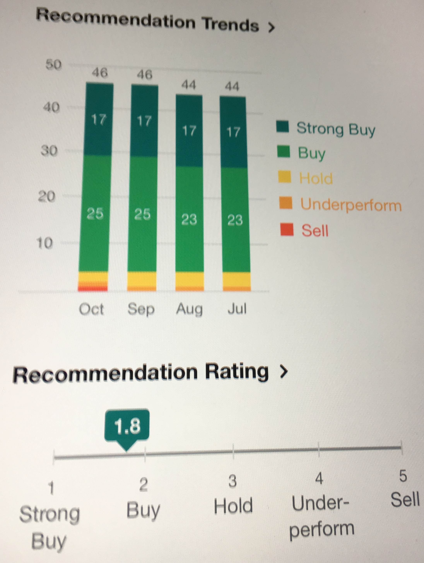
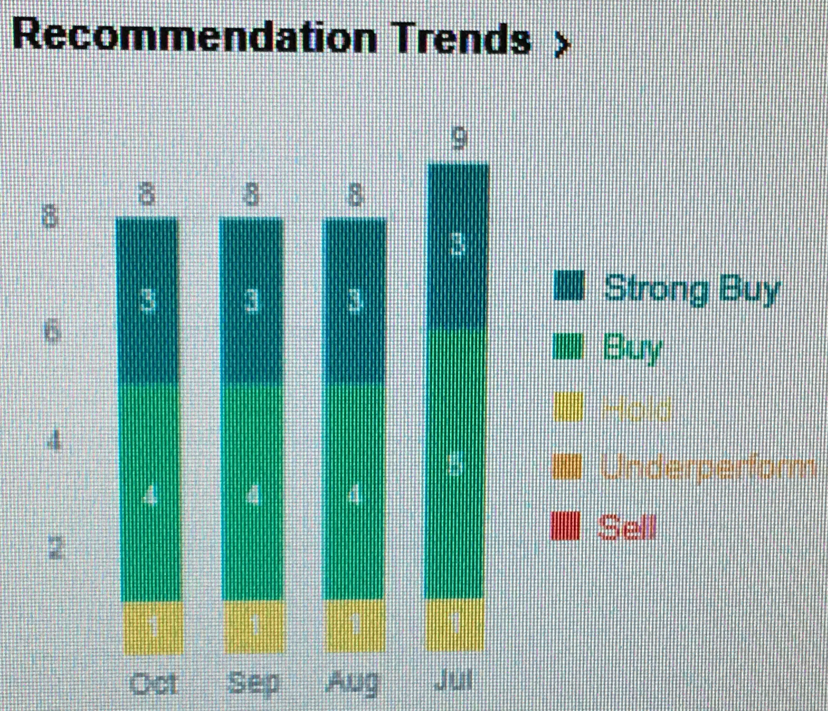
Internet Content & Information

Slide 15
Internet Content & Information
Thank You!

