Slide 1
E-commerce > Internet Computer software
Team A
Deb
Joe
Cliff
Brittany
Teresa

Slide 2
is a leading provider of on demand customer relationship management (CRM) services.
It offers services to manage and share information regarding sales, customer service and support, and marketing operations worldwide.
As of 1/31/18 it had over 100,000 customers in more than 70 countries.

Slide 3
Sell, service, market, and build apps on a single platform.
Easily log, manage, and analyze all customer activity in one place
Constantly monitor everything from sales leads to support tickets, and from channel marketing to website analytics.

Slide 4
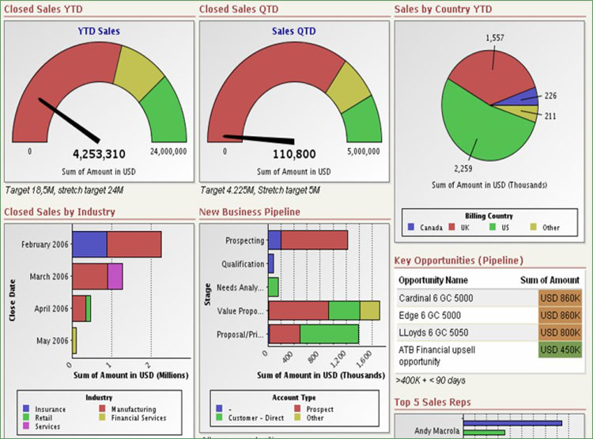

Slide 5
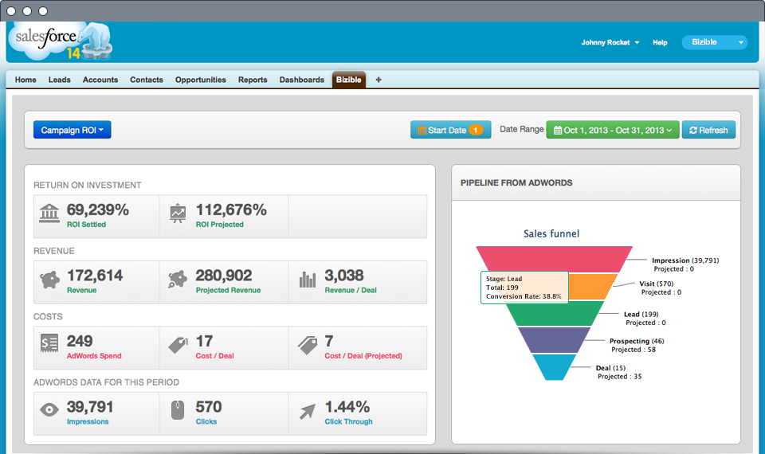

Slide 6
is a global provider of open source software
solutions, using a community-powered approach to develop
and offer operating system, middleware, virtualization, storage, and
cloud technologies.
Primarily offers enterprise technologies in the form of annual or multi-year subscriptions, and recognizes revenue over the period of these subscription agreements.
Int’l comprised 36% of 2017 sales

Slide 7
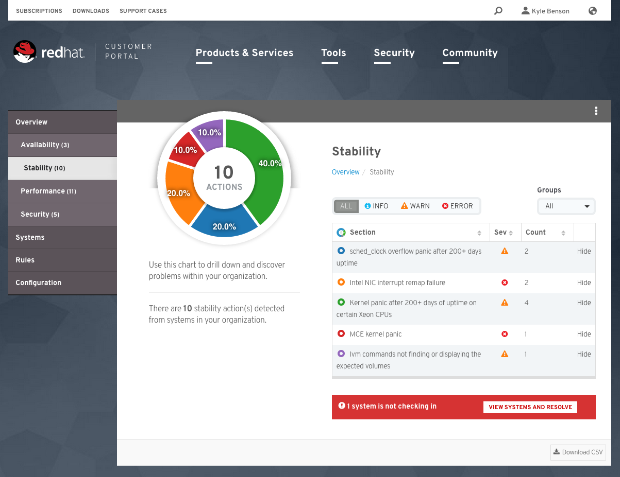

Slide 8
Provides Internet-based mailing and shipping solutions
Mail & ship: Postcards, envelopes, flats and packages, using a variety of USPS mail classes: First Class, Priority Mail, etc…
Sends customers a digital scale to weigh letters and packages to ensure the correct amount of postage is applied
The amount of postage applied is then deducted from the customer's Stamps.com account.
Customers can print postage on envelopes, regular paper or adhesive labels.

Slide 9
Customers using the service receive discounted postage rates compared to USPS retail on certain mail pieces such as First Class letters, etc…
Customers include individuals, small businesses, home offices, medium-size businesses & large enterprises, targeting both mailers and shippers.
Offers multi-carrier shipping solutions: ShipStation, ShipWorks, & Endicia.

