Slide 1
Stock Selection Guide (SSG) Training & Using Various Investing Data Sources
Jim, Aaron, Joe and Sudip
10/17/2020

Slide 2
Sources for Investment Ideas
BetterInvesting Top 100 list (imported & screened through Manifest)
Manifest Investing
Free Youtube channel https://www.youtube.com/user/manifestinvest
Paid newsletter
IAS (Investor Advisory Services), paid (~$150/yr)
Monthly newsletter
Barrons (use Airline miles for weekly magazine or library version; or online – look at key major articles)
Scan Morninstar’s 5-star stocks
Valueline access (Library website; research tab)

Slide 3
Mark Robertson Youtube Channel https://www.youtube.com/user/manifestinvest
From 9/29 episode:

Slide 4
Future estimates for Sales & Earnings
Valueline
Ask club member to download via library site & share
Yahoo Finance
Nasdaq 2 or 5 yr forecast (being retired?)
https://www.nasdaq.com/market-activity/stocks/goog/earnings
S&P Forecast (library tool)

Slide 5
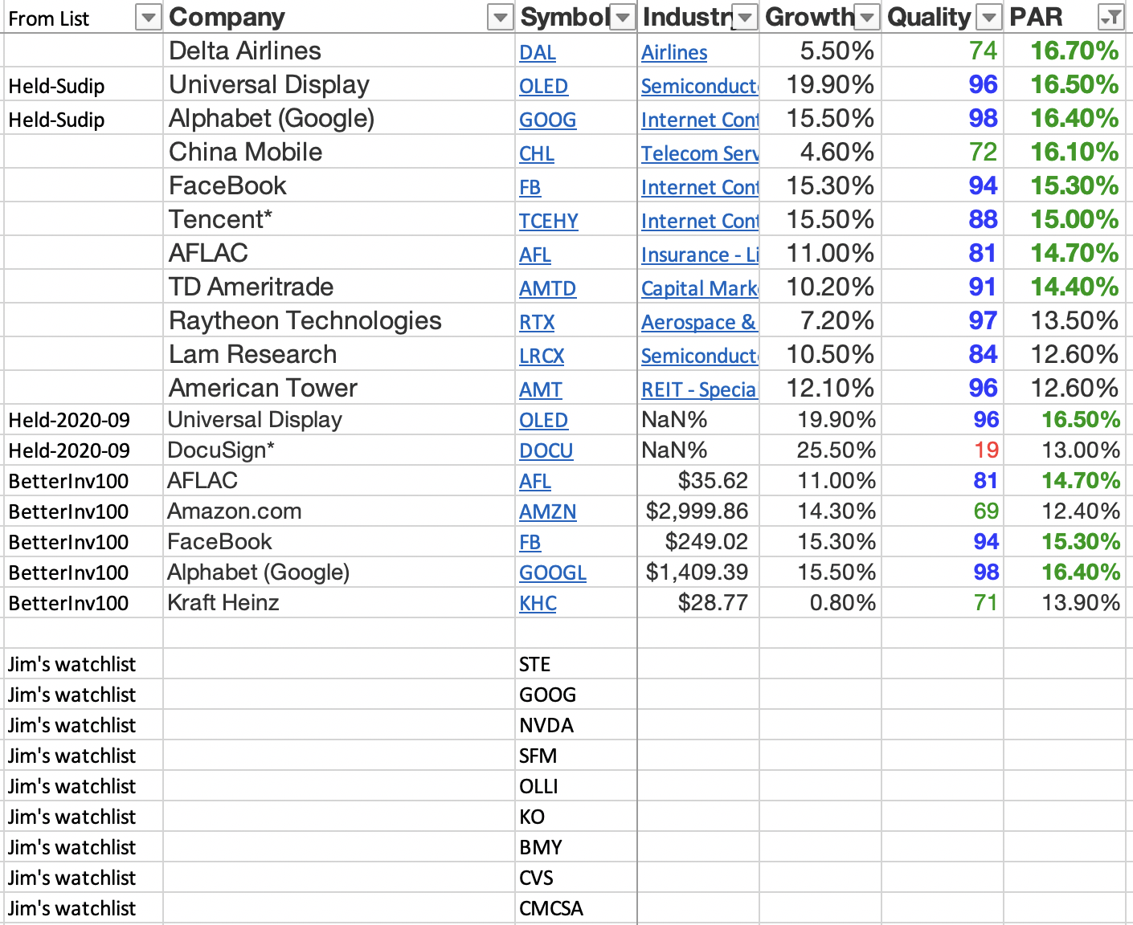
Ideas Sorted through Manifest Quality/PAR

Slide 6
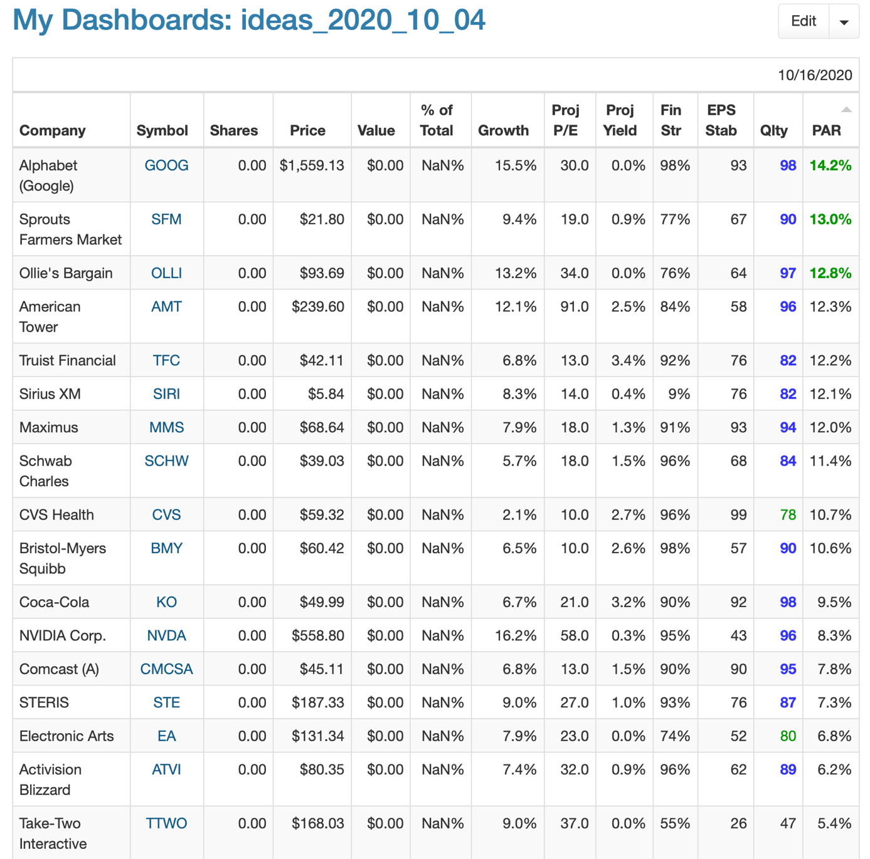
Our Choice of Stock to Study
Industrials featured on Barrons
Were low PAR
Gaming stocks (low PAR); Barron’s feature
Nvidia (NVDA); low PAR
Gunmaker & playing the election
===2 good choices====
Sprouts (SFM); good PAR
GOOGLE
GOOG
Came up with high PAR (Percentage Annual Return)
Good growth
Advertising company vs pure technology
Notes:
Jim

Slide 7
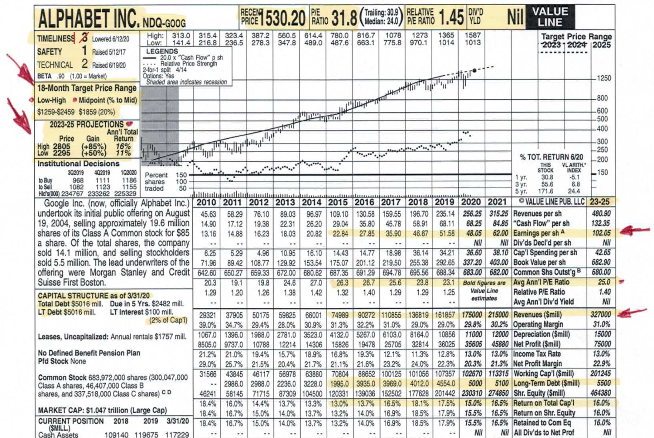
Valueline Pointers
Notes:
Joe

Slide 8
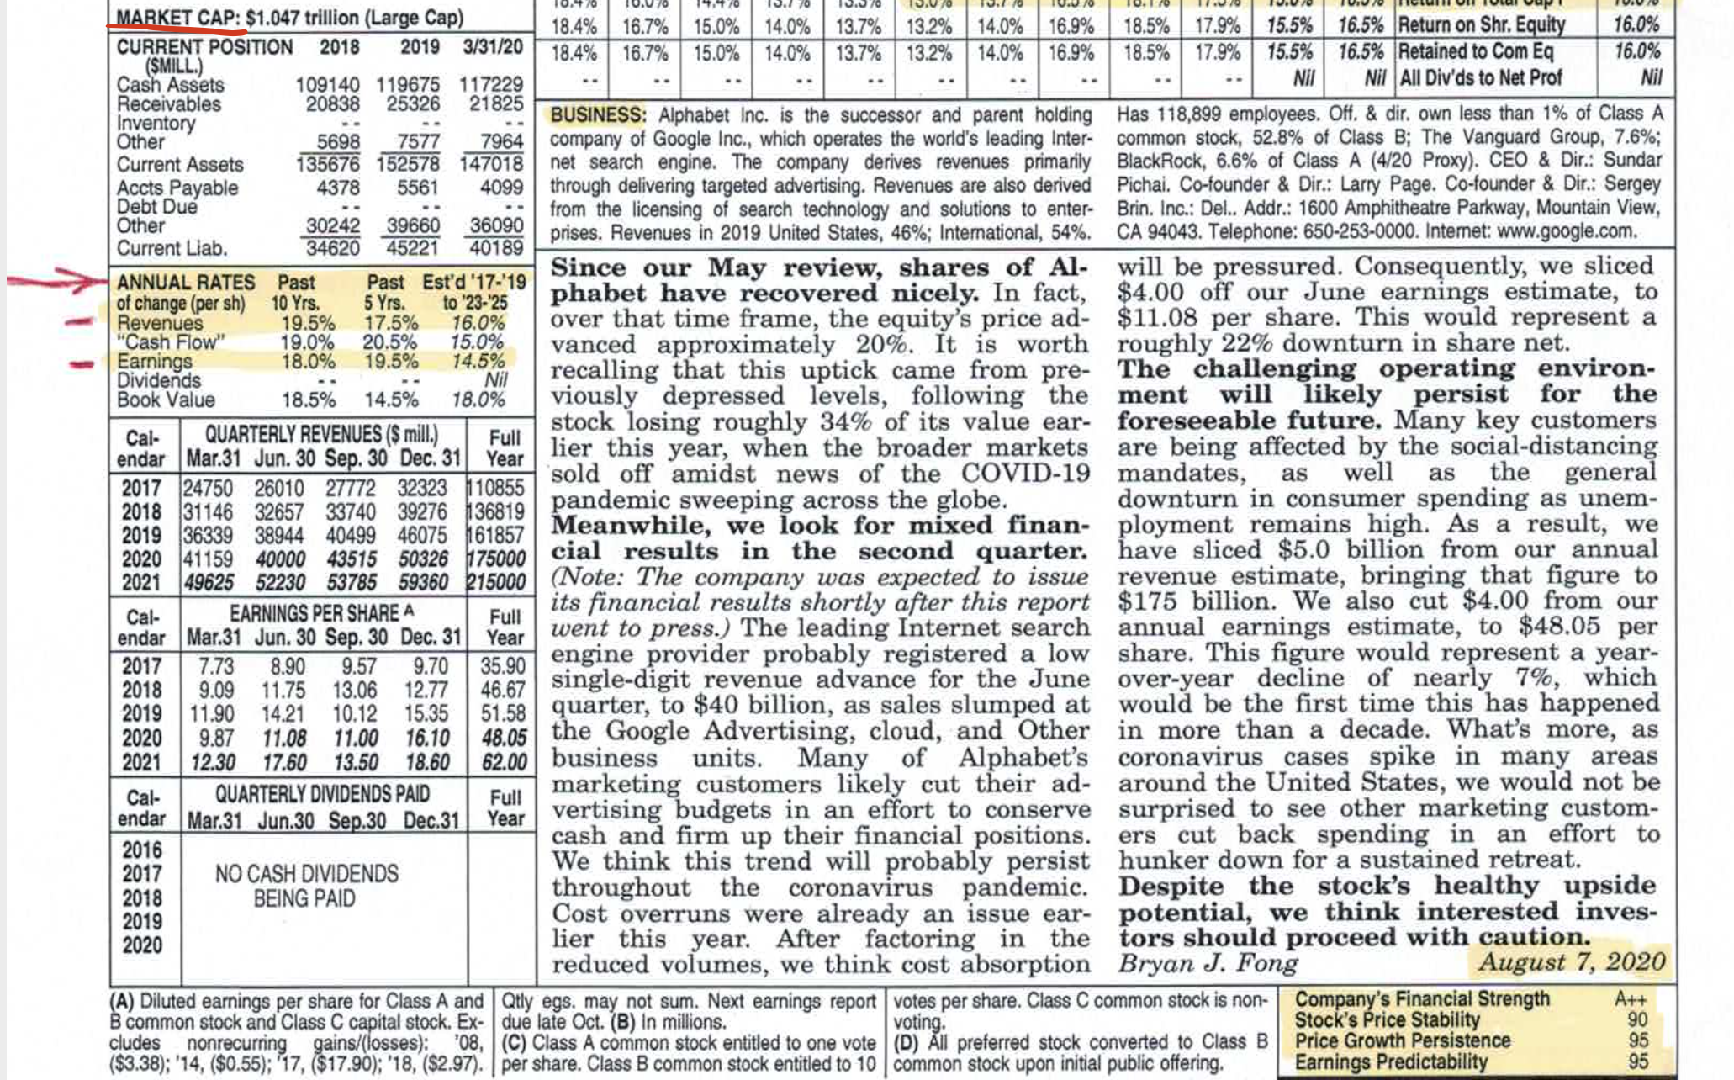
Valueline Pointers
Notes:
Joe

Slide 9
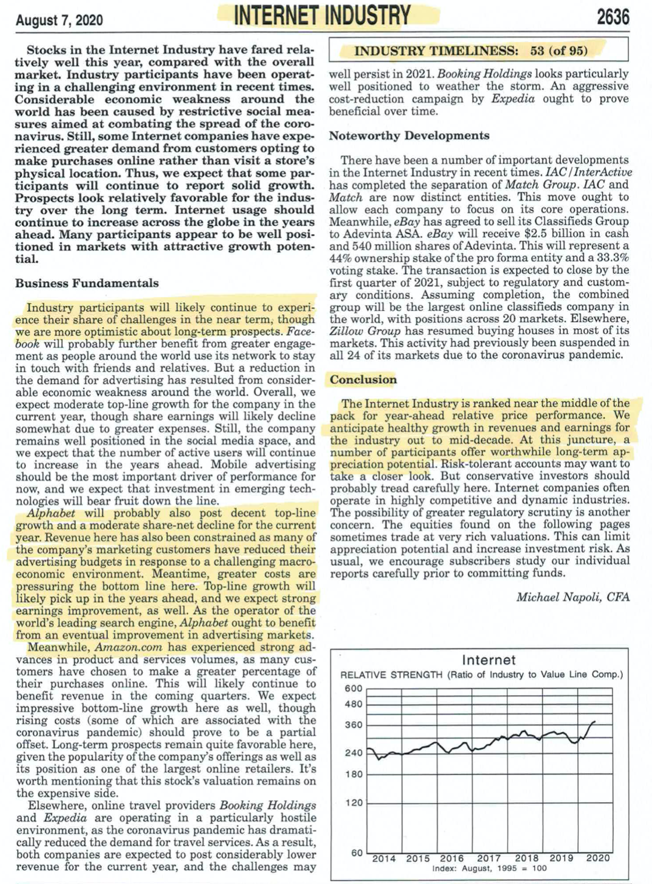
Valueline Industry Report
GOOG doesn’t fit Internet completely
Do you have the best company in an industry?

Slide 10
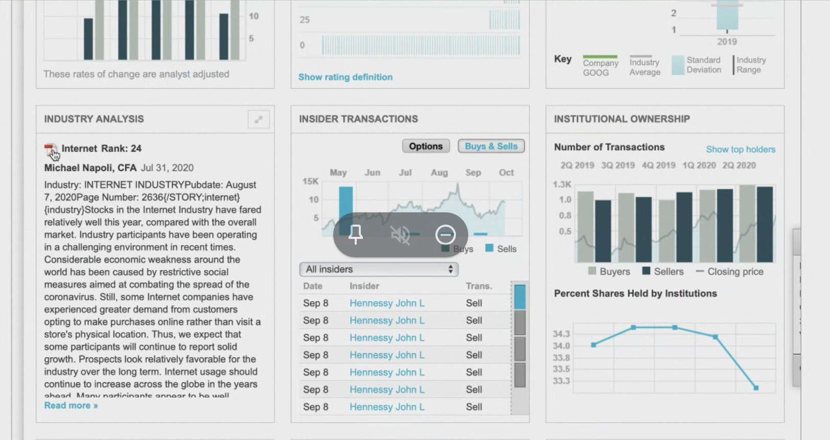
Valueline Industry Report
Where do you find this?
Find it in the Valueline Financial Report area

Slide 11
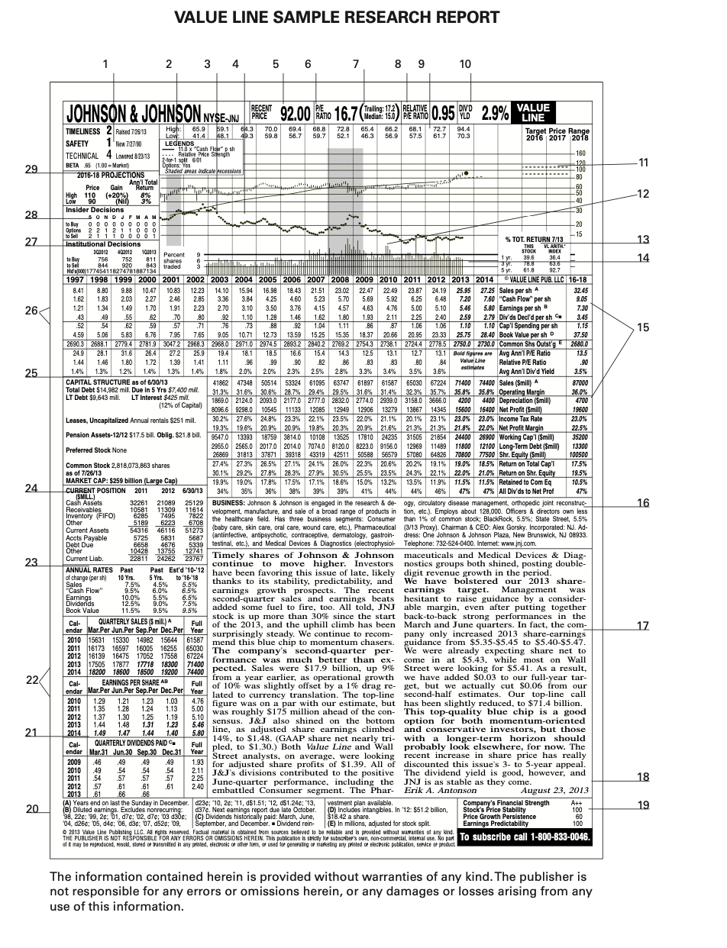
Valueline Industry Report
See guide on right (pg 21) and pages 3-19 on what each number designates
File is on Bivio site (see next page)

Slide 12
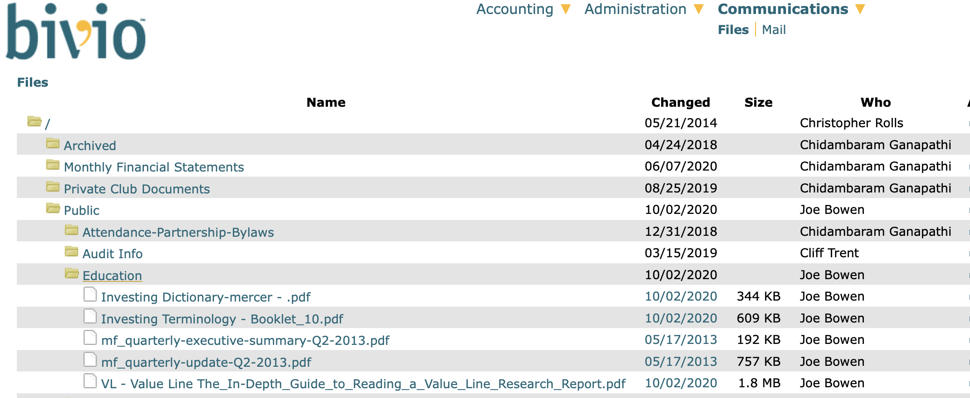
Bivio – Communications→ Files→ Education
See guide on right (pg 21) and pages 3-19 on what each number designates
File is on Bivio site

Slide 13
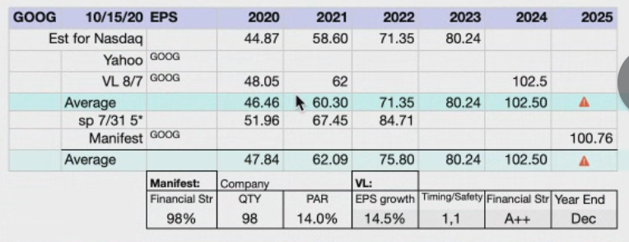
Organize Your Data
Courtesy: Jim Barret

Slide 14
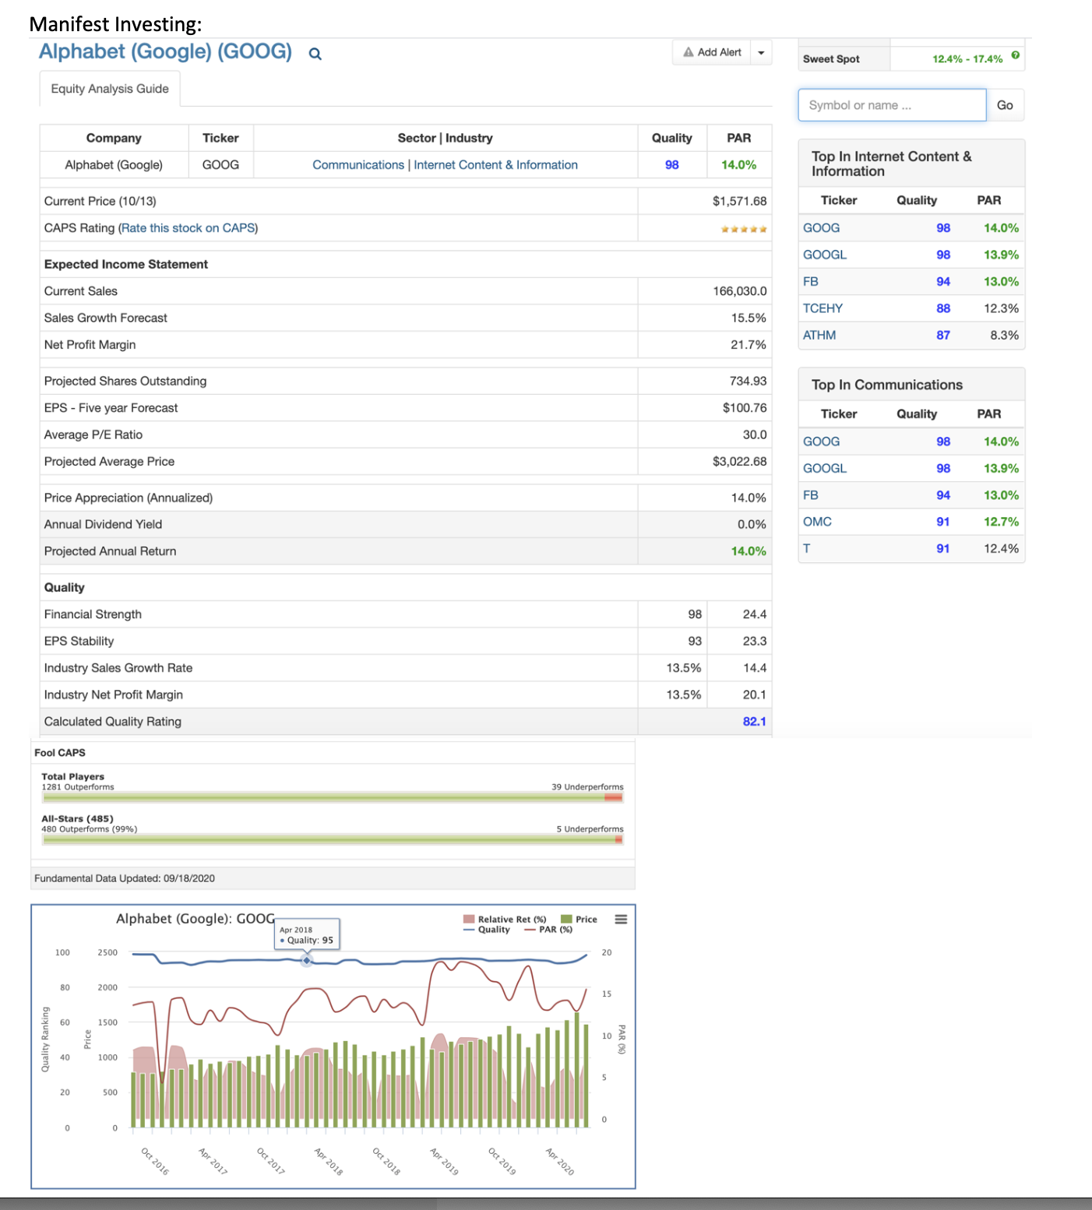
Manifest Data
Source: Manifestinvesting.com

Slide 15
IAS
Source: IAS Newsletter, 10/2020
data about 2 wks before this is published

Slide 16
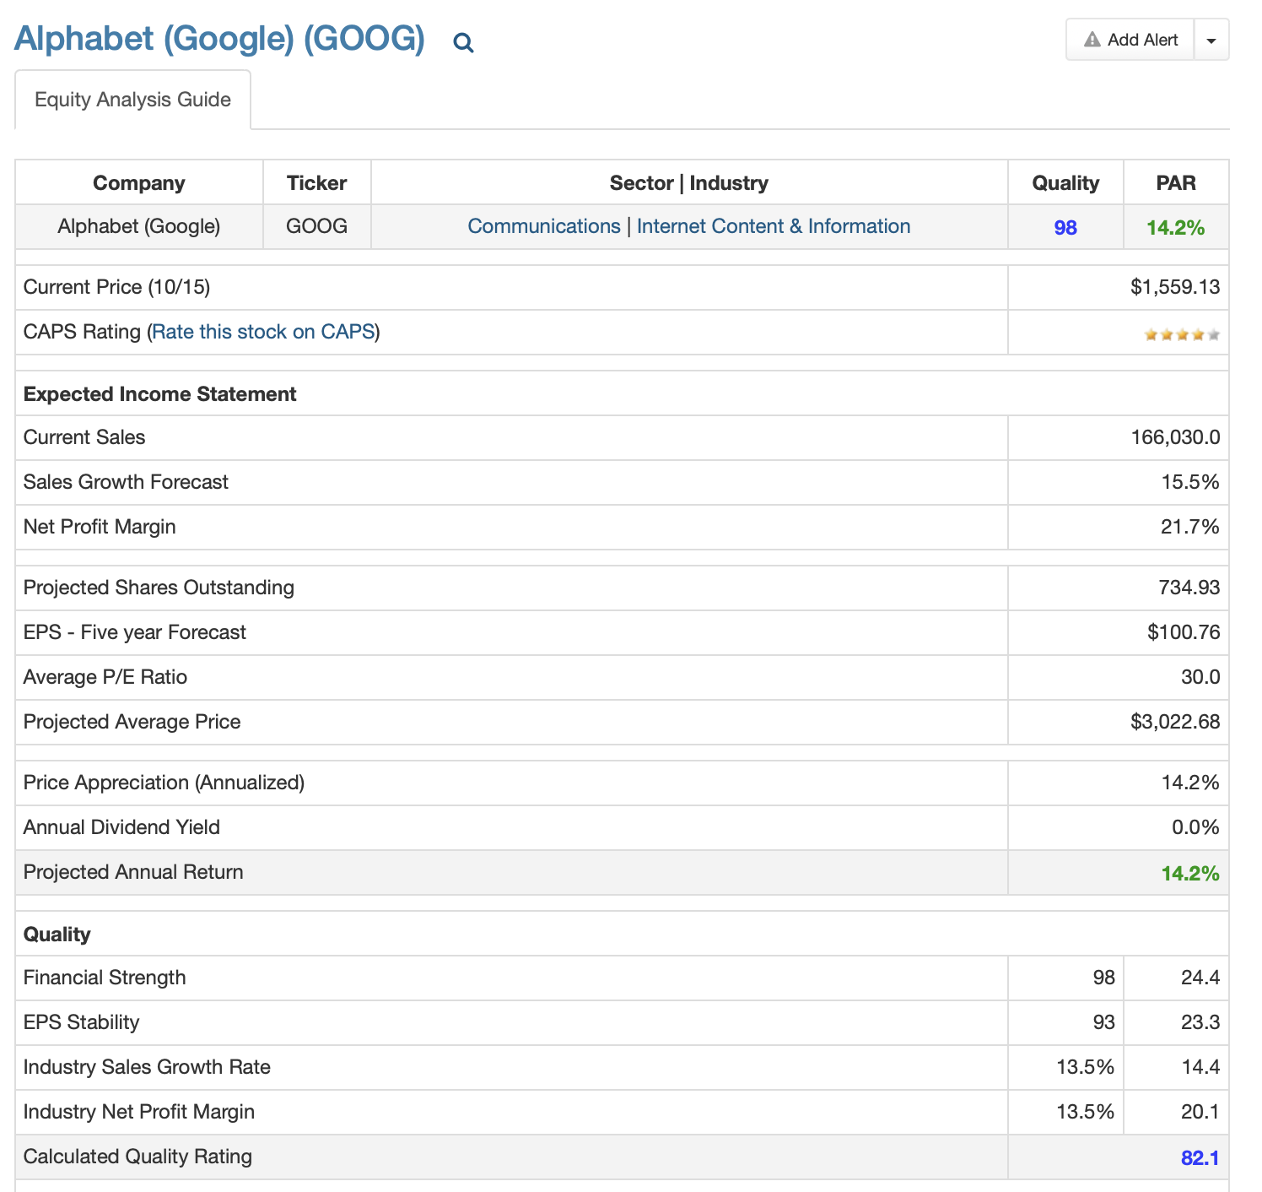
Latest PAR
Source: Manifest

Slide 17
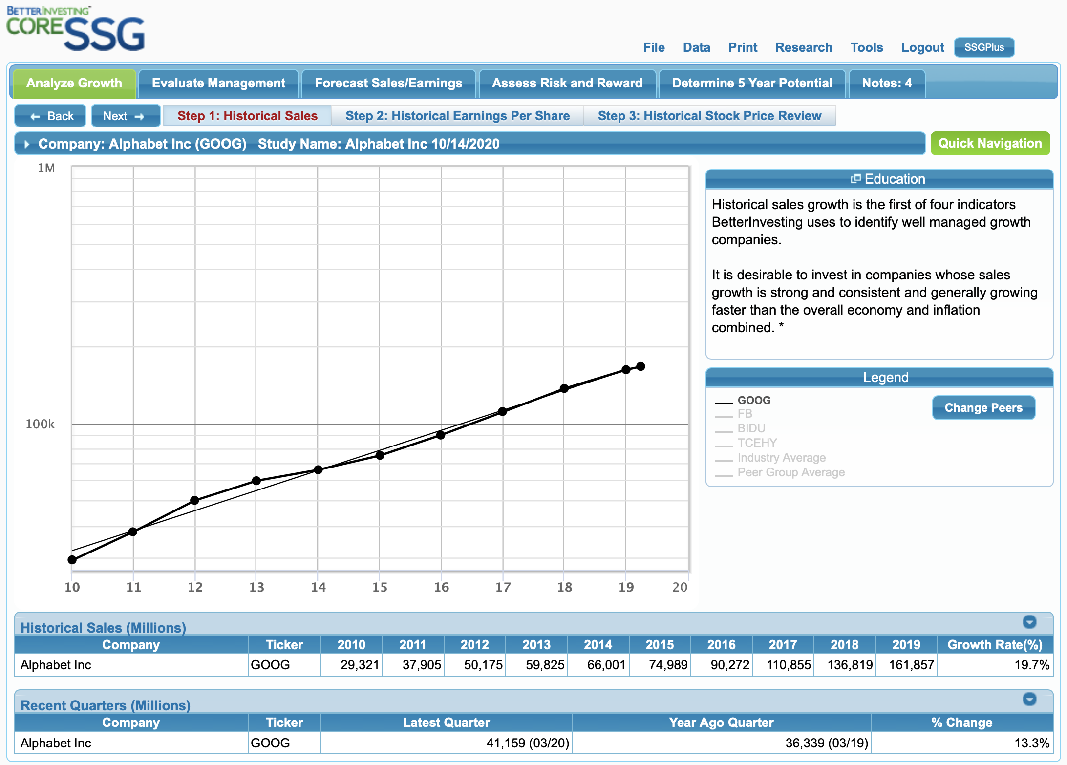
SSG with Online SSG Tools

Slide 18
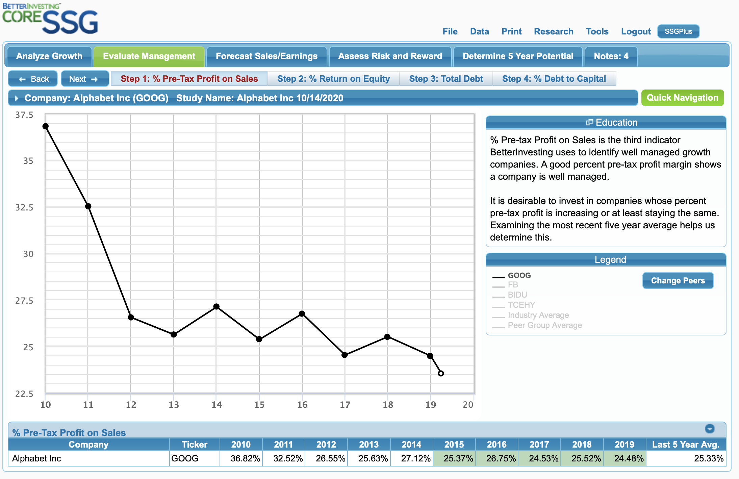
SSG with Online SSG Tools

Slide 19
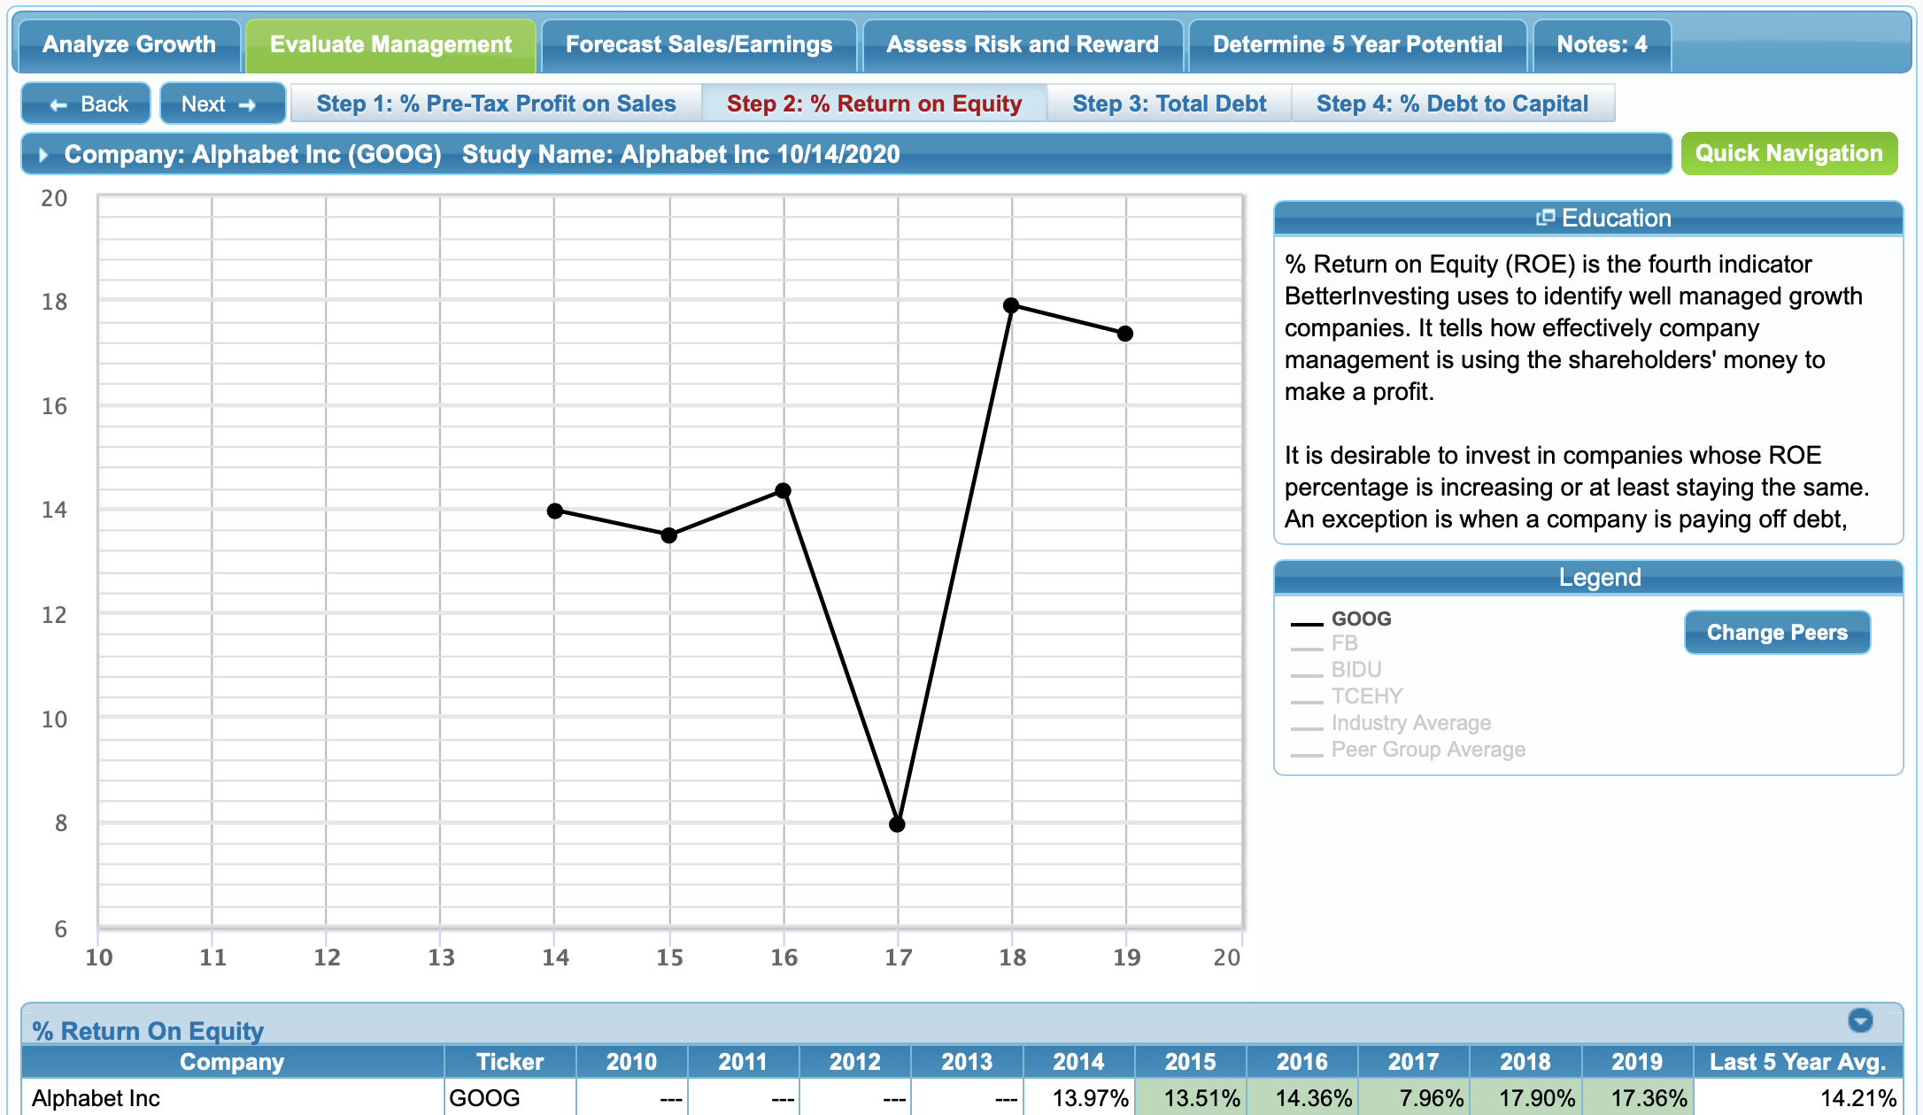
SSG with Online SSG Tools

Slide 20
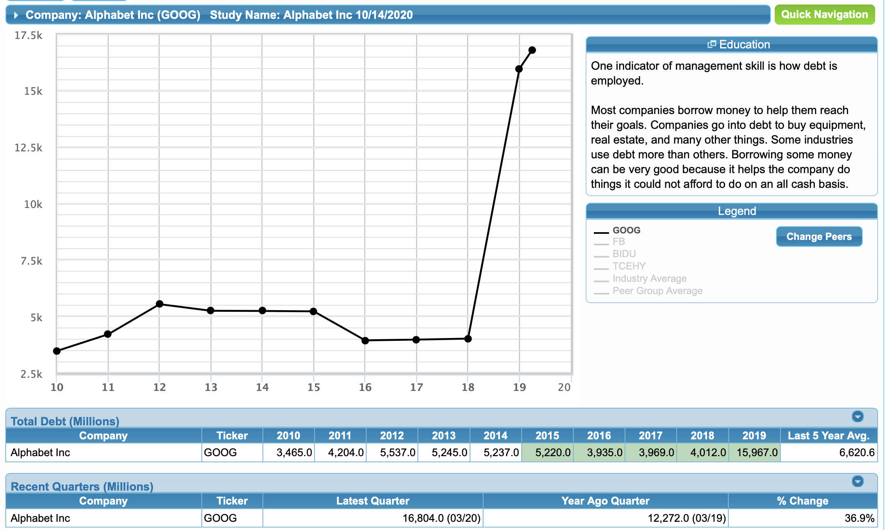
SSG with Online SSG Tools

Slide 21
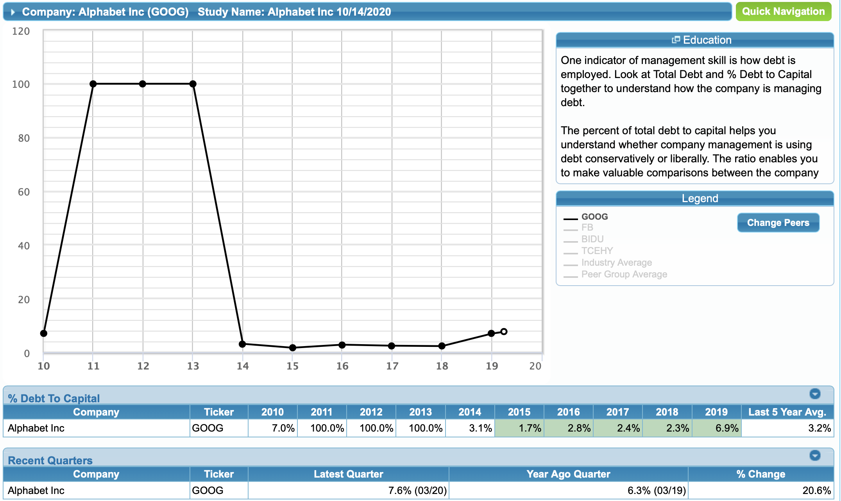
SSG with Online SSG Tools

Slide 22
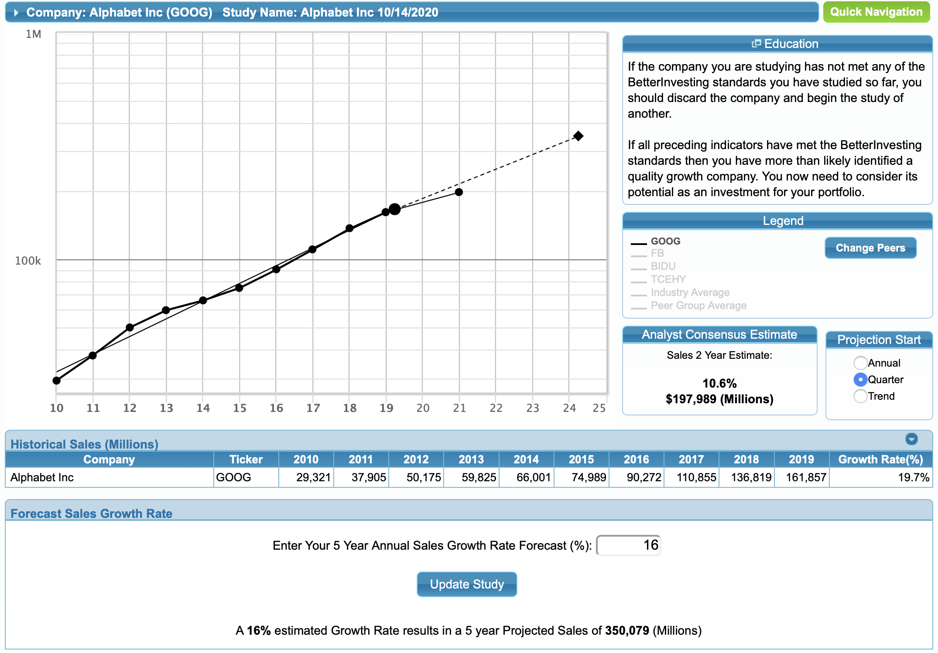
SSG with Online SSG Tools

Slide 23
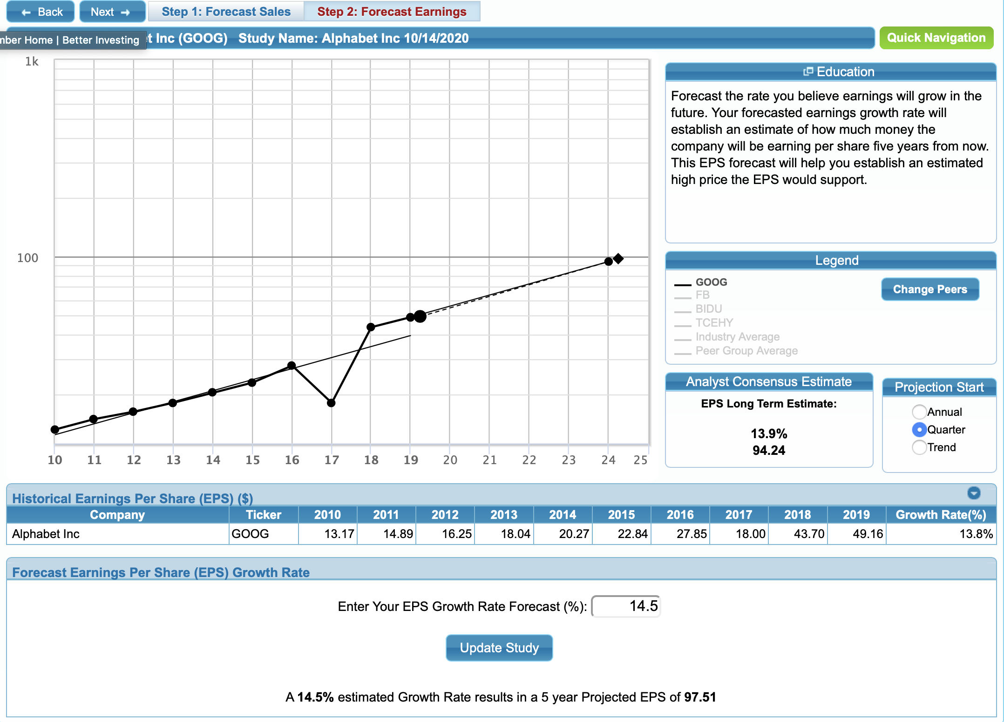
SSG with Online SSG Tools

Slide 24
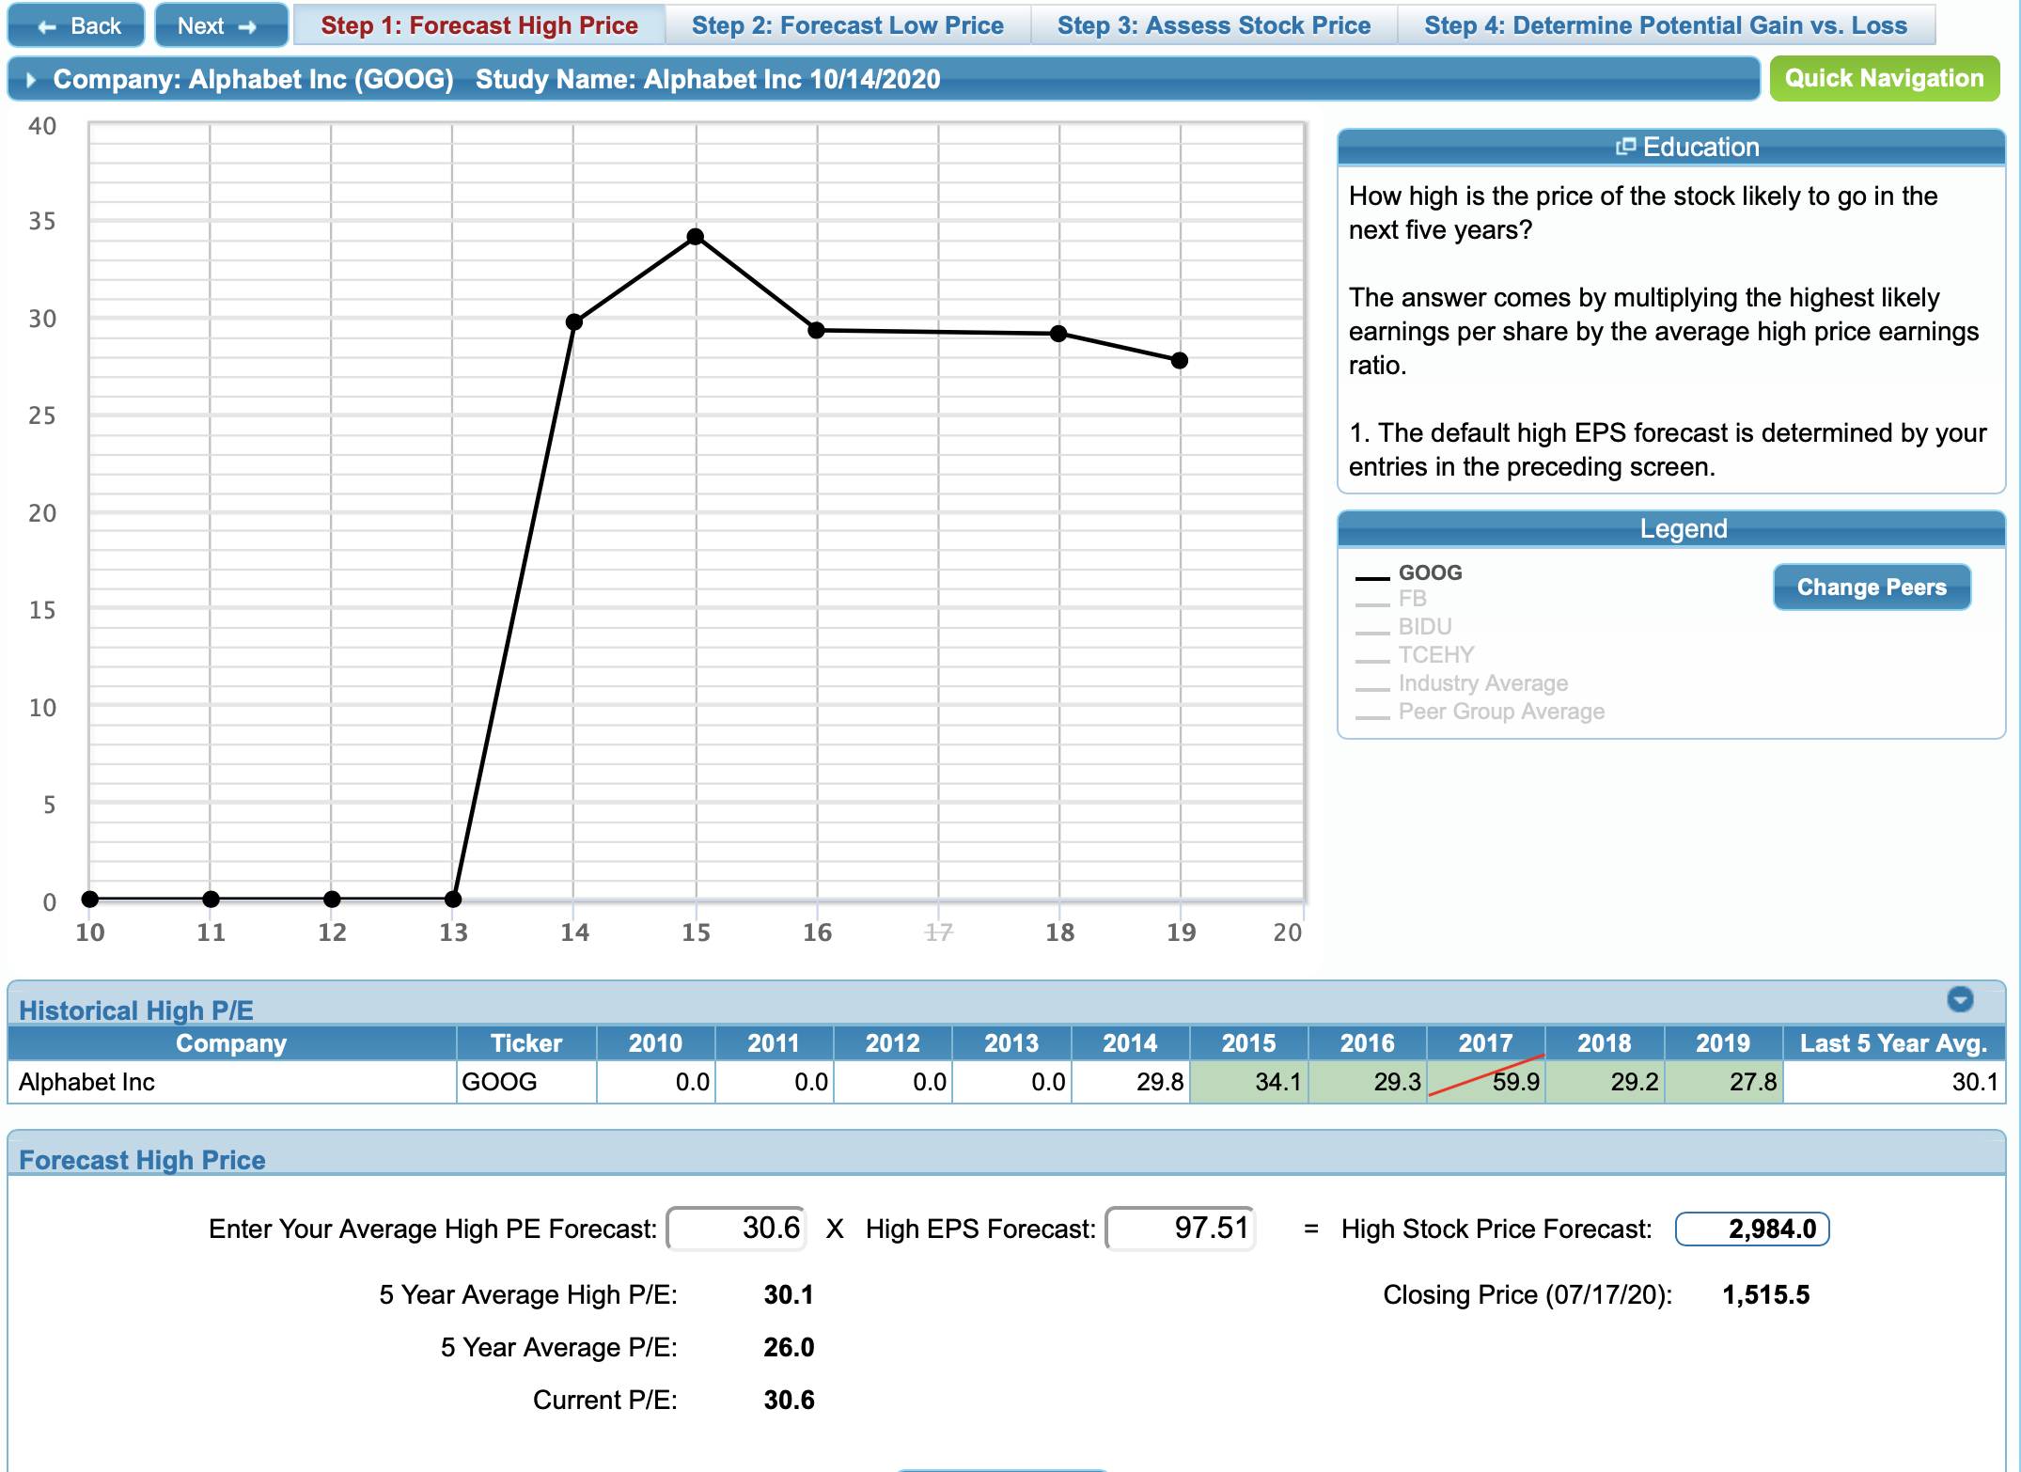
SSG with Online SSG Tools

Slide 25
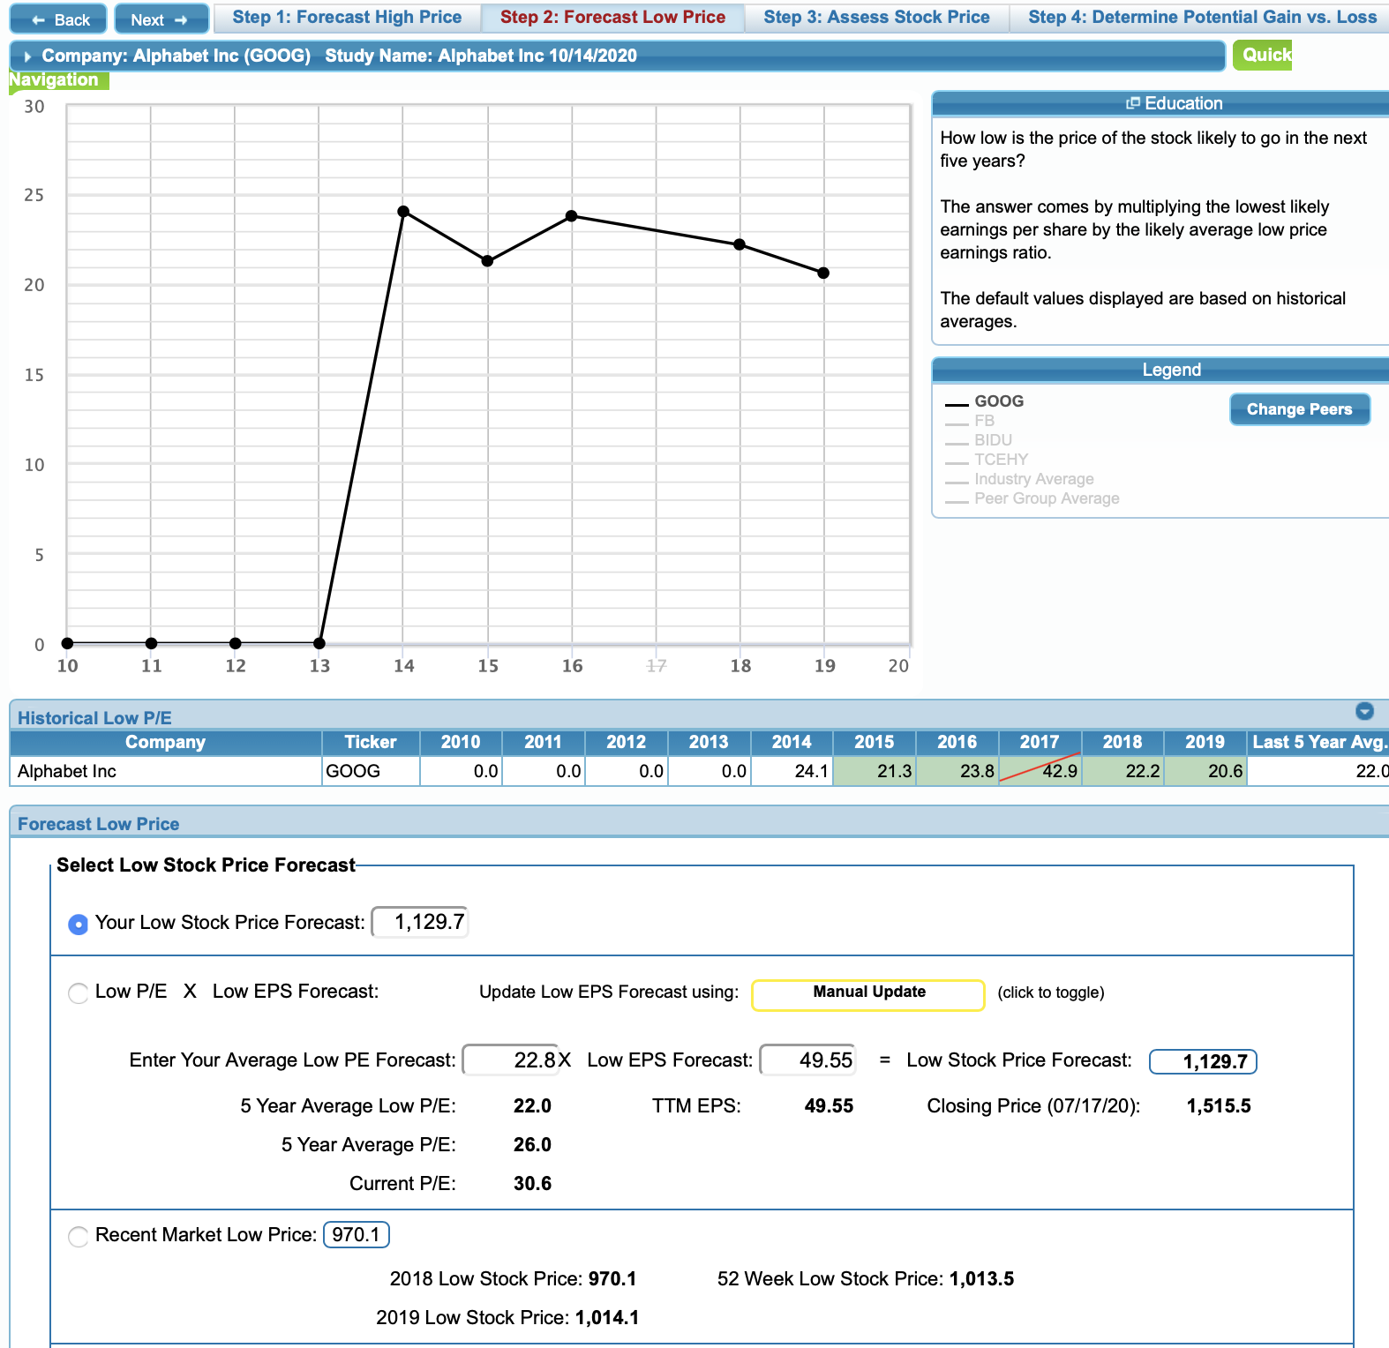
SSG with Online SSG Tools

Slide 26
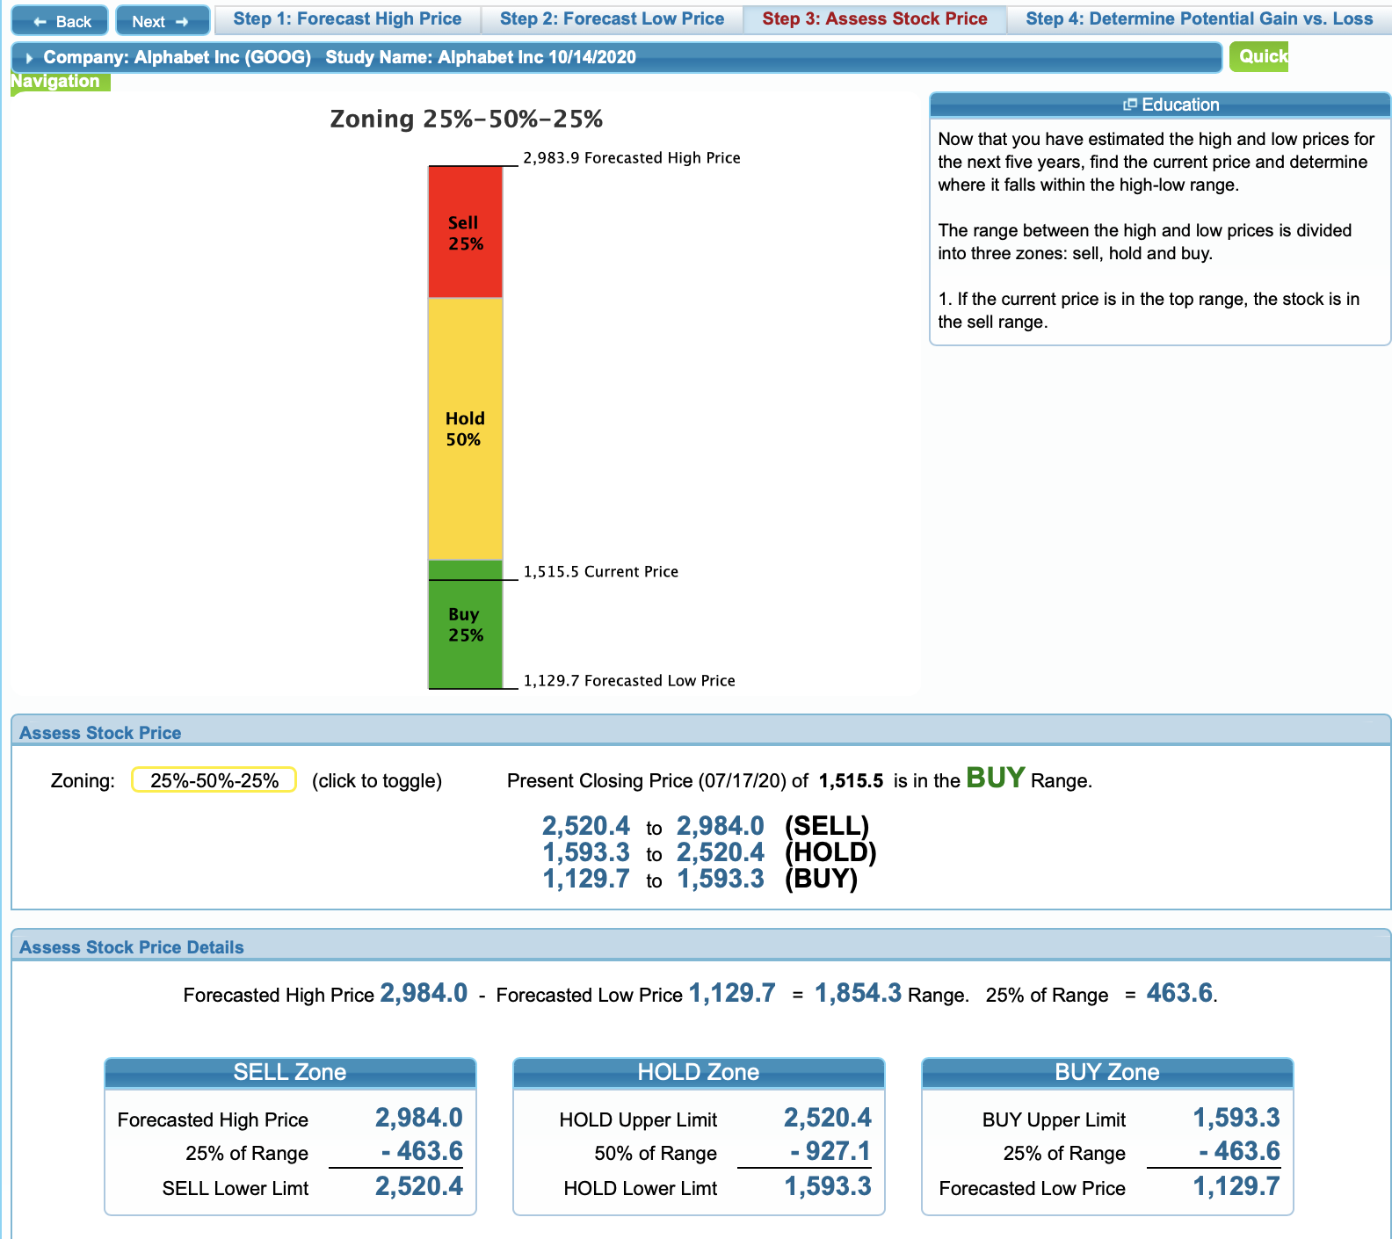
SSG with Online SSG Tools

Slide 27
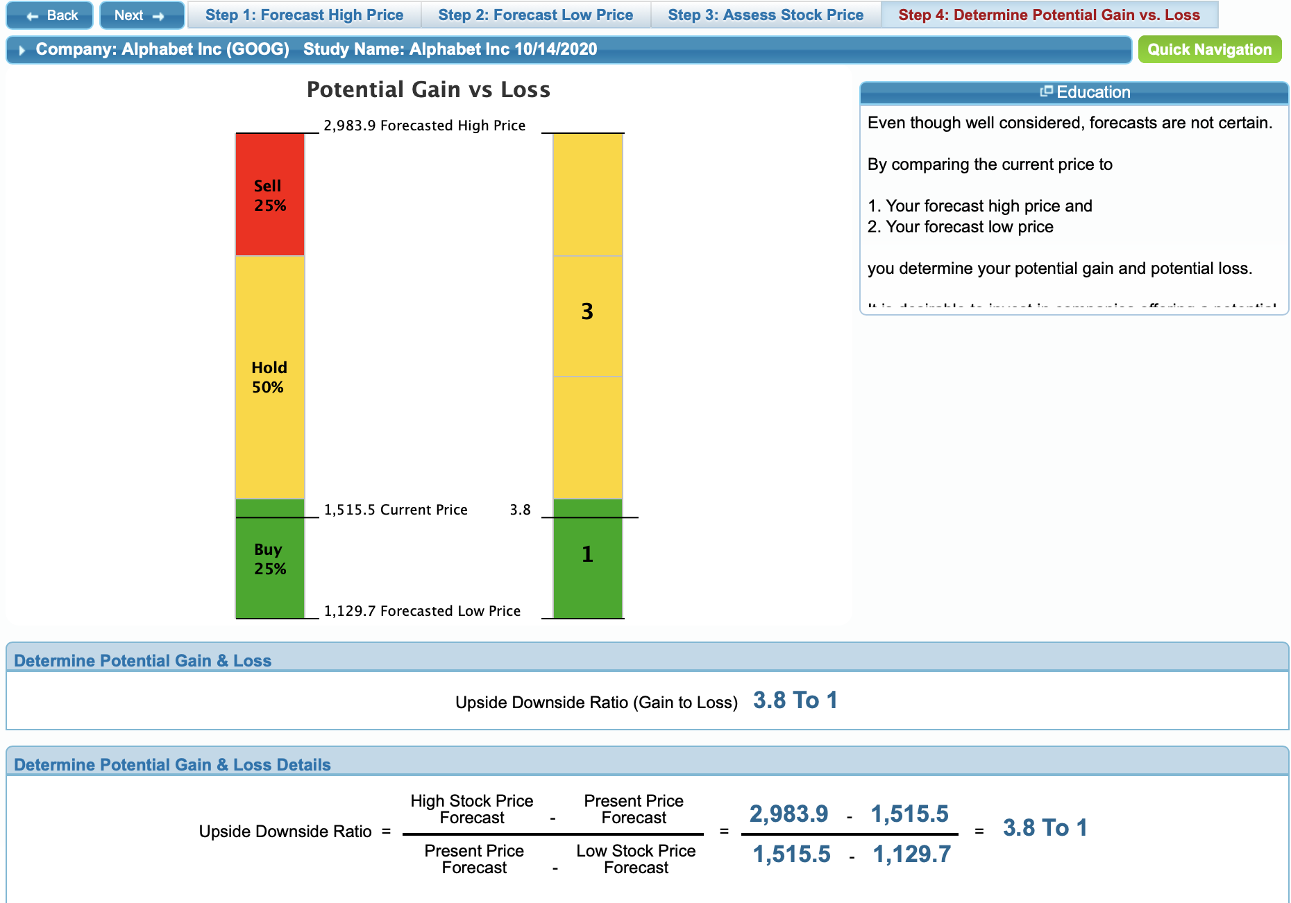
SSG with Online SSG Tools

Slide 28
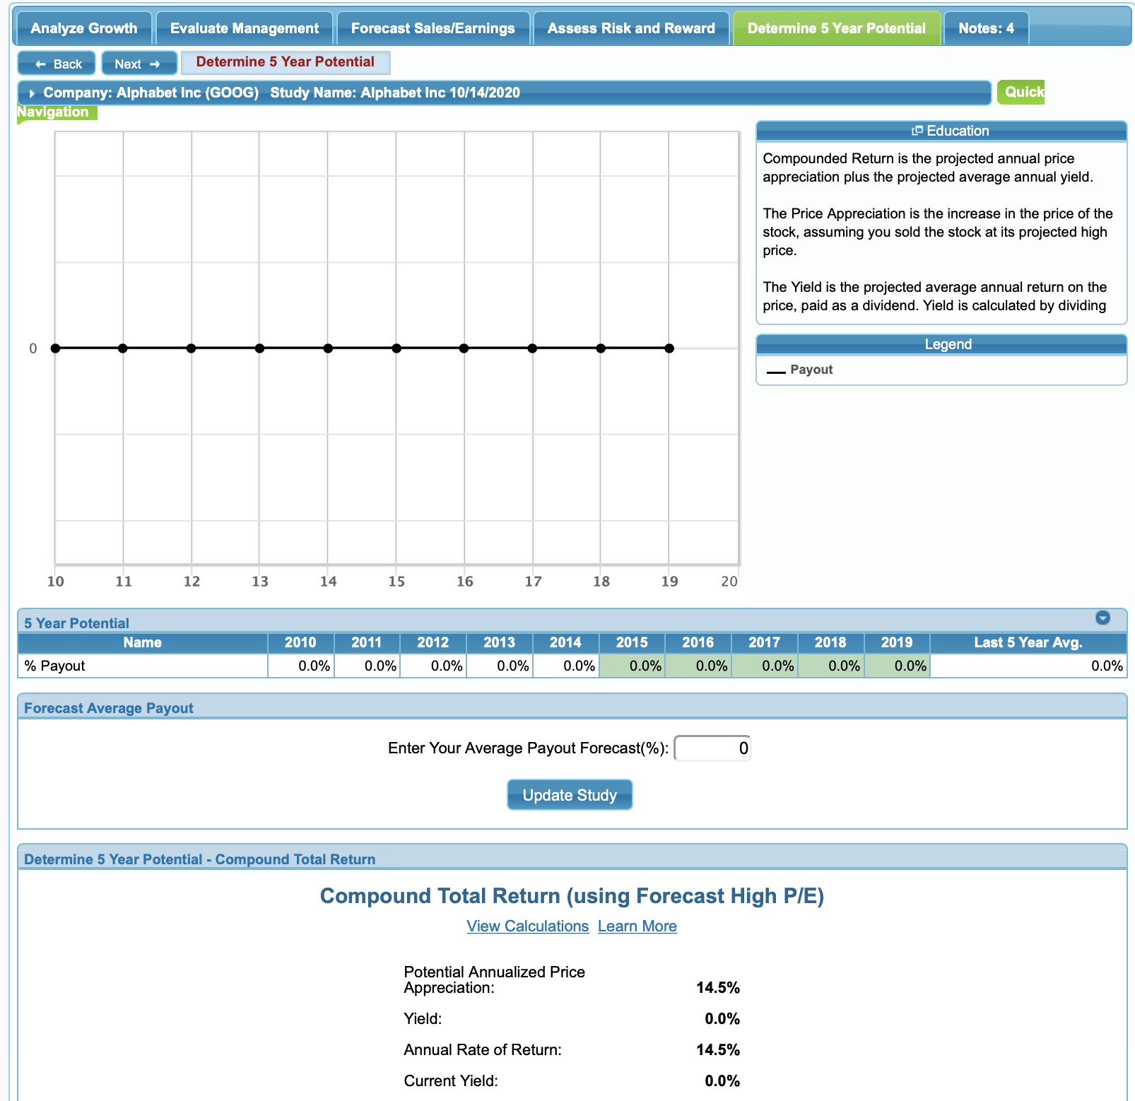
SSG with Online SSG Tools

Slide 29
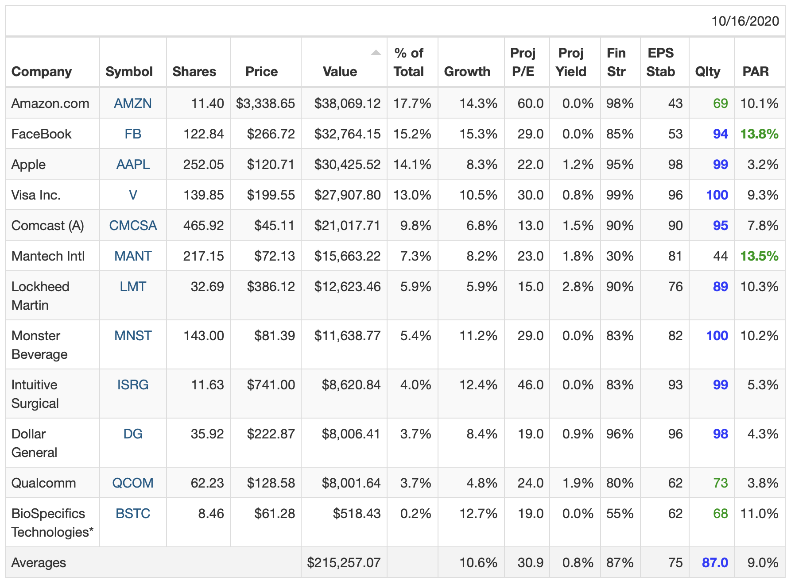
Recommendation
Sell AAPL ($10,000)
Buy Google ($10,000 + $2500 cash)
Improves our overall PAR from 9% to something higher as we swap 3% PAR for APPL with 14% for GOOG

