Slide 1
NVDA

Slide 2
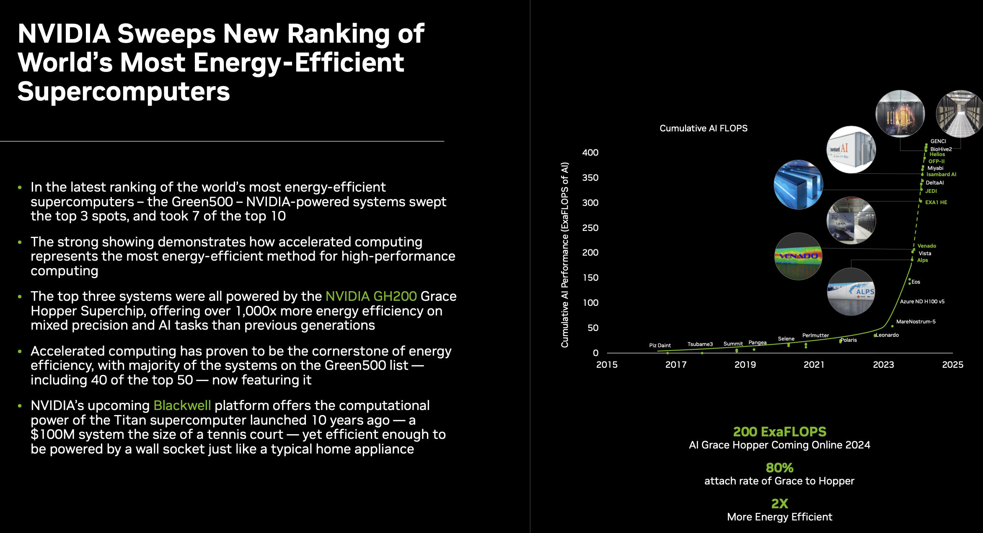
Very efficient chips for AI; MOST efficient

Slide 3
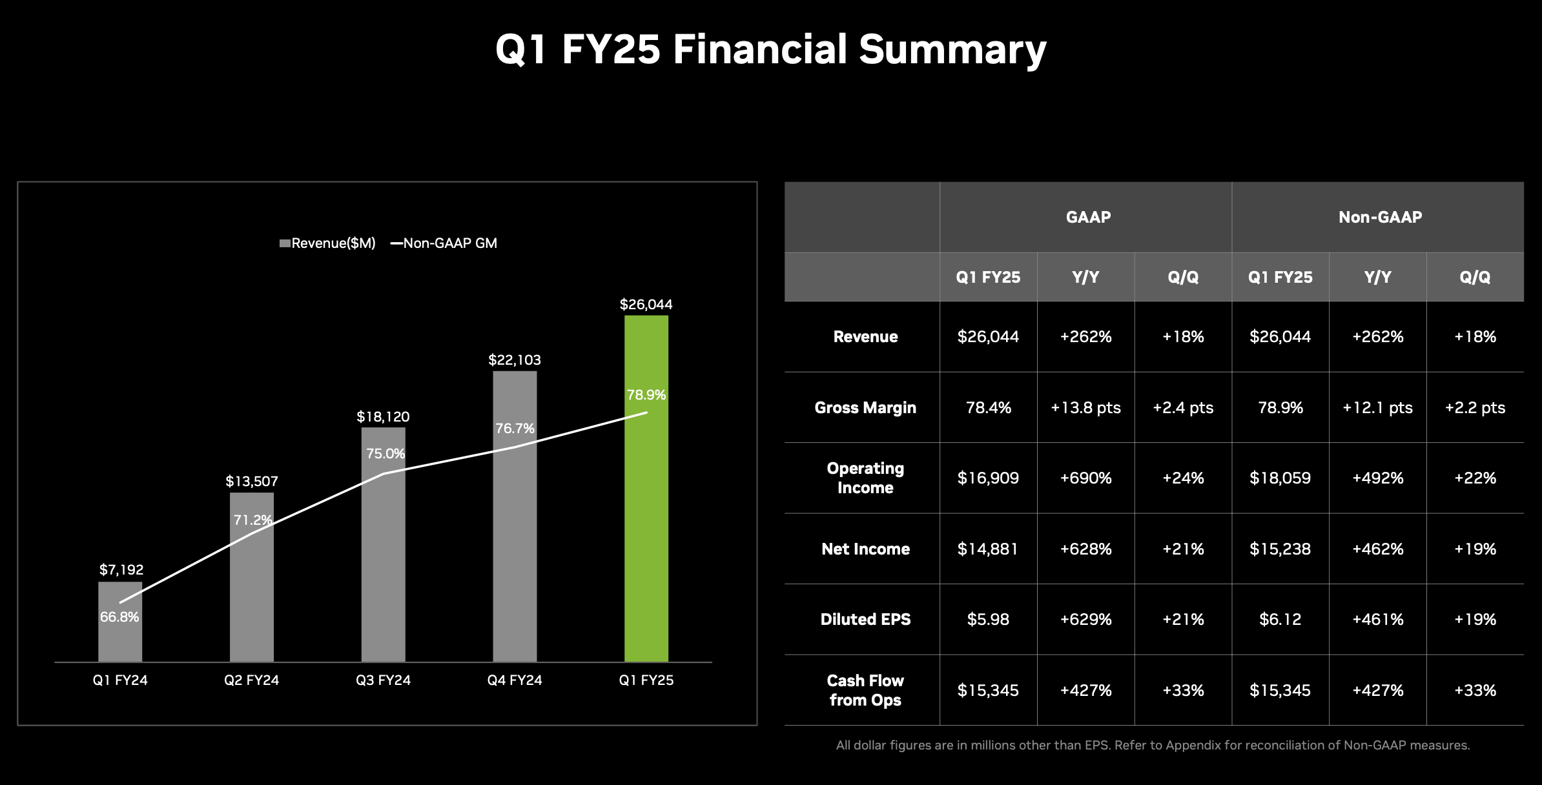
Note 262% Revenue growth Year over Year; CF up 427%; 78.9% is Quarter over Quarter

Slide 4
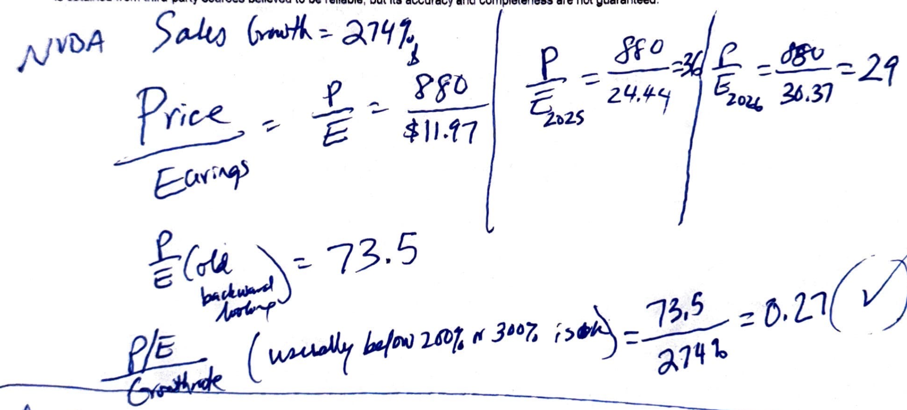
Do you understand that if I take P/E (expected) and multiply by a future E (earnings), I get a future price?
Analysis done 4/7/2024 w/my Dad, Prof of Agriculture

Slide 5
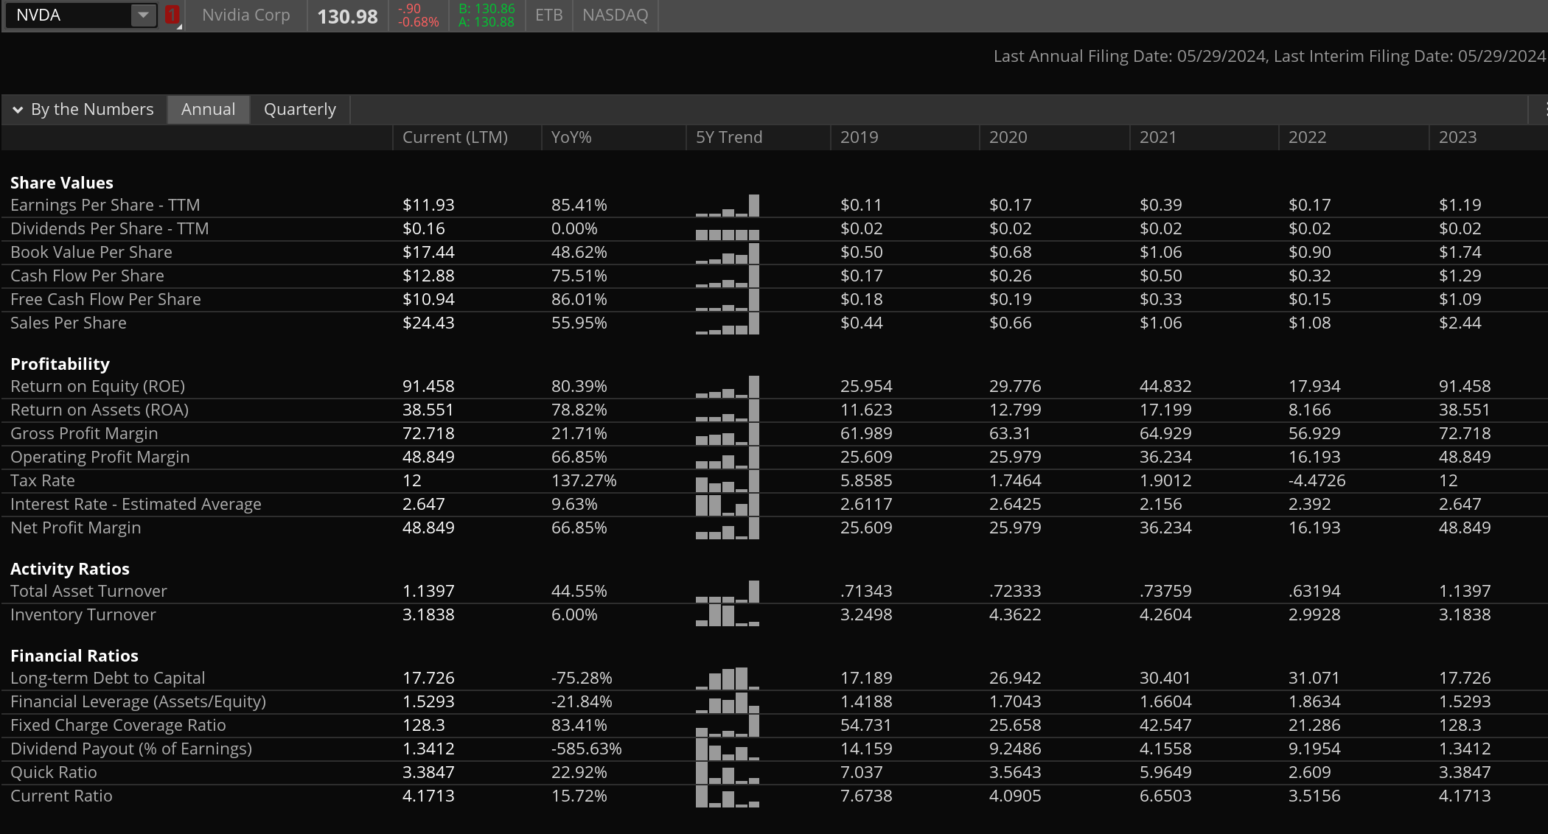
Quick snapshot; EPS (UP!) ROE (UP!) ROA (UP); Debt (LOW); fixed charge coverage ratio → investigate [likely ok]

Slide 6
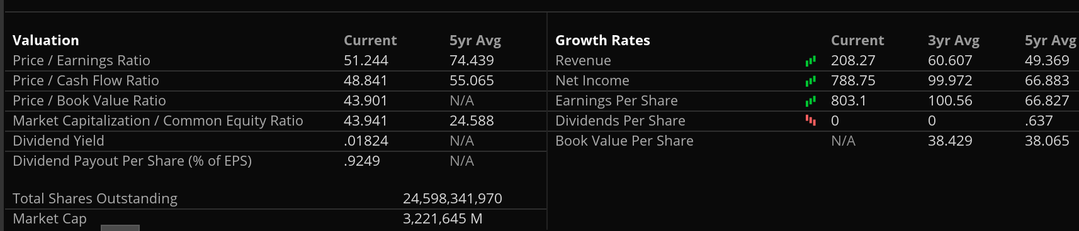
PE (reasonable); 1.8% yield; 3.3B mkt cap (one of the 3 largest companies)

Slide 7
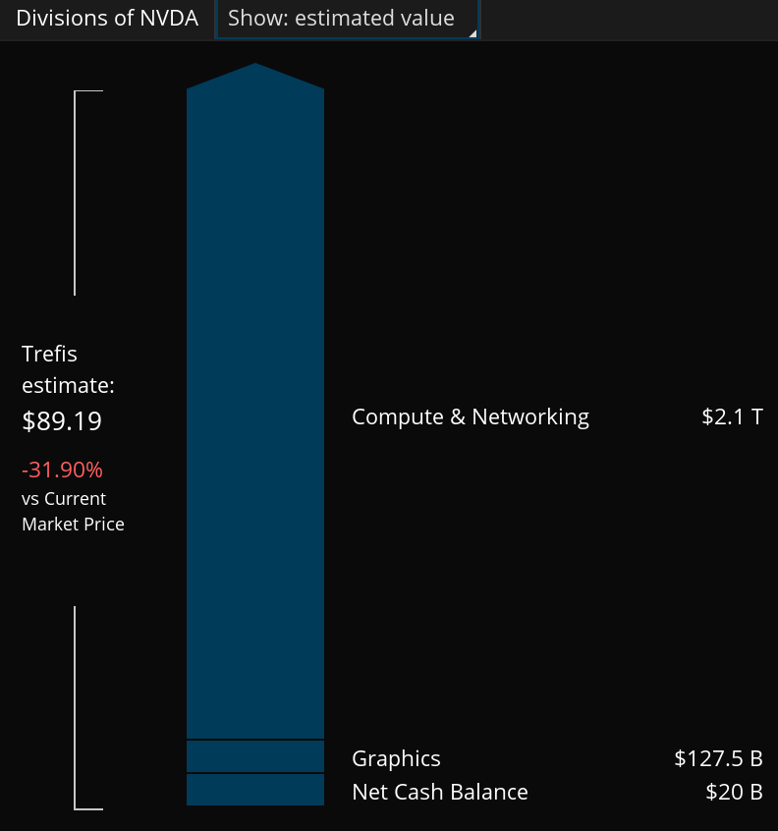
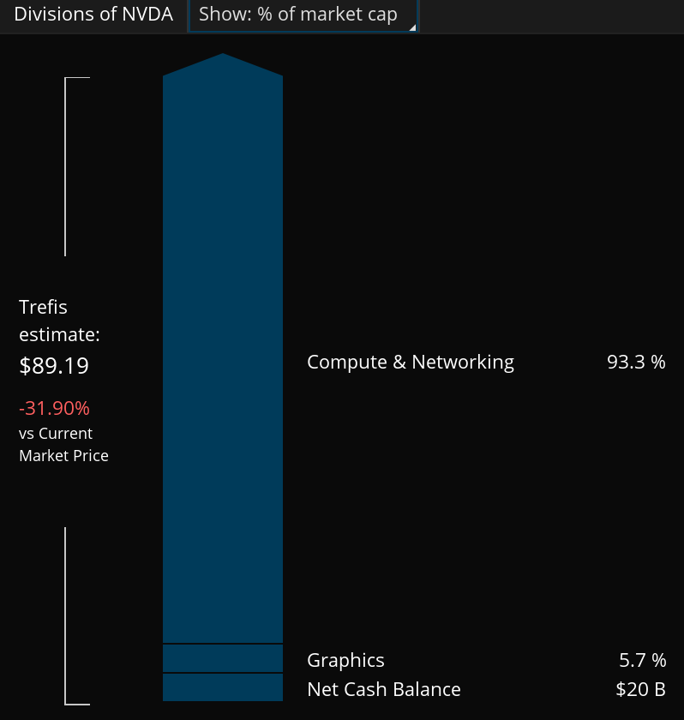
Trefis valuation (overvalued); Note 93% of company is now AI – computation/networking; this used to be a graphics cards company (think kids playing video games)

Slide 8
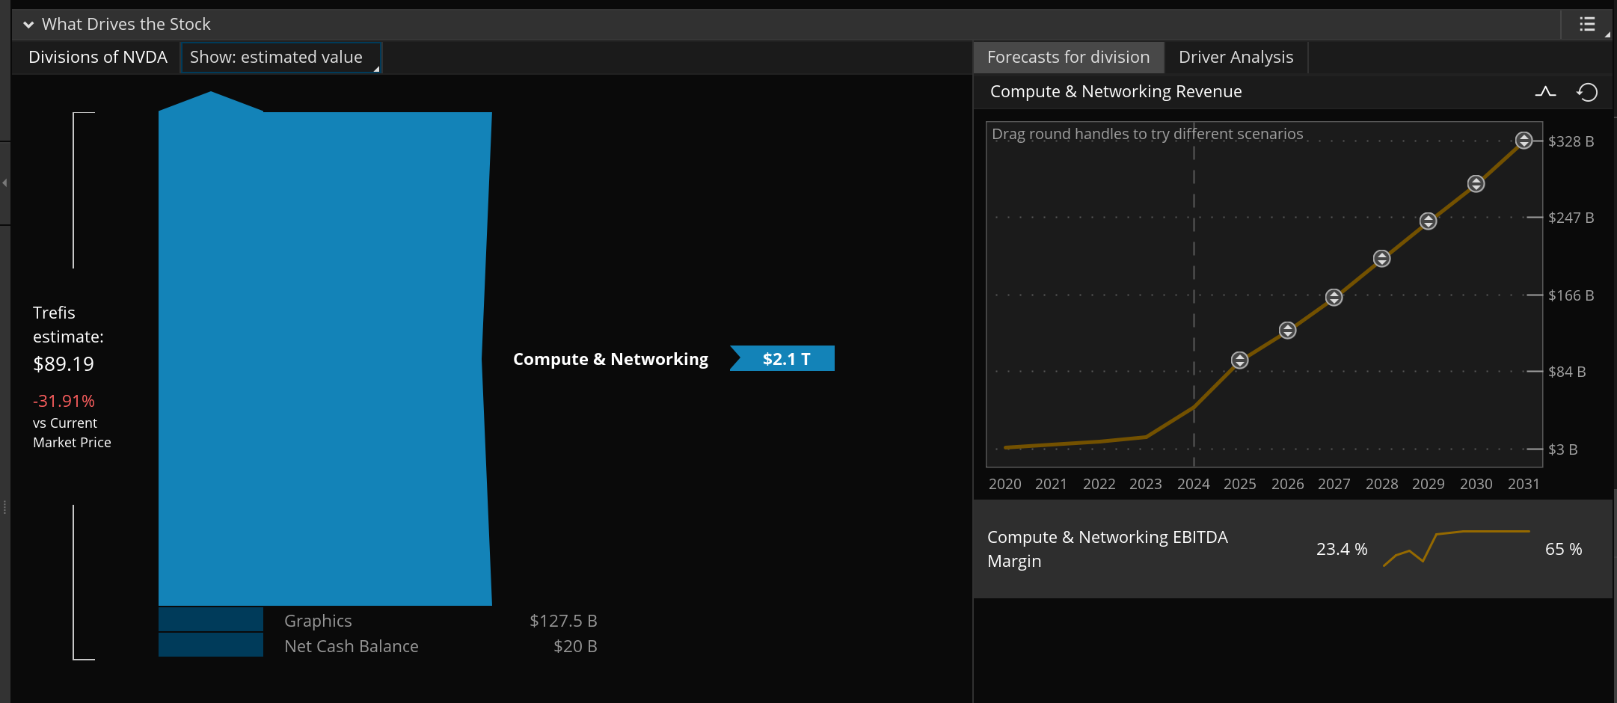
Trefis valuation (overvalued); Note 93% of company is now AI – computation/networking; this used to be a graphics cards company (think kids playing video games)

Slide 9
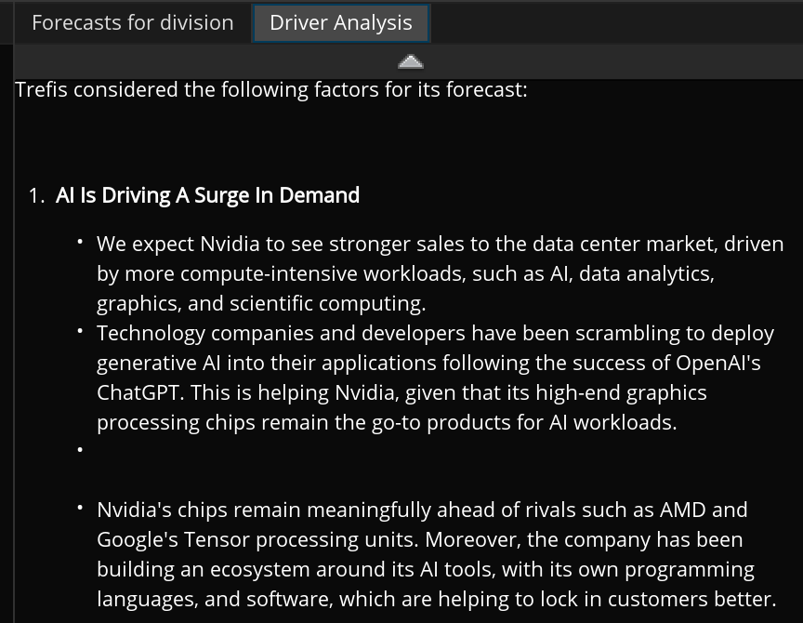
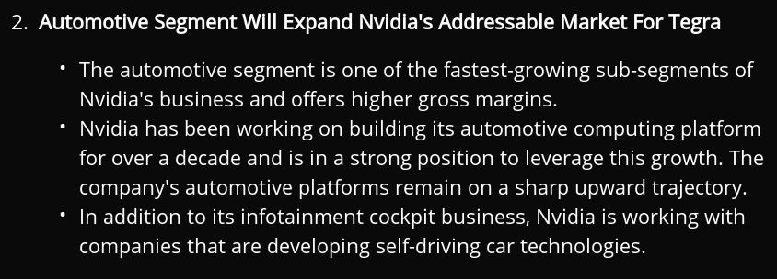
Main drivers for 100X growth in revenue next 10 years

Slide 10
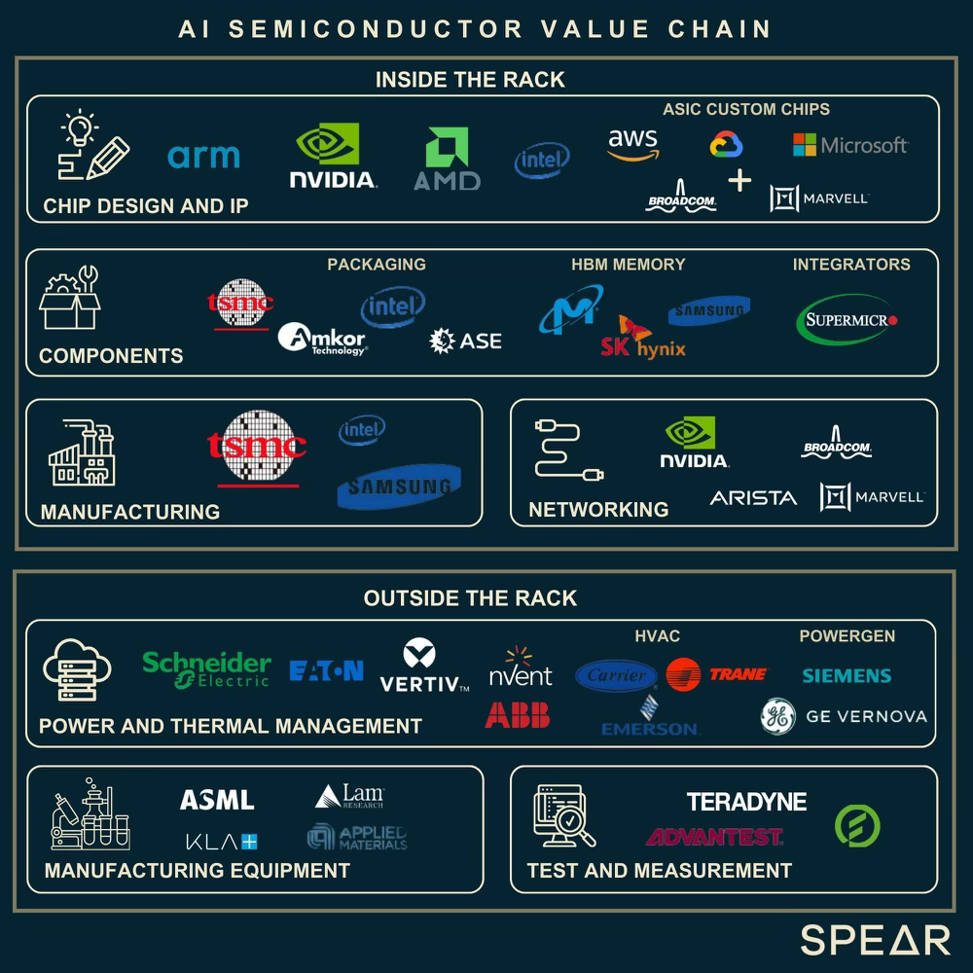
Value Chain of AI

