Slide 1
Healthcare/
Biotech
Team C
Brittany, Ram, Curt, Teresa

Slide 2
Biotechnology
Introduction
BioSpecifics Technology
GenMab A/S
Regeneron Pharmaceuticals
Recommendations

Slide 3
Healthcare
(Valueline)
A set of corporations that provide data,
products, and services to hospitals and physician practices, pharmaceutical and biotech companies,
and private individuals.

Slide 4
Healthcare
Target hospitals and physician practices
Software companies, offering information systems that automate the clinical side of healthcare.
Serve pharmaceutical and biotech companies
Market research and consulting firms
Provide health-related information to private individuals via a set of Internet portals supported by healthcare industry sponsorship and advertising.

Slide 5
Healthcare
Barriers to entry are generally moderate, given the
specialized nature of the group’s products and services.
Industry players are nicely profitable on an operating basis.
Moderate earnings growth is the norm.

Slide 6
Healthcare
Information Systems
Vendors providing CIS generally experience good profit margins, and R&D investments are heavy.
Allocate a relatively small portion of their capital budgets to IS
CIS are now incorporated in public health policy as a means to reduce costs.
CIS vendors receive a recurring revenue stream -provides a degree of stability to their top and bottom lines.

Slide 7
Healthcare
Market Research and Consulting
Wide profit margins - high return on invested capital
Cash flow is usually well in excess of funding needs, supports acquisition programs & allows for extensive share-repurchase programs
Products/services are primarily sold on an annual subscription basis, providing year-to-year stability (allows for the hedging of foreign currency risk).

Slide 8
Healthcare
Internet Portals
Ad spending accounts for an important portion of the Portals’ revenue
Much of the advertising is placed by Big Pharma
Relatively small portion of the drug industry’s ad budget
The Portal’s success is determined by attracting individuals to the sites.

Slide 9
Biotechnology
Highly volatile and unpredictable - Scientifically intensive
Markets served - Medical, agricultural, environmental, & industrial
Emerged in the 1970s - main goal of enhancing the quality of human life
Biotech firms differ from conventional drug makers - they utilize natural ingredients, as opposed to synthetic ones
Drugs are manufactured in a living system, i.e., a microorganism, plant or cell.

Slide 10
Biotech
Medically - Improve people's health through recombinant DNA
Among the most research-intensive organizations
Established companies typically fund growth ventures with cash flow, but debt and equity markets are sometimes tapped.
Since many biotech companies are small (scarce cash) - External funding/important.
Big pharma companies/investment entities stand to reap significant rewards from taking a stake in a drug that is commercialized.
During difficult economic times, outside funding often dries up.

Slide 11
Biotech
Growth Contingencies
New discoveries for the treatment of diseases
Volatile or weak results for investors in the short term
Company may have to endure a lengthy period of sometimes-heavy losses before yielding operating benefits
Sales and earnings potential of new commercial drugs or treatments can be immense and remain positive for years.
Patented biotech drugs - 12-year protection from generic competition

Slide 12
Biotech
Growth Contingencies
Biotech drugs are expensive - Pressure from insurers, governments, & consumers to rein in healthcare costs
Biotech drugs are scientifically complex, not easily duplicated, and costly to develop.
Legislators regularly attempt to increase industry competition.
Most prospective drugs never complete clinical trials and reach commercialization

Slide 13
Biotech
Regulatory Considerations
FDA is the primary regulator/medical - (Environmental Protection Agency and Department of Agriculture)
Statistically, odds are against a drug progressing through all the required clinical trial stages.
For every 5,000 compounds discovered in pre-clinical studies, about 5 are FDA approved.
Drugs remain subject to ongoing studies. Patients are monitored for negative side effects. Recalls due to injuries and/or fatalities are not uncommon. Patents are nullified in the event of a recall.

Slide 14
Biotech
Use of Cash
#1 Use of Cash = R&D
Gaining approval of new drugs and bringing them to full production.
Marketing and distribution
Acquisitions are more common among large industry players
Debt retirements, stock repurchases, and dividends are the least desirable uses of cash.

Slide 15
Founded in 1988: Publicly traded company (NASDAQ: REGN) since 1991
More than 7,500 employees in the U.S. and EU
Regeneron Pharmaceuticals discovers, develops, and commercializes products that fight eye
disease, cardiovascular disease, cancer, and inflammation.
The company has six marketed products:
Eylea: Wet age-related macular degeneration and diabetic retinopathy (Sales: $4.8 billion)
Praluent: LDL cholesterol lowering
Zaltrap: Colorectal cancer
Dupixent: Atopic dermatitis, asthma, and nasal polyposis
Libtayo: Cutaneous squamous cell carcinoma
Kevzara: Rheumatoid arthritis.

Slide 16
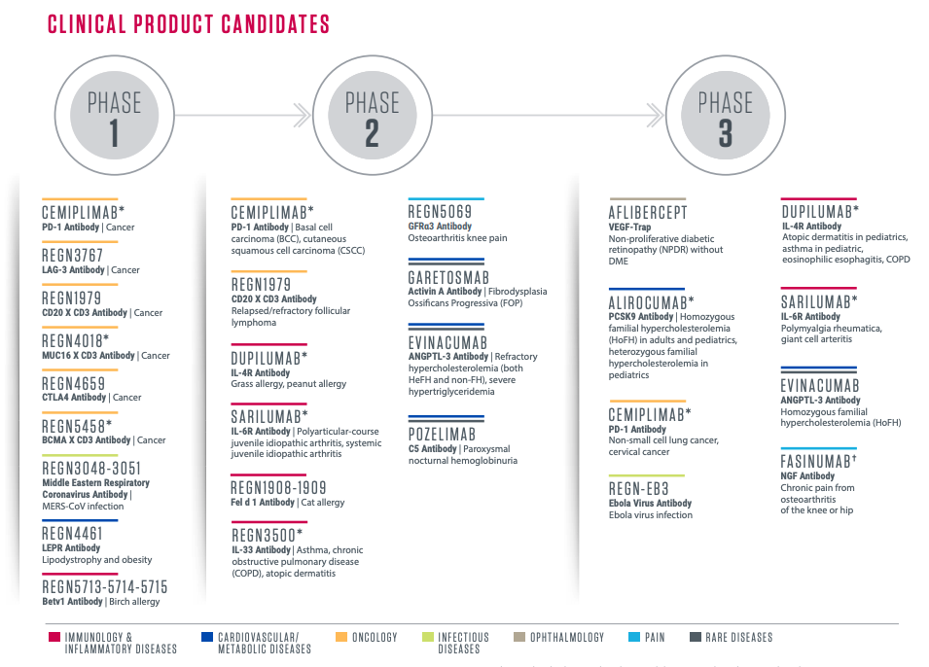

Slide 17
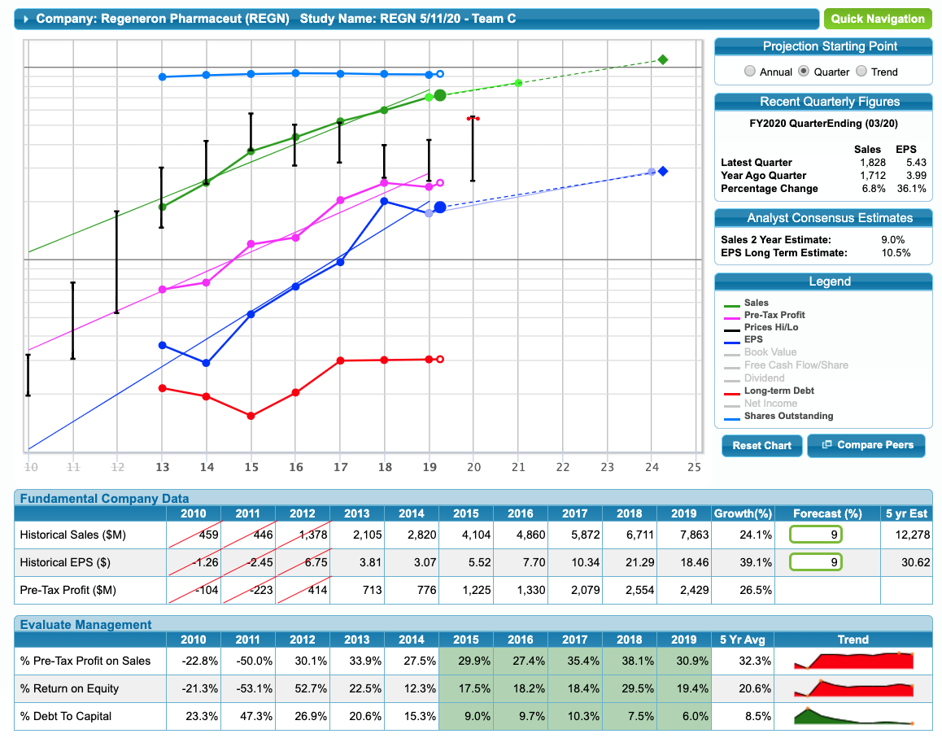

Slide 18
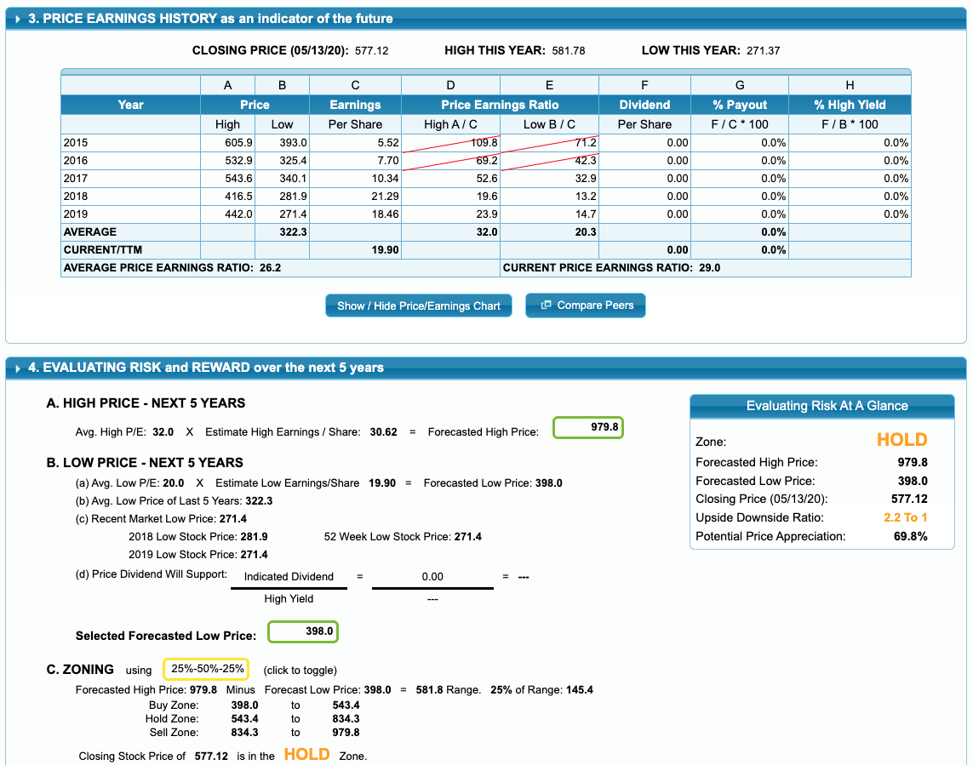

Slide 19
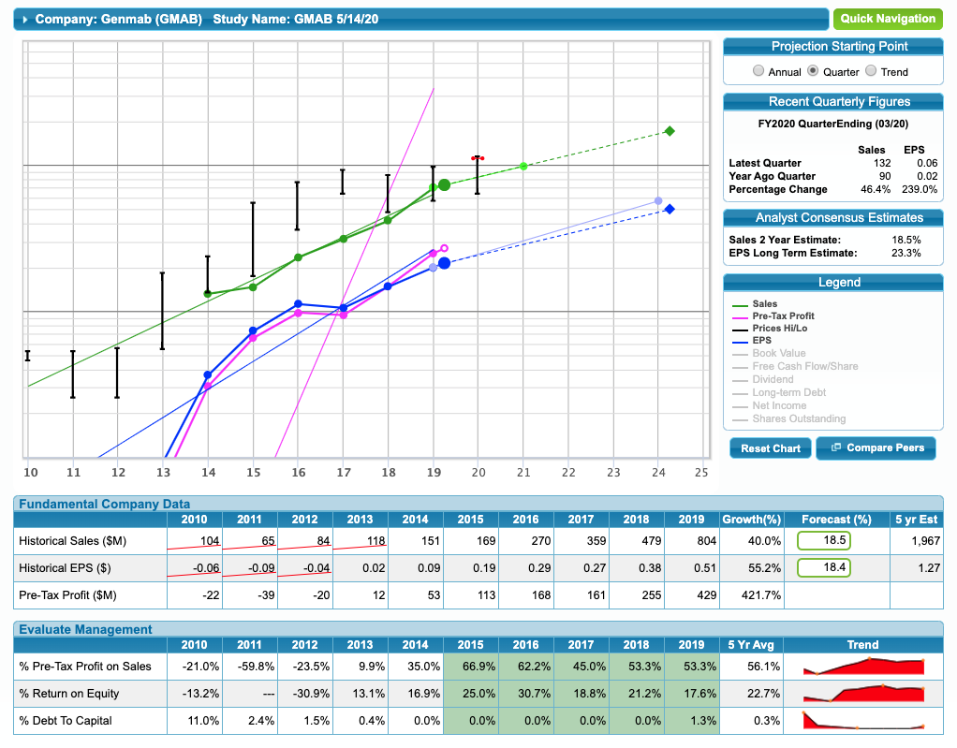

Slide 20
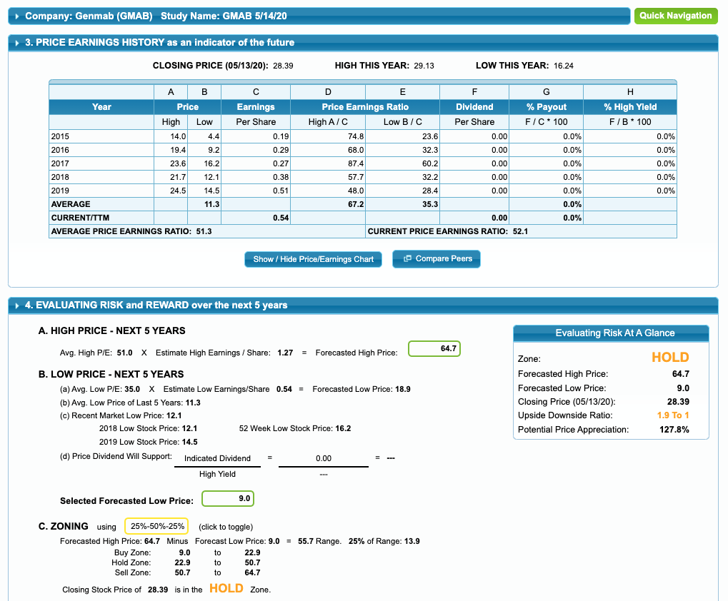

Slide 21
BioSpecifics Technologies Corp.
Ticker : BSTC
Biopharmaceutical company involved in the development of an injectable collagenase clostridium histolyticum
Dupuytren’s contracture (“DC”) - Hand deformity
Peyronie’s disease (“PD”)
Frozen shoulder syndrome
Plantar fibromatosis
Cellulite
and uterine fibroids
Generates revenue primarily from their licensing agreement with Endo

Slide 22
BioSpecifics Technologies Corp.
Revenue of $38 million for 2019
Net Profit $24.469
Has 5 employees.
Xiaflex is the product for shoulder abduction and internal rotation.
Sold in 28 Euro nations and 22 Middle Eastern countries.
Major licensee is Endo Global Ventures

Slide 23
BioSpecifics Technologies Corp.
Estimated Future Sales Growth: 15.9%
Yahoo Finance – 22%
Zack’s Industry -16.10%
Used the same growth percentage for EPS
Estimated High Price was calculated at $208.10.
Average Low Price used was $38.1
Upside down ratio : 8.1 to 1

Slide 24
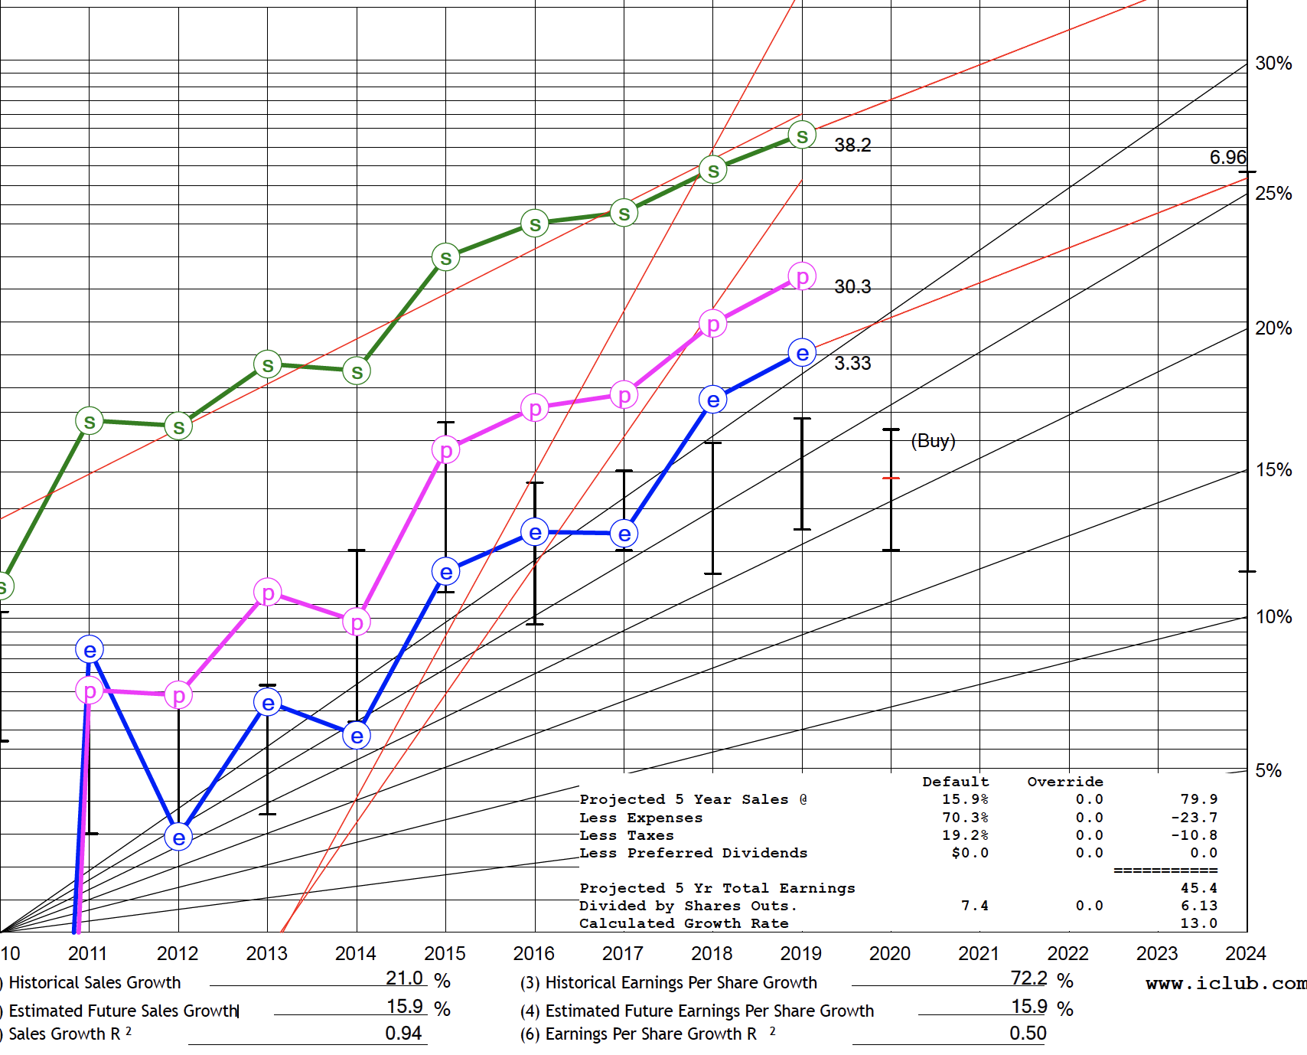
BioSpecifics Technologies Corp.

Slide 25
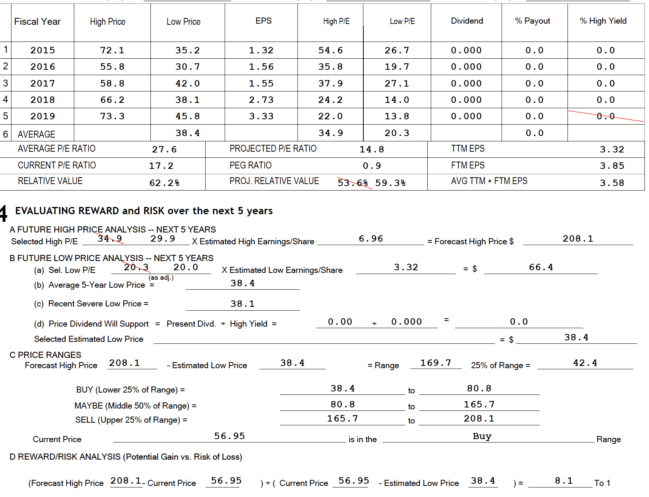
BioSpecifics Technologies Corp.

