Slide 1
5G SE MI Model Club 2019-04-20

Slide 2
Overview
5G ("5th Generation") is the latest generation of cellular mobile communications. It succeeds the 4G (LTE-A), 3G (LTE) and 2G (GSM) systems.
5G networks will rely on dense arrays of small antennas and the cloud to offer data speeds up to 50 or 100 times faster than current 4G networks.
Before 5G becomes a reality for consumers, two transitions need to take place:
Mobile operators to upgrade their networks (more towers also) (some like AT&T and Verizon have started in some cities)
Phone makers need to upgrade to 5G radios (3+ phones available)

Slide 3
Transition
From today’s ~15MB speed to 1,000MB to 10,000MB
Video/data transfer at very high speeds
Backbone for future generation self-driving cars

Slide 4
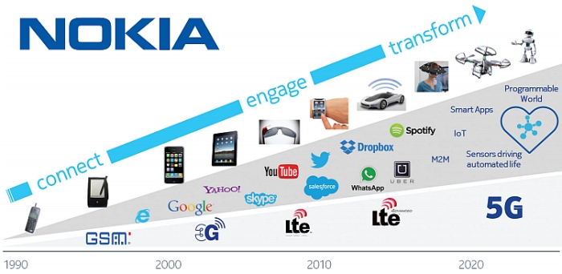
Transition
5G enables – sensors driving more automated life, higher use of cloud services

Slide 5
Network

Slide 6
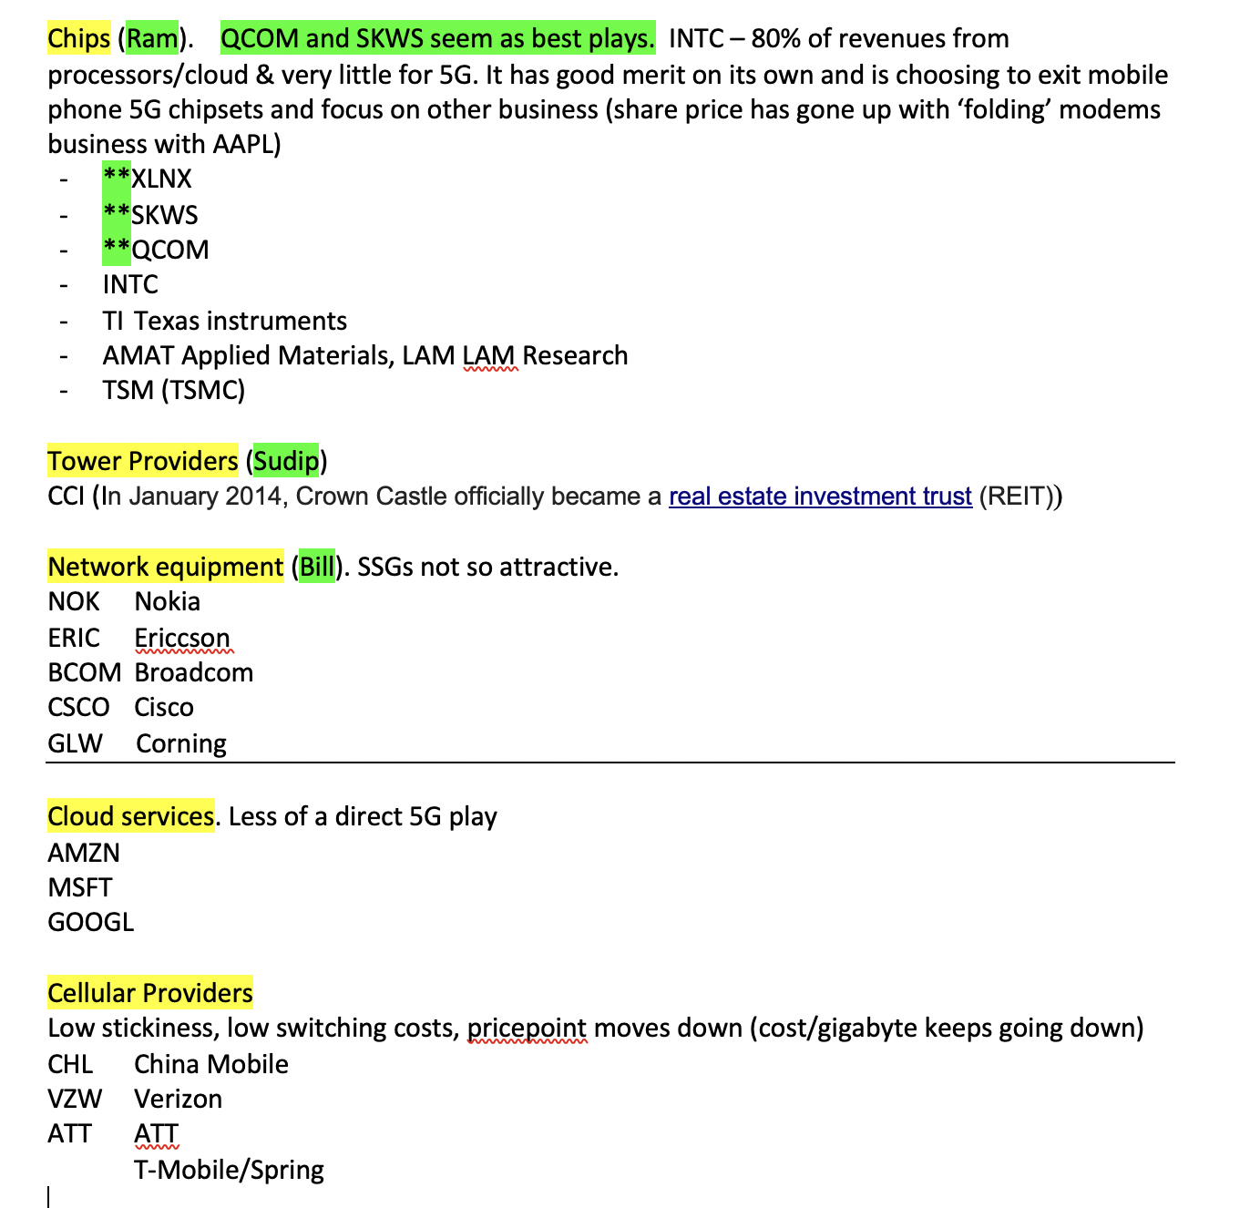
Team’s Approach for Analysis
After considering 5 areas, we were settling on SKWS, INTC and QCOM was debatable. But after AAPL/QCOM agreement, we still think QCOM has room to run

Slide 7
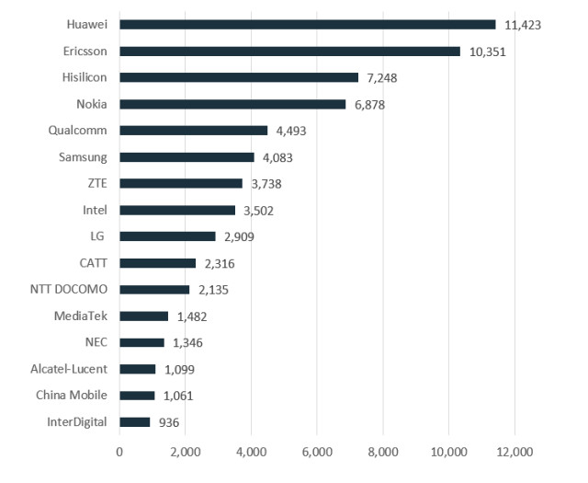
5G Patent Race
Top 5G SEP (Standard Essential Patents) owners
Top companies making tech contribution to 5G standard
Qualcomm and Intel are the only 2 notable US Companies; many Chinese

Slide 8
Qualcomm
Qualcomm is the dominant player in smartphone communications chips, making half of all core baseband radio chips in smartphones.
It is one of the last big U.S. technology companies with a major role in mobile communications hardware.
Its dominant position in 5G comes from its mastery of two areas:
1. Getting its patents adopted in what are known as standards and
2. Then selling the chip designs that work with those standards.
Qualcomm has landed a number of these foundational patents, which means that both handset makers and telecommunications gear makers will have to pay it licensing fees.
It dominated standards setting in 3G and 4G wireless and looks set to top the list of patent holders heading into the 5G cycle.

Slide 9
Qualcomm – Business Summary
Qualcomm is a leading developer of Code Division Multiple Access (CDMA), a mobile device technology that facilitates communication between mobile devices and wireless towers.
Qualcomm makes money by selling chipsets for mobile devices, tablets and femtocells. It sells chipsets to mobile device manufacturers such as Apple, Samsung, Nokia and Motorola Mobility; and charges a royalty to mobile manufacturers on every device sold that incorporates its technology. The royalty charge is typically determined as a percentage of the selling price of the mobile device.
Qualcomm also licenses its CDMA technology to other chipset manufacturers that wish to sell CDMA-based chipsets to mobile manufacturers. In addition to licensing fees, the company also collects a royalty on every CDMA handset sold from the handset manufacturers.
SOURCES OF VALUE (source: TREFIS)
Qualcomm derives over 80% of its valuation from its mobile licensing and mobile chipset business.

Slide 10
QCOM – Lawsuit summary (before AAPL case)
ONGOING LAWSUITS AGAINST QUALCOMM
The various ongoing lawsuits against Qualcomm has raised serious doubts about the sustainability of the company's licensing business. Recent lawsuits filed against Qualcomm include:
- A $1 billion lawsuit filed by Apple alleging that Qualcomm overcharged it for chips and refused to pay rebates worth $1 billion. Apple also alleged that Qualcomm attempted to persuade it to provide false information to the Korea Fair Trade Commission (KFTC) in order to get the rebates. Apple is withholding royalty payments that its contract manufacturers owe Qualcomm until its current legal issues are sorted out.
- U.S. Fair Trade Commission (FTC) initiated a lawsuit against Qualcomm, alleging that certain monopolistic business practices of the company were in violation of the Fair Trade Commission Act of 1914, in which basic US patent law was first set down.
- KFTC alleged Qualcomm abused its market dominance and slapped an approximate $850 million fine on the company. Furthermore, the KFTC issued a broad set of guidelines that Qualcomm will have to follow while executing licensing contracts in South Korea subsequent to the formal filing.
Though Qualcomm strongly disputes these charges, there can be significant negative implications for the company if its appeal gets rejected. Qualcomm is confident of navigating these challenges in time and has taken several steps to address the matters.

Slide 11
Qualcomm
Undisclosed sum being paid by Apple. $7B was due. Some say as high as $20B. May 1 earnings may shed some light.

Slide 12
Qualcomm
From Qualcomm

Slide 13
Qualcomm
POTENTIAL UPSIDE & DOWNSIDE TO TREFIS PRICE
MOBILE DEVICE CHIPSETS
Chipset Pricing: We currently forecast Qualcomm's chipset pricing to decline from $20 in 2018 to approximately $19 by the end of Trefis forecast period, due to increasing competition and exposure to emerging markets. There could be a 8% upside to the Trefis price estimate if higher priced chipsets help Qualcomm increase ASPs to $23 by the end of the forecast period.
Chipset Shipments: We currently forecast Qualcomm's chipset shipments to increase from 800 million in 2017 to about 880 million in 2024. Qualcomm has aggressive plans to tap emerging markets like China and India for 3G/4G rollout. Also, it was the first player to come out with a multimode chipset for LTE technology. However, Qualcomm is seeing increased competition from other chipset makers. The company's chipset business is also threatened by its own customers like Samsung, Apple and Xiaomi, as the smartphone makers plan to develop in-house chipsets to improve margins.
MOBILE DEVICE ROYALTIES
Royalty Rate: We currently forecast that Qualcomm's royalty revenues will decline from levels of around $6.5 billion in 2017 to about $4.5 billion in 2024. Royalty rates have come under pressure as Qualcomm expands its business to emerging markets, which command lower rates. Another reason for the expected decline in royalty rate is Qualcomm's not so strong patent position in 4G technology as compared to 3G. However, if Qualcomm is able to maintain these revenues at current levels by building a strong position in 5G, while fending off lawsuits relating to the patent licencing business, there could be a 10% upside to our current price estimate.

Slide 14
Qualcomm
After a year-long battle, Qualcomm last year agreed to pay China’s National Development and Reforms Commission (NDRC) $975 million in fines for alleged monopolistic practices in the region. China is a major source of growth for Qualcomm’s 3G/4G LTE chipsets.
As part of the settlement with NDRC, Qualcomm has agreed to ease its royalty rate regimen for Chinese vendors. Under the terms of the agreement, Qualcomm will offer licenses to its current 3G and 4G essential Chinese patents, widely used by Chinese device makers, separately from other patents. For companies opting for the new agreement, which applies to phones sold for use in China, Qualcomm will calculate royalties based on 65% of the phone’s selling price, instead of on the whole price. Lowering its royalty rates in China could affect the Qualcomm's licensing deals elsewhere, forcing the company to reduce its royalty rates globally.

Slide 15
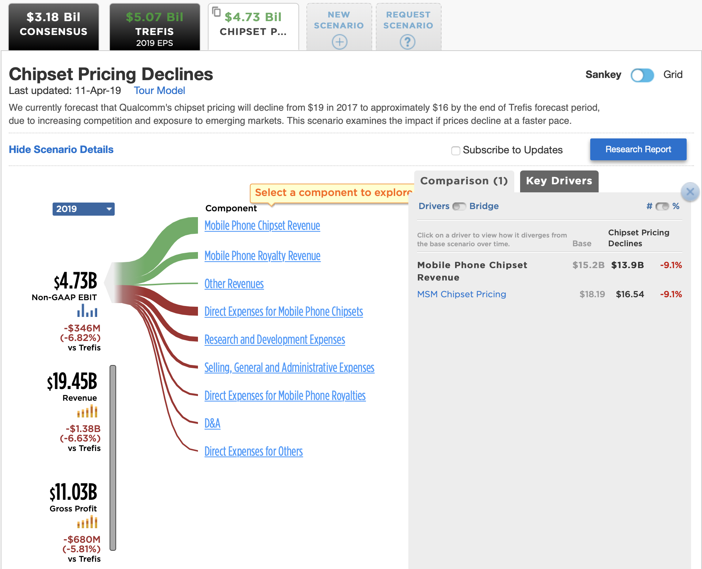
Qualcomm
Note – key drivers are chipset revenue deterioration (with AAPL settlement – likely won’t be true and revenues for future years will be increased with future iPHone business

Slide 16
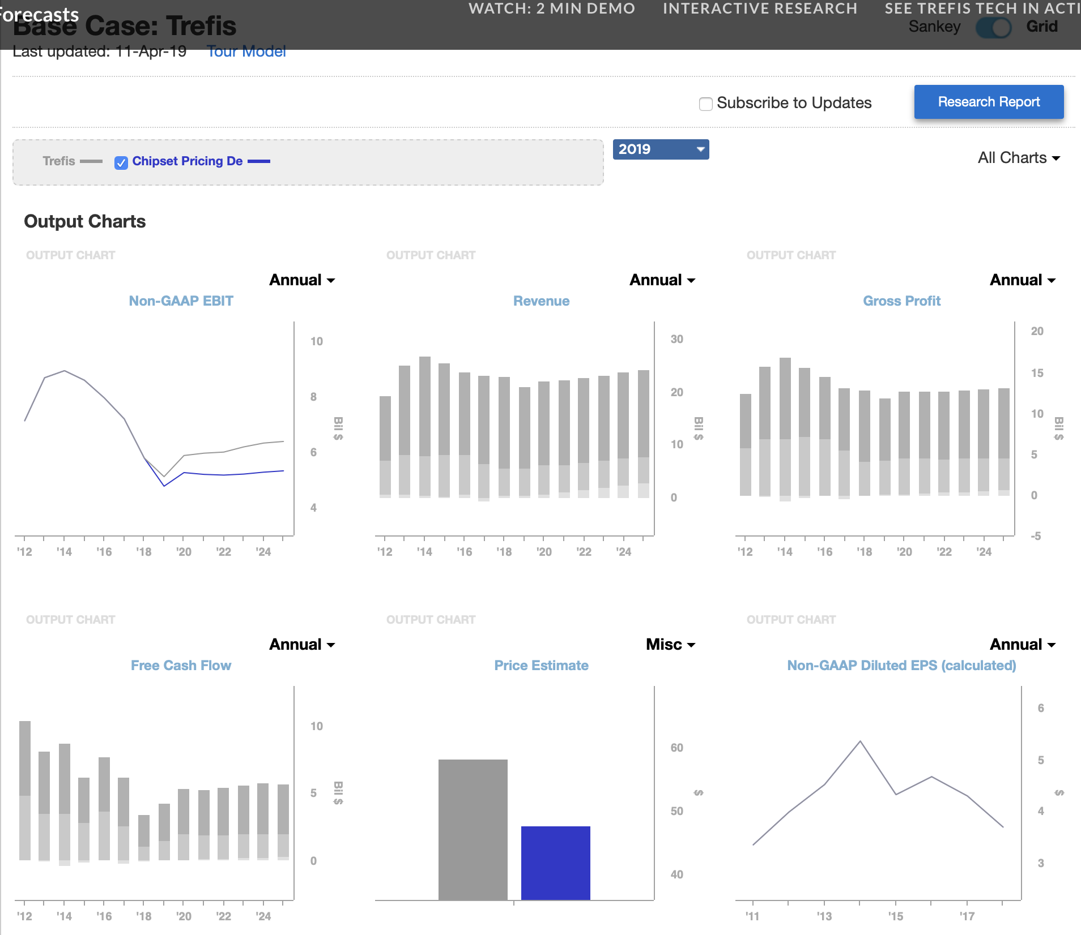
Qualcomm
From Trefis – note EBIT positiveness; Revenue up; FCF up (note from 4/11, before AAPL agrmt)

Slide 17
From QCOM 3/12/2019 Shareholder Mtng

Slide 18
From QCOM 3/12/2019 Shareholder Mtng

Slide 19
From QCOM 3/12/2019 Shareholder Mtng

Slide 20
Club Reco
Qualcomm's Bet on 5G Pays Off -- 2nd Update
BY Dow Jones &amp; Company, Inc. — 6:57 PM ET 04/17/2019
Through more than two years of takeover threats and legal strife, Qualcomm Inc. (QCOM) trained its focus on the future promises of 5G. That fixation is paying off so far.
The chip maker's lead in fifth-generation wireless technology persuaded the Trump administration last year to block a hostile bid by Broadcom Inc. (AVGO) out of national-security concerns. It helped muscle Apple Inc. to the table to settle a patent-royalty dispute on Tuesday and it contributed to Intel Corp.'s (INTC) decision to discontinue developing rival 5G modem chips for smartphones.
The success of Qualcomm's (QCOM) strategy -- accelerate spending on 5G while staring down existential threats -- has pushed up the company's stock 38% since Monday's close to $79.08, hitting highs not seen since 2014.
While the Apple deal removes a significant overhang, it doesn't clear away all of Qualcomm's (QCOM) challenges.

Slide 21
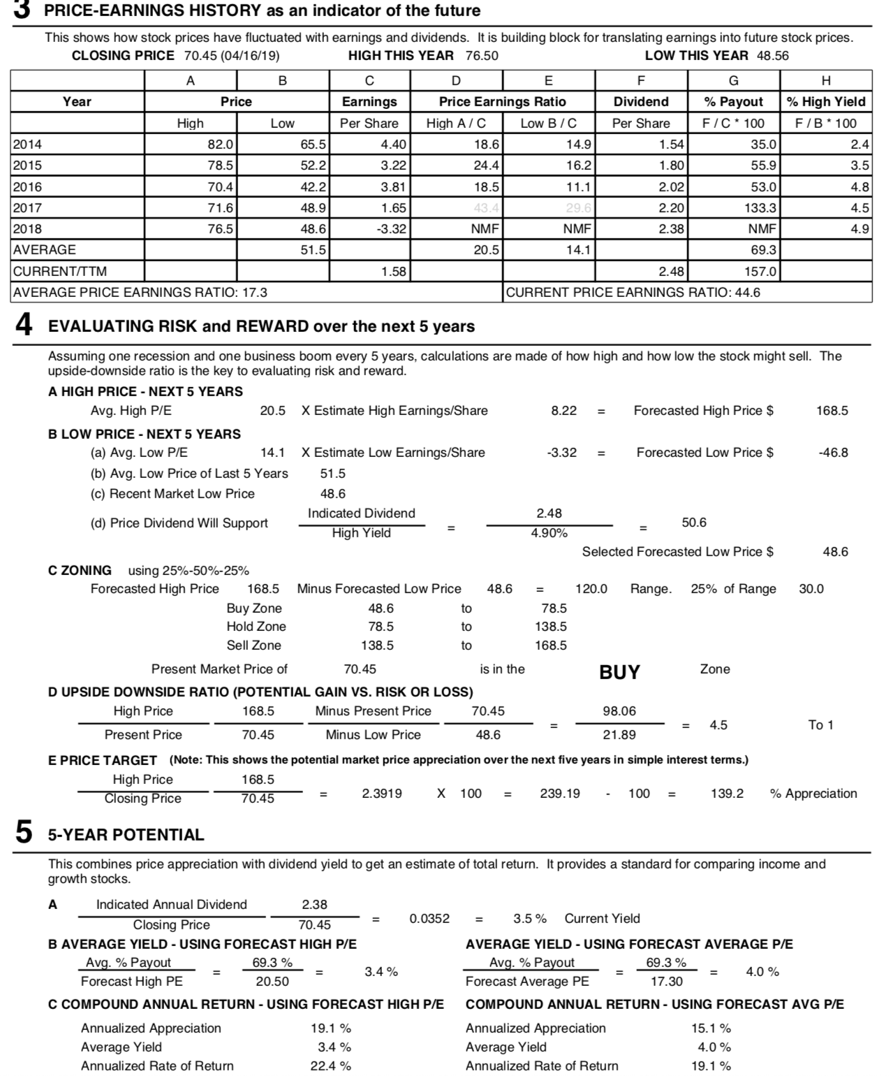
Our Draft SSG
Avg high PE – 20; low-14
EPS was $3.62 (see 10K and last slide from annual report PPT; actual EPS is showing as negative in SSG due to taxes – see further next slides)

Slide 22
Club Reco
Buy QCOM
May 1 earnings report is coming up
Lot of analysts have updated 12 month price target
We need to think about a 3-5 yr price, which is what SSG will help us with
There is a lot of growth to 5G and QCOM being first ready with chipsets is ready to capture this
For future revisions (6G, etc. they’ll still be in the front row seat)

Slide 23
BACKUP

Slide 24
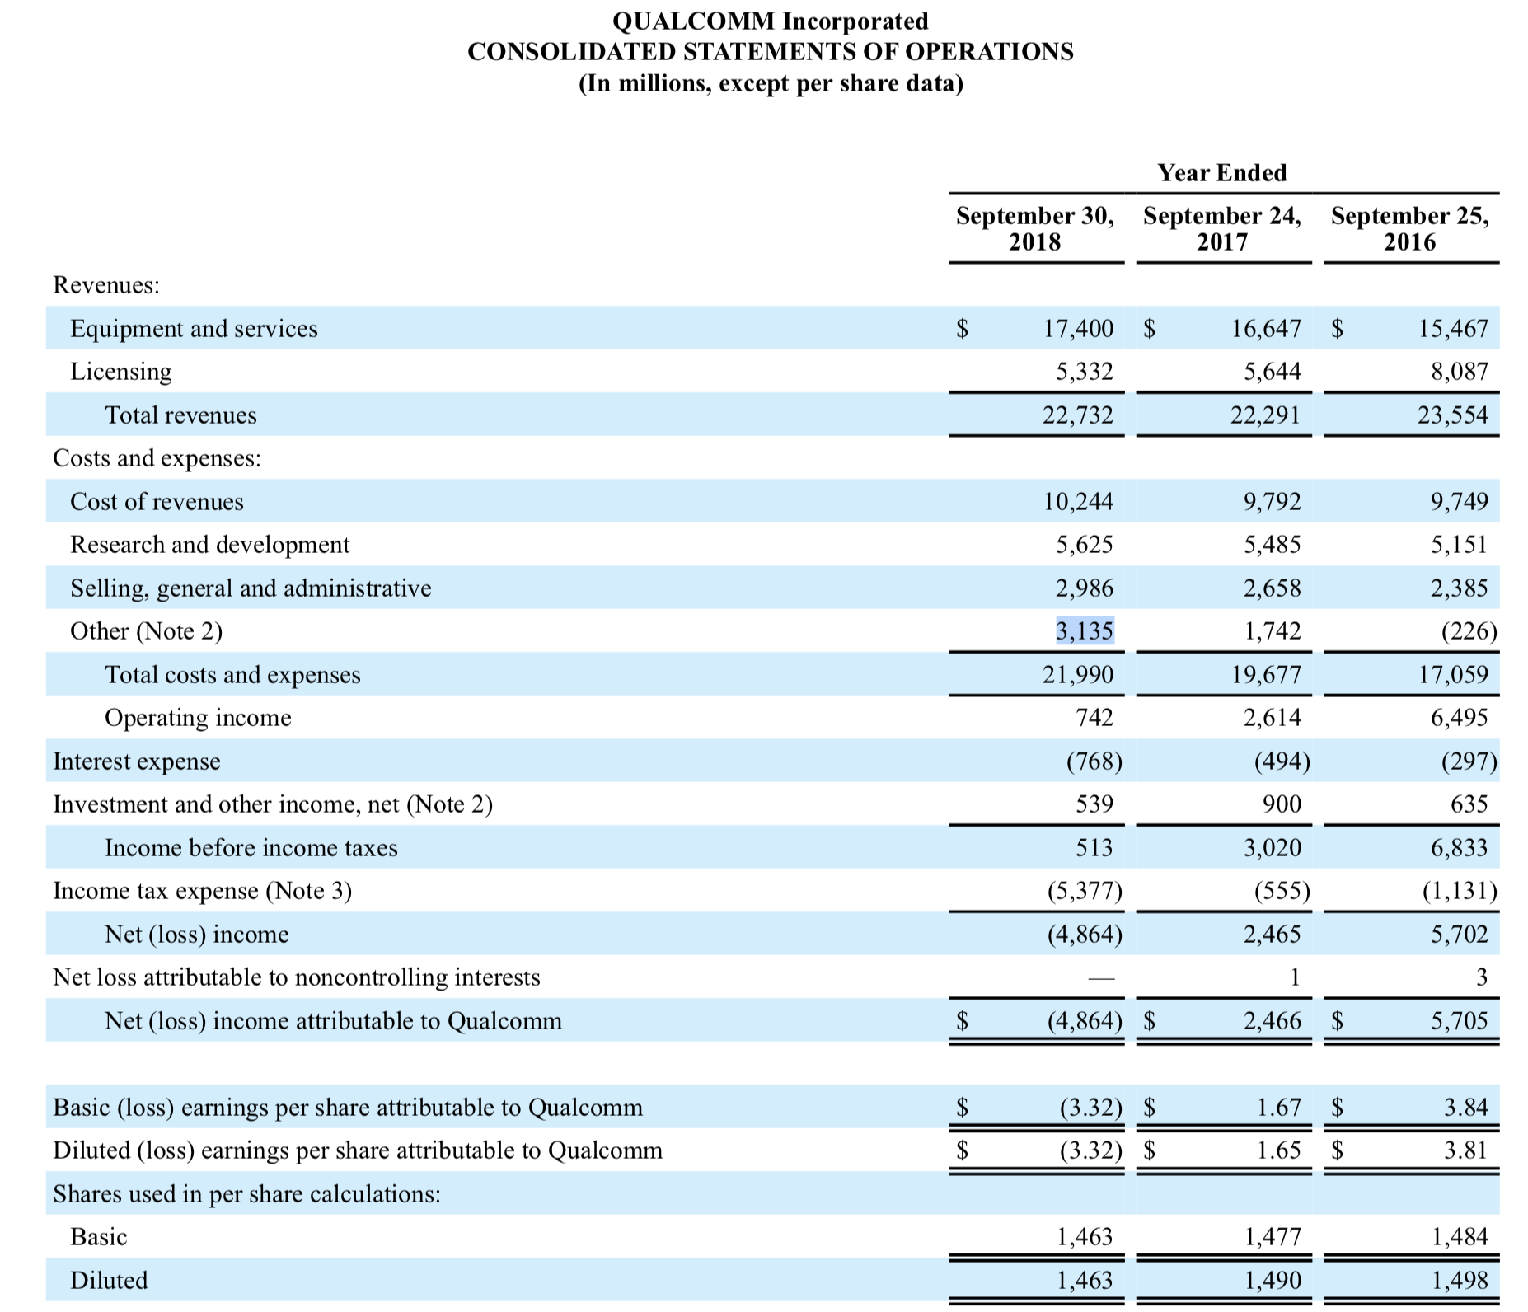
10K
Interesting $3.1 B ‘other expense
Also, Tax $5.4B note 3

Slide 25
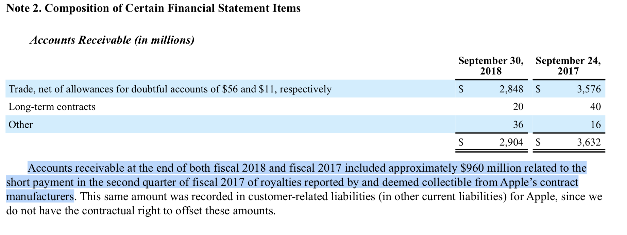
10K
Note 2 – Apple’s supplier owe $0.96 Billion

Slide 26
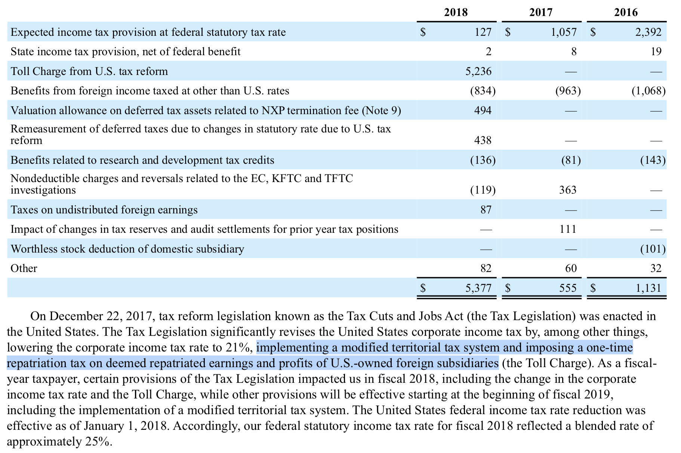
10K
Note 3– with Tax cut, I think QCOM repatriated earnings/profits.
One-time…

Slide 27
QCOM 10K from 2018-Sep
In searching ”Apple” in 2018 10K for QCOM
146 results

Slide 28
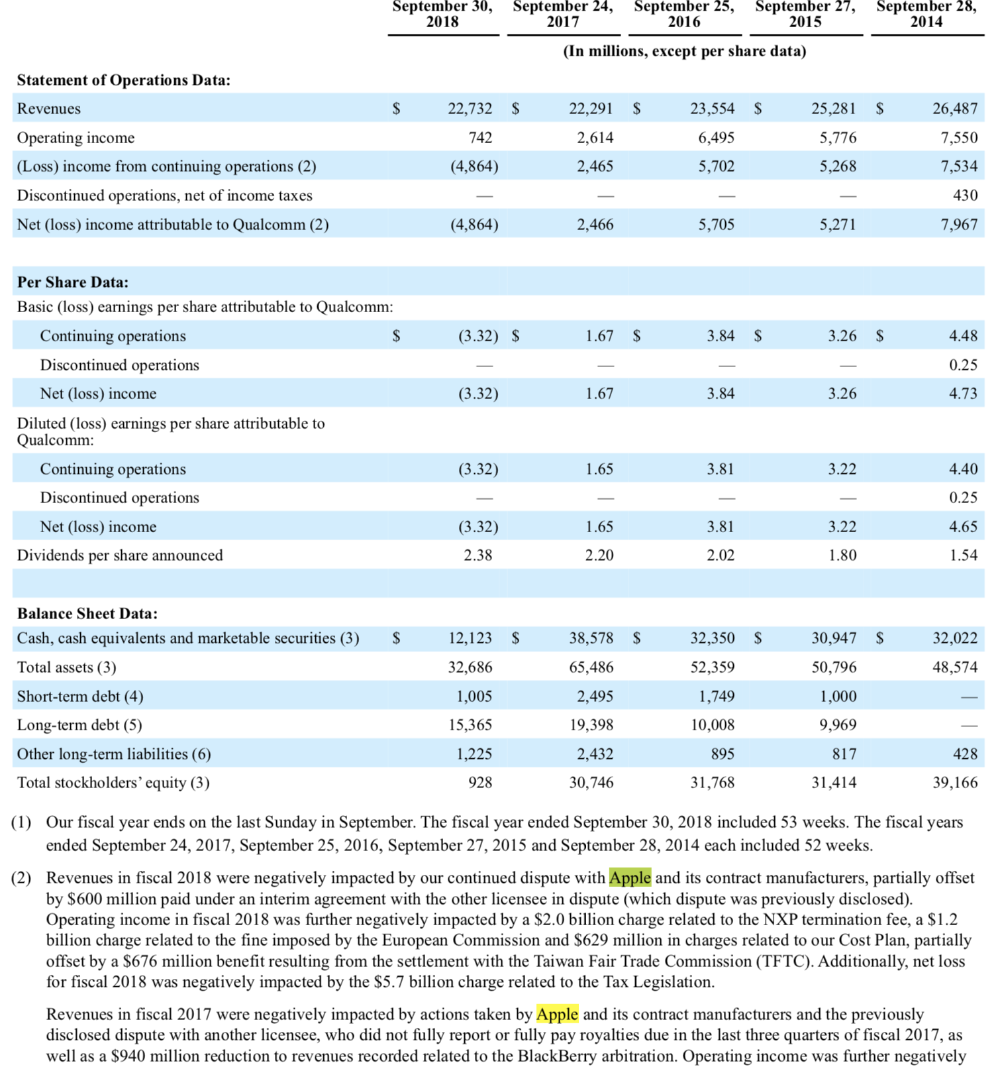
QCOM 10K from 2018-Sep
2017 and 2018 revenues impacted from AAPL
EPS was around $3.81/3.22/4.65 in 2015/15/14

