Slide 1
Bank Industry Study
Jun 15, 2019

Slide 2
Industry Background Review
Why financials?
  Diversification
  Some good PAR (percentage annual return) potential
Other industries/companies considered
  Defense
  Looked at top quality companies with PAR>15% in Manifest
  GOOG, Spirit (SAVE), FAST, AL come up on the list
Notes:
Sudip will cover background

Slide 3
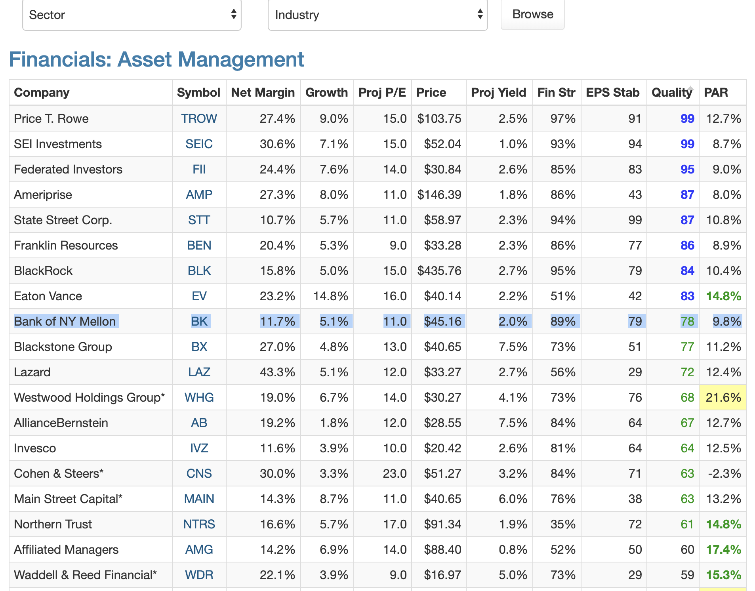
Manifest Scan, Financials – asset mgt (quality sort), 5/28/19
Notes:
Sudip will cover background

Slide 4
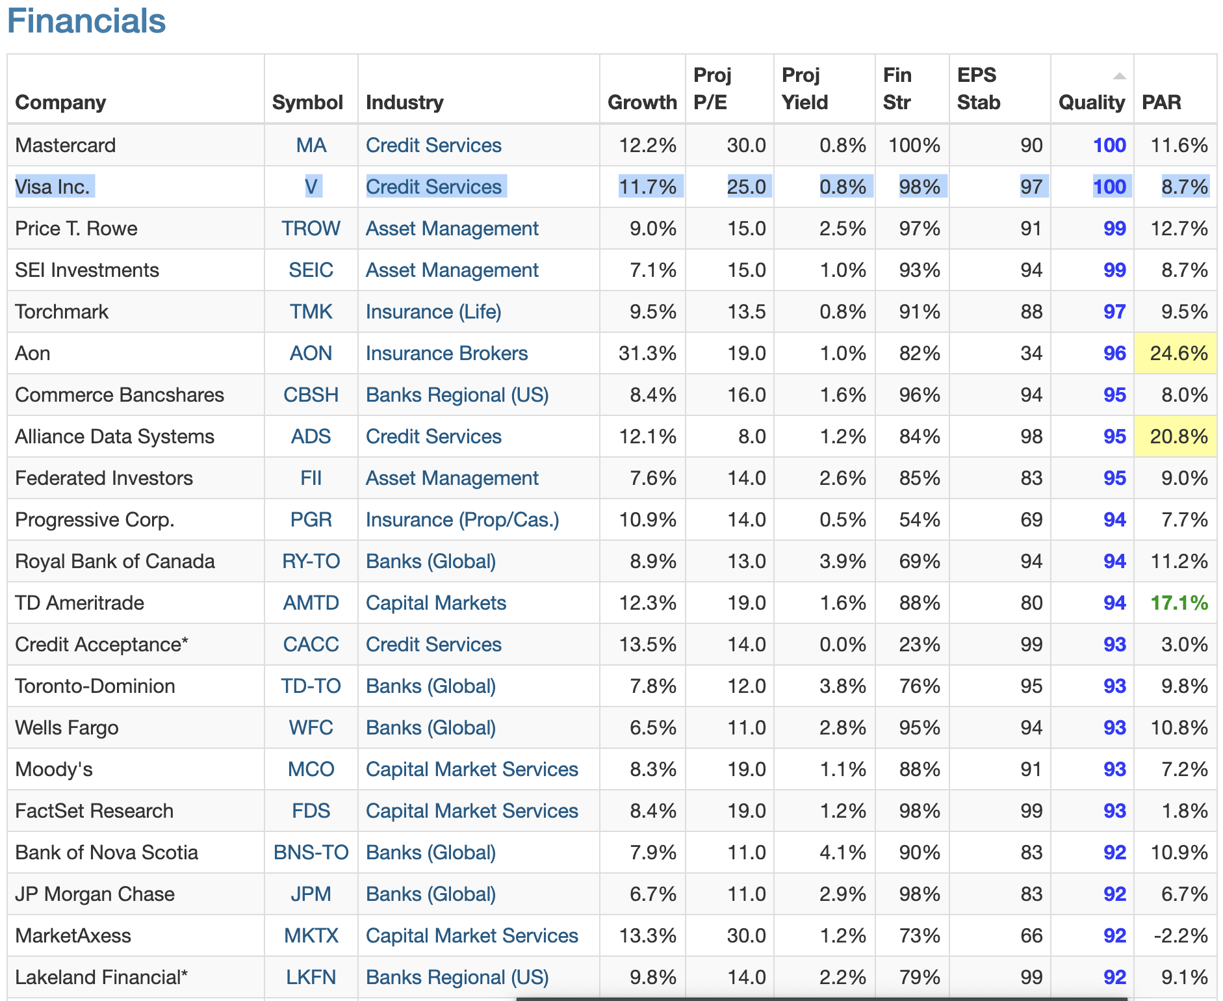
Manifest Scan, Financials (quality sort), 5/28/19
Notes:
Sudip will cover background

Slide 5
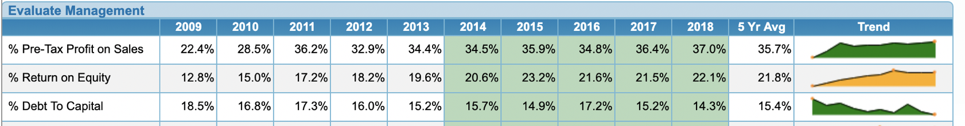
Deeper dive and SSGs done on:
Royal Bank RY-TO
  We liked RY-RO the most
  The debt-to-capital is fairly low at about 14% (vs >60% for some banks)
  Diversifies our portfolio, into banking and also a steady Canadian company
  We would buy the ADR’s of this foreign bank
Toronto-Dominion TD-TO
  Debt to capital ratio much higher than RY-TO
East West Bancorp EWBC
  Attractive bank; Chinese American higher customer base; had higher PE’s
Notes:
Sudip will cover background

Slide 6
Royal Bank Of Canada Overview
Headquartered in Toronto, Ontario led by CEO David McKay
Canada largest bank by market capitalization
One of North Americas largest diversified financial companies
Top 15 Bank globally based on market capitalization in over 36 countries
Over 84,000 employees and serves 16 million clients
Notes:
Aaron to cover starting at slide 6….
Source: Company web site

Slide 7
RBC Strategic Goals
To be Canada undisputed leader in financial services
To be preferred partner to corporate, institutional, and high net worth clients in the United States
To be a leading financial service partner valued for our expertise globally
Notes:
Source: company web site

Slide 8
RBC Key Business Segments
Residential mortgages account for over 49% of business
Personal loans account for 16% of business
Business and government loans account for over 31% of business
Other segments loans accounts for only 4% of business

Slide 9
RBC Corporate Governance
12 member board of directors
Non employee Kathleen Taylor is Chair of Board
RBC is led by 30 year RBC insider CEO David McKay
Four U.S. citizens and Eight Canadians comprise board members
Notes:
Source: company web site

Slide 10
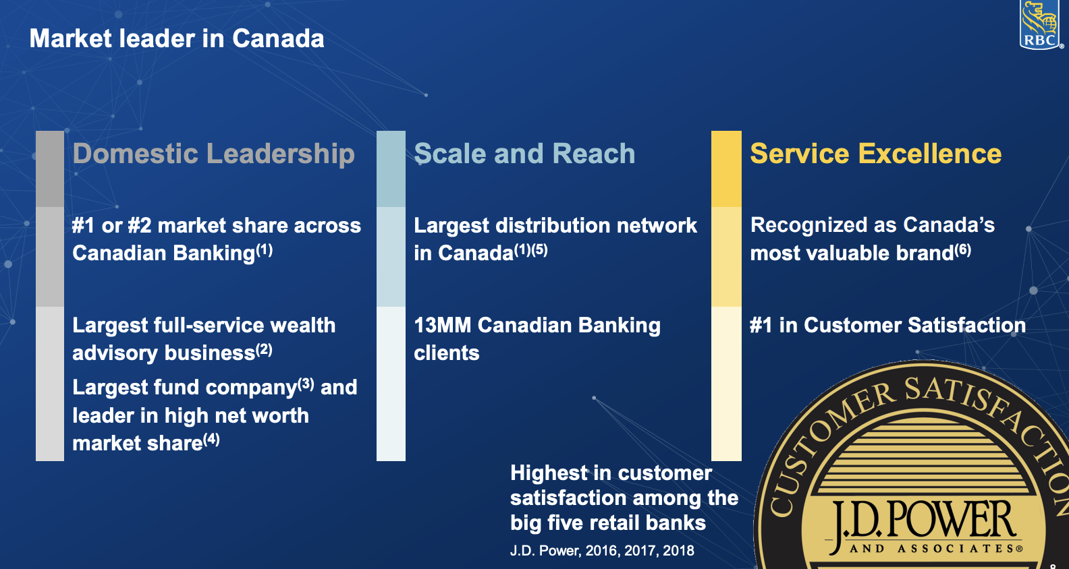
RY-TO Company Presentation Documents
Notes:
Source: RBC web site

Slide 11
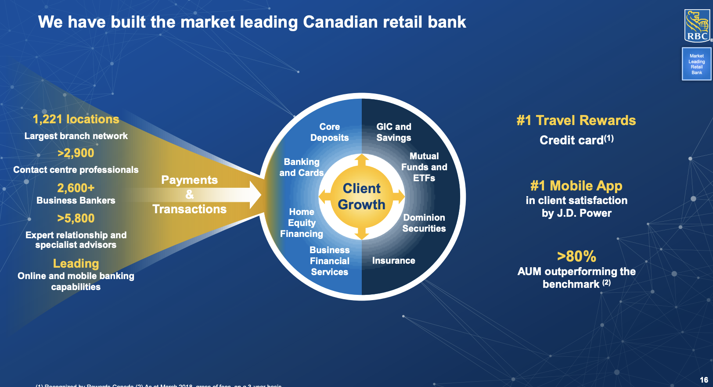
RY-TO Company Presentation Documents

Slide 12
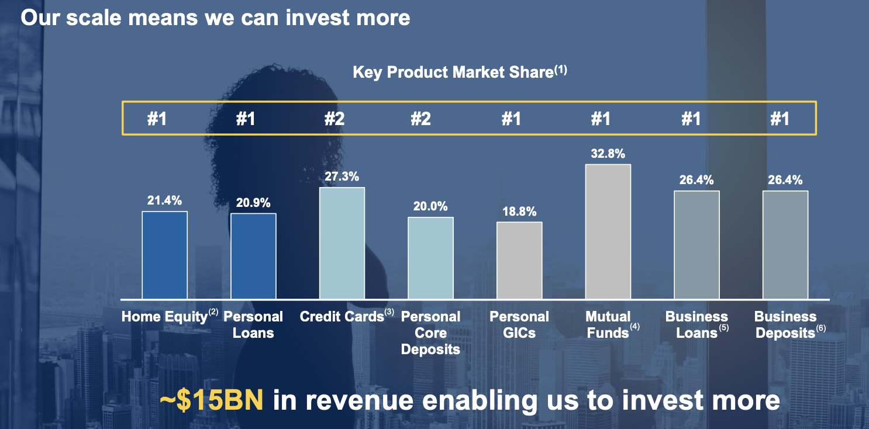
RY-TO Company Presentation Documents

Slide 13
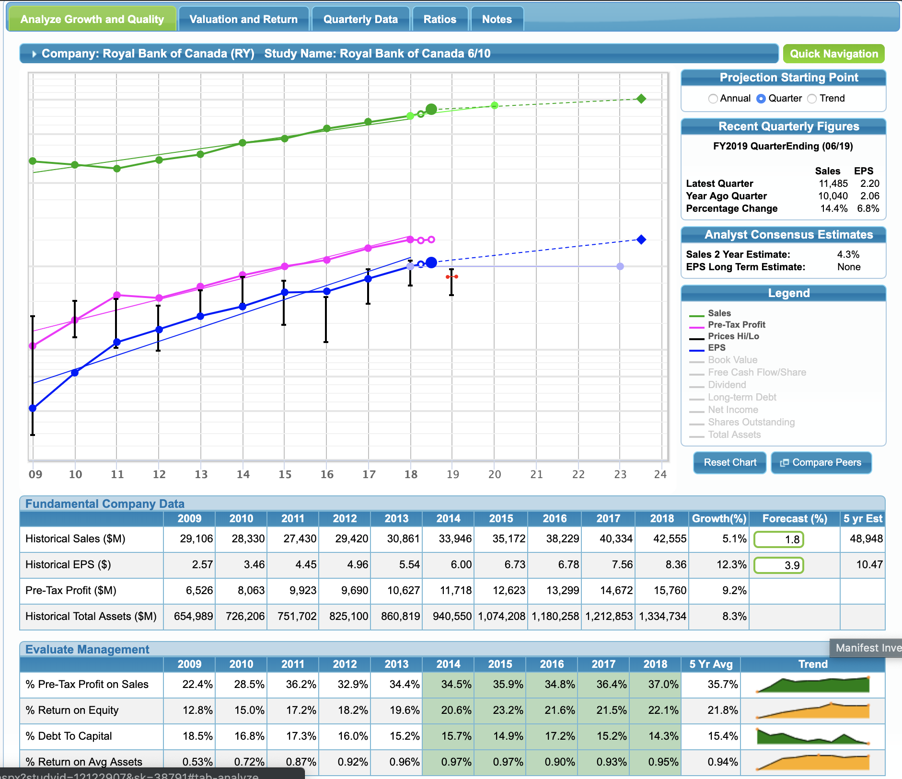
SSG for RY-TO
Notes:
Aaron to present SSG
1) talk about sales growth rate – historical and then forecast
2) Earnings per share growth rate. (10.47 EPS 5 yrs out is close to valueline estimate)
share next slide about CAD for earnings estimate…

Slide 14
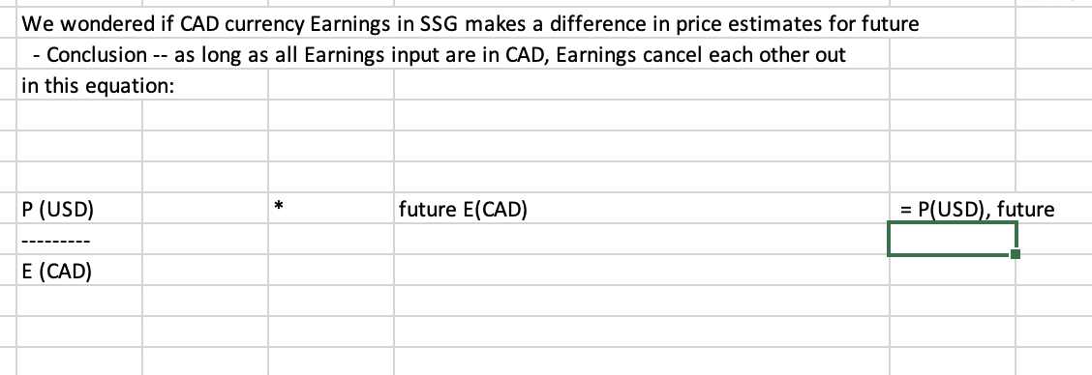
SSG for RY-TO - Note on Earnings being in CAD and impact to future price estimate

Slide 15
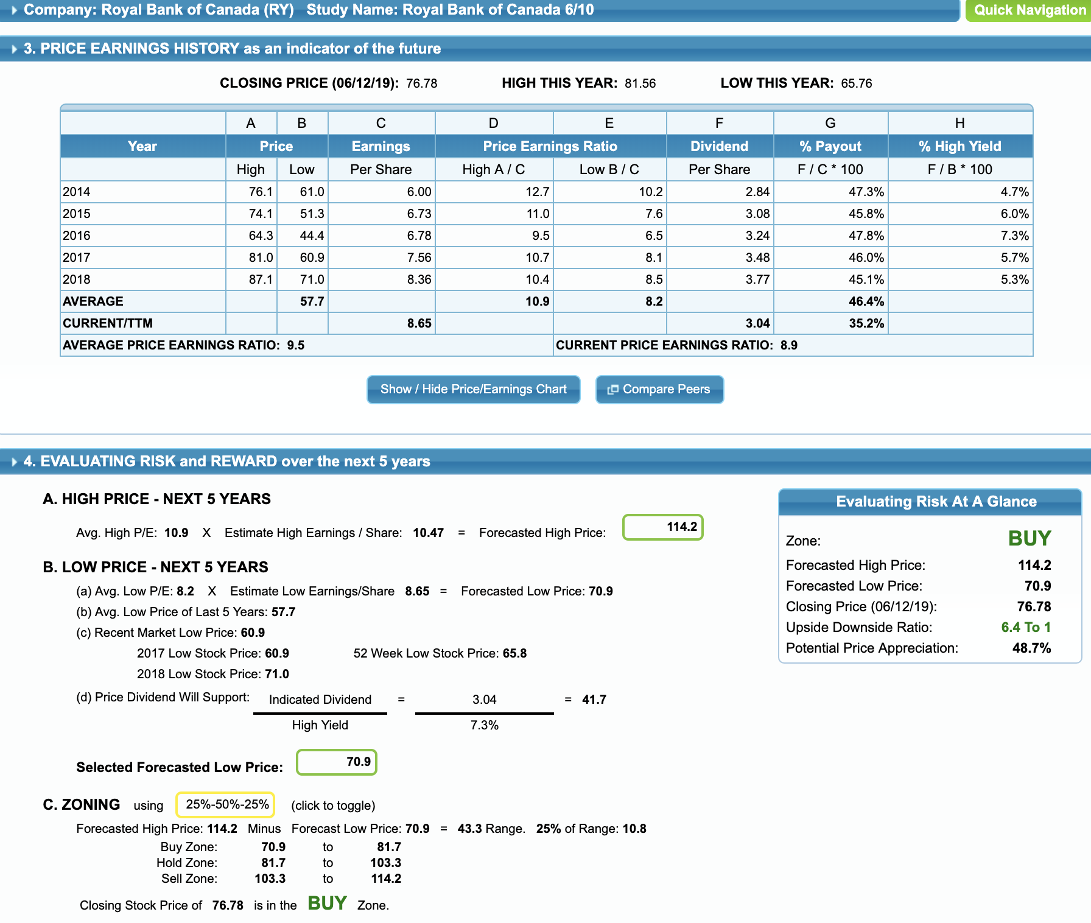
SSG for RY-TO
Notes:
Average high PE
Average Low PE
High price based on PE estimates
Low price based on trailing twelve month EPS of 8.65. x low PE of 8.2

Slide 16
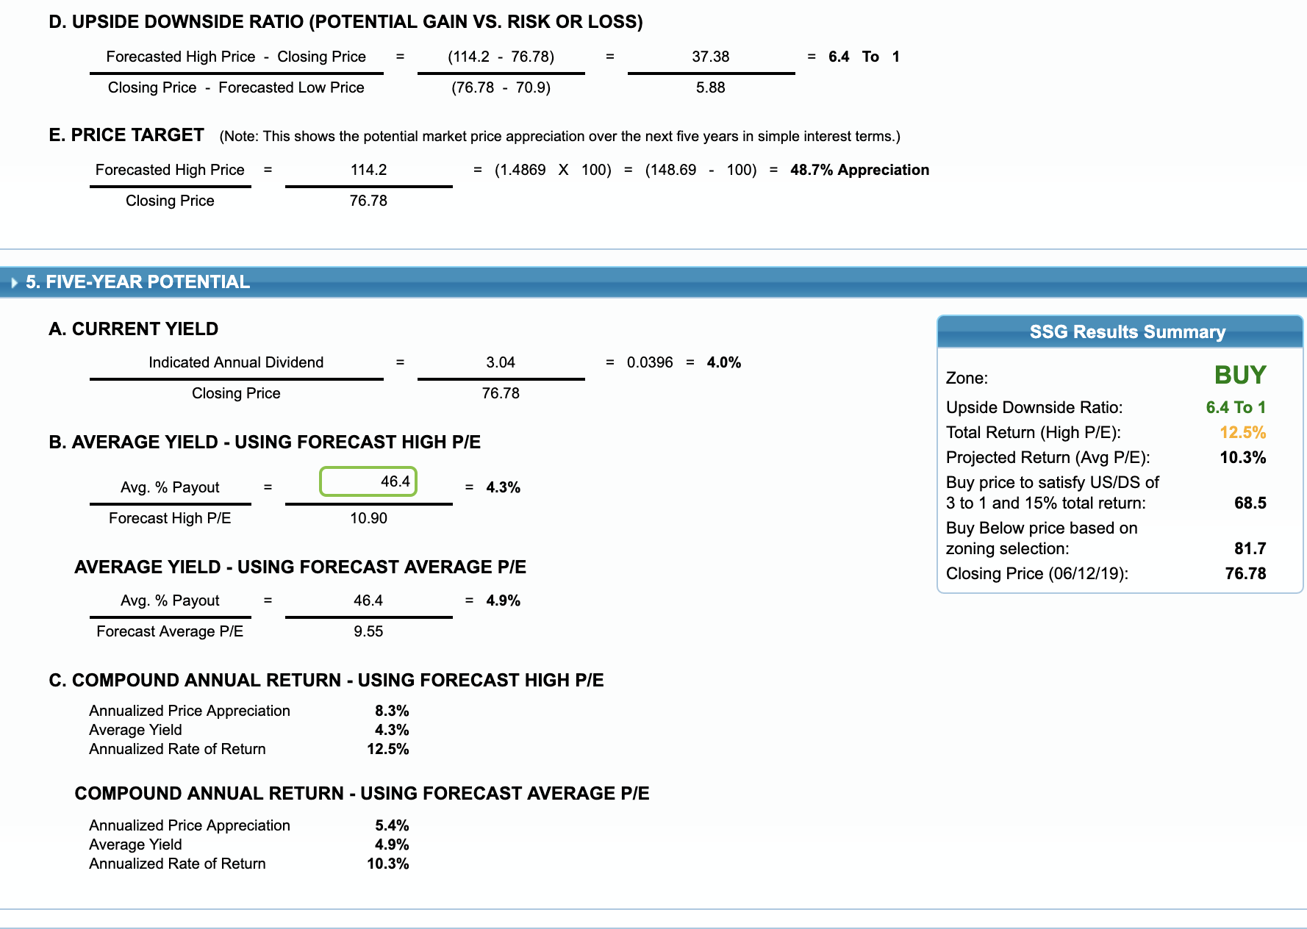
SSG for RY-TO
Notes:
Yield is strong at 4.9%
Overall annualized rate of return about 10.3%

