Slide 1
NAIC January 18th 2020 Meeting
Comcast & Facebook Stock Performance Presentation

Slide 2
Comcast Business Profile
Founded in1963 and Headquartered in Philadelphia, Pa leading national cable provider and Network T.V. provider.
21 million residential video subscribers in 39 states and D.C.
25 million internet service subscribers
10.2 million cell phone subscribers
Comcast is the sole owners of NBC/Universal theme parks in Orlando, Hollywood, and joint venture theme park in Osaka, Japan. Owns NBC, Telemundo, Msnbc, Cnbc, Bravo, USA Network and Universal Pictures Studio. Comcast recently purchase European T.V. Network Sky in 2018 with over 23 million subscribers.

Slide 3
Comcast 2022-24 Price Earnings Projections $18
 | 2013 | 2014 | 2015 | 2016 | 2017 | 2018 | 2019 | 2020
Sales Per Share | $ 12.45 | $ 13.58 | $ 15.25 | $ 16.92 | $ 18.20 | $ 20.88 | $ 24.45 | $ 26.10
Cash flow per share | $ 2.83 | $ 3.24 | $ 3.45 | $ 3.80 | $ 4.33 | $ 5.05 | $ 5.75 | $ 6.15
Earnings per share | $ 1.47 | $ 1.47 | $ 1.63 | $ 1.74 | $ 2.06 | $ 2.51 | $ 3.10 | $ 3.35
Dividens Per Share | $ 0.45 | $ 0.45 | $ 0.50 | $ 0.55 | $ 0.61 | $ 0.76 | $ 0.84 | $ 0.90
Capital Spending per share | $ 1.47 | $ 1.47 | $ 1.74 | $ 1.92 | $ 2.06 | $ 2.26 | $ 2.00 | $ 2.00
Book value per share | $ 10.41 | $ 10.41 | $ 10.70 | $ 11.35 | $ 14.77 | $ 15.82 | $ 17.80 | $ 19.72
Common shares | $ 5,063.20 | $ 5,063.20 | $ 4,884.80 | $ 4,751.60 | $ 4,526.00 | $ 4,526.00 | $ 4,525.00 | $ 4,500.00
Average Annul PE | $ 16.90 | $ 18.20 | $ 18.10 | $ 18.20 | $ 18.60 | $ 14.00 | $ - | $ -

Slide 4
Wall Street Analyst Projections
Overall, Harrigan’s estimate is for Comcast’s revenues to grow by 3.5% a year from 2018’s $94.5 billion. He sees adjusted Ebitda margins expanding 4.5 percentage points to 33.9% in 2023. That will drive a 6.6% annual growth rate in the company’s adjusted earnings before interest, takes, depreciation, and amortization through 2023, from $30.2 billion in 2018, according to Harrigan’s estimates.
Harrigan also sees Comcast resuming share buybacks in 2020, after halting the payouts to focus on debt reduction after acquiring Sky. The buybacks, together with growing profits, will help Comcast’s adjusted earnings per share to increase at annual percentages in the low teens through 2023, he estimated.
Several other Wall Street analysts have been bullish on Comcast stock in recent months. Overall, 88% have a Buy or equivalent rating, while 13% recommend a Hold. No analysts rate Comcast stock Sell. Their average price target is $50.57, close to 11% above the stock’s recent value. The stock has a 1.8% dividend yield.

Slide 5
Barrons, Dec. 2019
Here’s the case for Comcast (ticker: CMCSA).
Comcast
Cable TV has emerged as a great business in recent years. And most cable companies have focused on their lucrative high-speed internet services. But the leader, Comcast, has pursued a diversification strategy, highlighted by its acquisition of European satellite provider Sky last year.
Comcast also plans to invest $2 billion over the next two years to start a streaming service called Peacock, which will use programming from its NBCUniversal division.
Wall Street doesn’t like Comcast’s approach and prefers No. 2 Charter Communications (CHTR), which uses its free cash flow for an aggressive share-repurchase program.
Comcast stock, at $44, is up 30% this year and has trailed the overall market in the past five years. Charter has climbed 68% in 2019 and has crushed the S&P 500 over the past five years. But Comcast now looks like the better bet. It trades at a discount to Charter, based on pretax cash flow, and carries less risk because of its lower debt-to-cash-flow ratio. Comcast fetches just 13 times projected 2020 earnings.
“We believe the shares are inexpensive, relative to peers, especially given the quality of the company’s assets,” wrote Credit Suisse analyst Douglas Mitchelson. He expects Comcast’s buybacks to restart in 2021 after the cable operator pays down debt related to the Sky deal. He has a price target of $55 on the stock, which he rates Outperform.

Slide 6
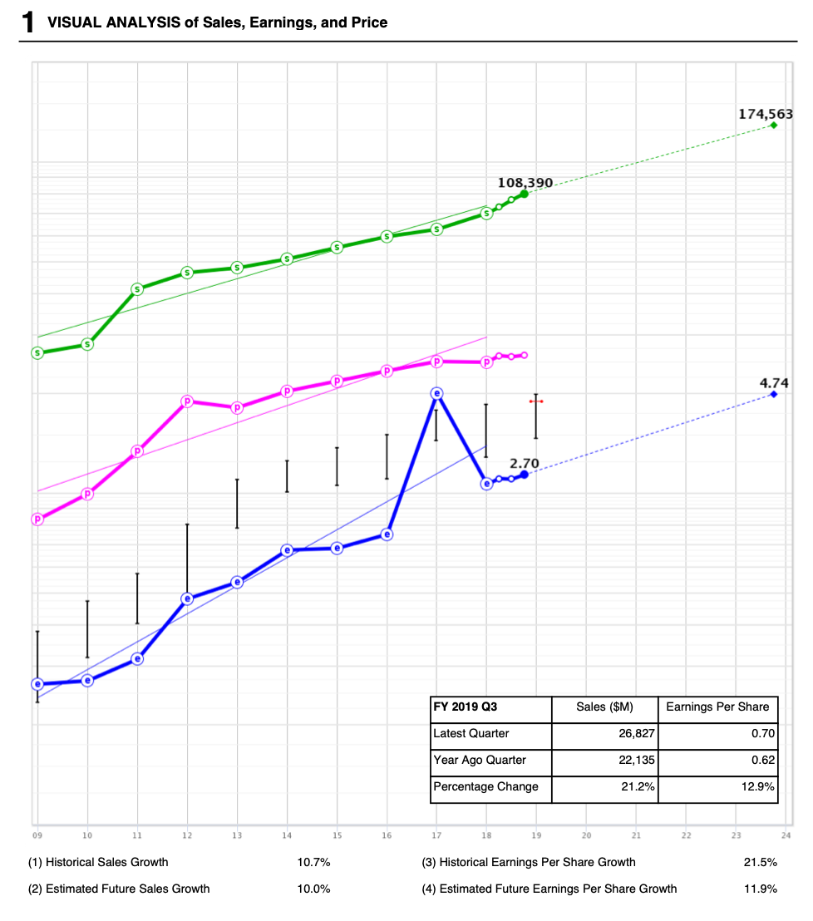
CMCSA, Comcast
Good railroad track growth

Slide 7
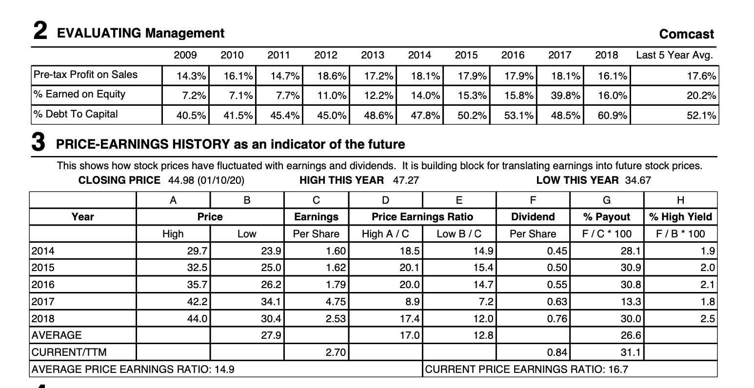
CMCSA, Comcast
x

Slide 8
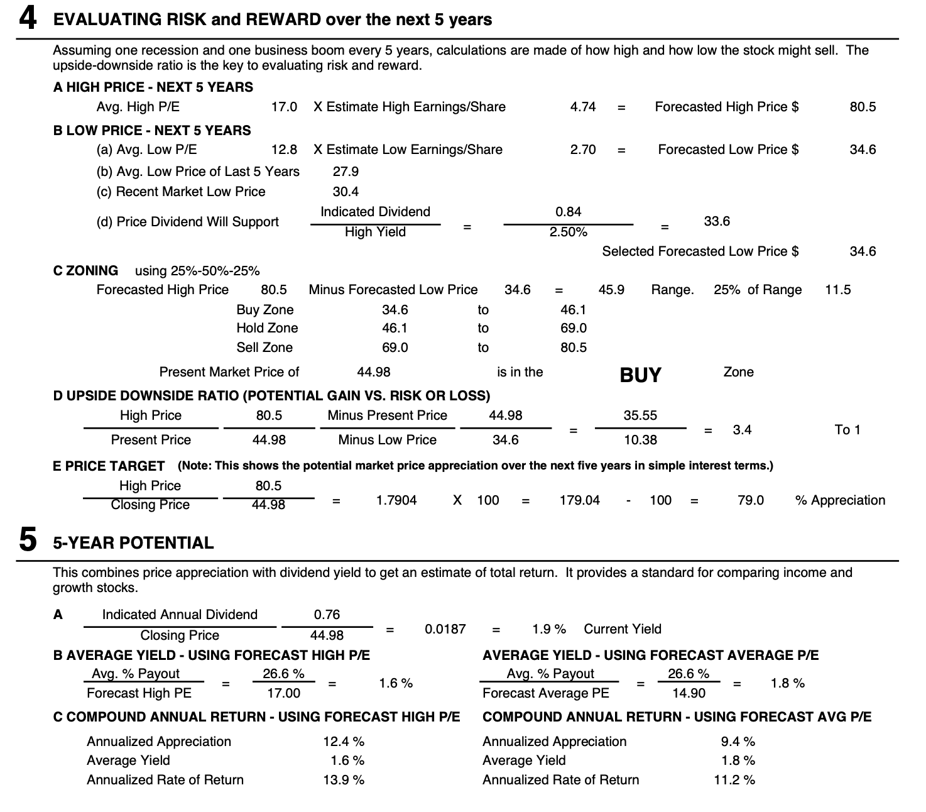
CMCSA, Comcast
Strong 13.9% PAR

Slide 9
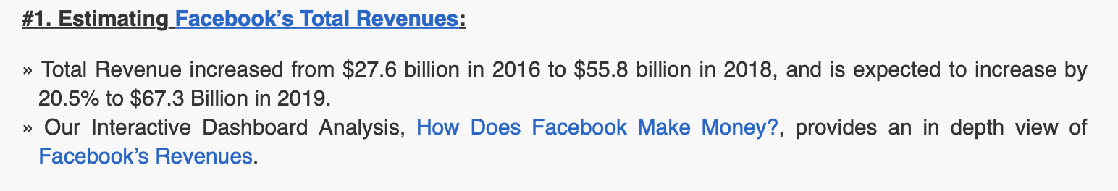
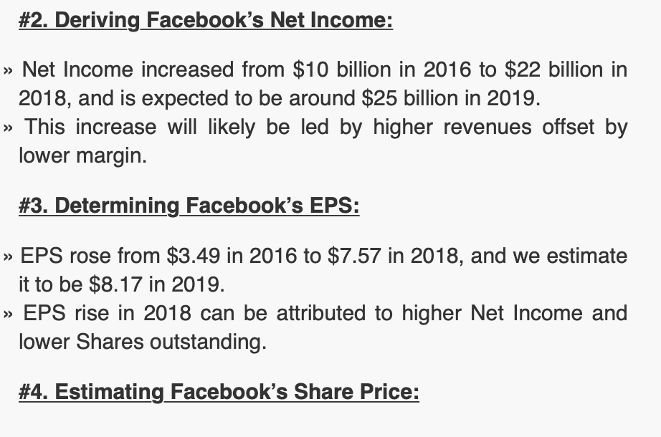
Facebook
Trefis

Slide 10
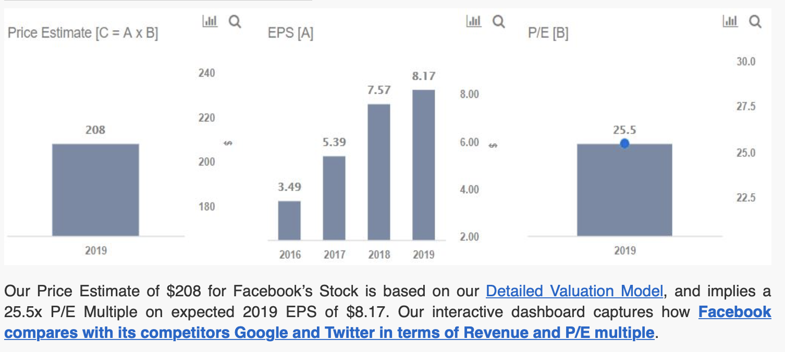
Facebook
Trefis

Slide 11
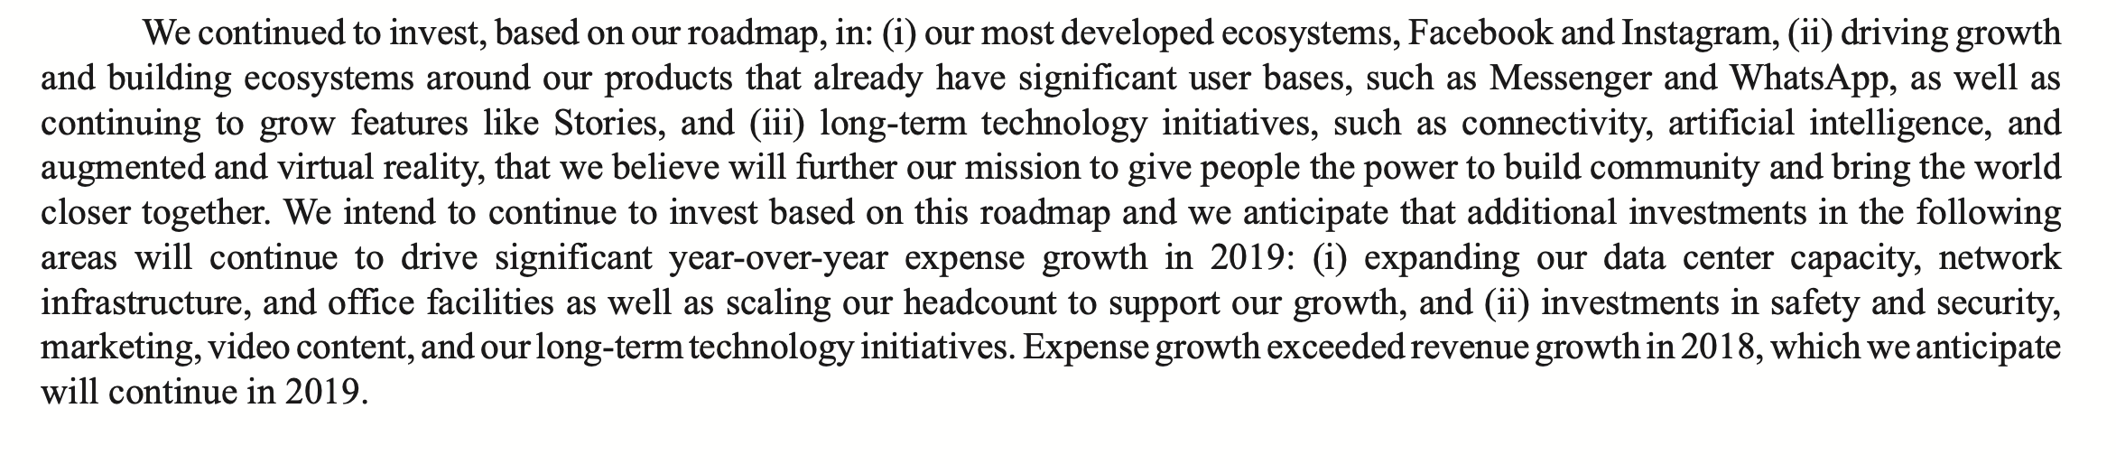
Facebook
Annual Report, 2018 (released 1/2019)

Slide 12
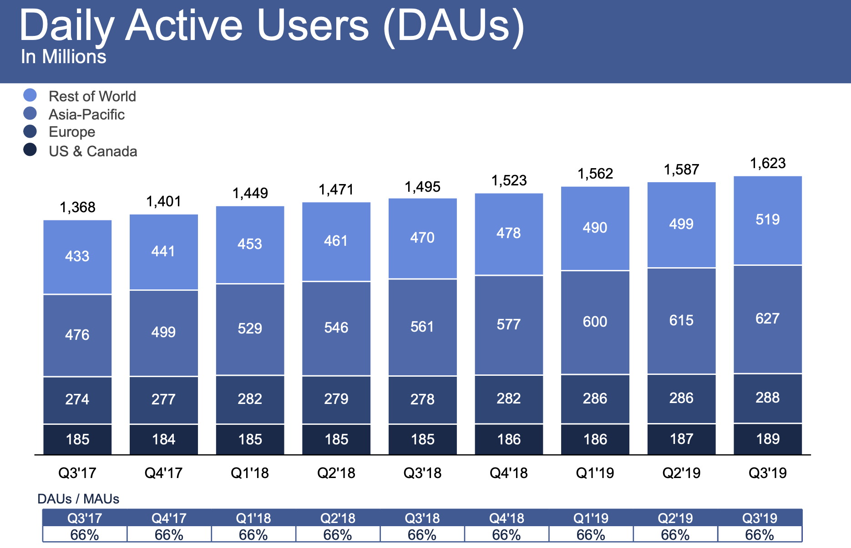
Facebook
Q3 2019

Slide 13
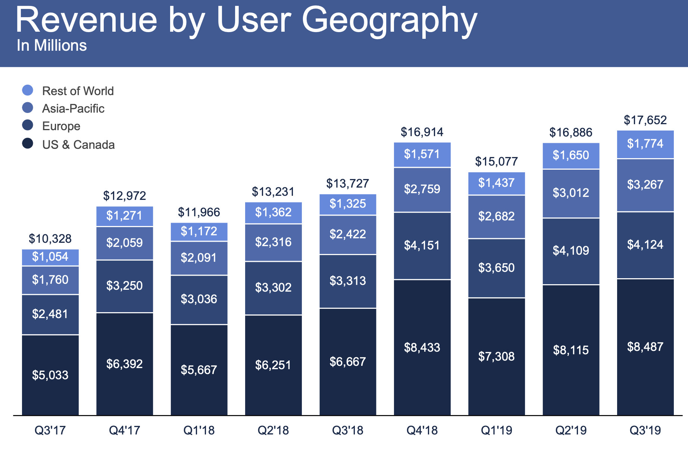
Facebook
Q3 2019

Slide 14
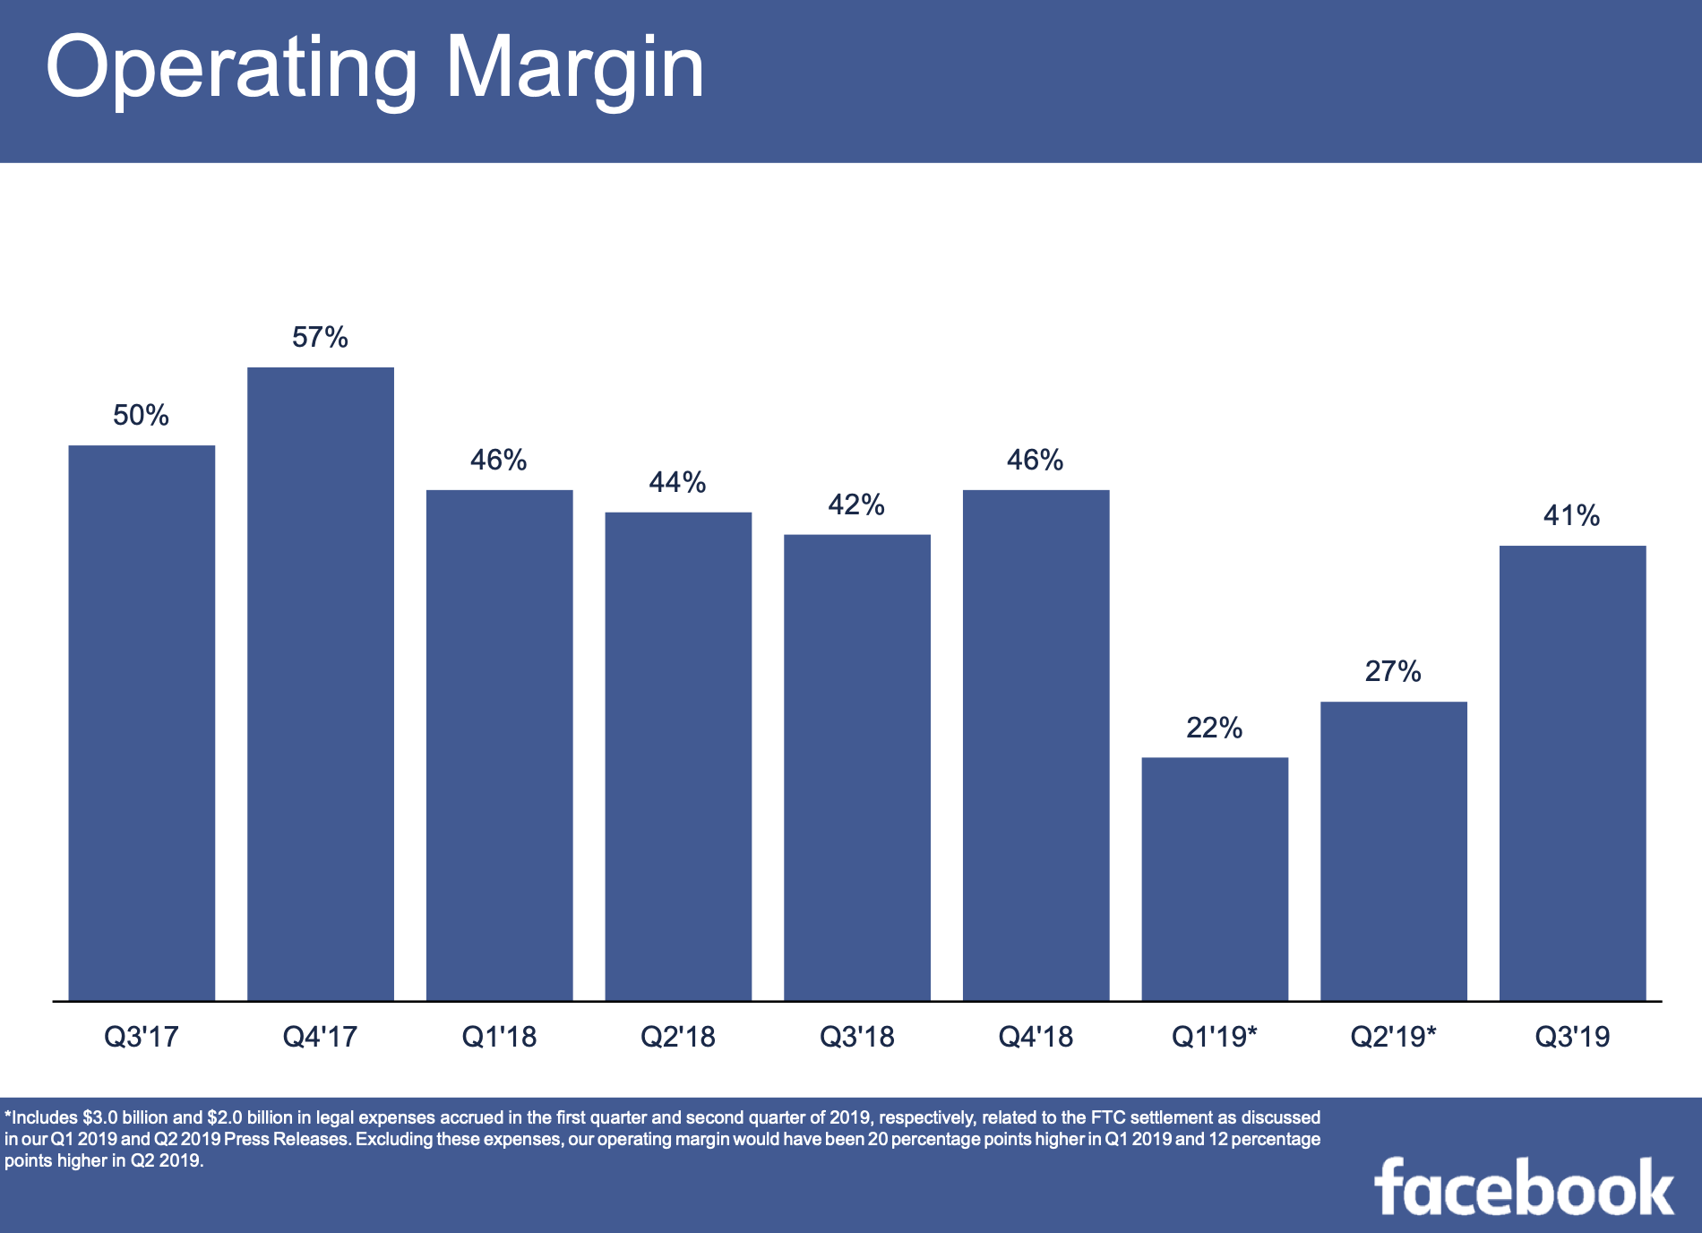
Facebook
Q3 2019

Slide 15
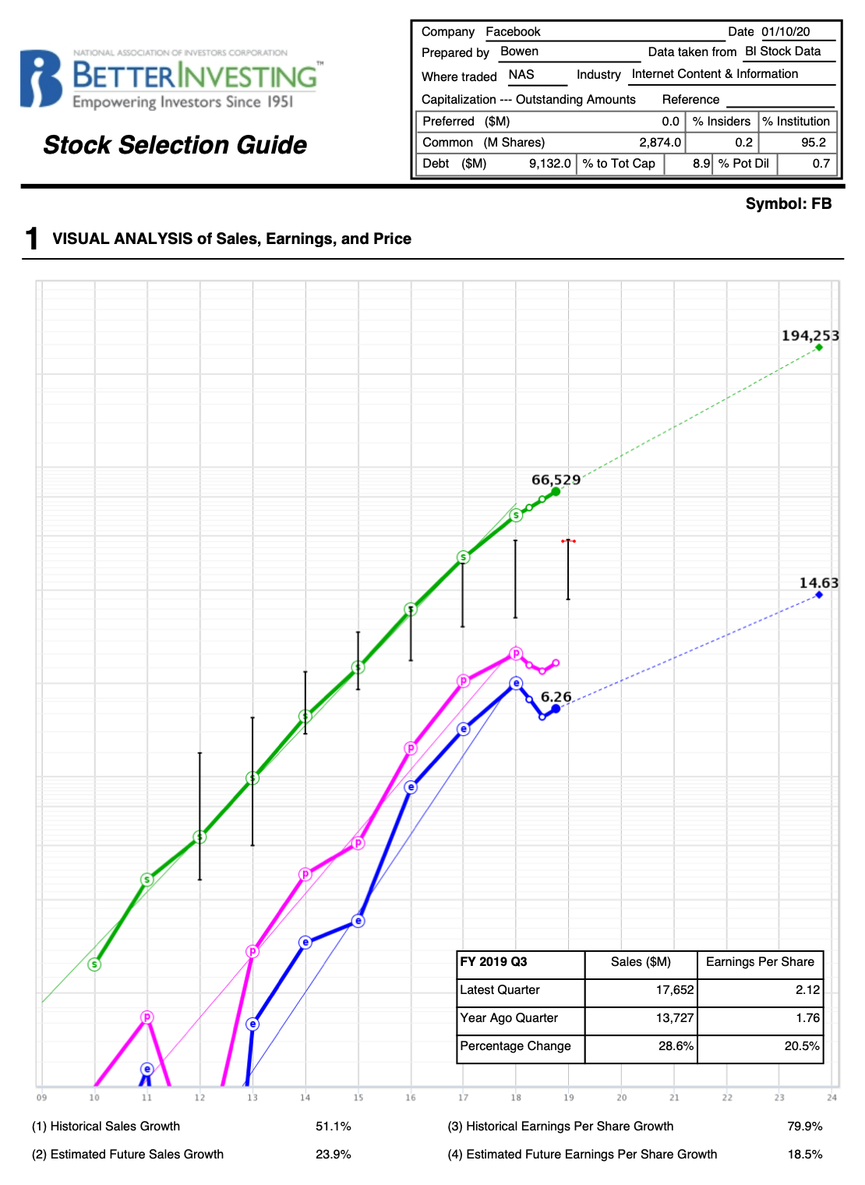
Facebook
Strong railroad growth
Little hiccup in PTP, EPS in 2019, but due to high Capex & investment in people (R&D, security, etc.)

Slide 16
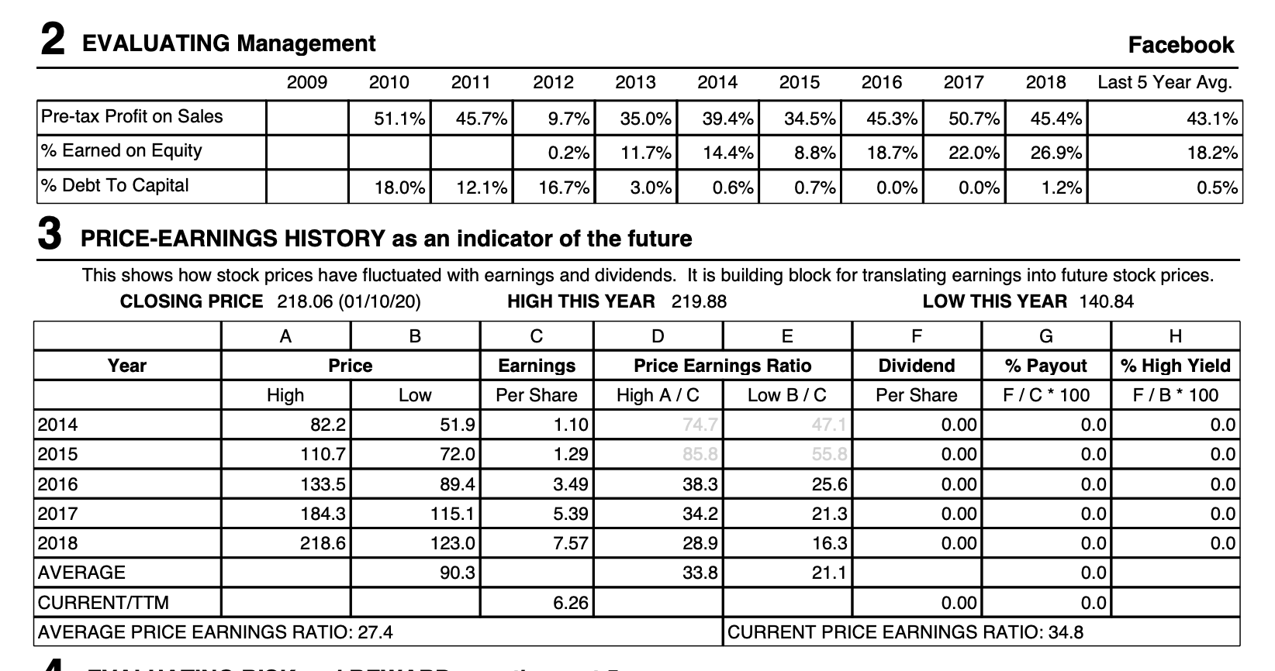
Facebook
Strong mgmt. results
PE stable

Slide 17
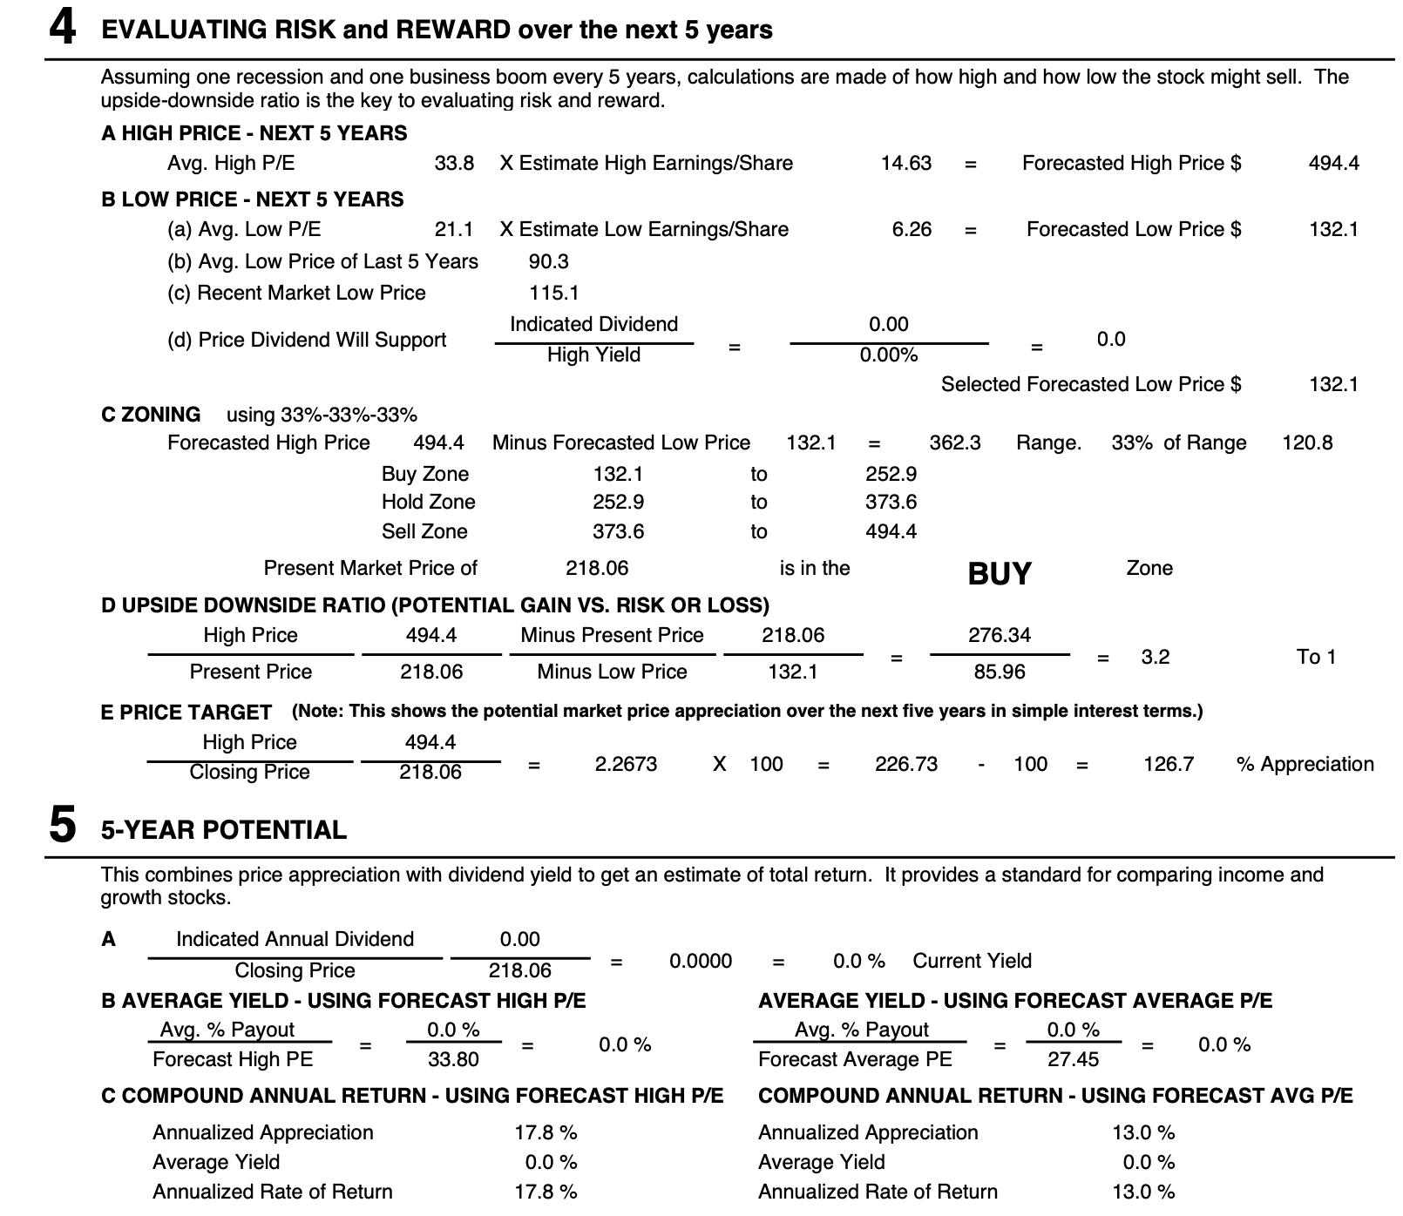
Facebook
Strong 18% PAR potential

Slide 18
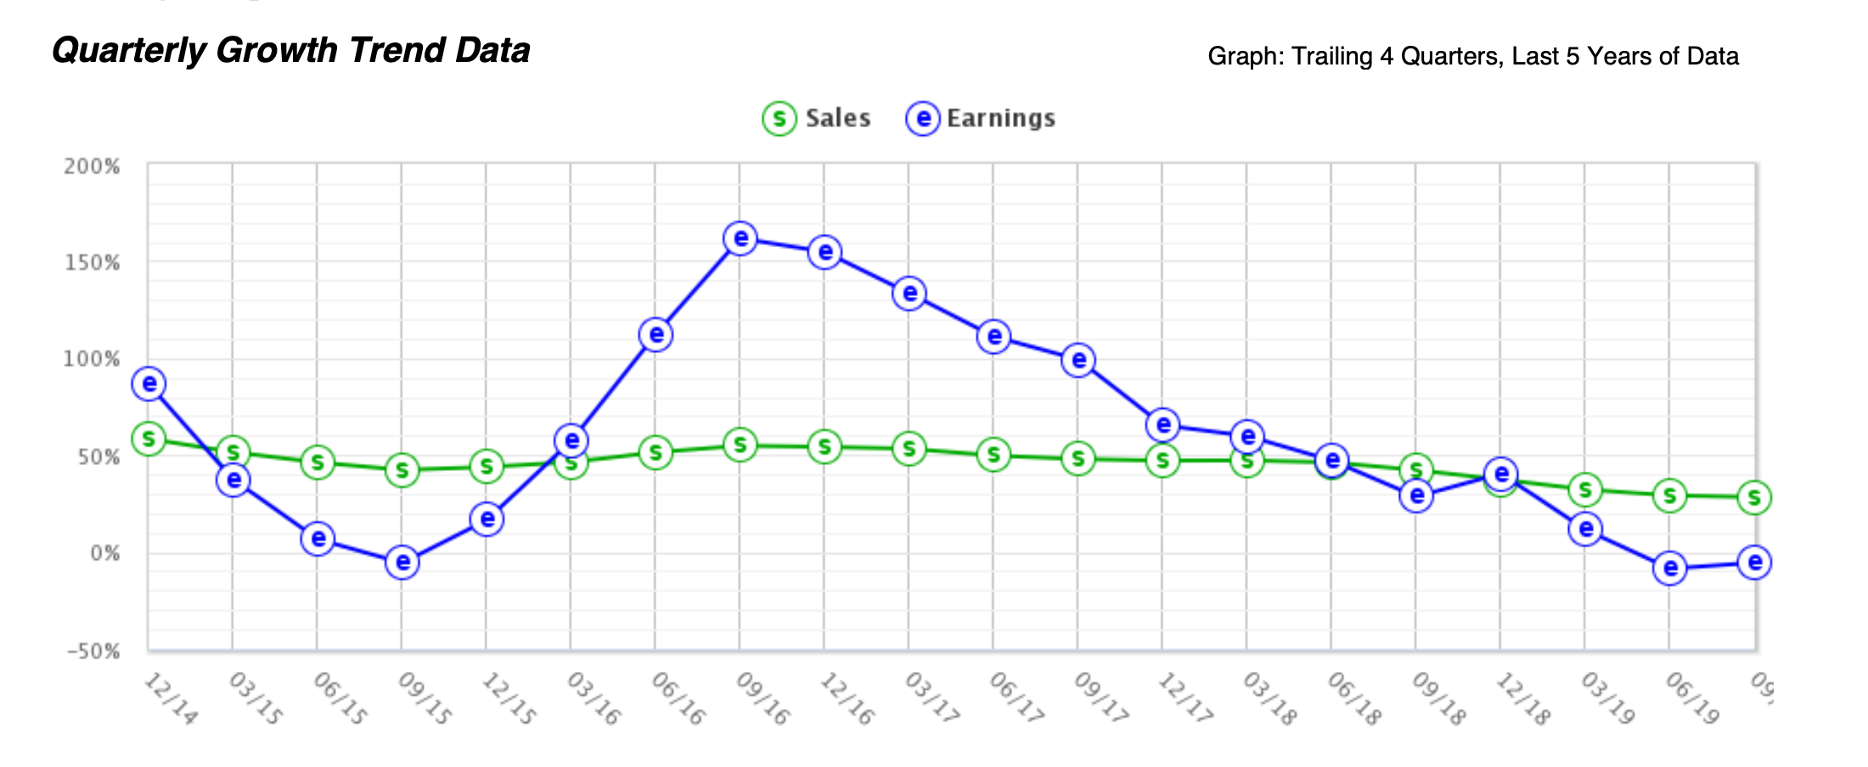
Facebook

Slide 19
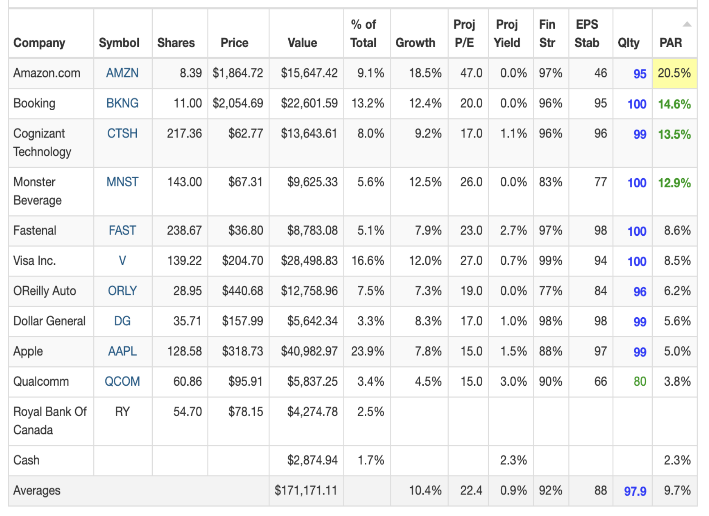
Proposal 1/18/2020
$2875 in cash
24% of holdings in AAPL
Proposal:
Sell AAPL, or 66 shares ~$21,000 ; Manifest PAR 5%
C)
Buy 225 Comcast approx $10,500, 13% PAR
Buy 50 shares FB approx $10,500, 17.8% PAR

