Slide 1
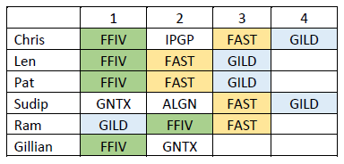
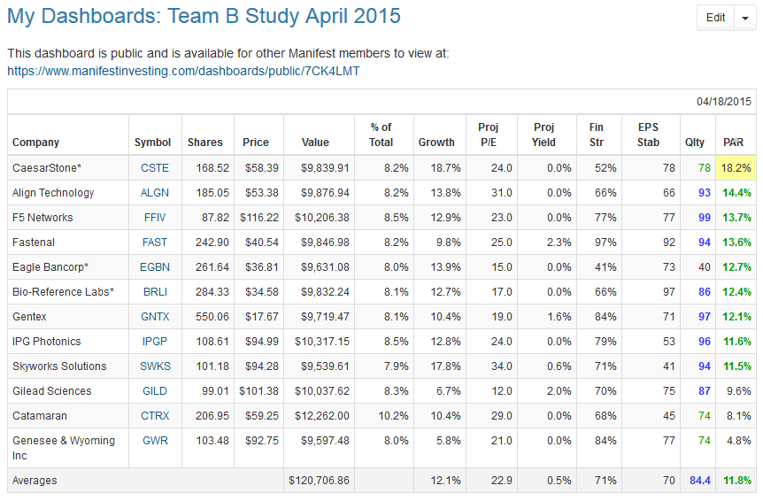
Initial Candidate List

Slide 2
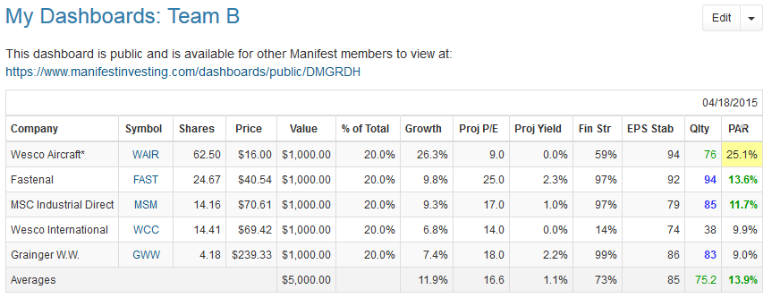
Prospector Screen Results

Slide 3
Team B Stock Study Industrial Distribution: MRO Market Participants
By
Pat Deak , Len Douglass, Ram Ganapathi,
Chris Rolls, Sudip Suvedi, Gillian Todd
04/18/2015

Slide 4
Industrial Distribution: Maintenance, Repair and Operations (MRO) Market
MRO US Market is valued at ~$150B.
Role of Industrial Distributors:
Many manufacturers do not have the scale to evaluate and select products from 1000s of vendors and 1Ms of SKUs.
Serve manufacturing customers by evaluating, recommending and supplying MRO products & services needed precisely and fluidly.
Serve product vendors by providing salesforces and distribution networks.
Fragmented Market.
Top 50 distributors represent only ~30% of the market.
Largest players: GWW (6.7%), FAST (2.5%), MSM (1.8%), WCC (5.3%).

Slide 5
Industrial Distribution: Maintenance, Repair and Operations (MRO) Market
Performance to some degree follows:
ISM Manufacturing Index performance.
Non-farm payrolls.

Slide 6
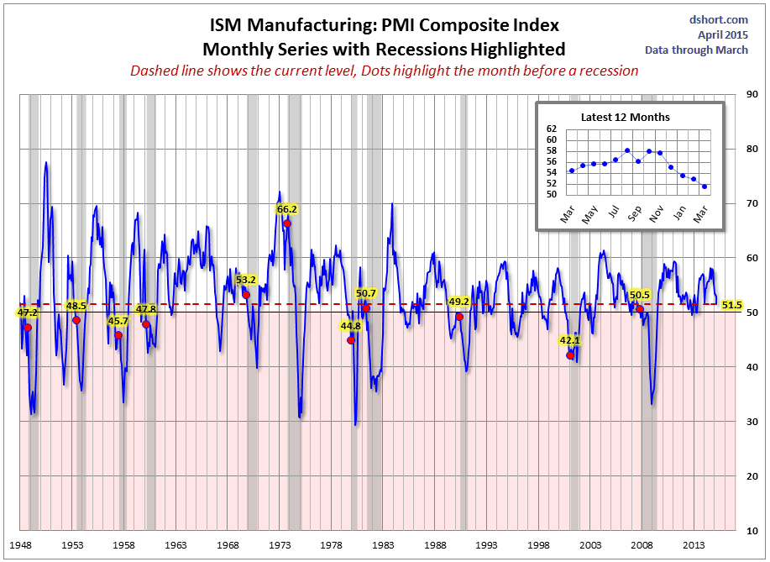
An index based on surveys of more than 300 manufacturing firms by the Institute of Supply Management. The ISM Manufacturing Index monitors employment, production inventories, new orders and supplier deliveries. A composite diffusion index is created that monitors conditions in national manufacturing based on the data from these surveys.

Slide 7
Industrial Distribution: Maintenance, Repair and Operations (MRO) Market
Strategies for developing competitive advantage:
Network Effect
Become integral in customers’ procurement and suppliers’ sales process (eg. supply chain services, value-additive information, multichannel distribution).
Cost Advantage
Economies of scale (volume rebates).
Direct product sourcing.
Private-label products.
Efficient logistics supply chain.
Customer Service

Slide 8
Primary Distribution Channels
 | FAST | GWW | MSM | Amzn Supply
eCommerce |  | 36% | 50% | 100%
Catalog Sales |  |  |  | 0%
Vendor Managed Inventory |  |  |  | 0%
Local Stores | ~2700 | ~700 (30%) | ~100 | 0%
Vending Machine | 40% | 7% |  | 0%

Slide 9

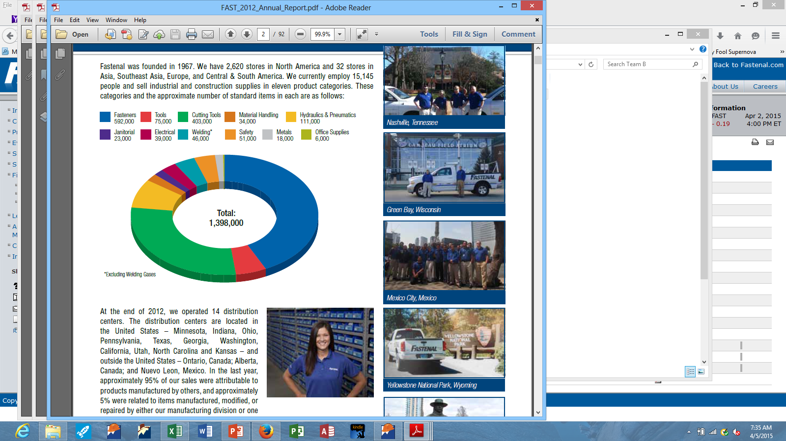
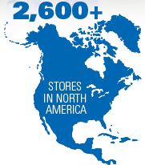
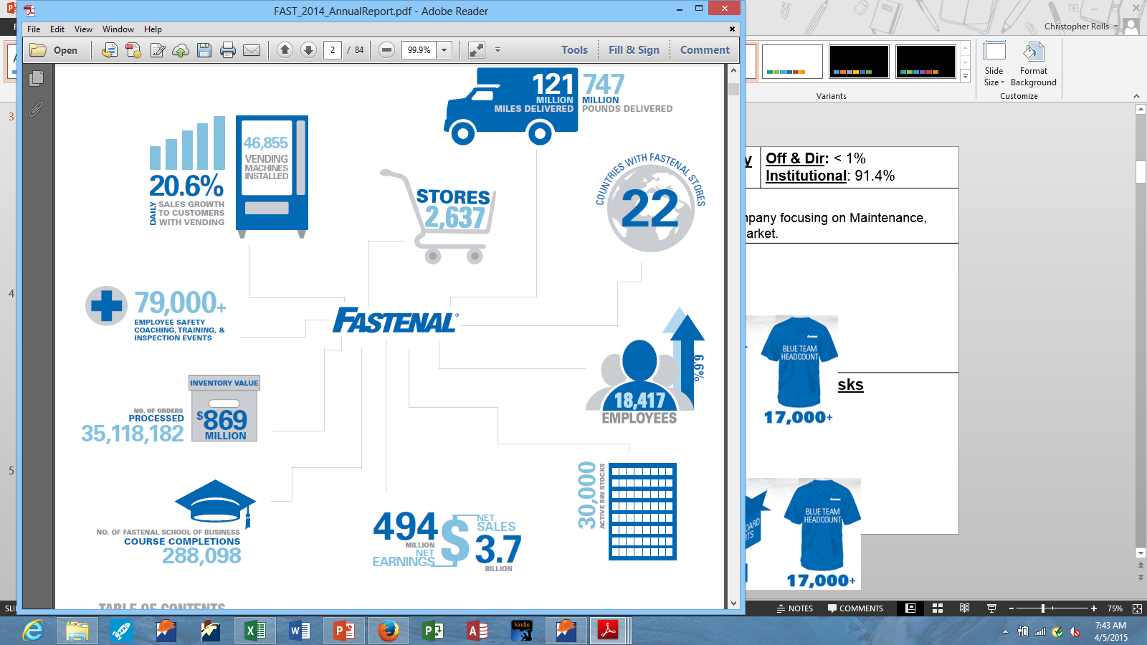
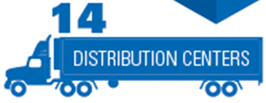
“Growth Through Customer Service” | Prospector Industry Industrial Distribution |  | Off & Dir: < 1% Institutional: 91.4%
 | Background Info Industrial distribution company focusing on Maintenance, Repair and Operations Market.
Strengths / Opps (Moat: WIDE) Low MRO market penetration. Scale and scope. World-class distribution network. Customer manufacturing. High technical capability and local customer service. Leader in industrial vending. |  | Weaknesses / Risks Products largely commodities. Close to saturating N.A. with stores (~2700 vs 3500 max). High competition (eg. Amazon Supply, Grainger, etc).
Sales $3.73B

Slide 10
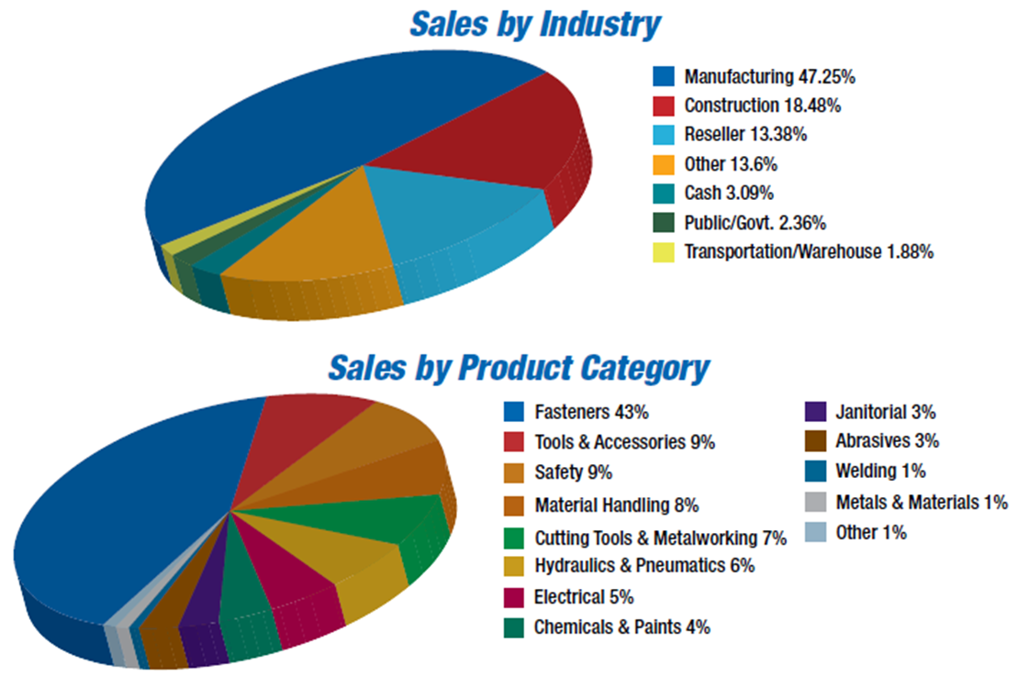
Fastenal: Sales Breakdown
Sales $3.73B

Slide 11
“Growth Through Customer Service”
Market share growth is driven by providing the greatest value to customers.
Elements:
Service customers at the “closest economic point of contact.” = Local Store (2600+ stores FAST vs. 755 GWW vs. 100 MSM).
Understand customer’s daily obstacles & opportunities.
Steps:
Recruit and enable service minded sales staff.
Decentralize (enable entrepreneurship).
Build a great machine behind the store to operate efficiently and help identify new business solutions.
Deliver consistently.
Generate strong profits & cash flow to replicate the cycle.

Slide 12
Fastenal Customer Quote
“ FAST has such a huge inventory of parts that their customers become dependent on them for the hard-to-find items, then come to rely on them for all their needs. Price becomes less important, even unimportant, because availability and reliability are more important and the price of each part is minor compared with the cost of the whole machine (buses in his case). As he explained it, FAST always has the goods and they are always in stock or quickly available. Any other supplier trying to break into the business has a very hard time.”

Slide 13
Fastenal: Growth Opportunities
New store openings.
Est. 3500 store potential in N.A. vs. 2600 existing.
Since 2007, reliance on this strategy has been scaled back in favor of higher profit margin same store growth.
Increased existing store sales & store enlargement.
Vending machine installations.
First mover advantage.
~50k installations.
Highly automated invoicing and stock replenishment.
Acquisitions
Top 50 Distributors represent only 30% of the market.
Foreign Countries.
Current penetration is low with only about 22 stores outside of North America.

Slide 14
Grainger (GWW)
Founded in Chicago, 1927. Distributor of maintenance, repair and operations (MRO) products; Industry leader
2014 revenues = $10 billion. 77% of sales in U.S, 12% in Canada and 11% in rest of the world
NA MRO market = $150 billion. Grainger (6%), Other top 10 (26%), All others (68%)
Active customers = More than 2 million
Products stocked = 1.4 million. More than 4,500 key product suppliers
Returning capital to shareholders: 43rd consecutive year of increased dividends. Shares outstanding - 118 million (1986), 68 million (2014)
The company's store footprint is nearly one fifth that of its closest rival, Fastenal. Despite generating 2.5 times Fastenal’s revenue, Grainger has 50% fewer store personnel than Fastenal.
Through its “KeepStock” program, it regularly visits customer facilities, refilling component bins and industrial product vending machines and servicing customer tools. This service connects 2,700 suppliers and 2 million customers in a way that neither can cost-efficiently recreate without Grainger.
Private-label products were 22% of 2013 U.S. sales relative to 10%-13% at MSC and Fastenal and far lower levels at smaller competitors. These products frequently cost 30% less than national brands, offering savings for Grainger and its customers.

Slide 15
Grainger – 2014 Sales

Slide 16
Grainger - Worldwide
Region | MRO Market Size | Market Share | Branches | Distribution Centers | Customers Served (2014)
United States | > $126 billion | 6% | 377 | 19 | 1,400,000
Canada | > 13 Billion | 8% | 181 | 6 | 40,000
Latin America | > 18 Billion | 1% | 34 | 3 | 54,000
Japan | > $43 Billion | 1% | 0 | 2 | 627,000
Asia | > 109 Billion | < 1% | 0 | 1 | 14,000
Europe | > 73 Billion | < 1% | 89 | 2 | 100,000
Total | > $380 Billion | 3% | 681 | 33 | > 2,000,000

Slide 17
Grainger – Operating models
Customer Size | 2014 - % sales/ Market share | Model | Channel
LARGE U.S. market size: $37B 270K business locations | 77% of sales (18% Market share) | Multichannel – High service, high touch model with sales coverage to tailor offer to individual customer needs and constraints | Branch network – 680 branches Services – 4900 sales people Sales reps – 1200 people at customer onsite Contact centers – 36000 calls and e-mails/day Websites – 13th largest e-retailer Tablet and Mobile – Smartphone applications (15% of eCommerce traffic from mobile)
MEDIUM U.S. market size: $37B 1.5M business locations | 20% of sales (7% Market share)
SMALL U.S. market size: $48B 20M business locations | 3% of sales (1% Market share) | Single channel Online – Low-touch, single price offer without significant investment in solutions, services or customization | Website, Tablet and Mobile – Simplicity and a consistent, competitive price

Slide 18
Grainger - Primary Distribution Channel Comparison
Channel | GWW
eCommerce | $3 billion sales (1/3 of total sales). 15th largest e-commerce company in U.S.
Vendor Managed Inventory | 1,40,000 products for 2700 vendors
Catalog Sales | Increased more than seven-fold from 82,000 SKUs in 2005 to more than 592,000 SKUs in the 2015 edition
Local Stores | 369 (averaging 23,000 sq ft). Second largest
Vending Machine (KeepStock) | KeepStock sales - $650 mil in 2014. ($250 mil in 2012). KeepStock provided services to around 18,000 customers at more than 33,000 customer locations in 2014 (2007: 1100 locations)

Slide 19
Grainger
Strengths:
More diversified by product and customer segments, which makes it less cyclical
Early mover in e-commerce which accounted for 36% of U.S sales in 2014
Primarily focused on larger customers, who have more complex needs
Leader in private-label products, which accounted for 22% of sales in 2014.
One of the most efficient distribution systems in the industry based on scale and automation
Currency exposure is limited (80% of sales in U.S)
Limited exposure to energy sector (only Canada)
Challenges:
Sluggish economic growth
Currency headwinds. Weaker currency in Japan and Canada (11% of sales)
Low inflation
Weakness:
Minor footprints in international markets. Will only experience small secondary effects from strong international economic growth, especially if U.S manufacturers move production overseas

Slide 20
Team Recommendation Slide
 | Most to Least Preferred 1 2 3
Ram | GWW |  | FAST |  | MSM
Pat | FAST |  | GWW |  | MSM
Len | FAST |  | GWW |  | MSM
Chris | FAST |  | GWW |  | MSM
Curt | AMZN ;)
Ratings Legend:
BUY |  | NEUTRAL |  | SELL

