Slide 1
NAIC Mar 19th 2020 Meeting
New Stock Idea, Homebuilders

Slide 2
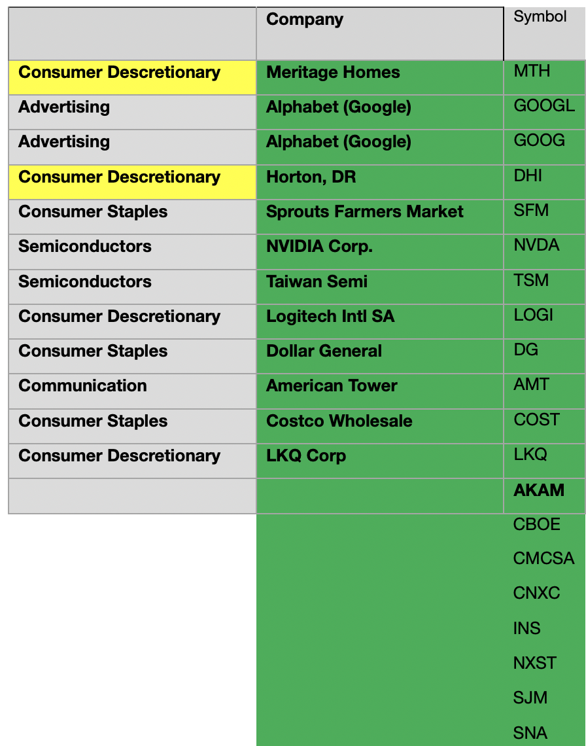
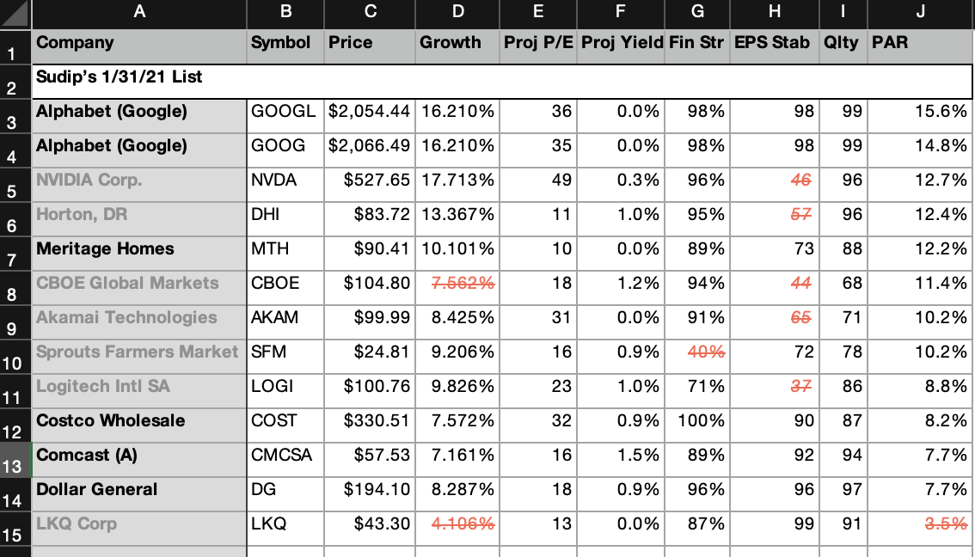
Methodology Used
1. We asked each team-member – what have you bought recently? What looks good?
Sudip’s replies above from late Jan in prep for Feb mtng (left)
Good stock ideas, determined around 1/31 after our discussions (right)

Slide 3
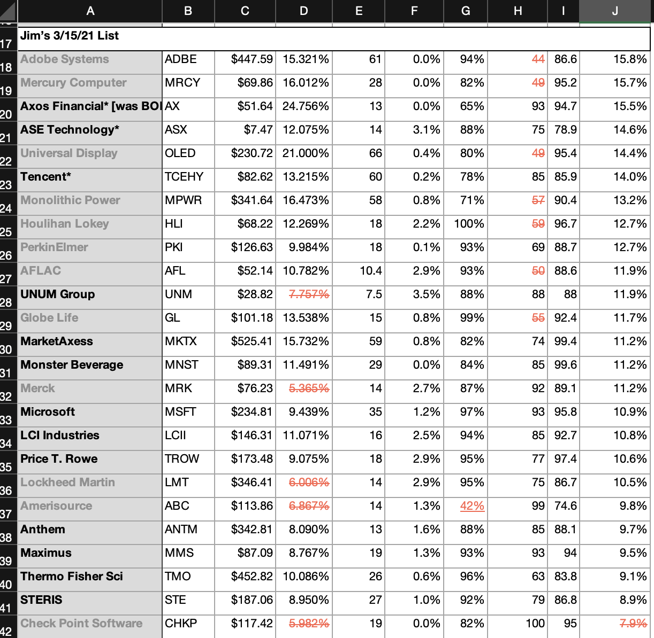
Methodology Used
1. We asked each team-member – what have you bought recently? What looks good?
Jim’s ideas, updated for PAR around 3/15

Slide 4
Methodology Used
2. In looking for industry we don’t currently own & fits NAIC profile, homebuilders still look positive (~12% PAR; mypar—industry PAR in Manifest is about 5%)
3. While interest rates may go up, Fed likely to keep rates lower; historic lows
4. In post-WWI and WWII areas, many homes were built for years

Slide 5
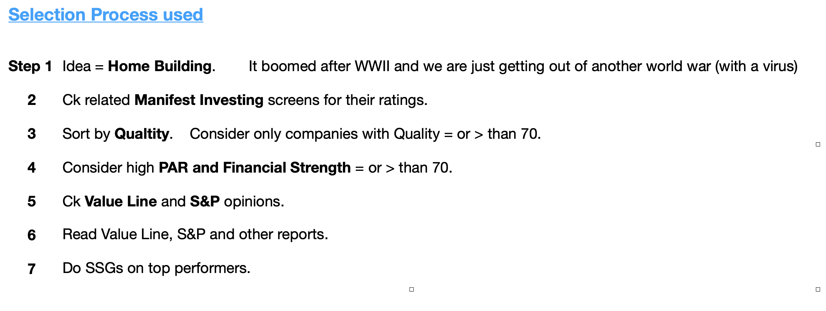
Methodology Used for Homebuilding

Slide 6
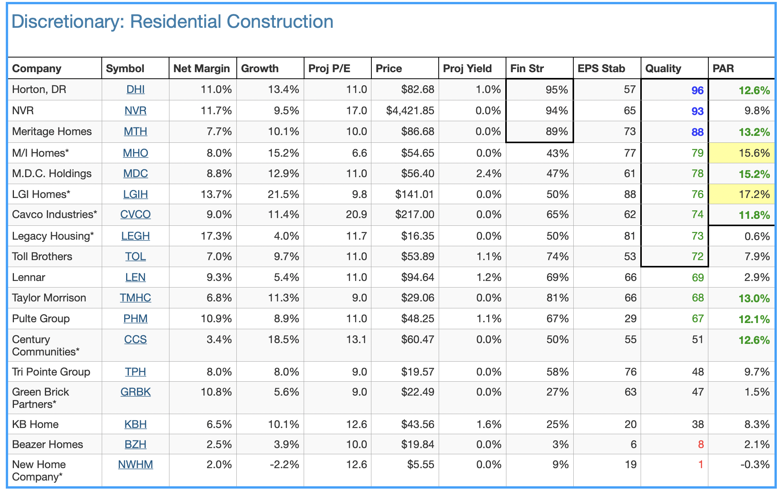
Various Building Industries Studied

Slide 7
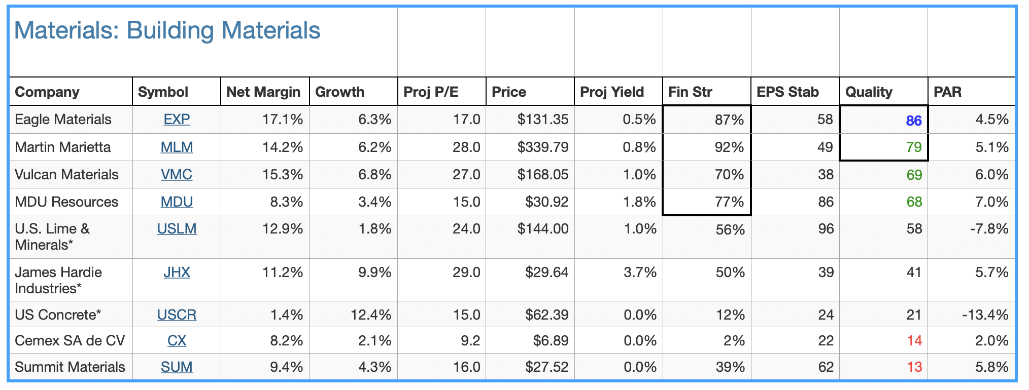
Various Building Industries Studied

Slide 8
Various Building Industries Studied

Slide 9
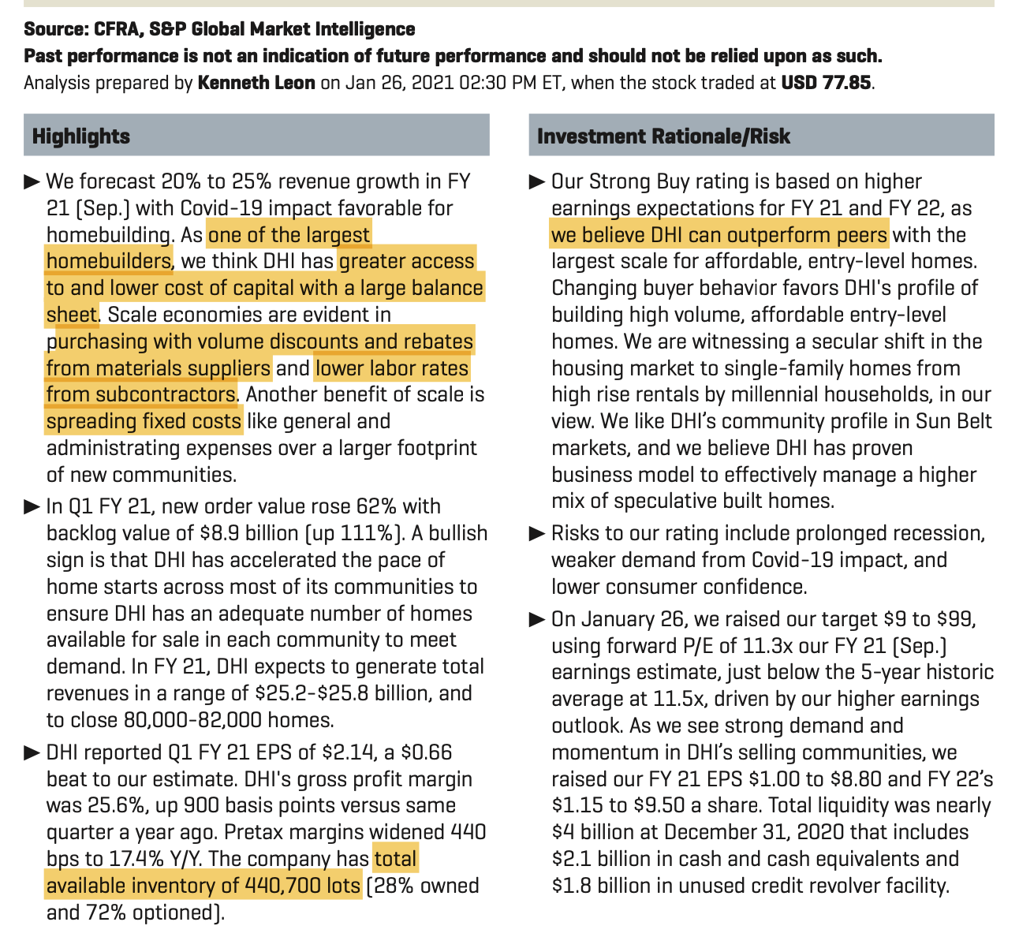
S&P Report Highlights DHI

Slide 10
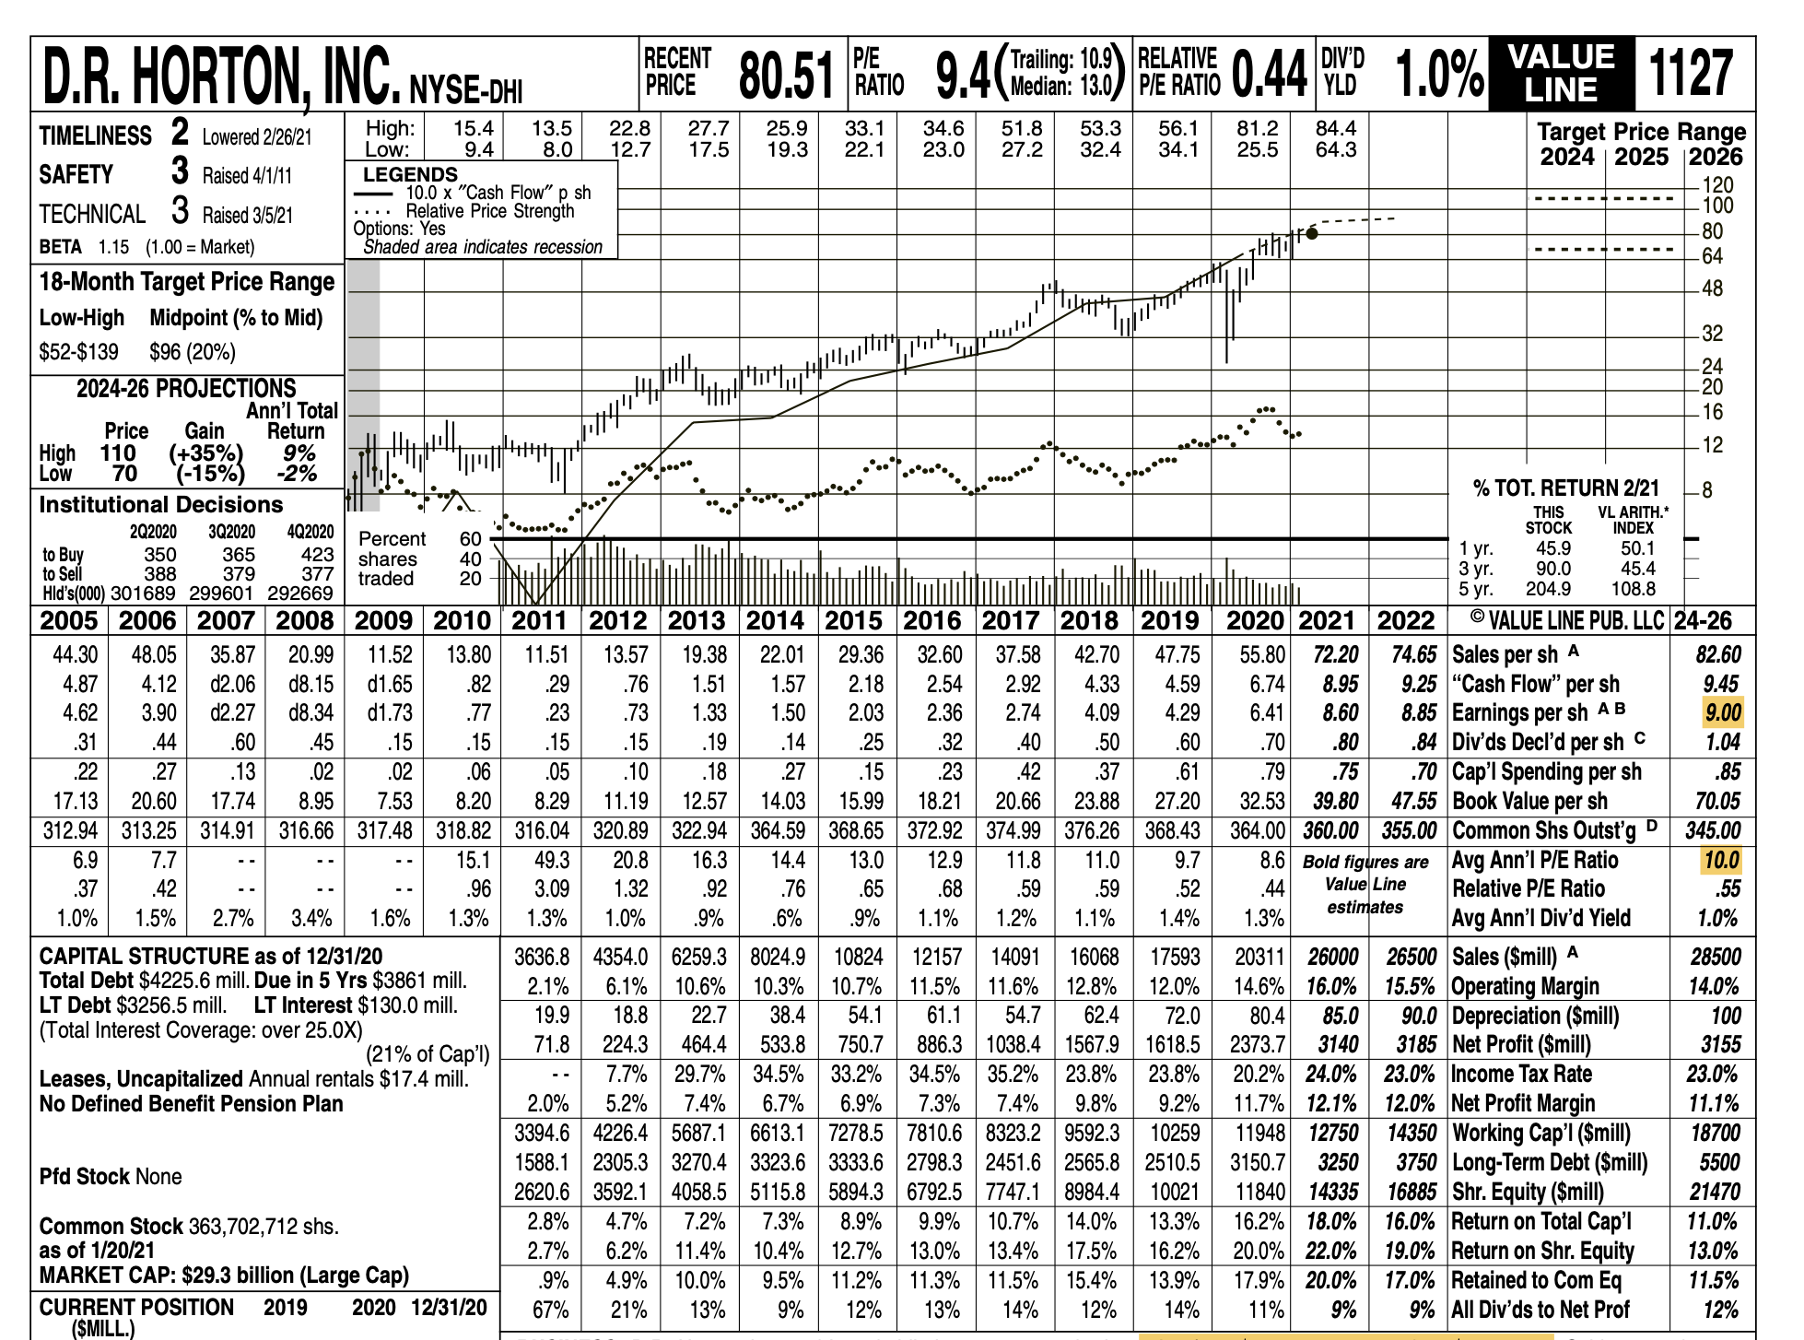
Valueline Report

Slide 11
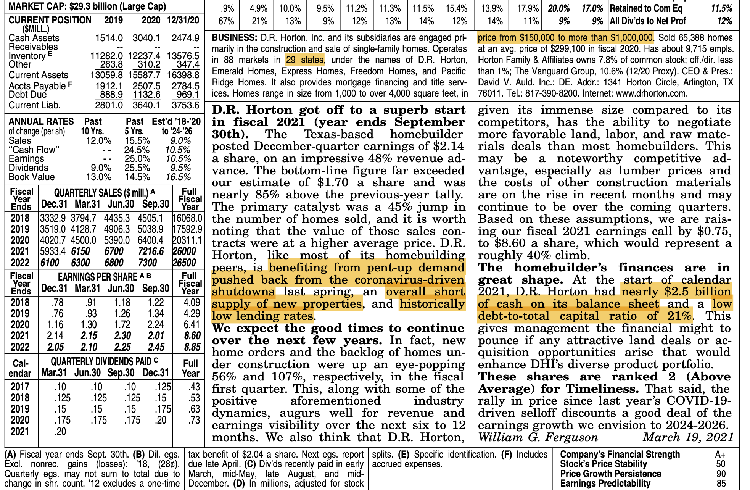
Valueline

Slide 12
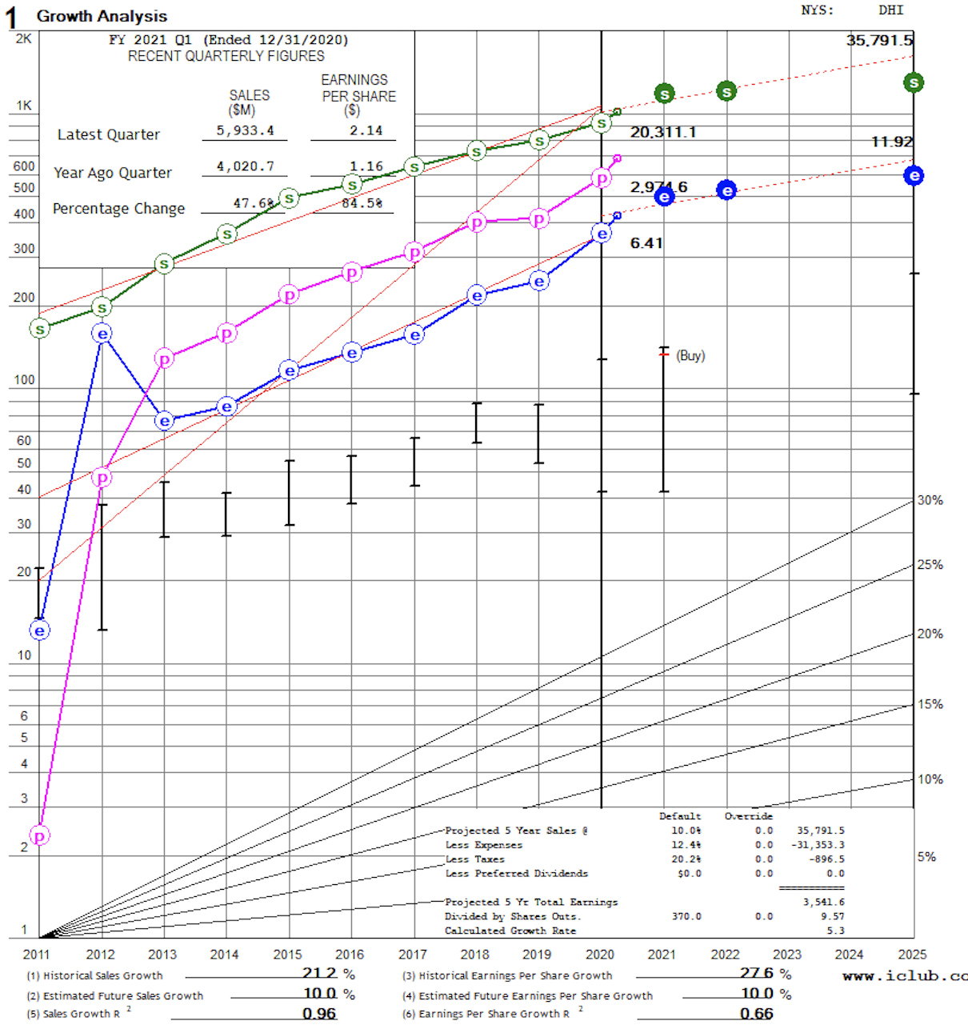
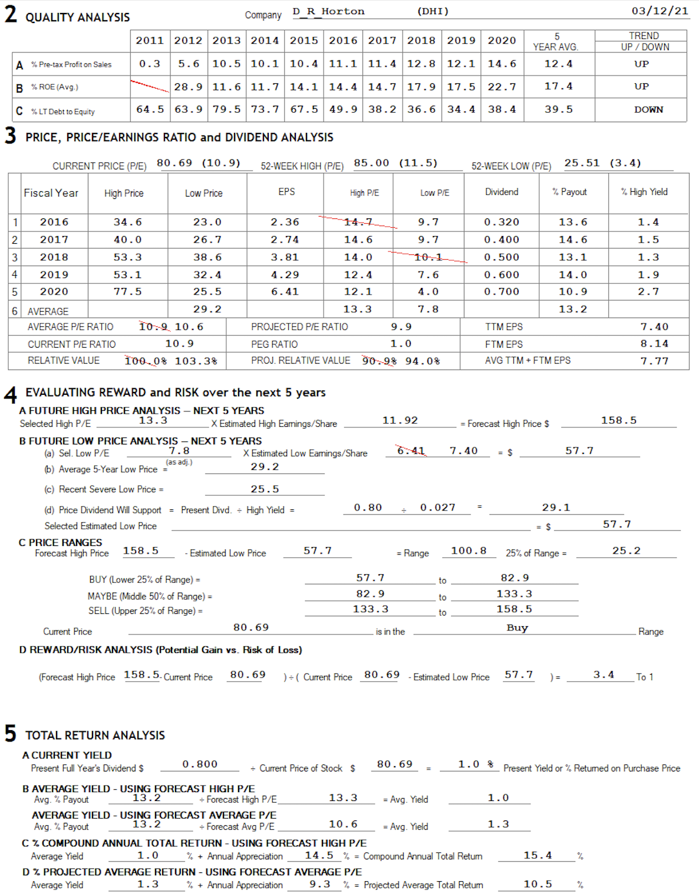
SSG, DHI

Slide 13
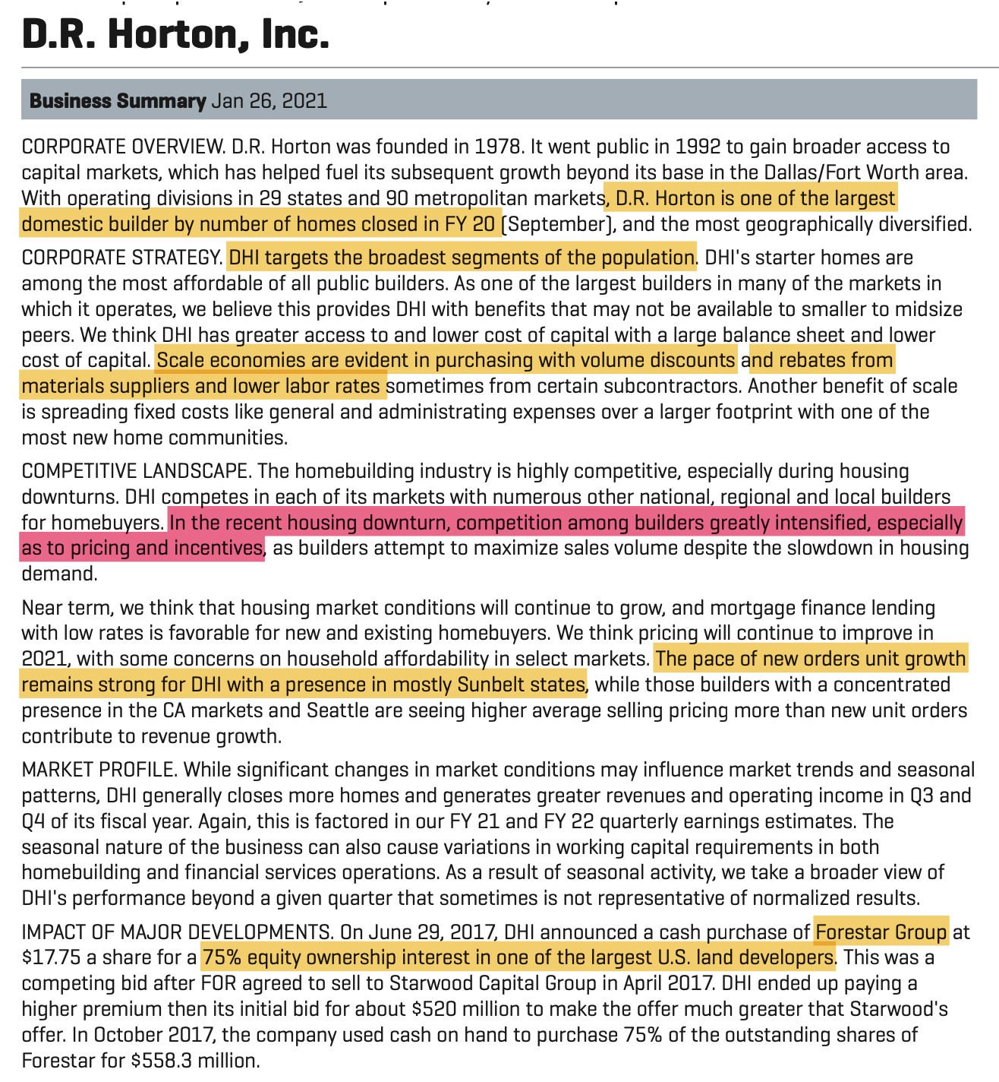
DR Horton Business Summary, S&P

Slide 14
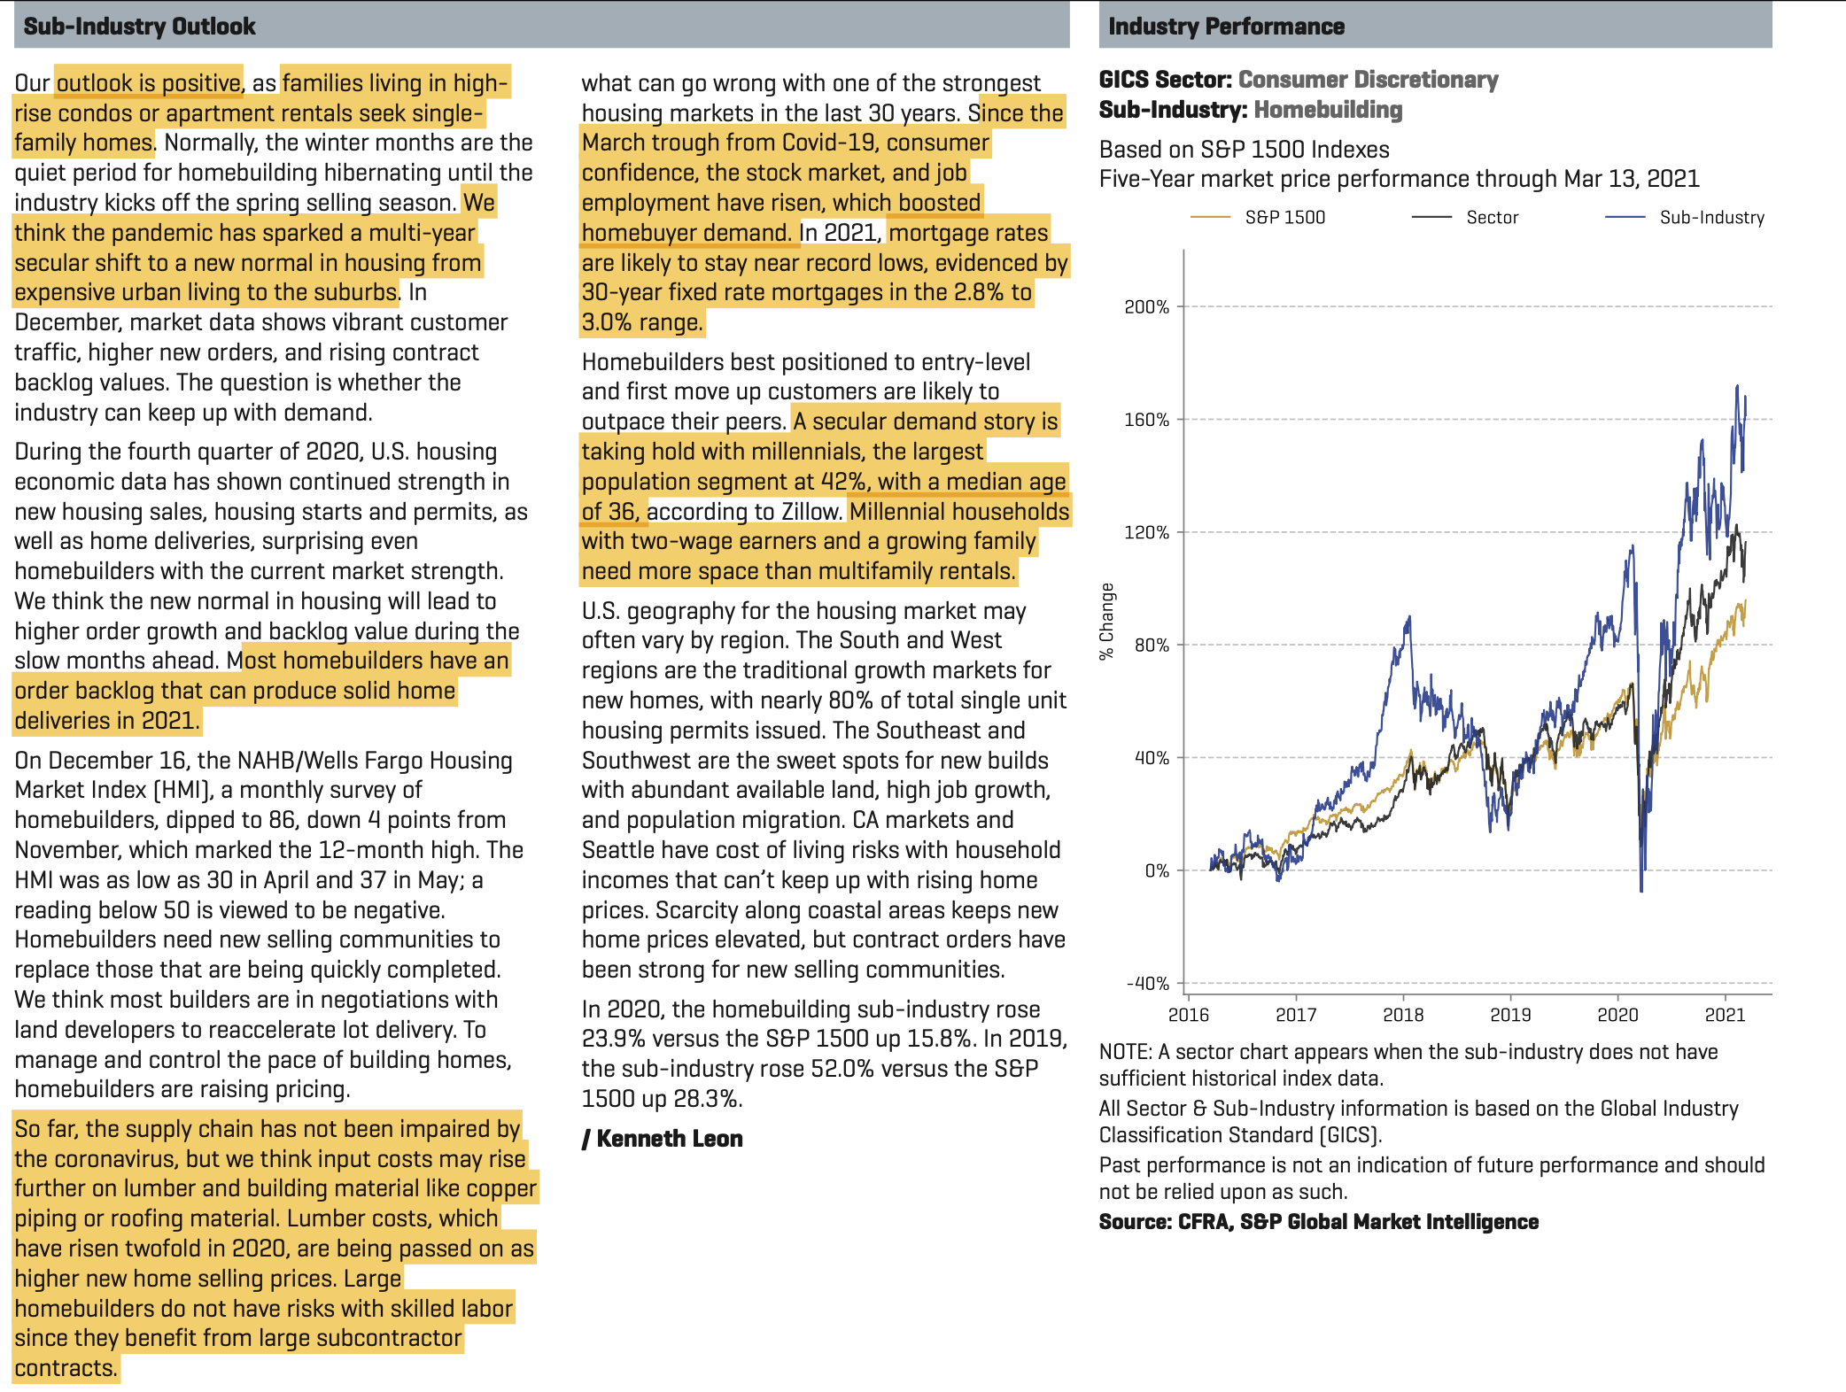
Industry Outlook, S&P → Favorable

Slide 15
S&P, 1/26/21 Update; High EPS; Large Growth

Slide 16
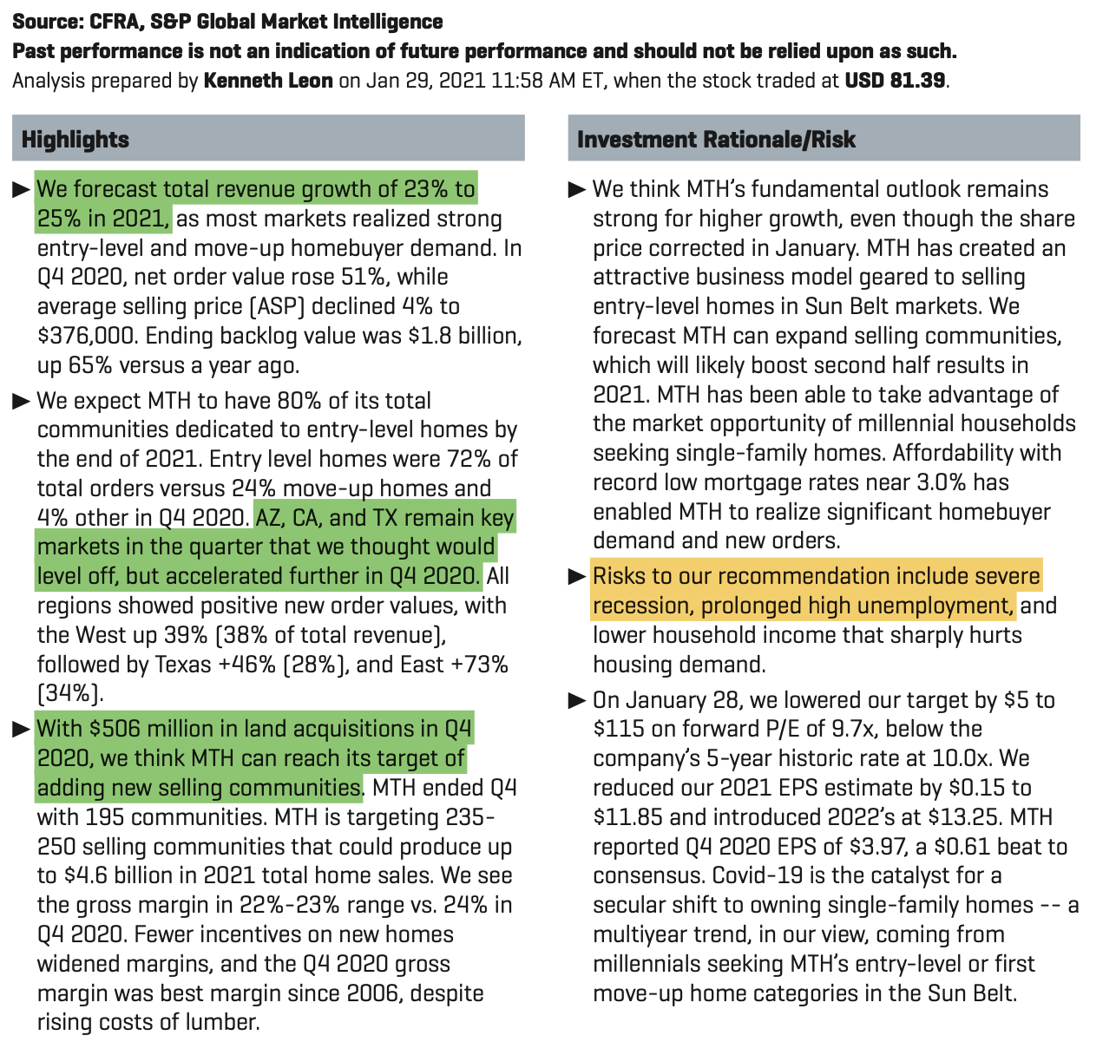
S&P Report Highlights DHI

Slide 17
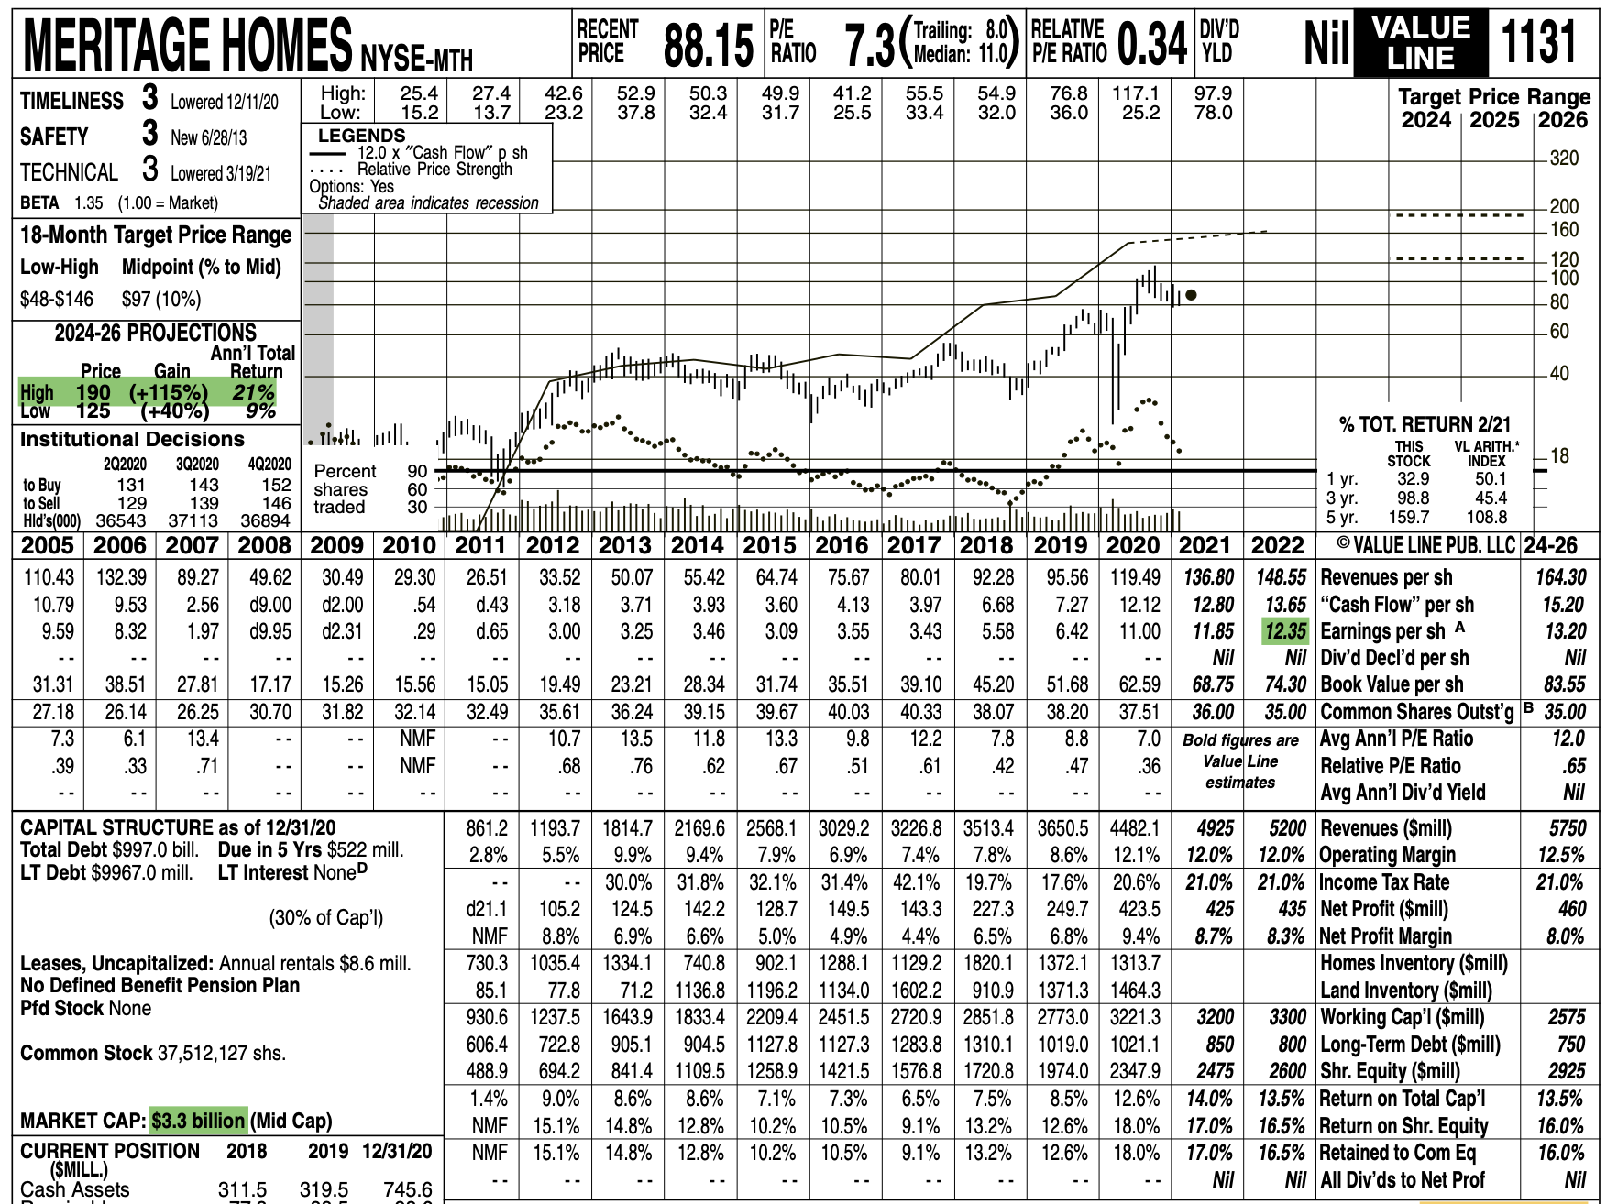
Valueline Report

Slide 18
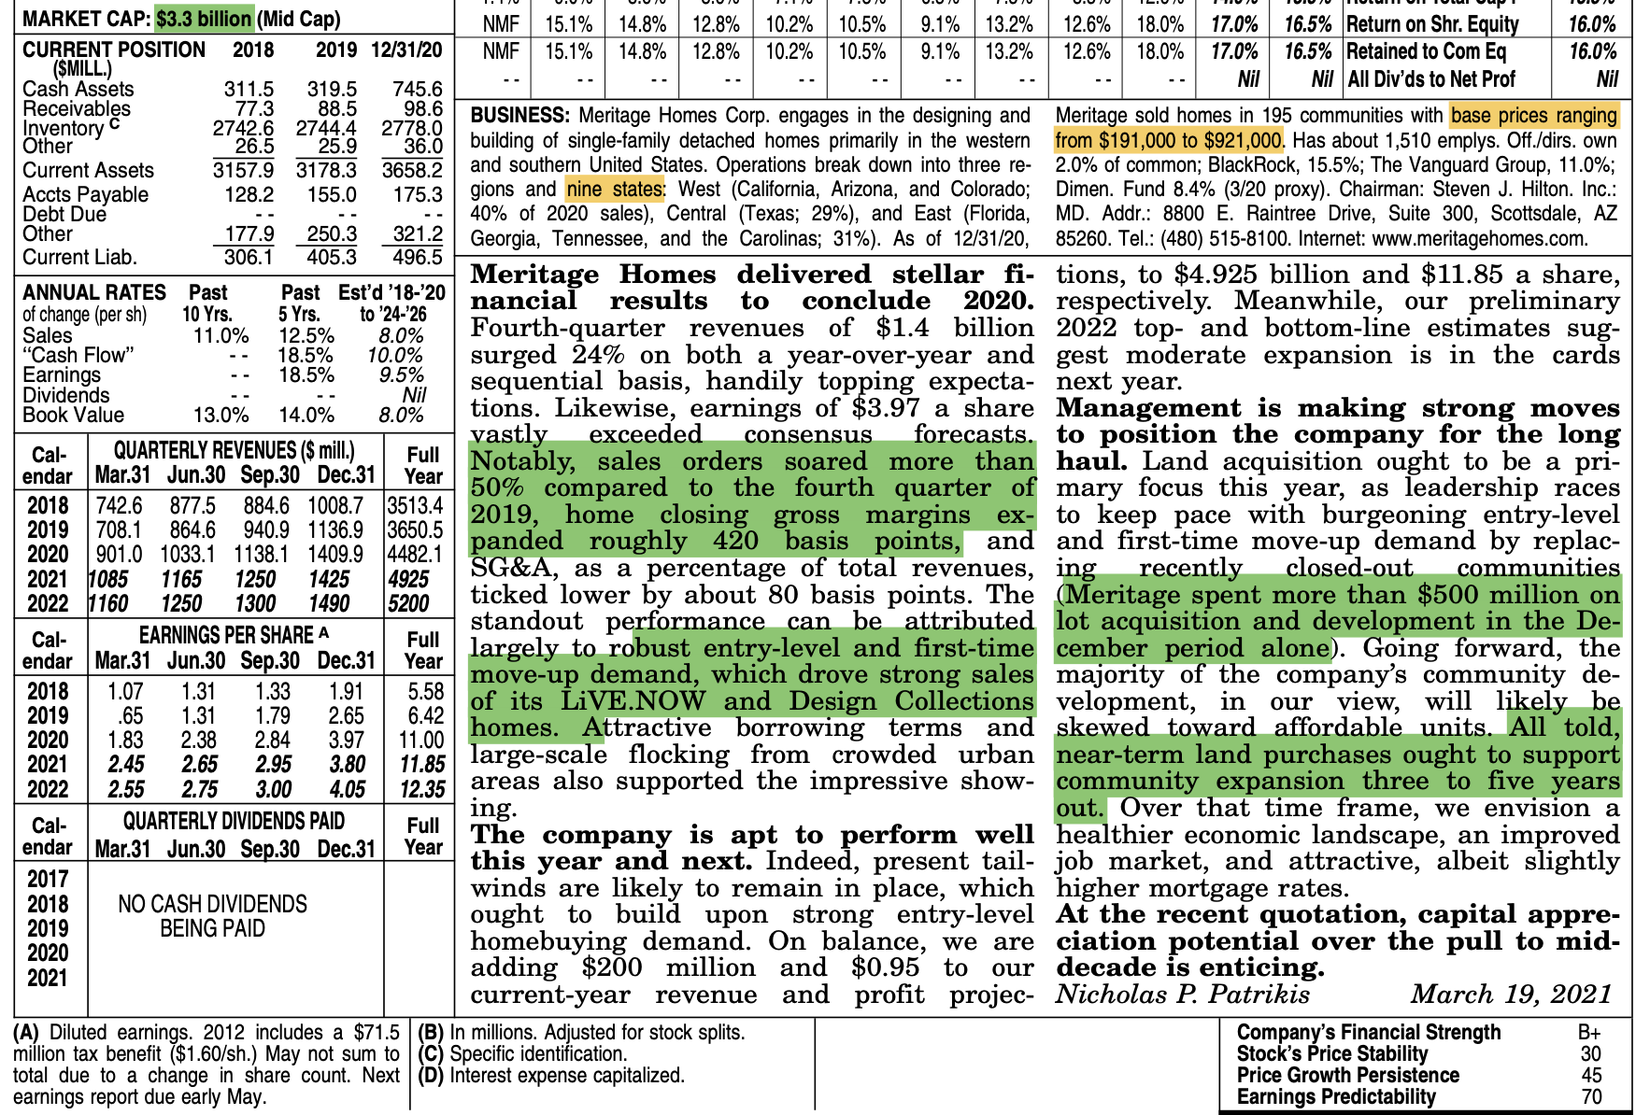
Valueline

Slide 19
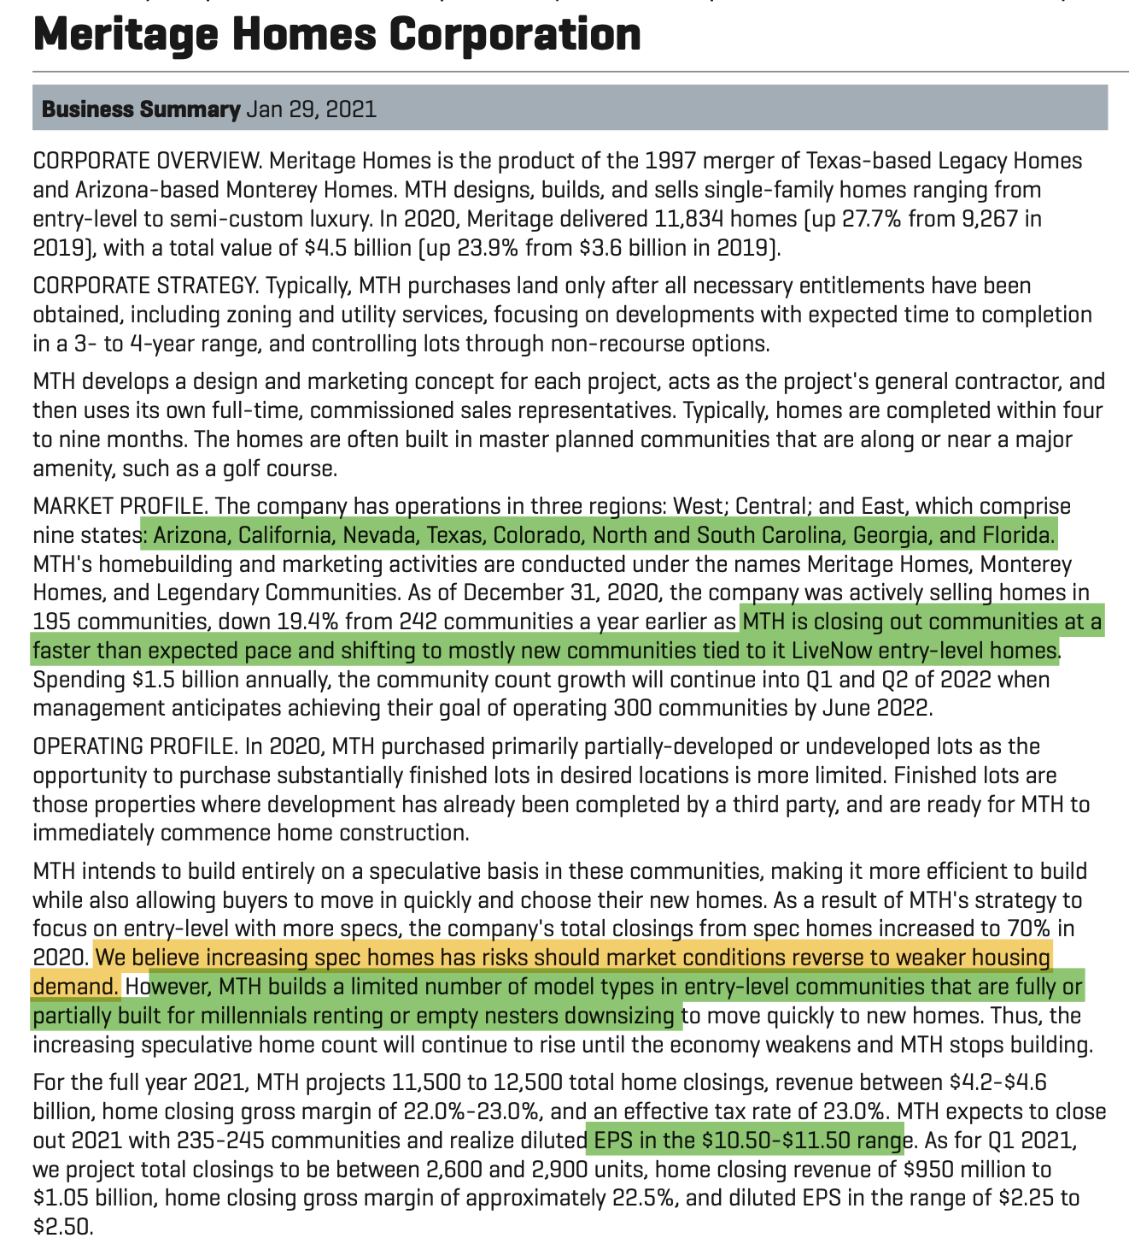
MTH Business Summary, S&P

Slide 20
Industry Peer Group, S&P → DHI, One of the Best

Slide 21
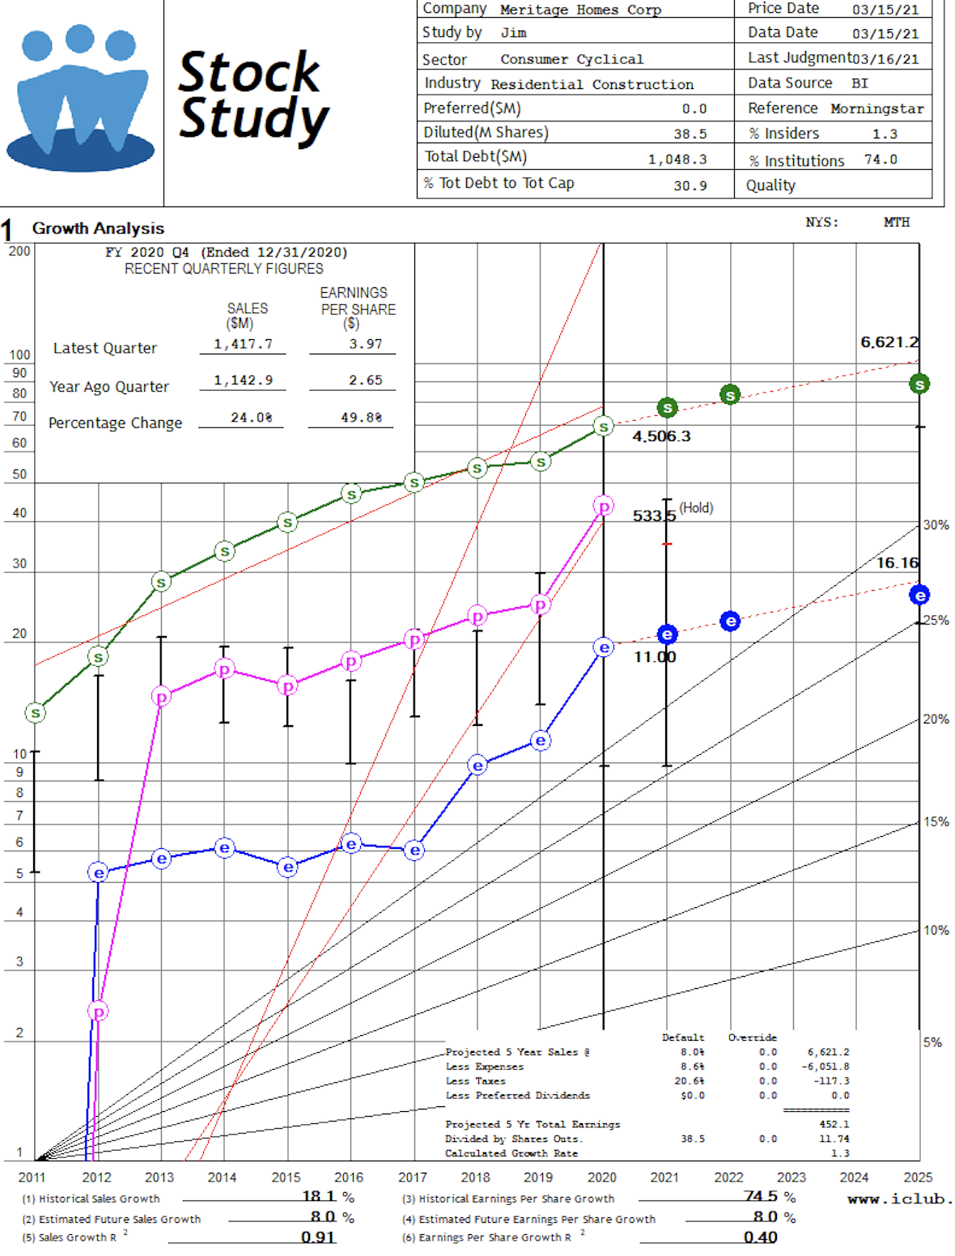
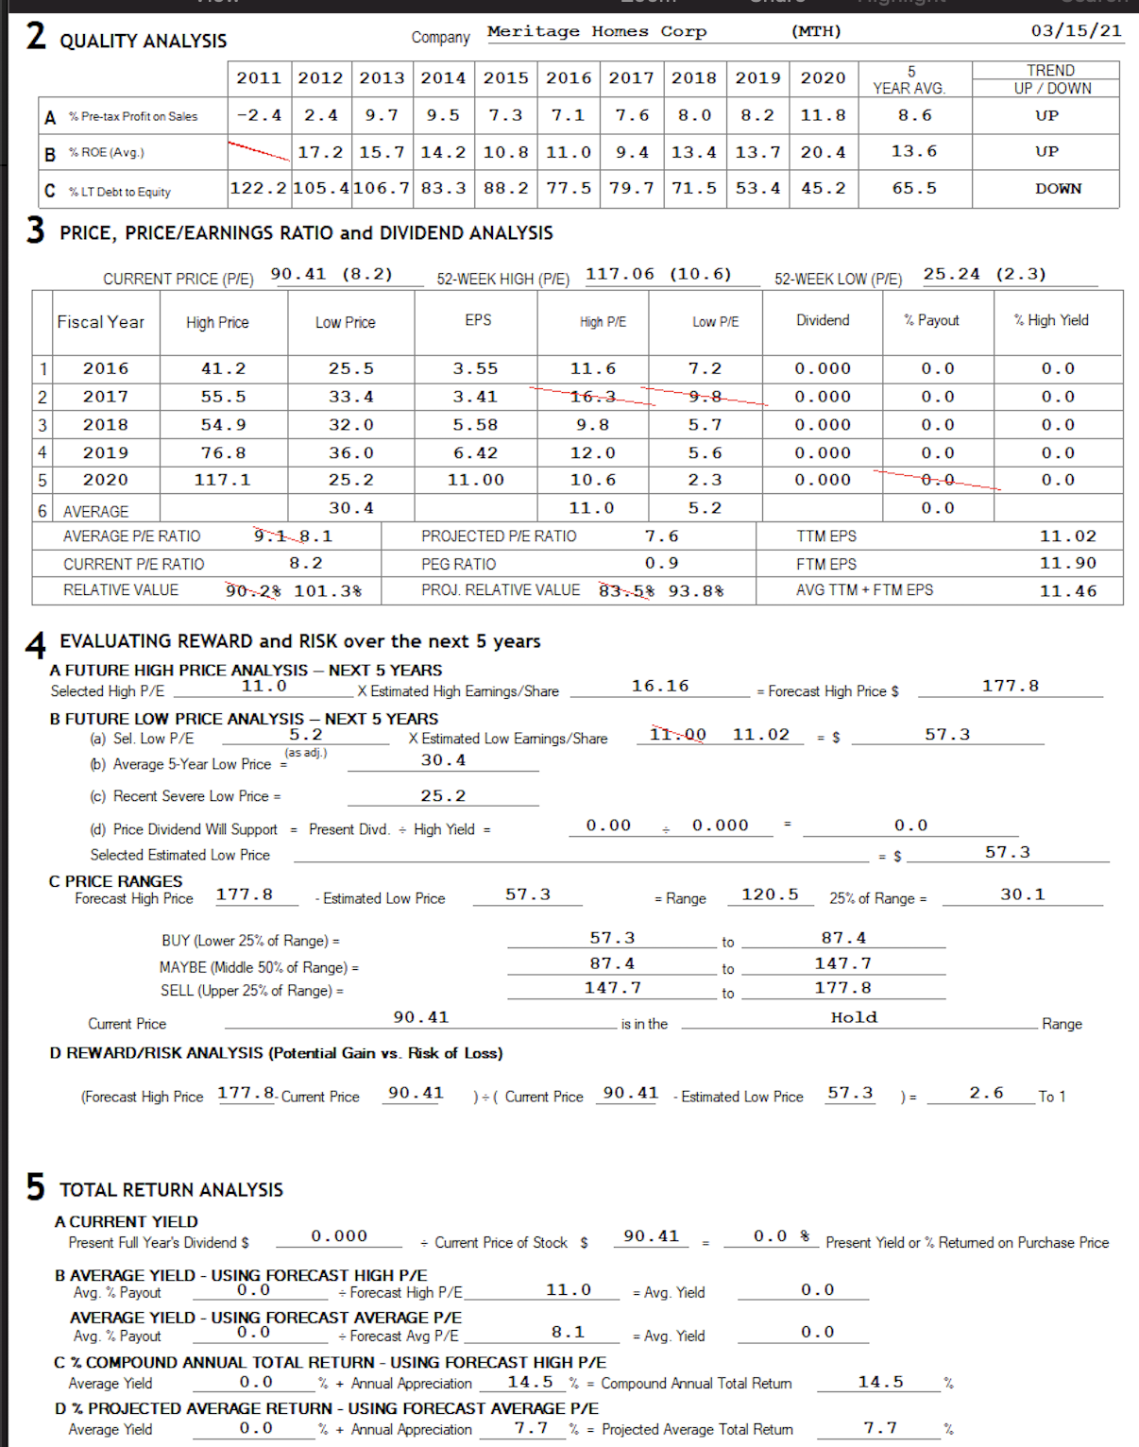
SSG, MTH

Slide 22
SSG, DHI

Slide 23
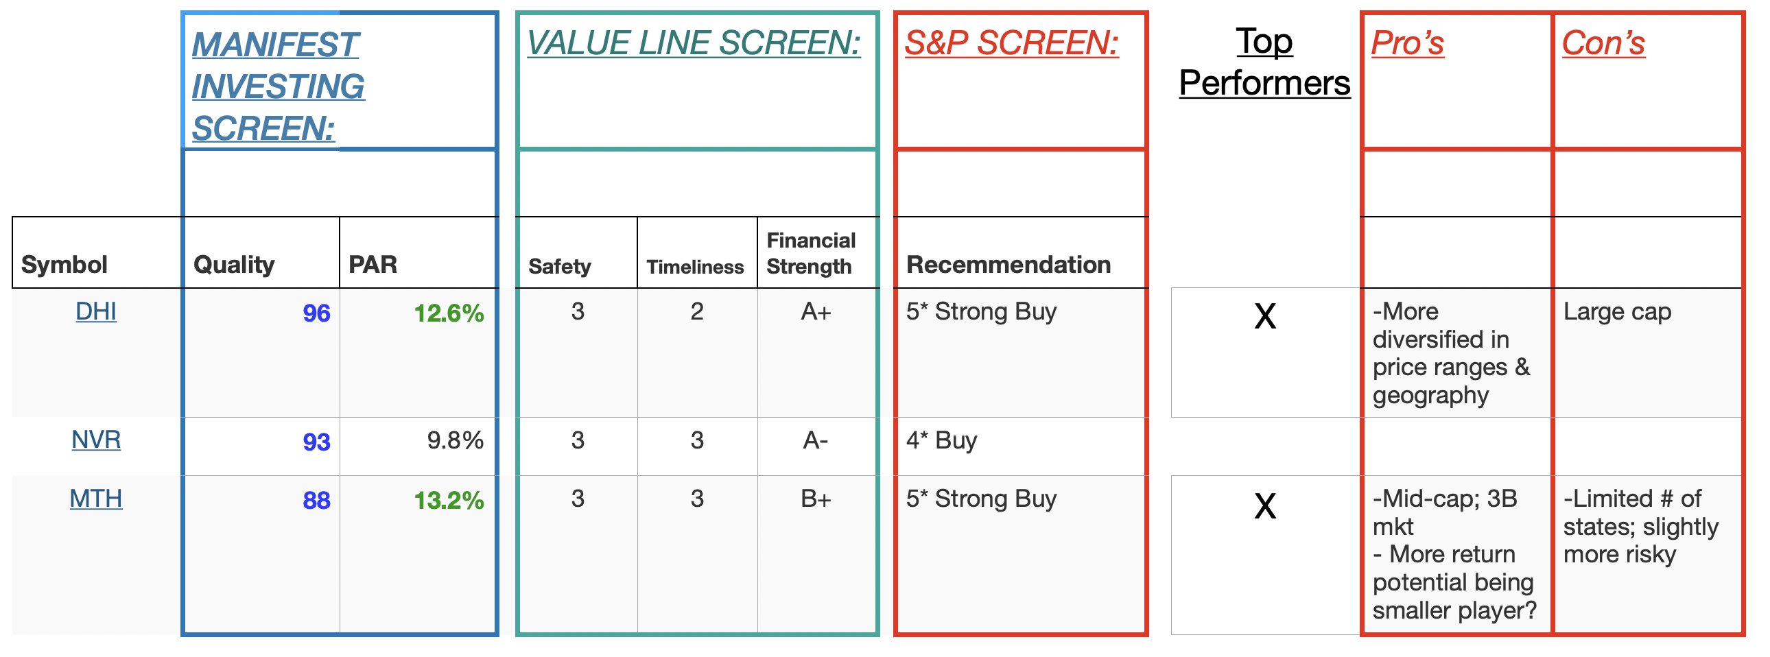
Summary of Recommendation

Slide 24
Recommendation/Questions?

