Slide 1
Team B – Stock Study
10/17/2015

Slide 2
Disclaimer
The information delivered here is for educational purposes only and is not intended to be a recommendation to purchase or sell any of the stocks or other securities referenced. All references are for illustrative purposes only and are not considered endorsed or recommended for purchase or sale by BetterInvestingTM National Association of Investors Corporation (“BI”). The views expressed are those of the instructors, commentators, guests and participants, as the case may be, and do not necessarily represent those of BetterInvestingTM. Investors should conduct their own review and analysis of any company of interest before making an investment decision.
Securities discussed may be held by instructors, commentators, guests and participants in their own personal portfolios or in those of their clients. BI presenters and volunteers are held to a strict code of conduct that precludes benefiting financially from education presentations or public activities via any BetterInvestingTM programs, events, and/or educations in which they participate. Any violation is strictly prohibited and should be reported to the CEO of BetterInvestingTM or the Director of Chapter Relations.
Presentations may contain images of websites and products or services no endorsed by BetterInvestingTM. The instructors, commentators, guests and participants are not endorsing or promoting the use of these websites, products or services.

Slide 3
Fortune 100 Fastest Growing Companies 2015
Annual list of the 100 fastest growing companies trading on a major U.S. Stock Exchange.
Criteria (as of end of June each year):
  Minimum market capitalization of $250M
  Stock price $5 minimum.
  Minimum 3 year trading history.
  Revenues > $50M (4 Qtrs ended on or before April 30).
  Net Income > $10M (4 Qtrs ended on or before April 30).
  > 15% annualized growth in Revenue and EPS for 3 years ending April 30).
  Ranked by Revenue growth rate, EPS growth rate, 3yr annualized Total Return (as of end of June) and Overall (sum of prior 3 elements).
  Excluded: REITS, LLCs, limited partnerships, business development companies, closed end investment firms, companies about to be acquired, and companies that lost money in the quarter ended on or before April 30, 2015. Also companies that have announced intentions to restate previously reported financial data, if these errors appear to have a significant impact and companies that lost money in the quarter ended May 31 or June 30, if the loss represents a deterioration in business conditions.
http://fortune.com/100-fastest-growing-companies/

Slide 4
The Triple Play Concept for Stocks
Term coined by George Nicholson.
Indicates potential for stock to significantly outperform the market.
Elements:
  Projected Return of the Stock significantly higher than the average stock.
  Room for P/E expansion exists.
  Room for Margin expansion exists.

Slide 5
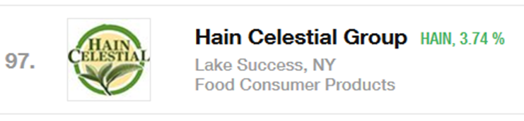
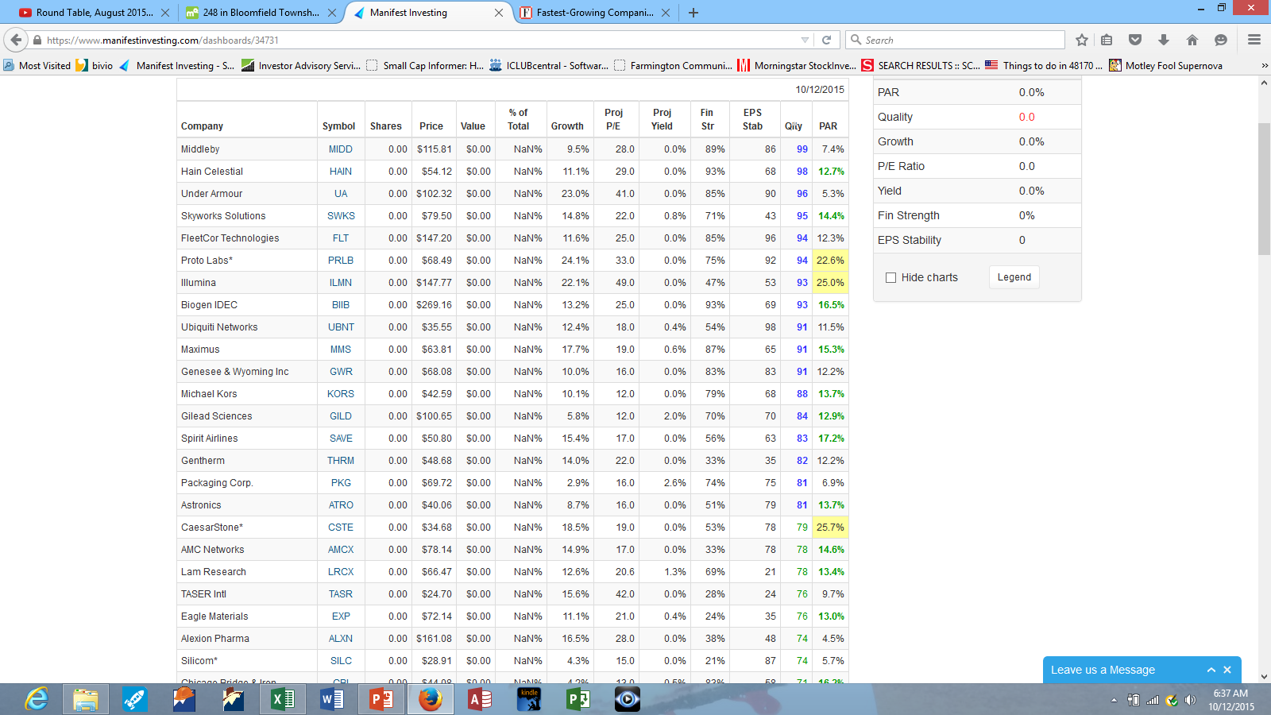
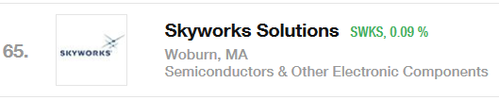

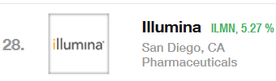
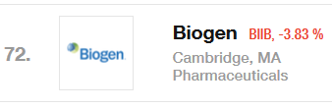
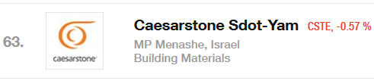
Manifest Investing Dashboard https://www.manifestinvesting.com/dashboards/public/WL2LH6Q

Slide 6
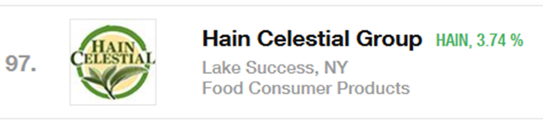
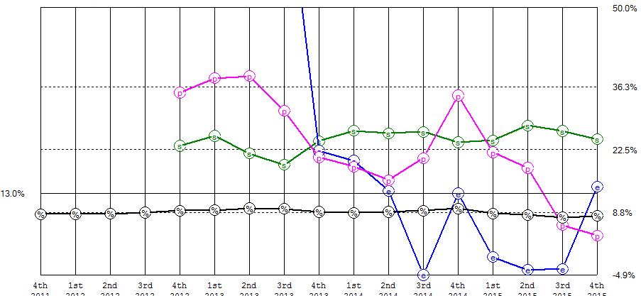
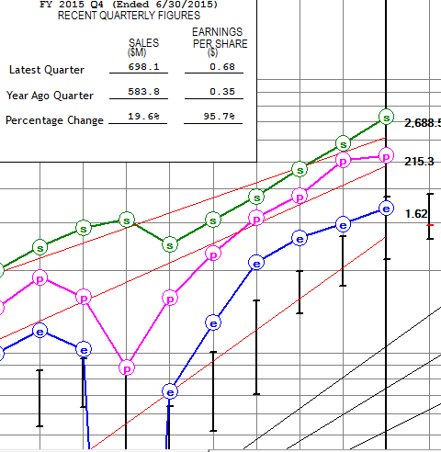
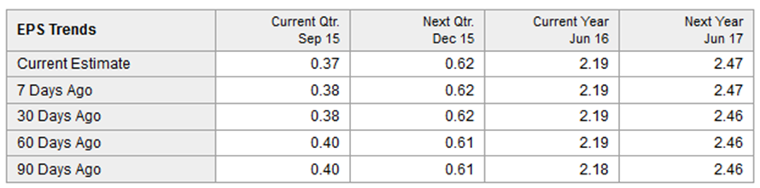
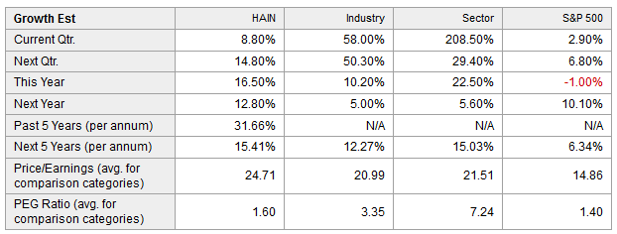
INVESTIGATE

Slide 7
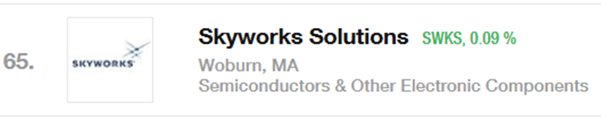
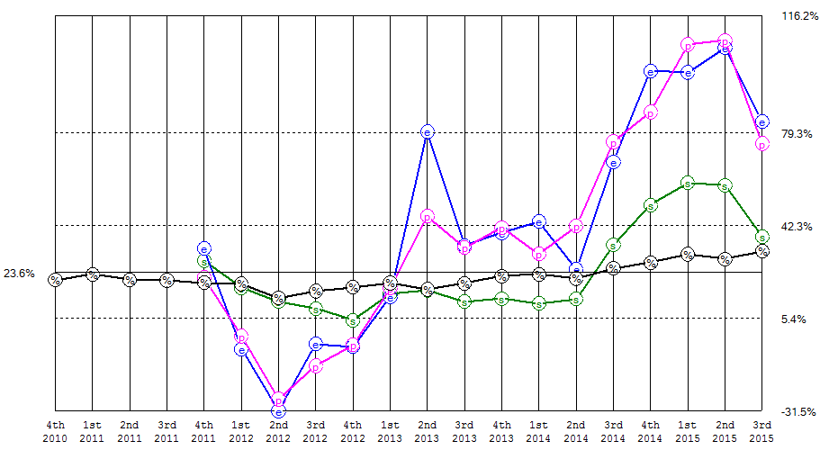
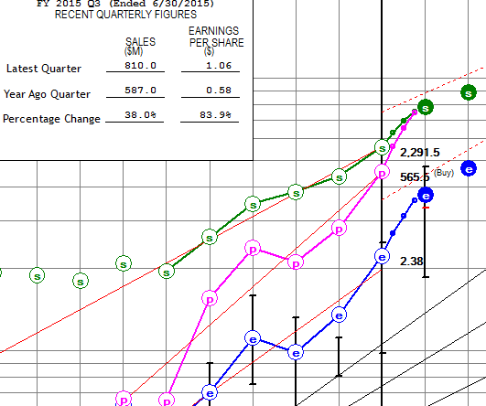
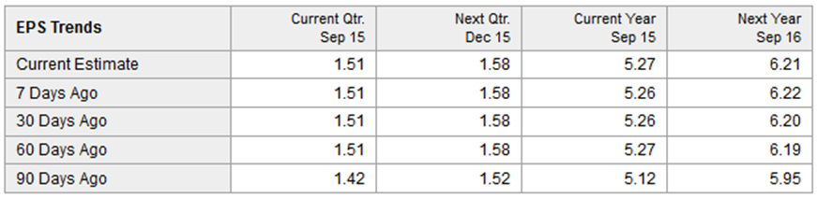

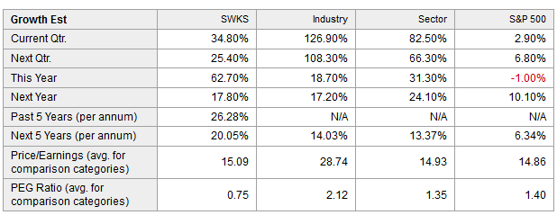
http://www.skyworksinc.com
BUY

Slide 8
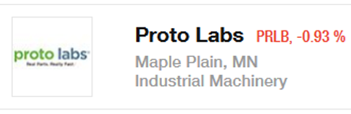
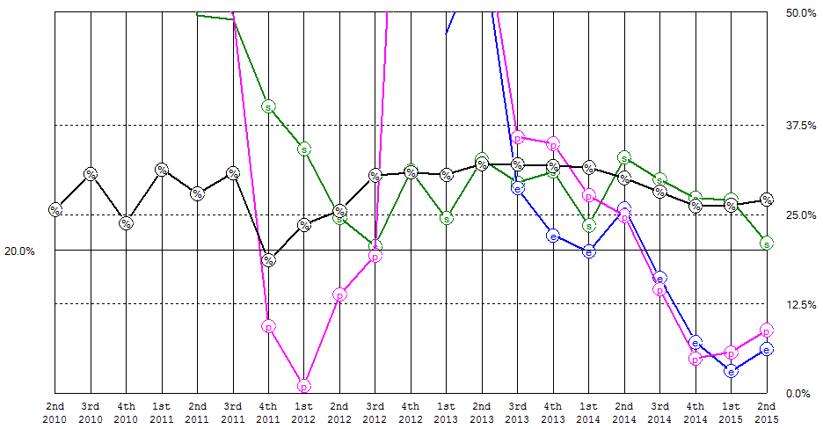
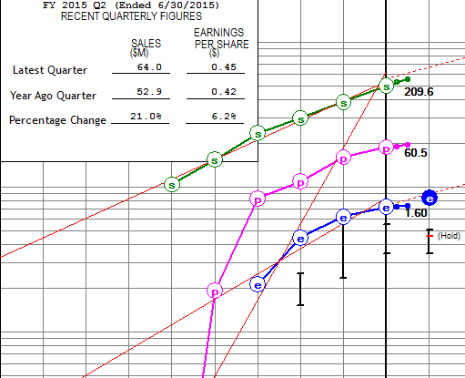
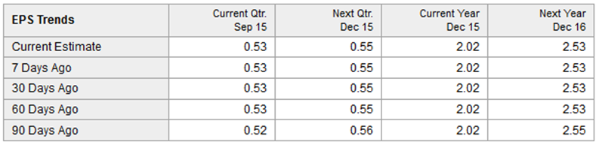

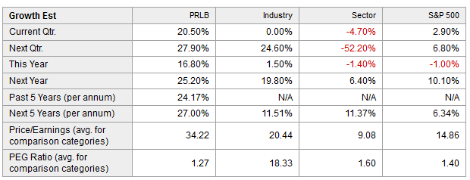
www.protolabs.com
BUY

Slide 9
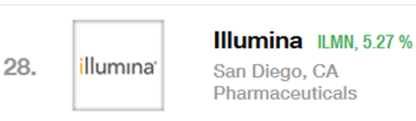
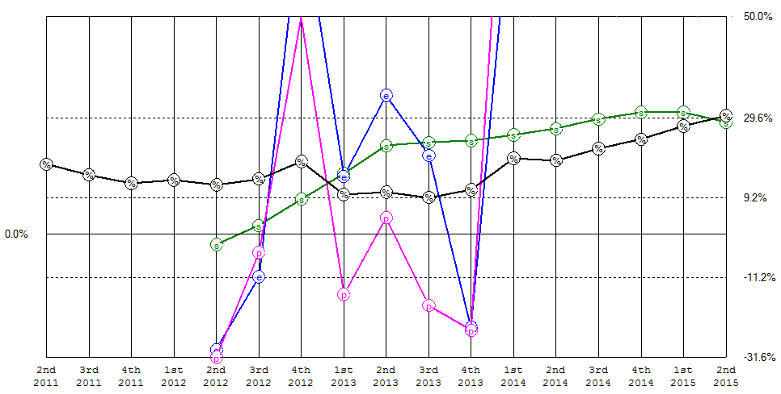
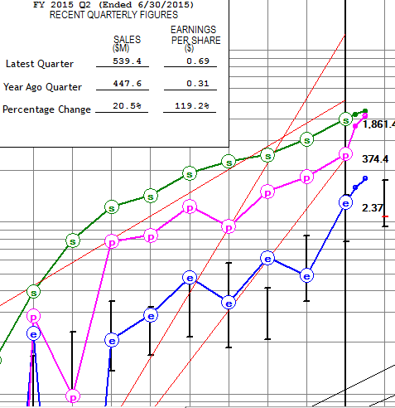
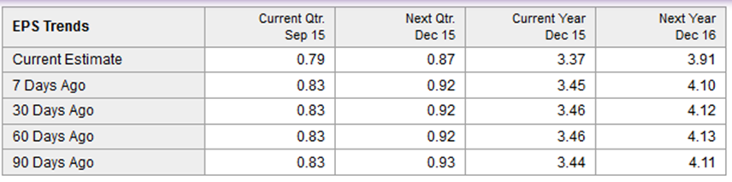
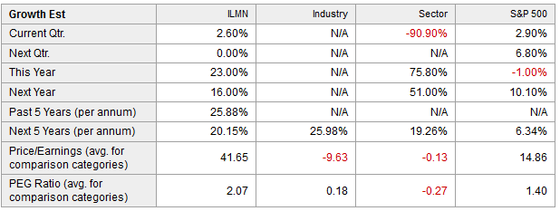
INVESTIGATE

Slide 10
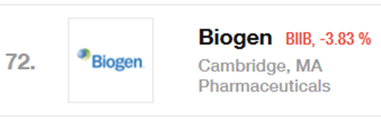
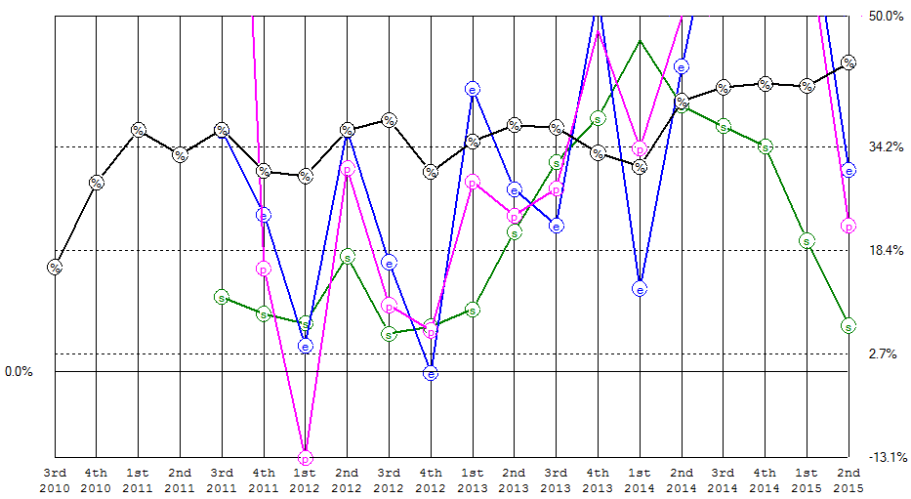
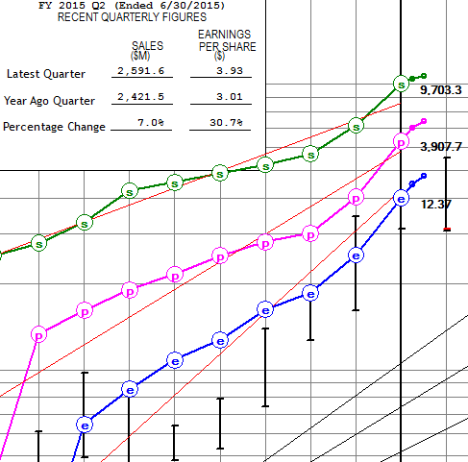

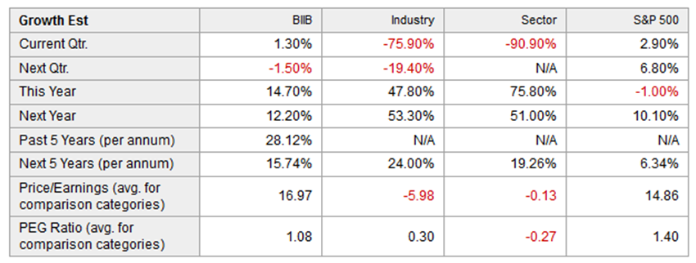
INVESTIGATE

Slide 11
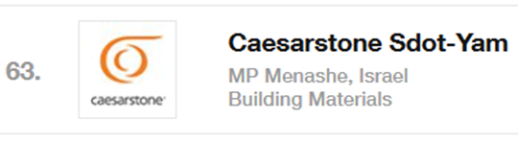
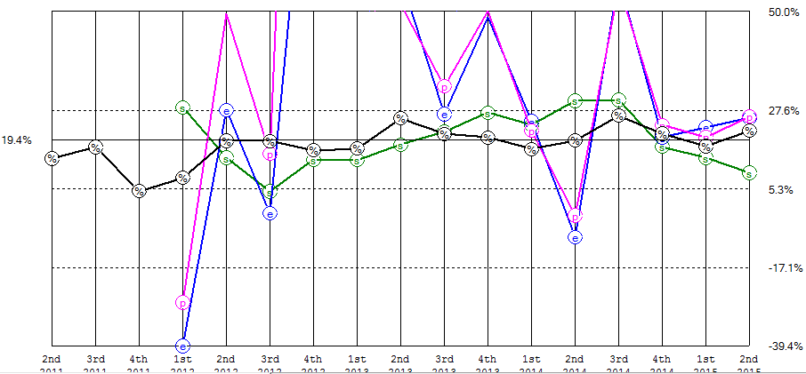
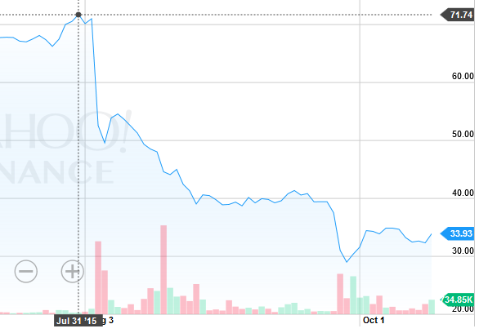
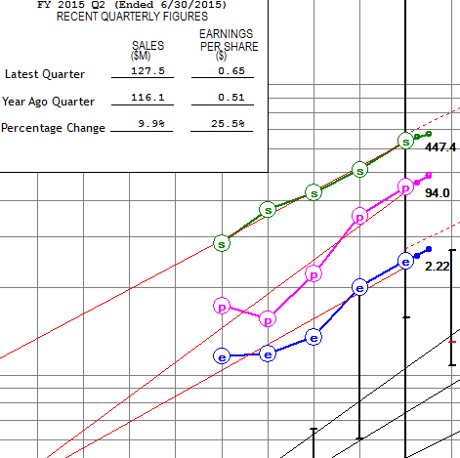
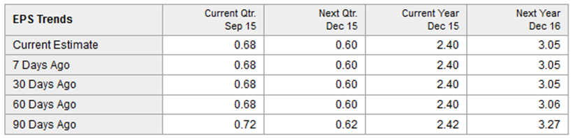
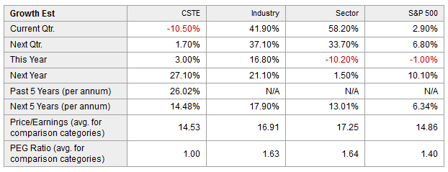
-$38.00 (-53%)
INVESTIGATE

Slide 12
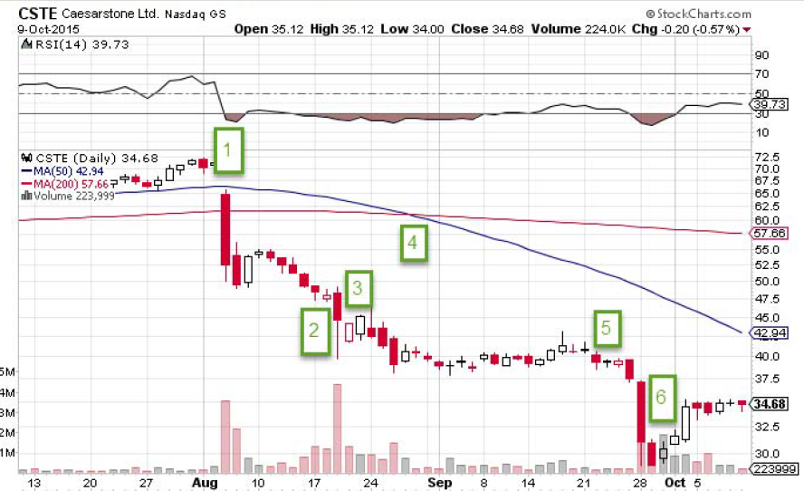
Sales Forecast Cut
Death Cross
Short Attack
2 Directors Resign
Lawsuit – Securities
Law Violations.
Short Attack #2

Slide 13

 | Proto Labs (PRLB)
 | Prospector Industry Tools & Accessories |  | Off & Dir: 8.4% Institutional: 96.9%
Background Info Leading online and technology-enabled quick-turn manufacturer of custom parts for prototyping and short-run production. Proprietary technology eliminates most of the time-consuming and expensive skilled labor conventionally required to quote and manufacture parts in low volumes. Customer transactions are conducted almost entirely though the Internet. Nearly 2/3rds of customers use some form of 3D printing. The addition of Fineline adds support capability for Proto Labs in this area.
Revenues (~$198M) |  | Geographic Breakdown Manufacturing Facilities in Maple Plain, MN; Raleigh, NC; Telford, UK; & Kanagawa, Japan.
Strengths (Moat = WIDE) 1. Prototype turnaround as quick as a day. 2. FineLine acquisition in May 2014 adds: Advanced stereolithography (STL), Selective laser sintering (SLS), and Direct metal laster sintering (DMLS) To existing capabilities in: Rapid CNC machining; and Injection molding processes. 3. No Debt. |  | Weaknesses / Risks Competition: Quickparts (subsidiary of 3D Systems (DDD)).

Slide 14
Skyworks Solutions (SWKS)

Slide 15
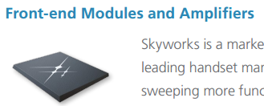
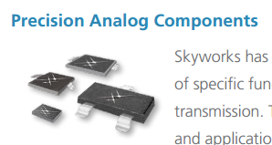

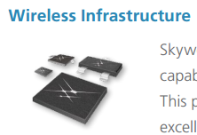
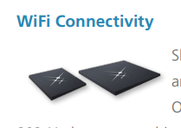

SWKS – Types of Devices

Slide 16
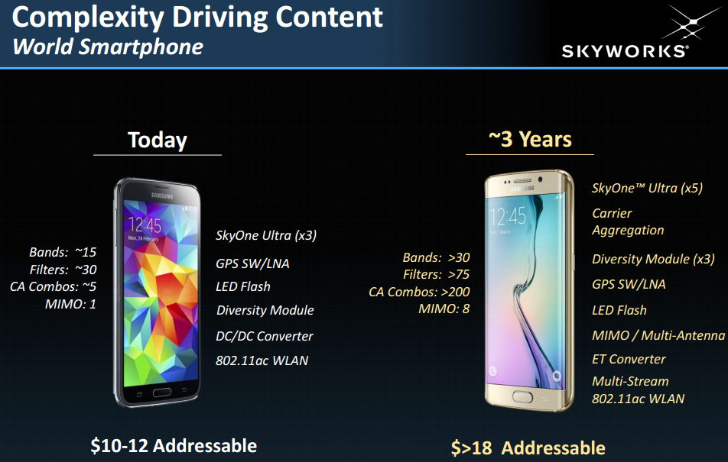
SWKS – Types of Devices in Phone
Large rise in $ content for complex Smartphones (iPhone/Samsung)

Slide 17
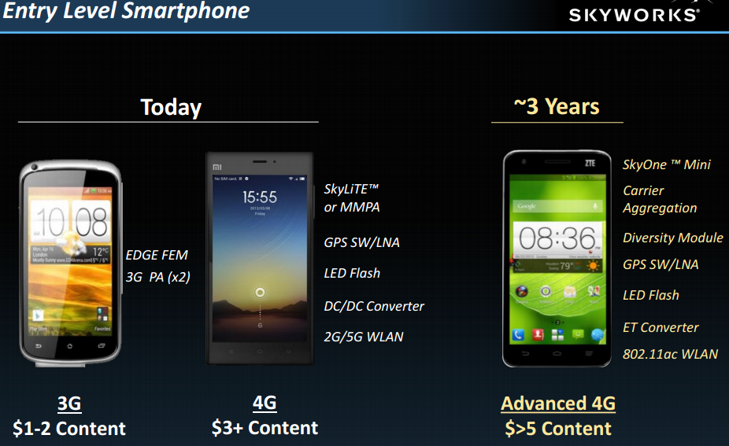
SWKS – Types of Devices in Phone
Decent rise in $ content for entry Smartphones (India / China, volume!)

Slide 18
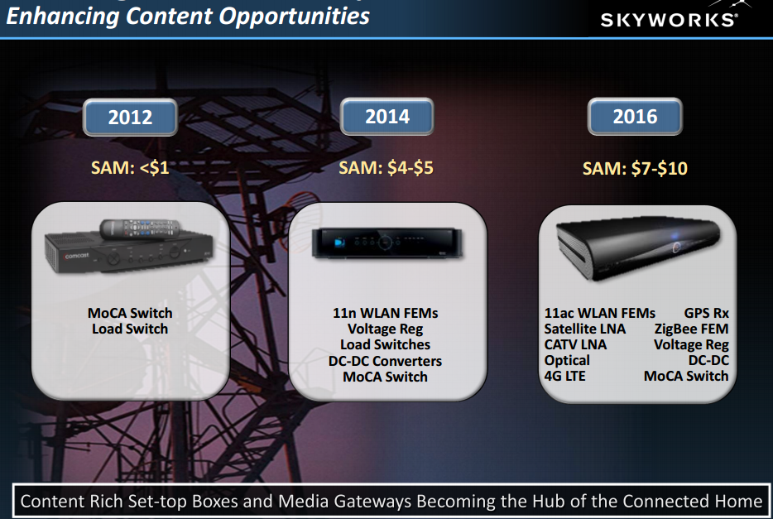
SWKS – Types of Devices in CableBox
Content rising in various devices

Slide 19
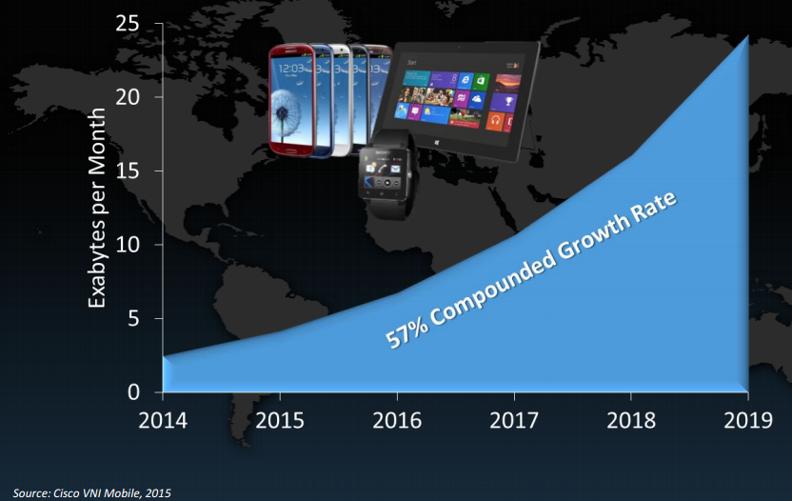
SWKS – Growth in Data Usage/month
2015-2017 – doubling of data consumption; huge 57% growth expected

Slide 20
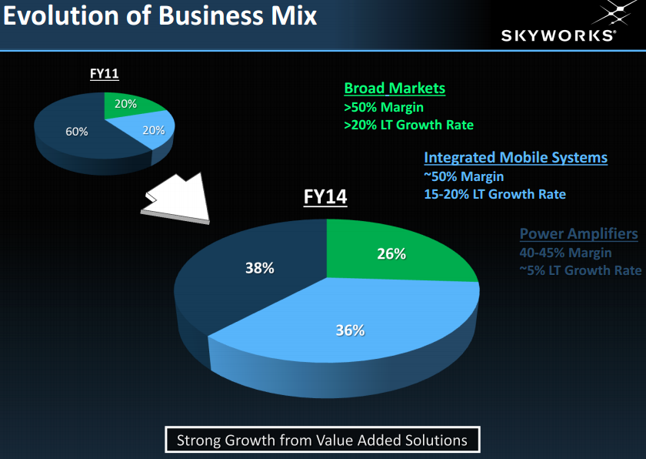
SWKS – Enhancing Margins
Green and Blue shaded areas have strong growth with higher margins

Slide 21
SWKS – Team A Sept Info + Team B
Customers: #1 Apple accounting for 35-40% of their company annual revenue, #2 Samsung
Competitors for Chip: Intel
Competitors for radio frequency: Leader is Skyworks followed by AVGO, QRVO
Nine straight quarters of double digit earnings growth
Growing connectivity will continue to drive demand for Skywork’s offerings translating into further top and bottom line advances in 2016.
------------------------------------------------------
Total dollar amount of Radio Frequency (RF) components in smartphones rising because of LTE or 4G adoption
  iPhone 6, for example. Total RF front-end content costs -- $15.89 per phone (Barclays’ analysis); up 324%, compared to a typical 3G phone. LTE (4G) penetration rates in China check in at a measly 12%
Manifest Aug 2015 Roundtable, recommended by Ken Kavula https://www.youtube.com/watch?v=APGW8E4n0Ns (start at min. 40)
  Per Valueline, profit margin expansion expected to go from 20% to 29.5%
Skyworks website full of good videos/product info:
  http://www.skyworksinc.com/About.aspx

Slide 22
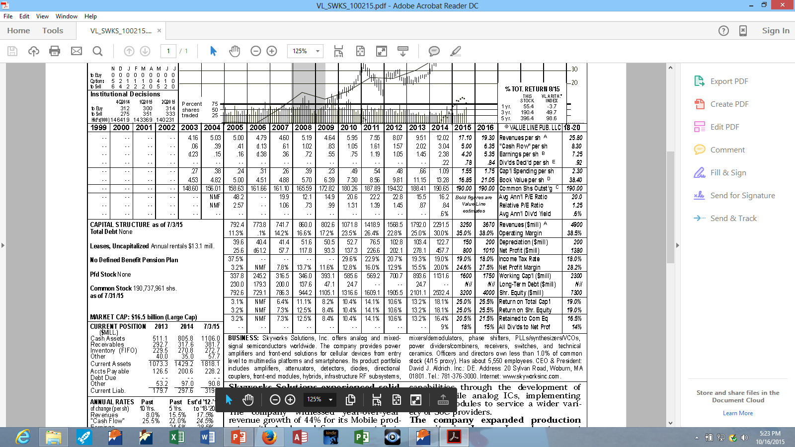

SWKS Meets the Triple Play Criteria
1. Projected Return significantly higher than the average stock.
2. Room for P/E expansion exists.
3. Room for Margin expansion exists.

Slide 23
 | Hain Celestial Group (HAIN)
 | Prospector Industry Food Distribution |  | Off & Dir: 2.7% Institutional: 91.6%
Background Info Hain Celestial manufactures, markets and sells natural, GMO free and organic products across several food, beverage, and personal care categories. Sells mainly to specialty and natural food distributors and markets to supermarkets, mass merchandisers, and natural foods stores. Brands include: Health Valley, Celestial Seasonings, Sensible Portions, Ella’s Kitchen, Terra, Earth’s Best, Arrowhead Mills, The Greek Gods, Rice Dream, Garden of Eatin’, Lima, WestSoy & others.
Revenues (~$2.7B) ~55% Traditional Grocers (Kroger, Target, Walmart, Publix) |  | Geographic Breakdown 51% Sales US 27% Sales UK
Strengths (Moat = NONE) Benefiting from rising demand of health oriented products (category growth 10%+). Efficient procurement, production and distribution infrastructure, but size limited. First mover advantage. Many years of experience managing natural and organic supply chains. Distribution wins in traditional grocery (benefit from mainstreaming of health oriented trend). |  | Weaknesses / Risks Competition. Products do not have enough brand recognition to command pricing power. Large CPG firms are increasing focus due to higher growth than traditional grocery. Overall trend has raised sector valuations. Margins lag CPG firms. High demand with constrained supply for key ingredients restricts sourcing leverage. Depend on local sources for ingredients.

Slide 24
Overall Team Recommendation
Add to SWKS.
Assign Stock Watcher and closely watch / investigate CTSE.
Consider PRLB for small position in future.
Potential Industry Study for next month:
  Food Distribution: HAIN, UNFI, CORE, SPTN

