Slide 1
EXPD
1-year chart
3-year chart
3-year chart
5-year chart
Stockcharts.com
Bigcharts.com
October 2010

Slide 2
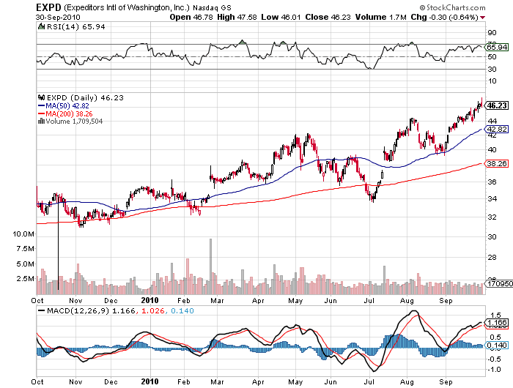

Slide 3
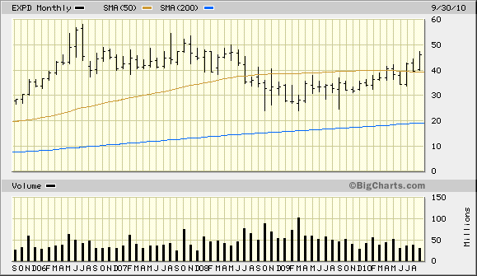
10/15/08
$30.17
1/14/09
$29.73
5-year chart

Slide 4
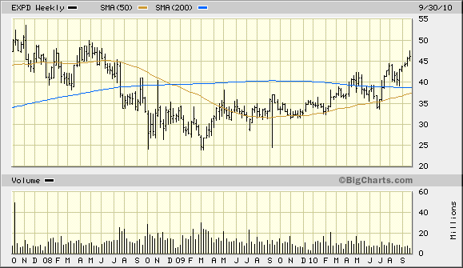
10/15/08
$30.17
1/14/09
$29.73
3-year chart

Slide 5
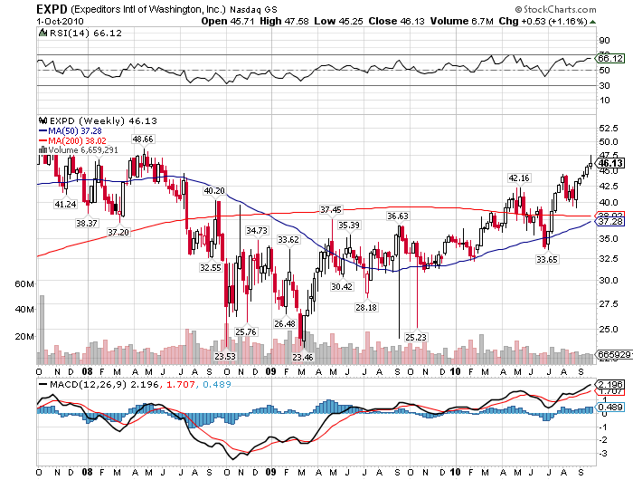
3-year chart
1/14/09
$29.73
10/15/08
$30.17

