Slide 1
EVALUATING BANK STOCKS
Elizabeth Tobin
Yankee Model Investing Club
January 8, 2022

Slide 2
REFERENCES
This presentation is based on the Better Investing 2017 seminar: Better Bank Stock Analysis Part 1by Ross Meredith Director of the Rocky Mountain Chapter
Link to the Video: https://www.betterinvesting.org/members/learning-center/video-learning-library/stockup/better-bank-stock-analysis/better-bank-stock-analysis

Slide 3
SMALL? MEDIUM? OR LARGE?
Small to Medium banks generally make money through loans funded by depositors
Larger banks offer other services such as, trading, insurance and investment banking services
This presentation will focus on loans and deposits

Slide 4
HOW BANKS MAKE MONEY
Primary source of revenue is generated by interest on the loans the bank gives to customers
Depositors fund these loans and the bank pays interest to its depositors
Net Interest Spread a/k/a Net Interest Margin: difference between the interest rate the bank earns from loans and interest rate the bank
pays for funding

Slide 5
LET’S LOOK AT EXPENSES
Overhead Expenses: all costs incurred other than the cost of
funding – facilities, staff, services, etc.
Efficiency Ratio: % of how much of each dollar of new revenue goes to overhead
Best banks maintain efficiency ratio of < 60%

Slide 6
TOTAL EXPENSES
Overhead + Interest Rate Bank for Funding =
Expenses
• Pricing Loans Is A Key Management Skill

Slide 7
LOAN QUALITY IS PRIMARY
Maintaining a high quality portfolio of bank loans is a KEY MANAGEMENT SKILL.
• Bad loans are expensive; entire loan amount is lost, not just the interest.
Loan Runoff is the portion of the bank’s loans that are paid off every year. (Average loan runoff is 10% per year.)
To increase revenue and income, a bank must increase it loans.

Slide 8
HIGH QUALITY US BANKS
Lose less than 1% of loans to default per year.
Grow assets at about 4‐5% per year.
Have actual growth, including replacement of paid off loans at 14-15% per year.

Slide 9
RECAP
So far we know that the best bankers:
• Make good use of their deposits, a low cost
source of funding
• Control their costs well
• Make good loans and price them well
• Achieve consistent growth of assets ‐ loans are a large portion of a bank’s assets

Slide 10
TWO NUMBERS TO
PINPOINT GOOD BANKS
Loan Loss Provision – the amount of loans the bank lost in the year is a good measure of the quality of the bank’s loans
Return on Average Assets (ROAA) measures the income the bank was able to earn after all expenses

Slide 11
MEASURING LOAN QUALITY
• Loan Loss Provision expense ratio – is the amount of Loan Losses to amount of Total Loans to measure bank’s ability to make good loans
• Calculate the ratio – Loan loss provision expense Divided by Total loans
If loan losses are well below 1% of loans for 8‐10 yearsthat’s a good lender.
• In Value Line look for the box Loss Provisions. Divide it by Net Loans and it should be less than 1%

Slide 12
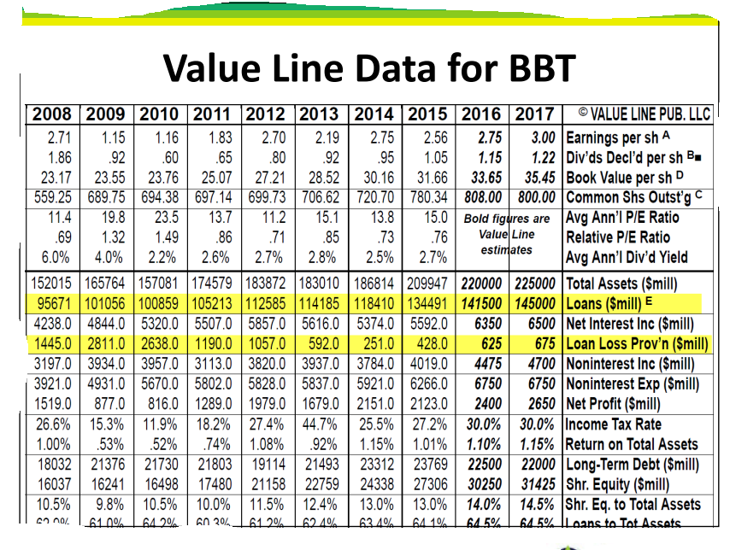
VALUELINE SHORTCUT

Slide 13
Return on Average Assets (ROAA)
A good measure of profitability for a bank
Defined as Net Income / Average Assets Average Assets = (Beginning year assets + Ending year assets) / 2
Quantifies management’s ability to control expenses and to maximize earnings from the assets
We want banks that consistently exceed over 1% earned on assets
Defined by Value Line as earnings divided by total assets (ROA)

Slide 14
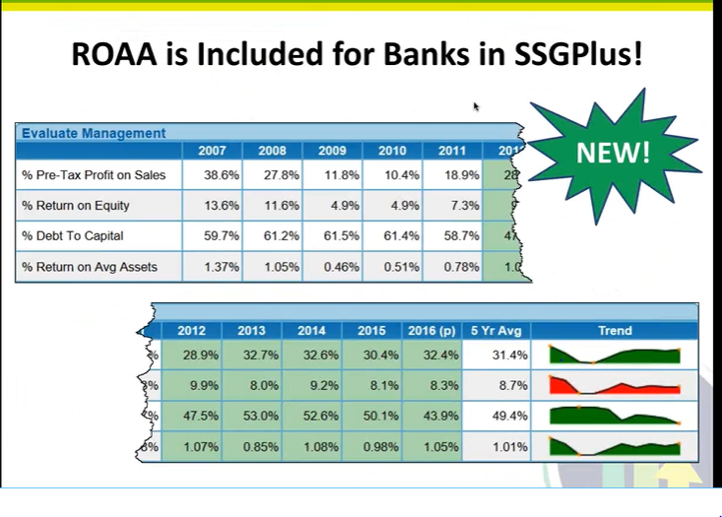
Thank You SSG!

Slide 15
WHAT’S A GOOD ROAA?
As of 2017 the average bank earns a return on assets of about 0.79%
Over 1.25% is good, only 9% of banks do that.
Over 1.5% is VERY good, less than 4% of banks do that.
A high ROAA is indicative of good management.
ROAA Average is About 0.8%
Good is Greater than 1.25%
Excellent is Greater than 1.5%

Slide 16
Forecasting Future P/Es
P/Es for banks, in general, tend to be low.
Historical averages are often a good reflection of future P/Es for a high quality bank.
Look at how the stock price performed in the Great Recession.
Bank P/Es may be more sensitive to economic trends, including interest rates.

Slide 17
IN THE SSG
Sales = Net Interest
Income + Non Interest Income
Total Assets is a line on the first page of SSG
ROAA is included in SSG Plus

Slide 18
RESOURCES
Better Investing Learning Center
Better Bank Stock Analysis Parts 1&2 by Ross Meredith Director of the Rocky Mountain Chapter
S&P Industry Survey ‐ Banks
• The Five Rules for Successful Stock Investing by Pat Dorsey
• Khan Academy (KhanAcademy.org) – Search Subjects: Finance and Capital Markets, Money, Banking and Central Banks
• Banks’ Investor Relations Website
• FDIC.gov

