Slide 1
Judgement Assistance for the Stock Selection Guide
Jack Finn
Yankee Chapter Model Investment Club

Slide 2
“Be fearful when others are greedy, and be greedy only when others are fearful.”
- Warren Buffett

Slide 3
Where Do We Need Help on SSGs?
Growth Rates
Revenues
Earnings
Future PEs (Price Earnings Ratios)
Current and Projected PEs
Trends in PE
Future Prices
High Price = Est High PE X Est. High EPS
Low Price = Est Low PE X Est. Low EPS (or other estimate)

Slide 4
Help Available from Many Sources
Growth Rates
Theory – businesses can only grow so fast
Trend Lines for Sales & EPS (Front of SSG)
Value Line, Morningstar, CFRA, Analyst Estimates
Future PEs (Price Earnings Ratios)
Current and Projected PEs (SSG, Value Line)
Trends in PE (Stable, Unstable, Up or Down?)
PEs tend to decline as a company grows
Future Prices
Fair Values (CFRA, Morningstar, etc.)
Value Line (3-5 year price range)

Slide 5
We are going to look at some of them
Growth Rates
Theory – businesses can only grow so fast
Trend Lines for Sales & EPS (Front of SSG)
Value Line, Morningstar, CFRA, Analyst Estimates
Future PEs (Price Earnings Ratios)
Current and Projected PEs (SSG, Value Line)
Trends in PE (Stable, Unstable, Up or Down?)
PEs tend to decline as a company grows
Future Prices
Fair Values (CFRA, Morningstar, etc.)
Value Line (3-5 year price range)

Slide 6
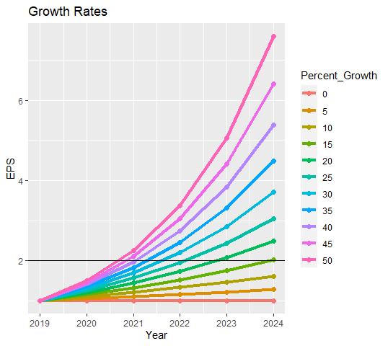
Theory: Exponential Growth
Doubling Times
15% - 5 years
20% - less than 4 years
25% - about 3 years
30% - about 2.6 years

Slide 7
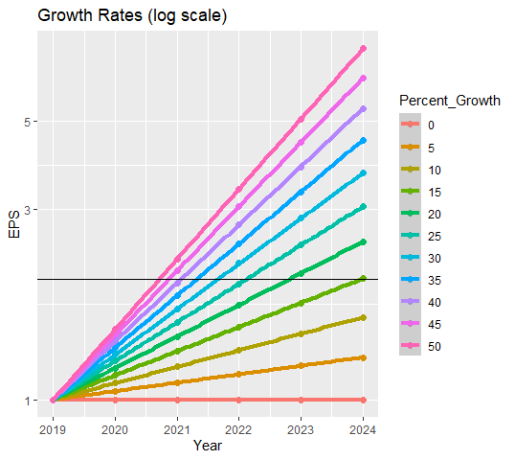
Theory: Exponential Growth
Doubling Times
15% - 5 years
20% - less than 4 years
25% - about 3 years
30% - about 2.6 years
Rule of Thumb:
No Growth Rate greater
than 25%!

Slide 8
Growth Rates from SSG Trend Lines
Trend lines (sales & earnings) show how fast a company has been growing.
Don’t expect big improvement in growth!
Exceptions
Recovery from a disaster
Mergers might change growth rate (for good or ill)
Compare your estimate to the long term trend
Examples

Slide 9
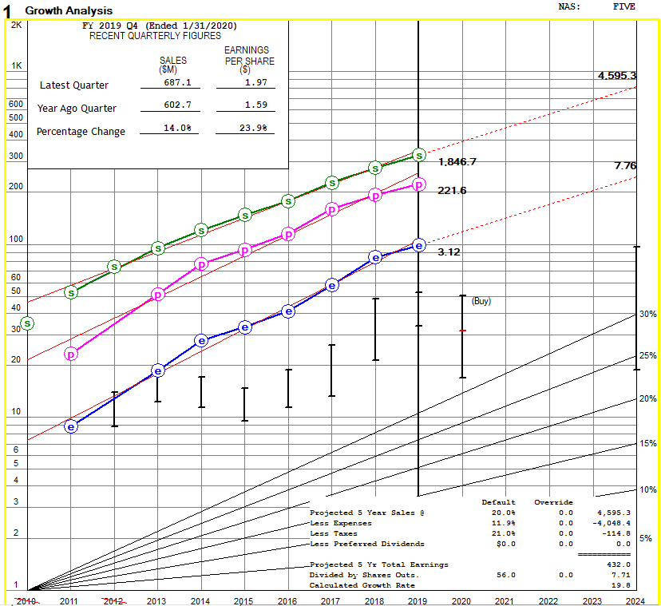
SSG for Five Below
Sales, EPS & Pre Tax Profit are all
UP
STRAIGHT &
PARALLEL
Projected growth rate a little lower than trend

Slide 10
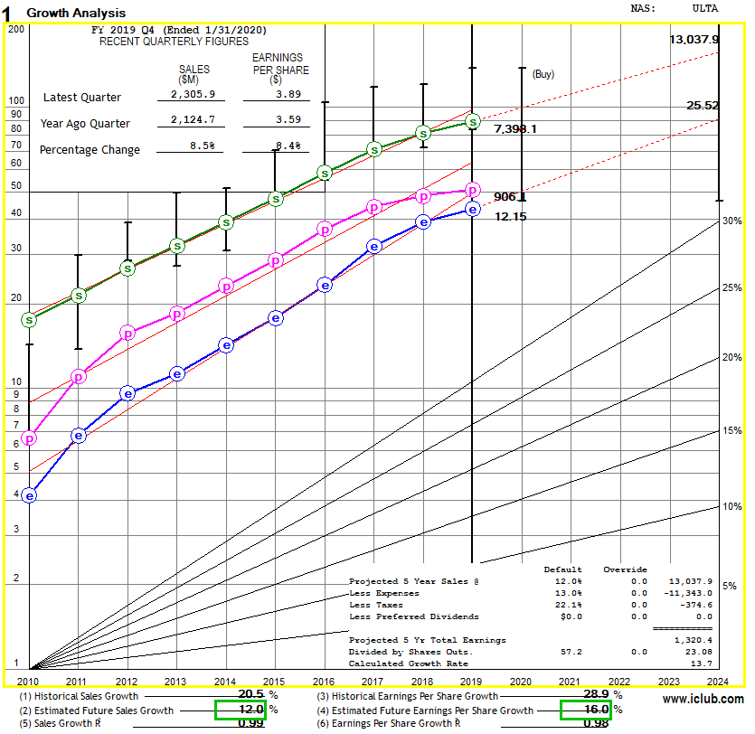
SSG for Ulta Beauty
Sales, EPS & Pre Tax Profit are all sort of
UP
STRAIGHT &
PARALLEL
BUT all three have slowed since 2017 because of competition (e.g., Sephora?)
Projected growth rate a little higher than trend
I am predicting an improvement vs. trend!

Slide 11
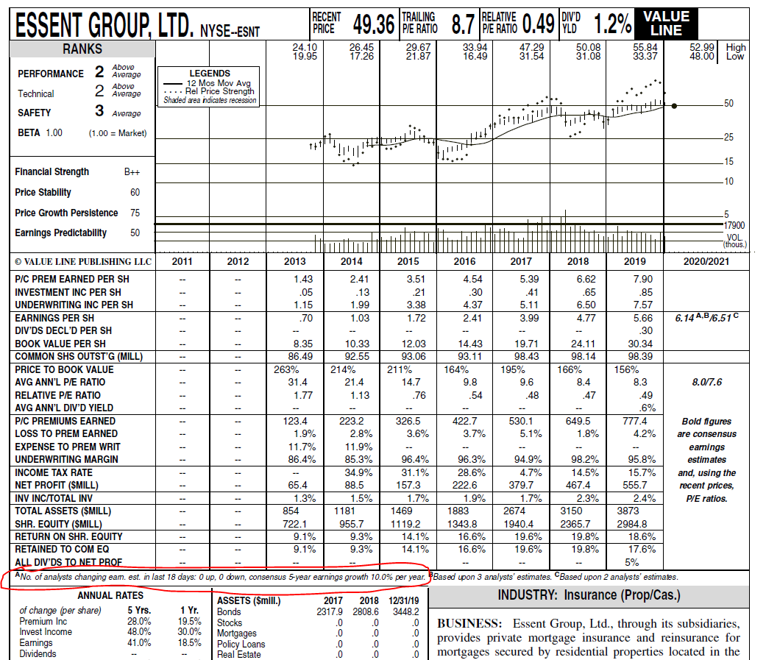
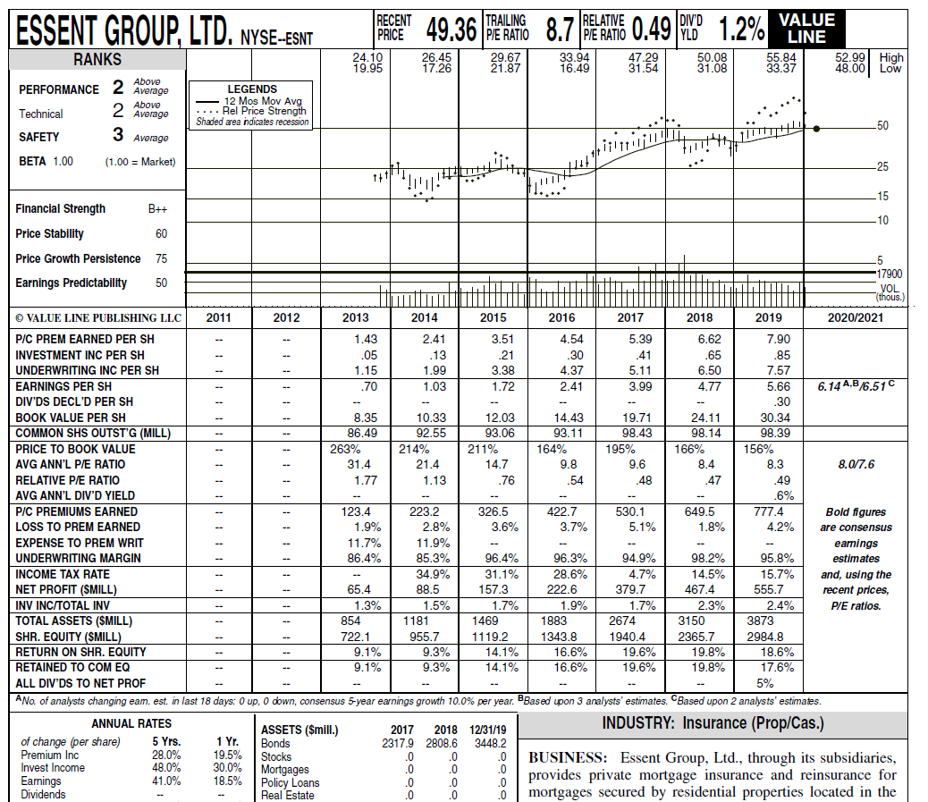
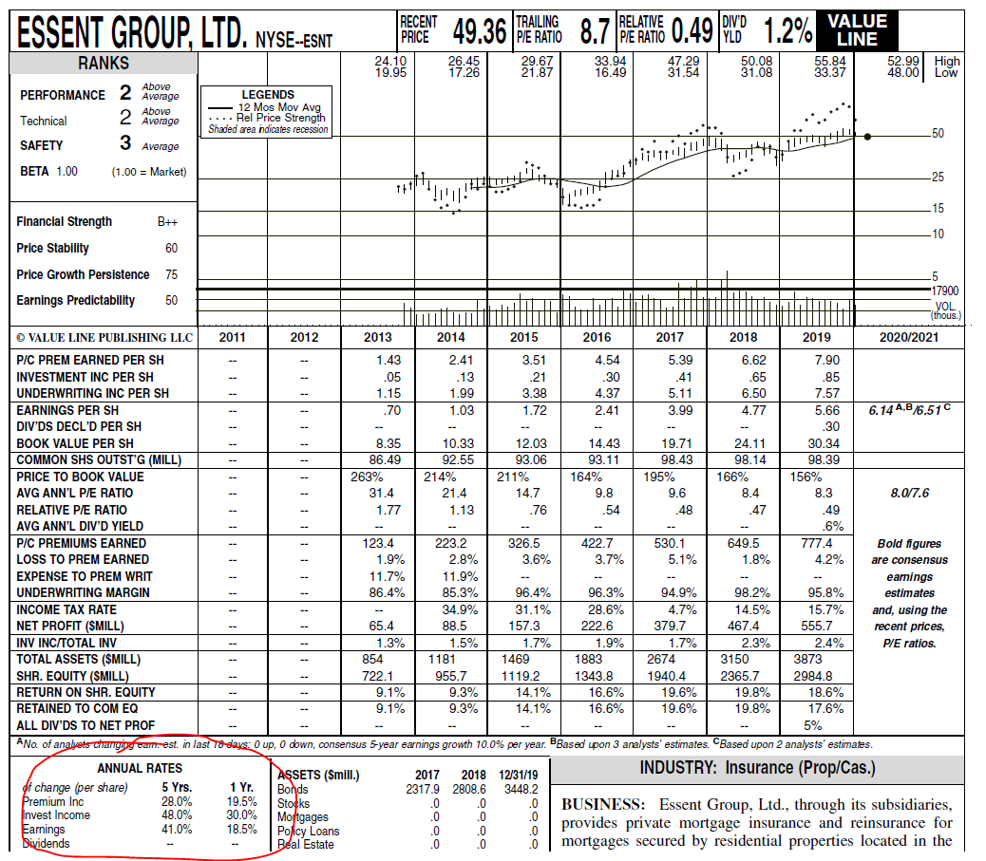
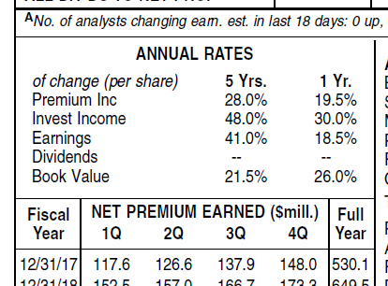
Growth Rates from Value Line
ESNT has Small Company VL Sheet
Annual Rates are historical
Analyst estimate of EPS growth is predictive

Slide 12
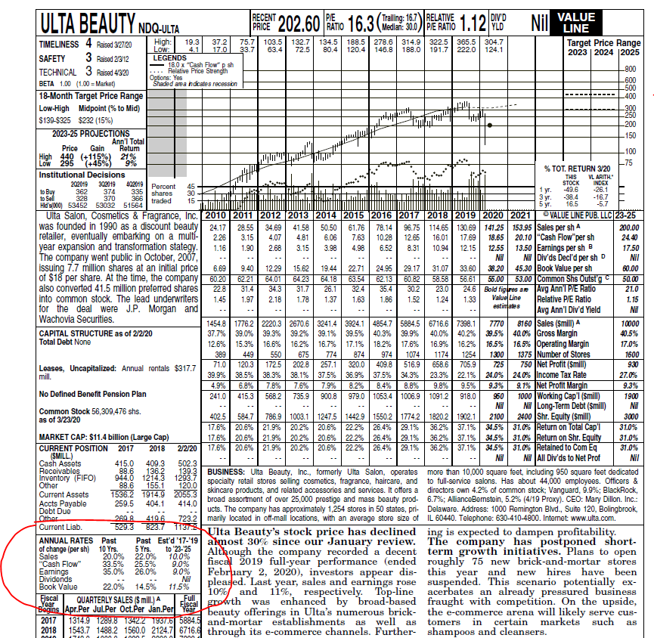
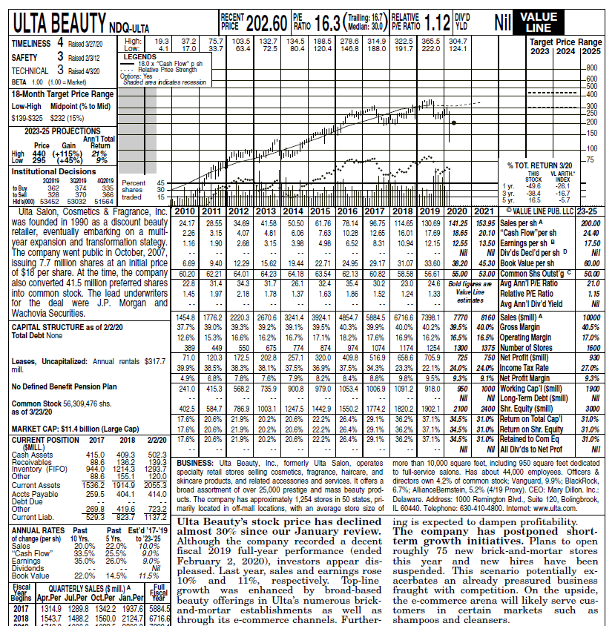
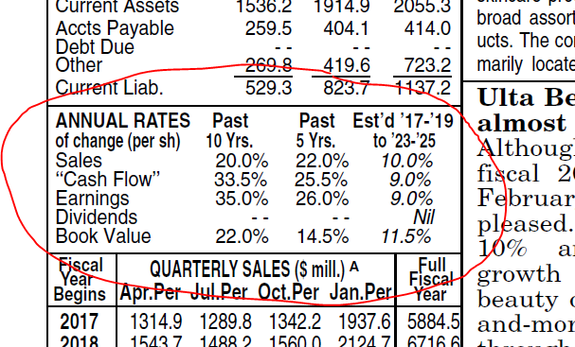
Growth Rates from Value Line
ULTA has a full VL Sheet
Annual Rates are historical & predictive

Slide 13
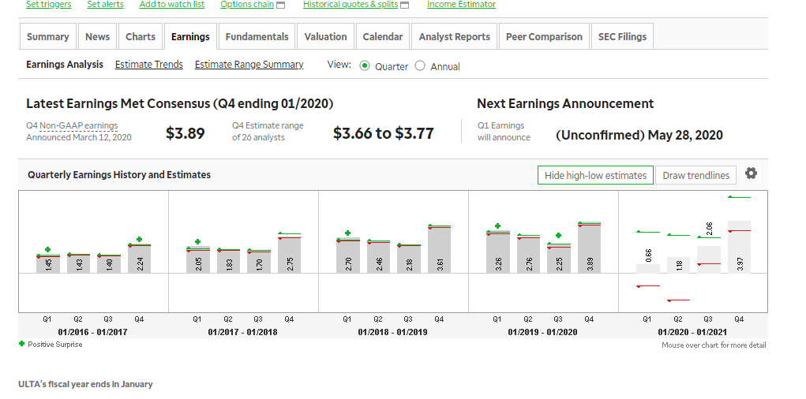
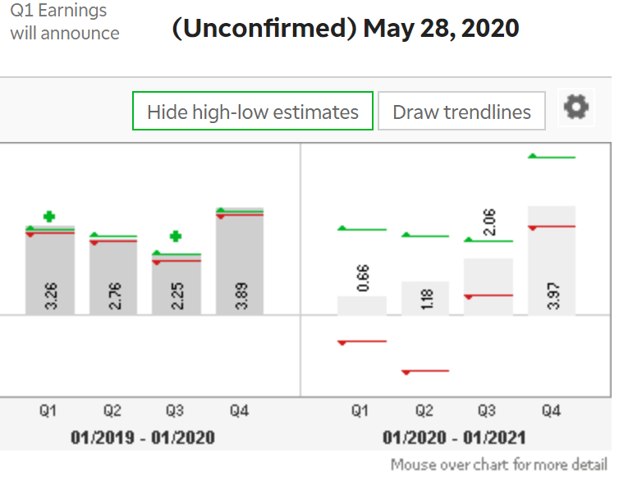
Growth Rates from Analyst Estimates
Analyst estimates for sales and EPS available from many sites
Ameritrade’s profile for ULTA showing history and prediction of quarterly numbers
Predictions indicate extreme uncertainty for this retailer!
Q1 2020 EPS estimates range from $(.97) to $3.13!

Slide 14
Future PEs from Value Line
ULTA has a full VL Sheet
Last column has prediction for 2023-2025
Sales
EPS
Avg PE

Slide 15
Conclusions
Judgements on companies are hard (EVEN FOR ANALYSTS!)
Don’t buck the trend lines unless you have a good reason
Let the various data sources guide you
Many other resources offer advice on judgement (See recorded BI Webinars)

