Slide 1
PREFERRED PROCEDURE
YANKEE INVESTING CLUB
February, 2021

Slide 2
SOURCES:
Better Investing (BI) Video 2019 Video: https://www.betterinvesting.org/members/learning-center/video-learning-library/special-programs/estimating-eps-using-the-preferred-procedure/estimating-eps-using-the-preferred-procedure
NOTE: BI Recommends that you use the Preferred Procedure AFTER you’ve already done a few SSGs, so this is not necessarily a presentation for beginners.

Slide 3
Use the Preferred Procedure to Refine Your EPS Growth Projections
Use the Earnings Per Share (EPS) Growth Projections to calculate your projected High Price for the stock you are studying.
You want to project your EPS growth 5 years into the future.
The better you can estimate the 5 year growth projection for EPS the better you can project your estimated HIGH PRICE, and this means your SSG’S BUY/HOLD/SELL range will be more realistic, too.

Slide 4
BI GUIDELINES FOR ESTIMATING
EPS GROWTH RATE
Make sure your estimated EPS growth rate is NO HIGHER than your sales estimate
It’s difficult and/or unlikely that a company will be able to sustain a growth rate of 15-20% long-term, so it’s a good idea to cap your estimated EPS at 20%

Slide 5
CAN YOU ANSWER THIS QUESTION?
How will the company make its earnings GROW?
Using the Preferred Procedure can help you to answer this question more fully.

Slide 6
THE IMPORTANCE OF BEING EARNEST
Do your Research and Look at the company’s income statement.
The income statement will take you on a journey starting at the company’s:
TOP LINE: Sales
to their
BOTTOM LINE: Earnings Per Share

Slide 7
PAST VS. FUTURE
A company’s Income Statement gives you a look into that company’s past performance
The Preferred Procedure helps you to project the company’s future performance

Slide 8
THE MAIN BENEFIT OF USING THE
PREFERRED PROCEDURE
Think of the Preferred Procedure as a simplified version of a company’s Income Statement …that…
Allows you to Project the company’s performance Five Years Into the Future …by…
Calculating future earnings based on revenue growth projections … this…
Connects future sales to future earnings per share

Slide 9
ELEMENTS OF THE
PREFERRED PROCEDURE
In Order to Reasonably Project Your High EPS
5 Years into the Future, You Need to Make Reasonable 5 Year Projections for:
Revenue
Pre-Tax Profit Margin
Tax Rate (%)
Preferred Dividend
Number of Shares of Stock Outstanding

Slide 10
SIMPLIFIED EXAMPLE
 | Historical Averages | Your 5 Year Projections
Revenue | 1000 | 15%
Pre-Tax Profit | 20% | 22%
Tax Rate | 30% | 30%
Preferred Dividend | $10 | 10%
No. Shares Outstanding | 100 | 110
Earnings Per Share | 1.30 | ?

Slide 11
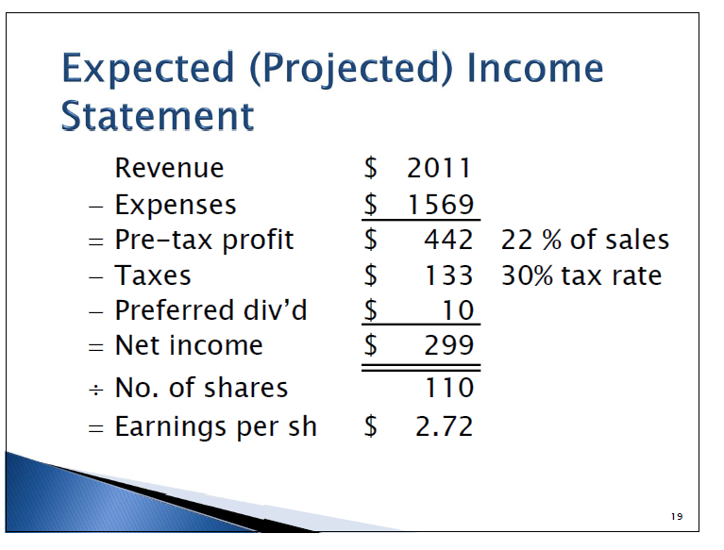
HERE’S THE FORMULA
Don’t Worry About the Math the SSG will do it for You

Slide 12
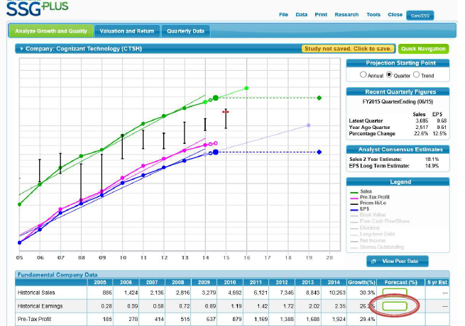
HOW TO FIND THE PREFERRED PROCEDURE ON THE SSG
Click on the SSG PLUS on the first page click on the Historical Earnings Box and it will open up the PP popup

Slide 13
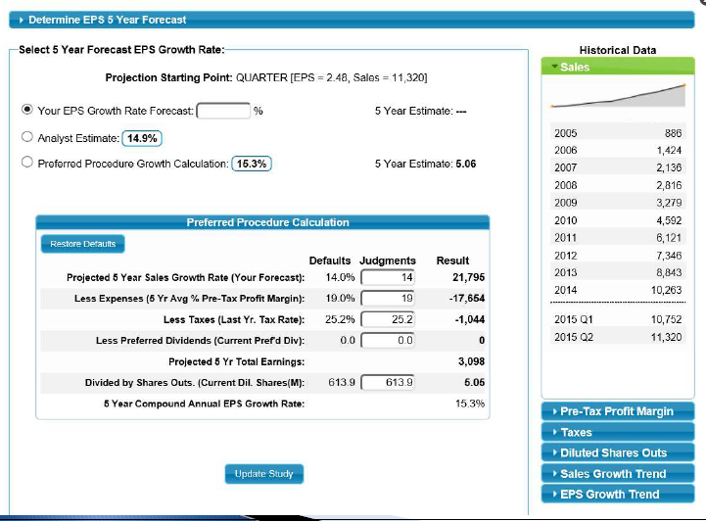
Here’s the Preferred Procedure Pop Up

Slide 14
WHERE DO THE DEFAULT JUDGMENTS COME FROM ON THE PP POPUP?
The Stock Selection Guide automatically populates these fields for you

Slide 15
THE SSG PULLS THE DEFAULT JUDGMENTS FOR YOU
The Projected 5 Year Sales Growth Rate is the number that YOU entered on the first page of the SSG (so make sure they it’s your best reasonable judgment backed up by your research)
The SSG calculates 5 Year Average % Pre-Tax Profit Margin for you and automatically populates this field
Tax Rate is the last year’s tax rate
Preferred Dividend is pulled from the current preferred dividend

Slide 16
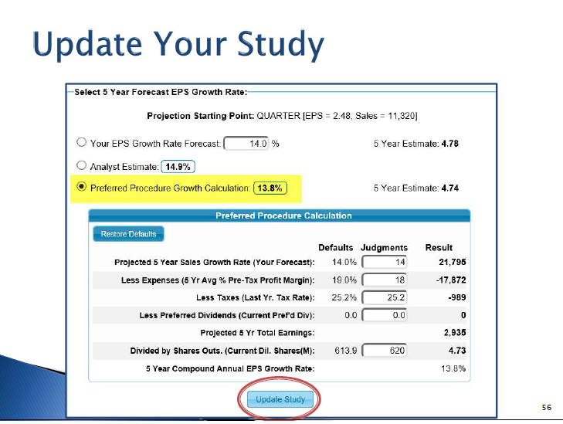
Remember to Save It!

Slide 17
WHY GO THROUGH THESE
EXTRA STEPS?
Sales growth is often more predictable and regular than earnings growth so it’s beneficial to use the Preferred Procedure to get a more accurate projection of Earnings Per Share
It’s also a way to get a second opinion on whether your initial analysis of EPS growth projection is reasonable.

Slide 18
YOU CAN KEEP YOUR FOCUS ON
THESE 3 KEY COMPONENTS:
Sales Growth,
Percentage of Pre-Tax Profits (%PTP), and
Number of Shares Outstanding
Because …

Slide 19
You Don’t Need to Spend Much Time
Tax rates don’t change much AND it’s out of the company’s control so you don’t have to spend a lot of time on this item
Most companies don’t have preferred stock so this is usually a non-issue that you don’t have to do any extra work on

Slide 20
YOU CAN CHANGE ALL THE
DEFAULT JUDGMENTS
Changing any of these default values will change your bottom line 5 Year EPS Growth Estimate –
Which remember, will CHANGE your projected HIGH PRICE, which will change your BUY/HOLD/SELL zones on the SSG

Slide 21
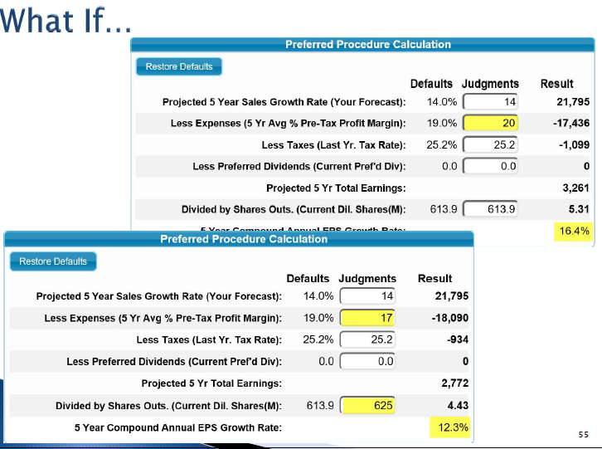
You can play with the numbers

Slide 22
THE PREFERRED PROCEDURE HELPS DEEPEN YOUR UNDERSTANDING
Makes you think about how a company makes money AND how it will grow
Helps you better understand the company’s business model
– how they manage the business,
-- what their expenses are, and
-- how profitable they are
Increases your confidence in your Earnings Projection by basing your earnings growth projections on your own research and analysis and by applying logic to what you know about the company’s business
Reduces your reliance on analysts

