Slide 1
Finding a Small Company in the Semiconductor Equip. Industry
Changing from cyclical to growth?

Slide 2
Cyclical But Growing
From World Semiconductor Trade Statistics

Slide 3
Monthly Semiconductor Revenues and Y/Y % Change

Slide 4
What Companies Say

Slide 5
What Companies Say
From Taiwan Semiconducter (TSM)

Slide 6
Semiconductor Packaging Becoming More Complex

Slide 7
Semiconductor Packaging Becoming More Complex
Advanced packaging is a general grouping of a variety of distinct techniques, including 2.5D, 3D-IC, fan-out wafer-level packaging and system-in-package
Autonomous Vehicles may require
High resolution video
Real-time video processing
Supercomputer in the trunk!
HBM - High Bandwidth memory
GPU-CPU Integration (NVDA)

Slide 8
Search for Small Semiconductor Equipment Stocks – First Pass
Use Search Tool in BI to identify small Semi-Equip. companies
Examine previews to identify QUALITY companies
Put up, straight & parallel charts in good pile
Put downward trend, short history and erratic charts in bad pile
Make maybe pile for companies you can’t decide on

Slide 9
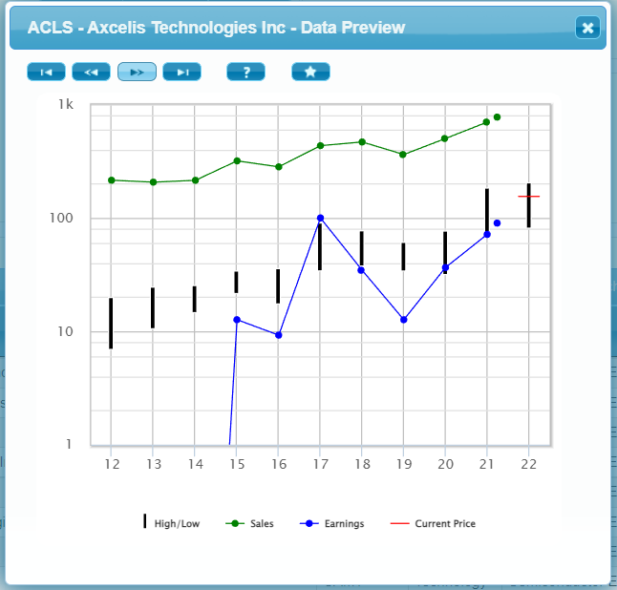
Search for Small Semiconductor Equipment Stocks – First Pass: Good (5)
A

Slide 10
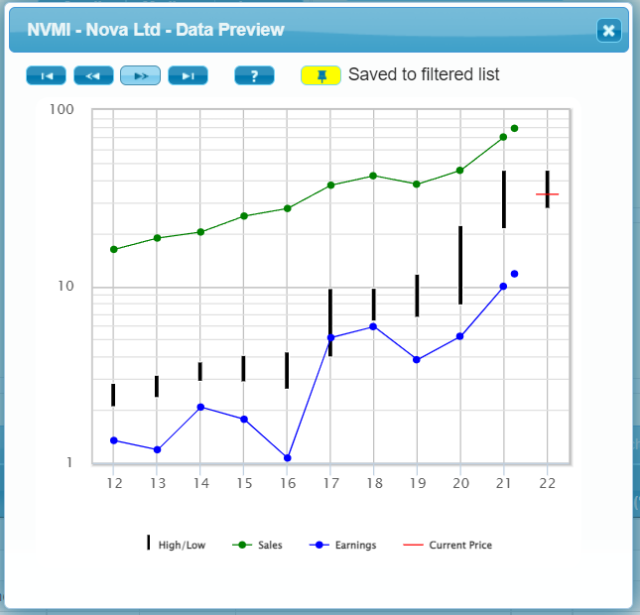
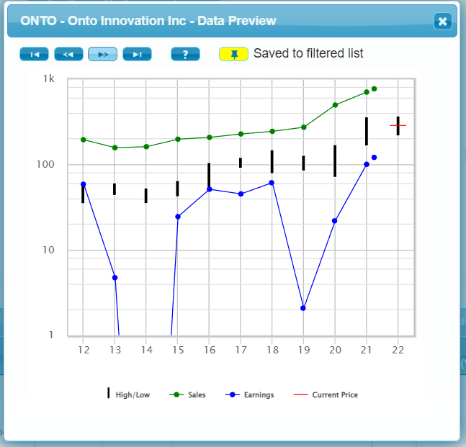
Search for Small Semiconductor Equipment Stocks – First Pass: Good (5)
B

Slide 11
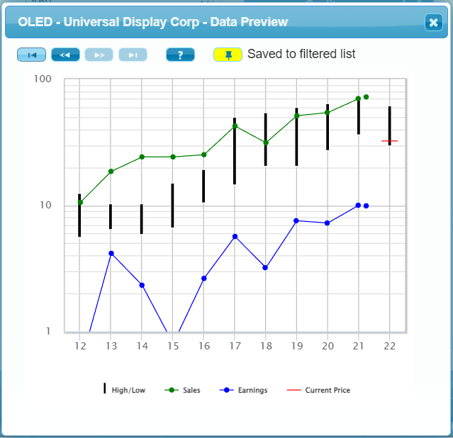
Search for Small Semiconductor Equipment Stocks – First Pass: Good (5)
C

Slide 12
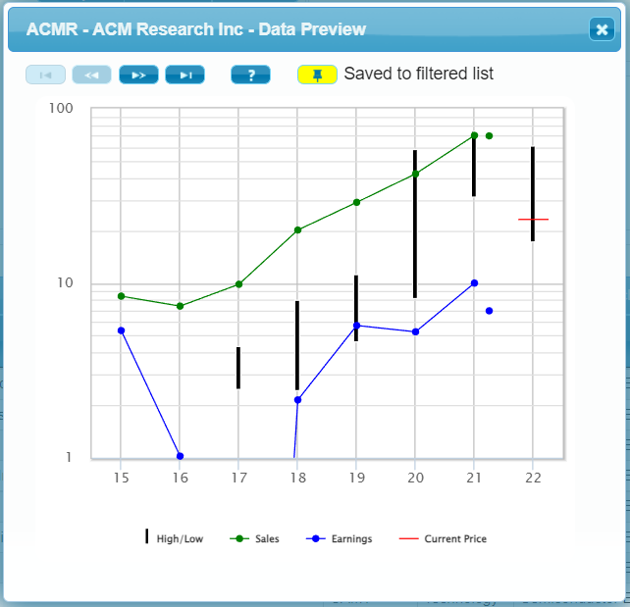
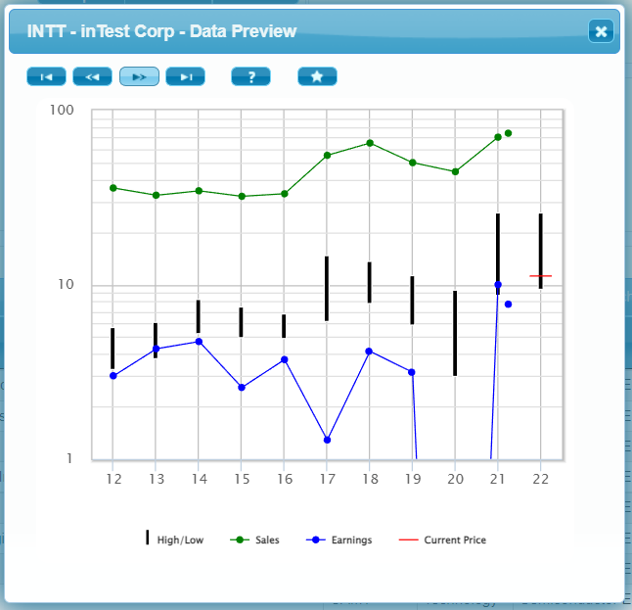
Search for Small Semiconductor Equipment Stocks – First Pass: Maybe (3)
A

Slide 13
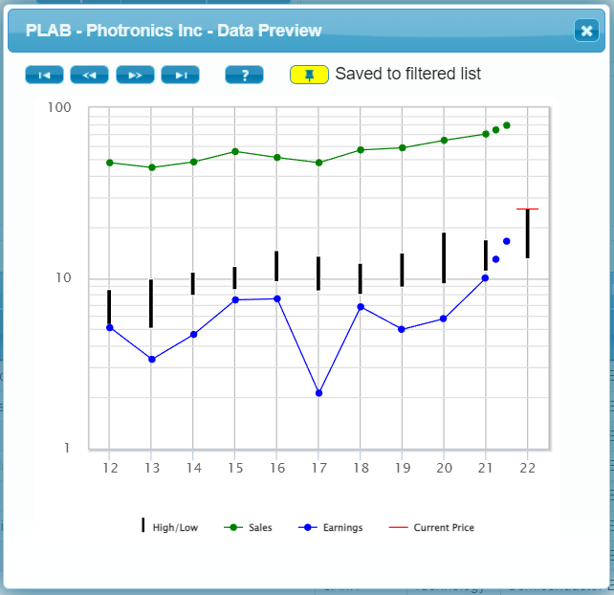
Search for Small Semiconductor Equipment Stocks – First Pass: Maybe (3)
B

Slide 14
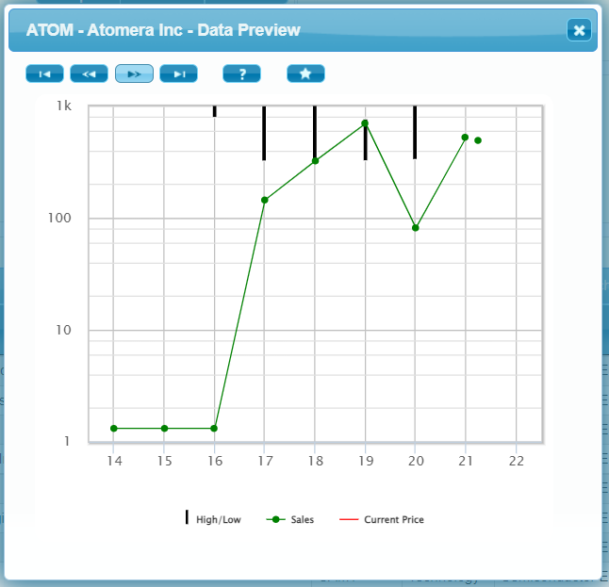
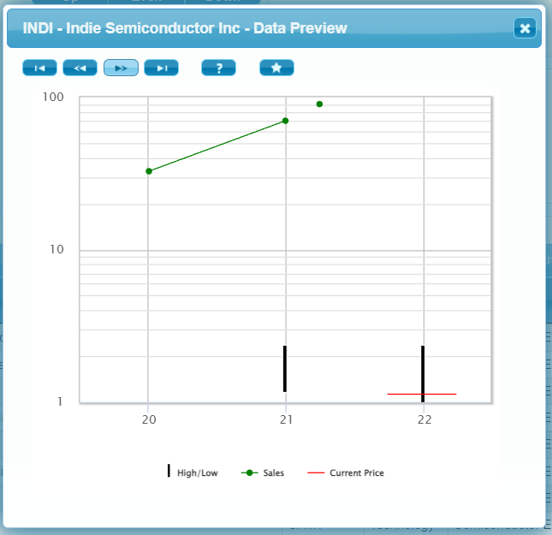
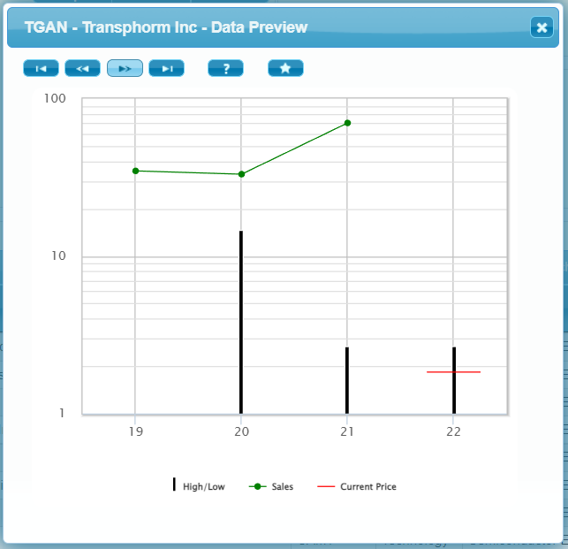
Search for Small Semiconductor Equipment Stocks – First Pass: Bad (12)
Too young and No earnings (3)

Slide 15
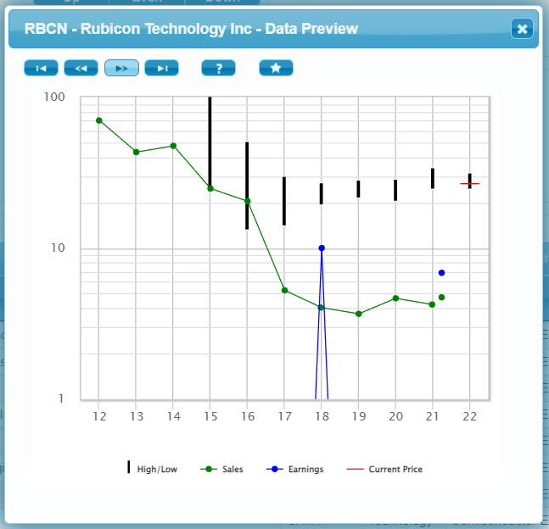
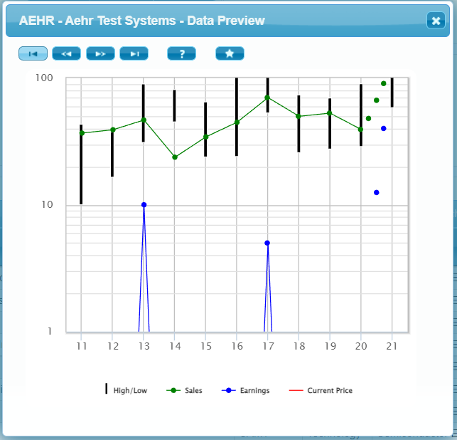
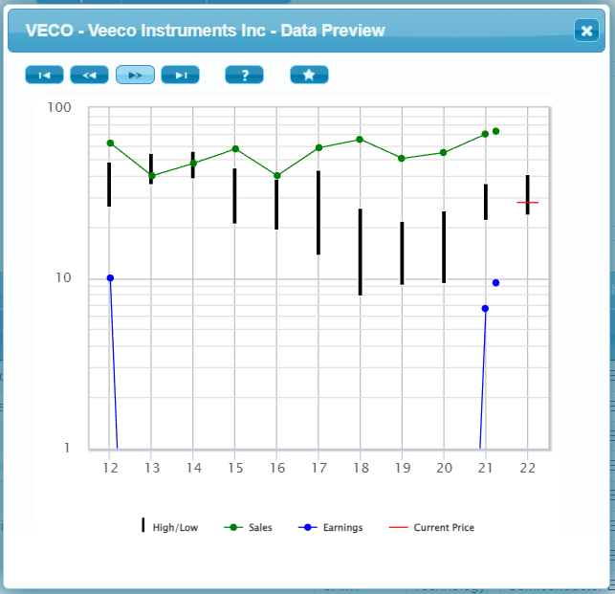
Search for Small Semiconductor Equipment Stocks – First Pass: Bad (12)
Not enough sales growth or earnings (7)
(3 Examples Shown)
AEHR
ASYS
ATOM
AXTI
RBCN
TRT
VECO

Slide 16
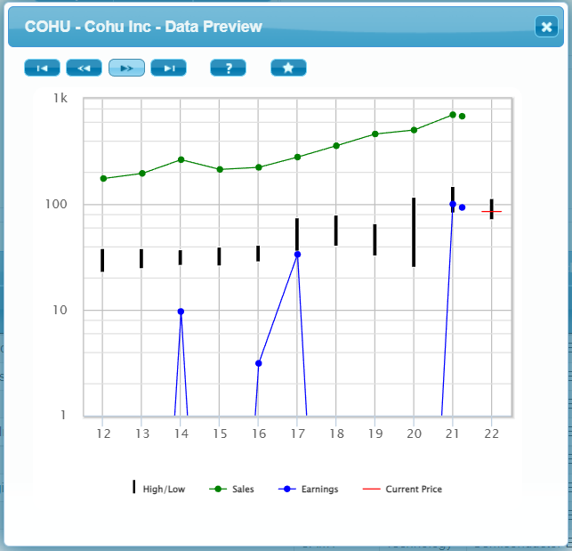
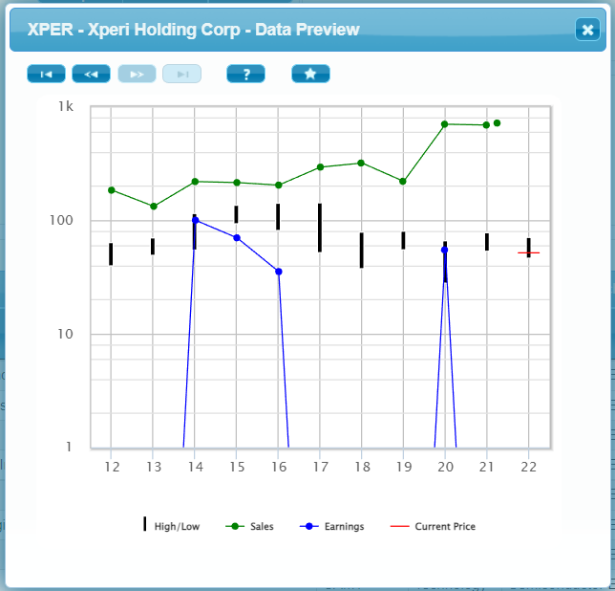
Search for Small Semiconductor Equipment Stocks – First Pass: Bad (12)
Erratic earnings (2)

Slide 17
Thin List
Keep Companies that Sell to Foundries
Foundry construction boom?
OLED sells screens for phones, TV, computer displays
Others sell equipment & service to foundries
Eliminate OLED (more consumer electronics)
Don’t need maybes
We have 3 better companies

Slide 18
Small Semiconductor Equipment Stocks – Preliminary List(4)
ACLS
CAMT
NVMI
ONTO

Slide 19
Small Semiconductor Equipment Stocks – Preliminary List(4)
ACLS
CAMT
NVMI
ONTO

Slide 20
Preliminary SSGs
All by one (experienced) person
Spend no more than 10 minutes each
Make the same kind of conservative judgements for each
Use same source for sales growth, if possible
Do not mess too much with PEs
Compare using Stock Comparison Guide

Slide 21
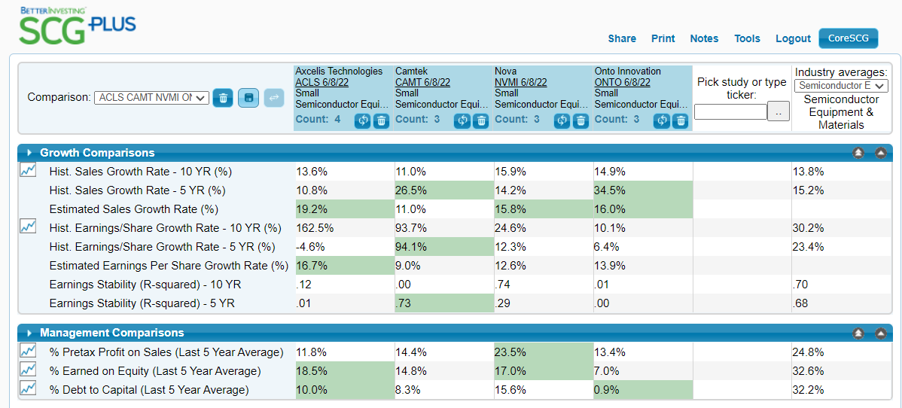

Slide 22
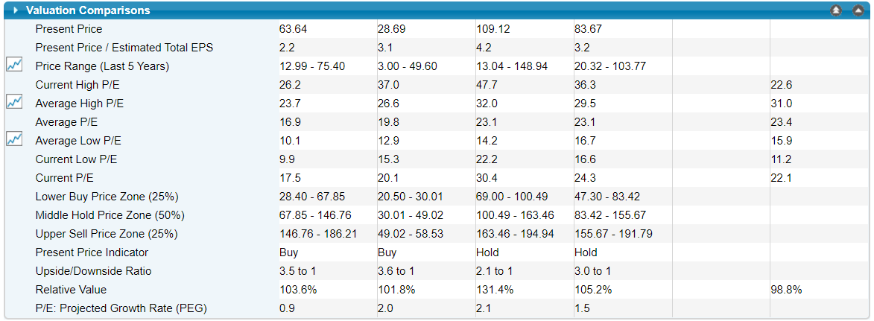

Slide 23
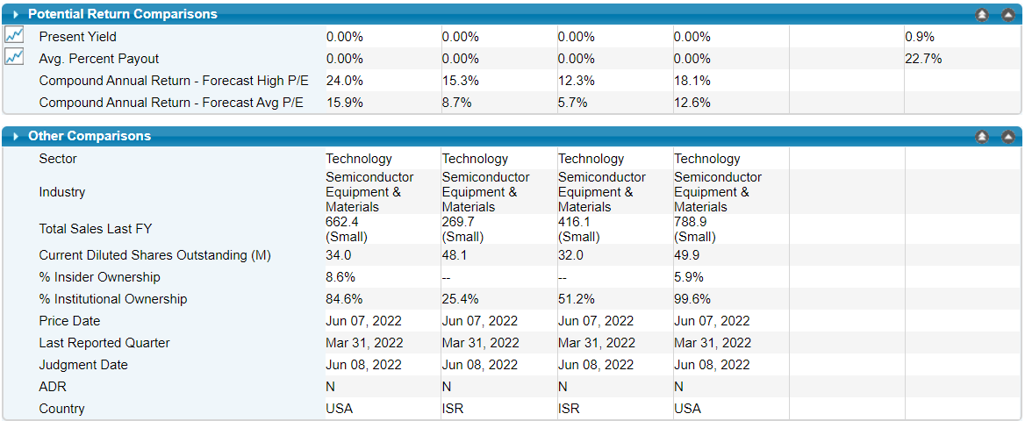

Slide 24
Which is Best?
ACLS appears best, BUT
Has the highest sales growth (ACE estimate). Is it real?
CAMT and NVMI also look like high quality companies
CAMT might have too short of a track record
ONTO earnings might be too erratic

Slide 25
Next Steps
Assign each quality stock to one or more people in your club (or committee)
Complete full research and redo the SSG
Compare Completed SSGs in a new SCG
Make decision on best buying opportunity if any
Quality companies are worth following, even if they are not a BUY now

Slide 26
How to do Industry Studies 3-Part Video Series by Ken Kavula and Ann Cuneaz
Sectors, Industries and Your Portfolio
A Step-By-Step Approach to an Industry Study
Select the Best Using the Stock Comparison Guide

Slide 27
Demo of Using BI Search Tool to Scan through an Industry?
Is there enough time?

Slide 28
THANKS! QUESTIONS?

Slide 29
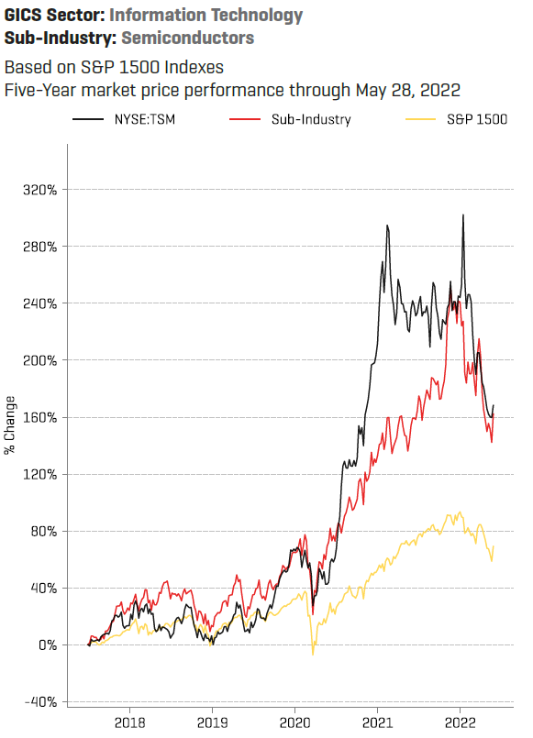
Are Semiconductor Stocks Cheap?
Yes, Relatively Cheap!

Slide 30
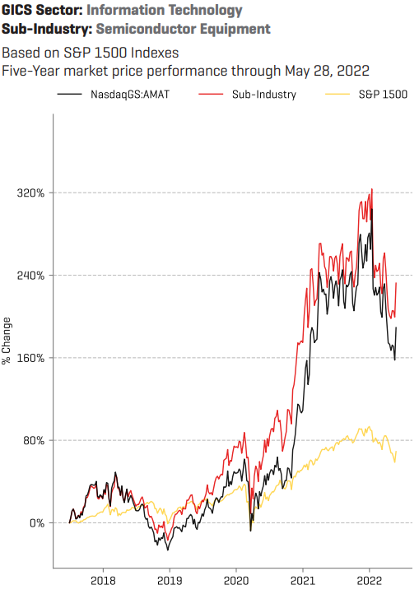
Are Semiconductor Equipment Stocks Cheap?
Yes, Relatively Cheap!

Slide 31
Which Stocks are Cyclic?
Semiconductors
Large Companies
TSM, INTC, GFS, NVDA, MU
Semiconductor Equipment
Large Companies
AMAT, ASML, AMKR, LRCX
Medium Companies
MKSI, TER, TDY, UCTT
Small
ACLS, CAMT, COHU, ONTO, PLAB

Slide 32
MU – Makes Memory Chips (DRAM & NAND)
$31 B TTM

Slide 33
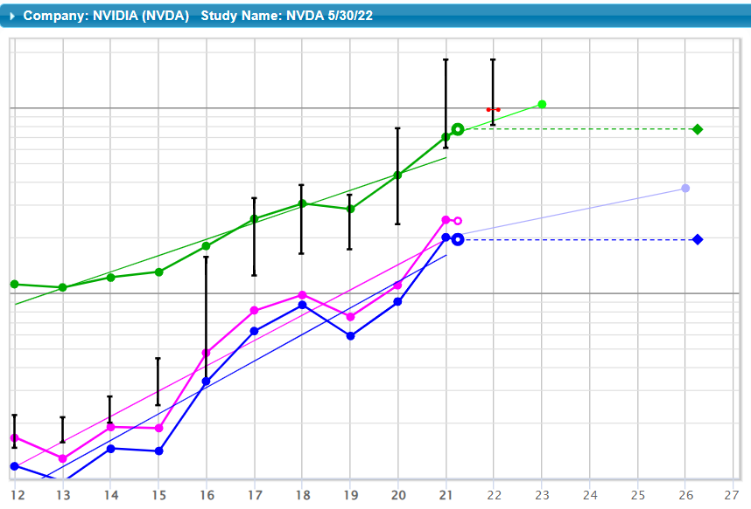
NVDA – Makes GPUs (Graphics Processing Units)
$31 B TTM
$29 B TTM

Slide 34
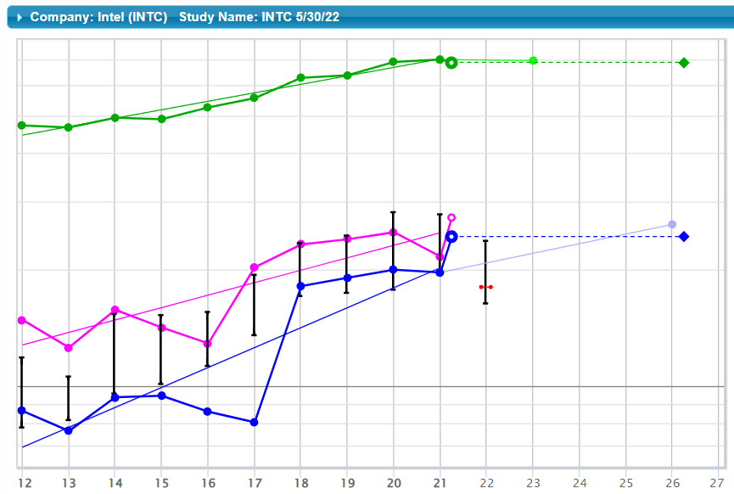
INTC – Makes CPUs (Central Processing Units)
$77 B TTM

Slide 35
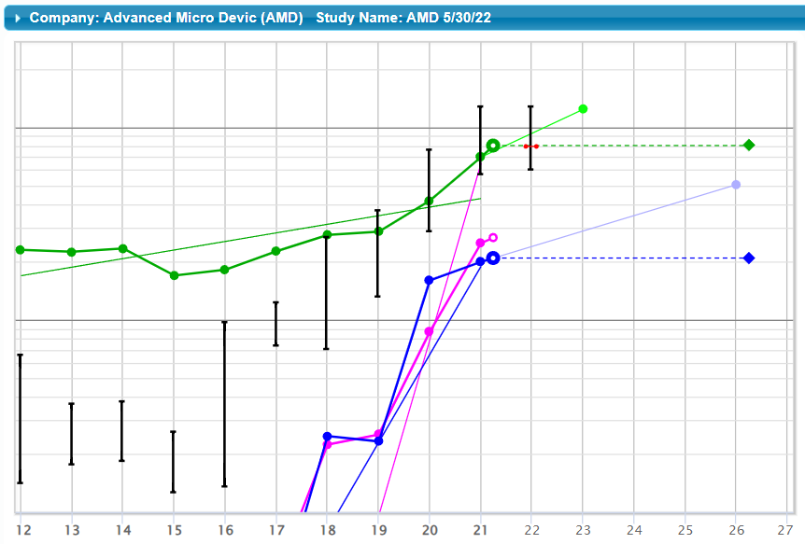
AMD – Makes CPUs (Central Processing Units)
$18 B TTM

Slide 36
Who’s Cyclic, Who’s Growth?
MU (Micron) – cyclic
NVDA (Nvidia) – growth
INTC (Intel) – growth?
AMD (Advanced Micro Devices) – highly volatile growth!

Slide 37
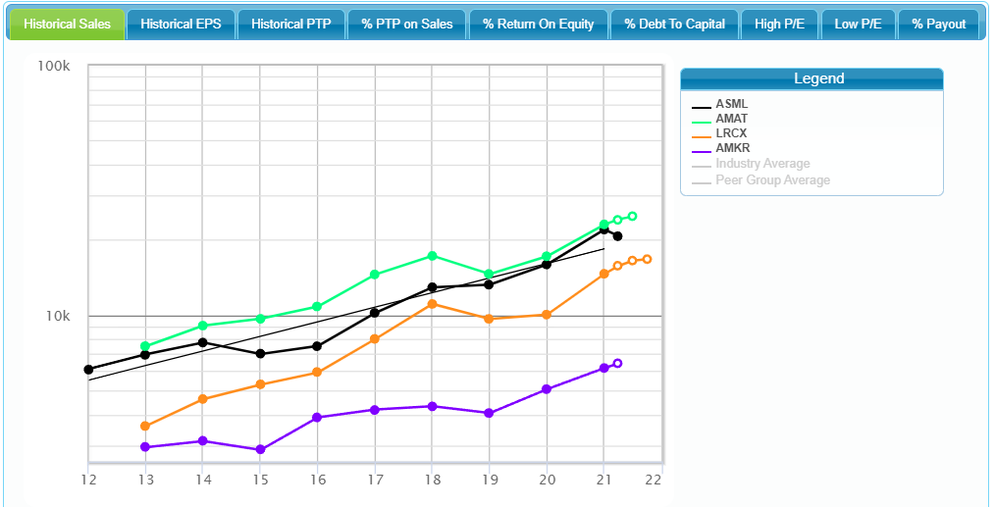
Large Semiconductor Equipment Companies - Sales

Slide 38
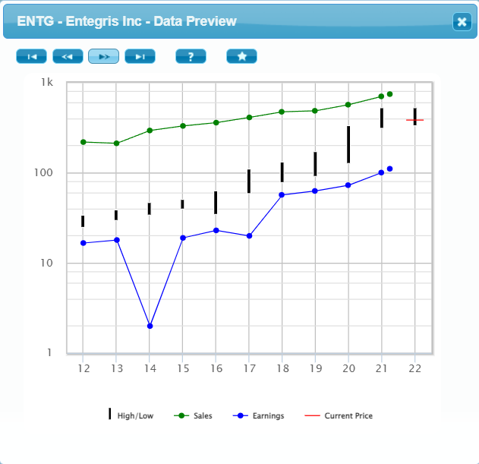
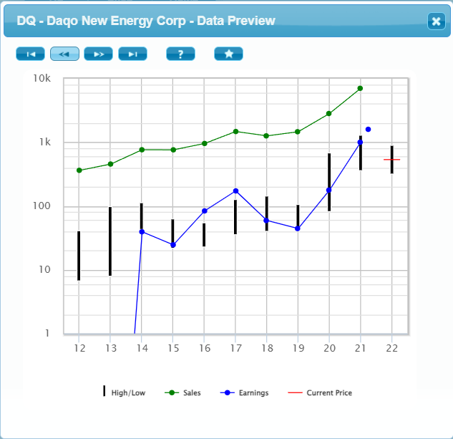
Medium Semiconductor Equipment Companies

Slide 39
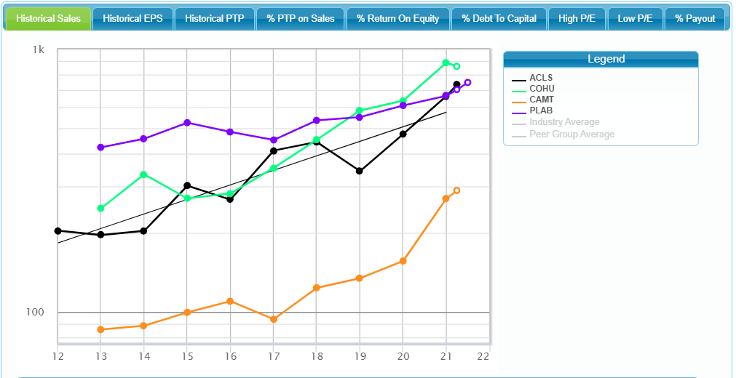
Small Semiconductor Equipment Companies - Sales

Slide 40
Conclusions
Demand for semiconductors is high and growing in AI, Autos, 5G, HPC, Cloud, IoT, Virtual Reality
Some semiconductor companies are quality growth companies!
Some types of semis (e.g., memory chips) are very volatile commodities (MU, …)
Semi equipment makers tend to be more stable
Long cycle time for foundry equipment
Make money servicing their equipment (~1/3)
Medium/Small Companies in Semiconductor Equipment sub-sector are worth a look (e.g., MKSI, CAMT, PLAB, COHU)

