Slide 1
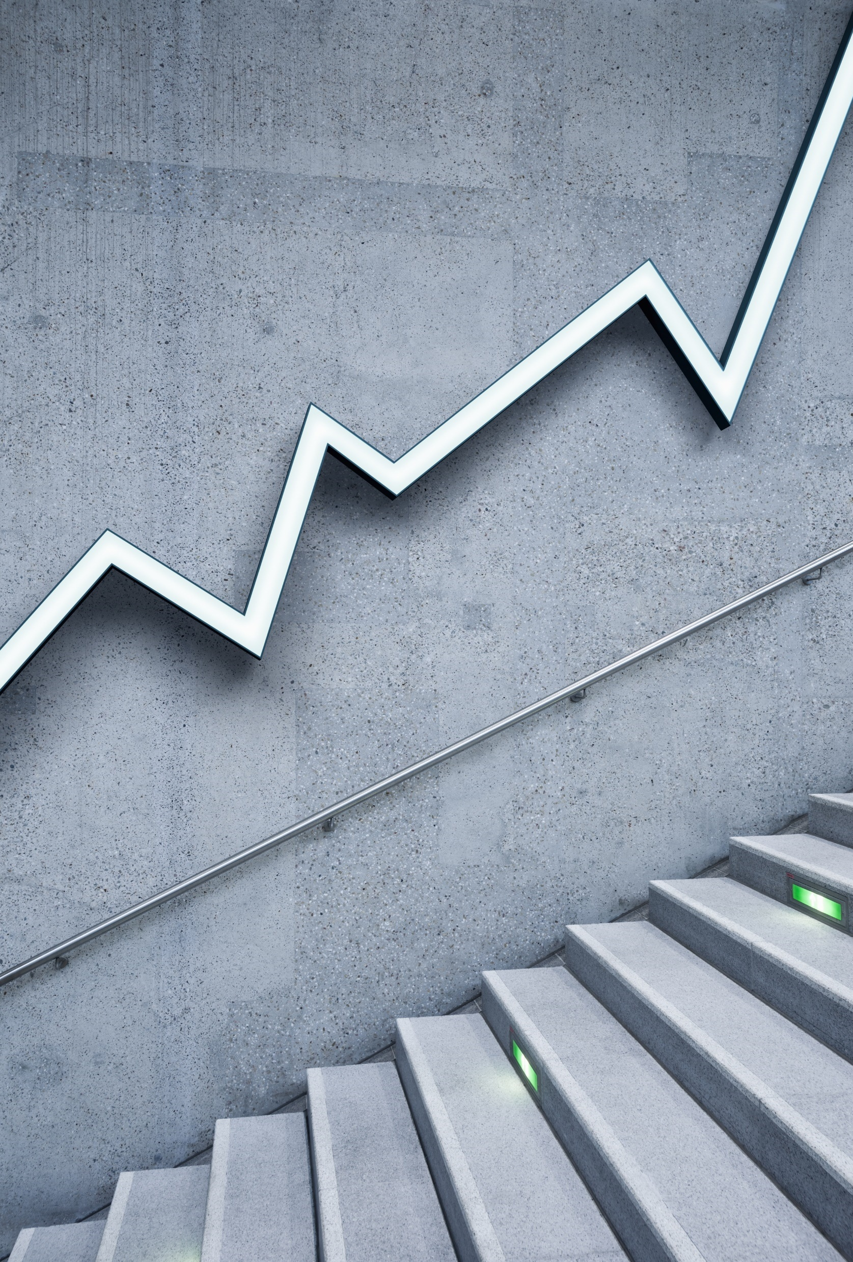
The 2010 Flash Crash
Can it happen again?

Slide 2
To find the cause of the crash the CFTC (Commodities Futures Trading Commission) was … “using bicycles to chase Ferraris.”
- Dr. John bates, contributor to Traders Magazine

Slide 3
Soundtrack of The 2010 Flash Crash
https://www.youtube.com/watch?v=E1xqSZy9_4I

Slide 4
What Happened on May 6, 2010?
Supposedly, one futures trader in Britain, Navinder Singh Sarao, sold futures for S&P 500 E-minis for about $200 million (one source says $40M)
That caused S&P 500 futures to crash
When arbitragers saw S&P 500 futures plummet, they sold S&P 500 stocks & bought now cheap S&P 500 futures
The NYSE fell 900 points in 15 minutes, losing a trillion dollars in value

Slide 5
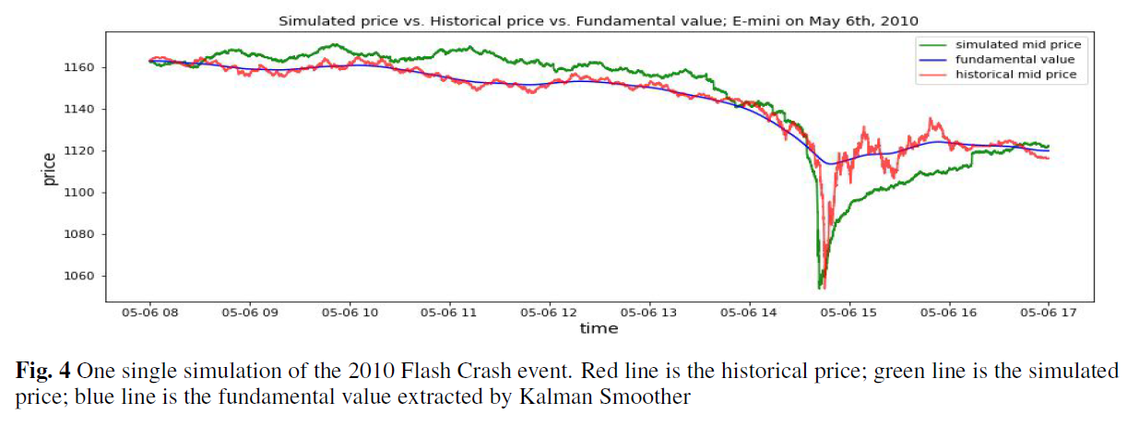
What Happened on May 6, 2010?
Supposedly, one futures trader in Britain, Navinder Singh Sara, sold futures for S&P 500 E-minis for $4 million
That caused S&P 500 futures to crash
From Gao et al. 2022

Slide 6
What Happened on May 6, 2010?
Buyers quickly came back as stocks were undervalued
The market rebounded to about where it was when the panic began in less than an hour
This was the first FLASH CRASH
Another major one happened in 2015

Slide 7
The Dodd-Frank Act (July 21, 2010)
In response, congress passed the Dodd-Frank act, which addressed consumer protection issues and banned trading practices such as spoofing, often used with layering and front running:
Spoofing – the illegal practice of bidding or offering with intent to cancel before execution. This influences price
Layering – as prices drop, repeatedly lowering bid
Front Running – knowing a big sell order is coming, putting your order in first to get a better price (easy to do if you are a broker)

Slide 8
Why Did the Flash Crash Happen?
Regulators and academics struggled to understand why
The CFTC and other regulators tried to figure out the cause. How could a $40 Million trade cause a $1 trillion shock to the market?
It took until 2015 for Singh to be arrested
Modeling of markets using agent based models can reproduce some of the time line, but not perfectly (Gao et al. 2022)
The overreaction of High Frequency Traders is blamed, but no consensus has been reached as to why the 2010 crash happened

Slide 9
Additional Resources
The Two Biggest Flash Crashes of 2015. August 2021. Investopedia. https://www.investopedia.com/articles/investing/011116/two-biggest-flash-crashes-2015.asp
Post Flash Crash, Regulators Still Use Bicycles To Catch Ferraris. Editorial Staff, John Bates. Traders Magazine, April 24, 2015. https://www.tradersmagazine.com/departments/technology/post-flash-crash-regulators-still-use-bicycles-to-catch-ferraris/
The Man Behind the Flash Crash: Navinder Singh Sarao. Finance Blitz. YouTube. https://www.youtube.com/watch?v=OKTCTJnWOUc
High-Frequency Financial Market Simulation and Flash Crash Scenarios Analysis: An Agent-Based Modelling Approach. Gao, K., P. Vytelingum, S. Weston, W. Luk and C. Guo. 2022. https://arxiv.org/abs/2208.13654

